Slide 1
Systems and Scale Unit Activity 5.4: Other Examples of Combustion
Carbon: Transformations in Matter and Energy
Environmental Literacy Project Michigan State University
Notes:
Image Credit: Craig Douglas, Michigan State University

Slide 2
Unit Map
You are here
Notes:
Use the instructional model to show students where they are in the course of the unit.
Display slide 2 of the 5.4 Other Examples of Combustion PPT.

Slide 3
Answer each of the questions (numbered 1-4) below to explain how matter and energy move and change in a system. Note that matter movement is addressed at both the beginning (1) and end (4) of your explanation.
Question
Where are molecules moving?
How do molecules move to the location of the chemical change?
How do molecules move away from the location of the chemical change?
Evidence We Can Observe
Moving solids, liquids, and gases are made of moving molecules.
A change in mass shows that molecules are moving.
Rules to Follow
All materials (solids, liquids, and gases) are made of atoms that are bonded together in molecules.
Scale: The matter movement question can be answered at the atomic-molecular, cellular, or macroscopic scale.
Question
How are atoms in molecules being rearranged into different molecules?
What molecules are carbon atoms in before and after the chemical change?
What other molecules are involved?
Evidence We Can Observe
BTB can indicate CO₂ in the air.
Organic materials are made up of molecules containing carbon atoms:
• fuels • foods
• living and dead plants and animals
decomposers
Rules to Follow
Atoms last forever in combustion and living systems.
Atoms can be rearranged to make new molecules, but not created or destroyed.
Carbon atoms are bound to other atoms in molecules.
Scale: The matter change question is always answered at the atomic-molecular scale.
Question
What is happening to energy?
What forms of energy are involved?
What energy transformations take place during the chemical change?
Evidence We Can Observe
We can observe indicators of different forms of energy before and after chemical changes:
• light energy • heat energy
• chemical energy stored in organic materials
• motion energy
Rules to Follow
Energy lasts forever in combustion and living systems.
Energy can be transformed, but not created or destroyed.
C-C and C-H bonds have more stored chemical energy than C-O and H-O bonds.
Scale: The energy change question can be answered at the atomic-molecular, cellular, or macroscopic scales.
Notes:
Have students discuss general characteristics of combustion of organic materials.
Display slide 3 of the 5.4 Other Examples of Combustion PPT.
Ask students questions to see if they can articulate a general pattern of what happens when organic materials burn. Ask students to think about this using the Three Questions.
Ask students questions relating to The Matter Movement Question: fuel and oxygen enter the flame from below, carbon dioxide and water vapor leave the flame into the air.
Ask students questions relating to The Matter Change Question: atoms of fuel and oxygen are rearranged to make molecules of carbon dioxide and water vapor.
Ask students questions relating to The Energy Change Question: energy in high-energy C-C and C-H bonds is released as heat and light when the high-energy bonds are replaced by low-energy C-O and H-O bonds. Tell students that breaking bonds requires additional energy and the chemical energy is released when the low-energy C-O and H-O bonds are formed, not when the high-energy bonds are broken.

Slide 4
Writing an explanation for how your organic material burns
Pay special attention to the numbered questions on the Three Questions poster. Here are some specific versions of these questions for combustion:
Matter movement: How do fuel and oxygen molecules move into the flame?
Matter change: How are atoms in the fuel and oxygen molecules rearranged into different molecules?
Energy change: What happens to energy?
Matter movement: How do product molecules move out of the flame?
Notes:
Have students read through the numbered questions on the Three Questions poster.
Display slide 4 of the 5.4 Other Examples of Combustion PPT. Distribute the Three Questions Poster with the same questions shown on the PPT.
Students will need the Three Questions Poster questions to help guide their explanations for the organic materials.

Slide 5
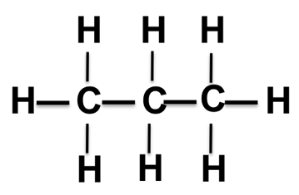
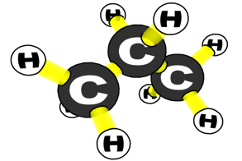
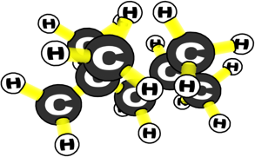
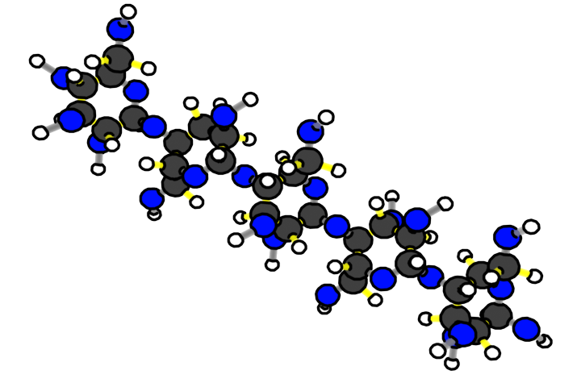
Burning materials
Propane
Octane
Cellulose
Chemical change
Notes:
Photo Credits: Craig Douglas, Michigan State University
log: https://openclipart.org/detail/252925/log
Have students complete the reading and corresponding explanation worksheet for one other organic materials.
Display slide 5 of the 5.4 Other Examples of Combustion PPT.
Give each student a copy of one of the 5.4 Other Organic Materials Readings. About 1/3 of the students should read about each organic material.
Have students read using the Questions, Connections, Questions Student Reading Strategy for a discussion of tools and classroom strategies to support sensemaking of readings. See the Question, Connections, Questions Reading Strategy Educator Resource document for information about how to engage students with this strategy.
Have students complete the 5.4 Explaining Combustion Worksheet for the organic materials they read about.
Modifications: Students can work in pairs or groups with those who have the same organic material.
Have students who focused on the same organic material form a group.
In their groups, have students discuss their answers and come to consensus about their explanations and answers to the questions.
Students can use the Three Questions Explanation Checklist on the back of the Three Questions Handout to check that their explanation includes each of the parts (matter movement, matter change, energy change, and matter movement) and answers the prompt in a cohesive way.
Have students share their explanations for their organic material.
Decide how to have students share the explanation for their organic material.
Students who focused on the same organic material can present to the whole class. They could make a poster to share.
Students can form groups of three with students who focused on each of three organic materials.

Slide 6
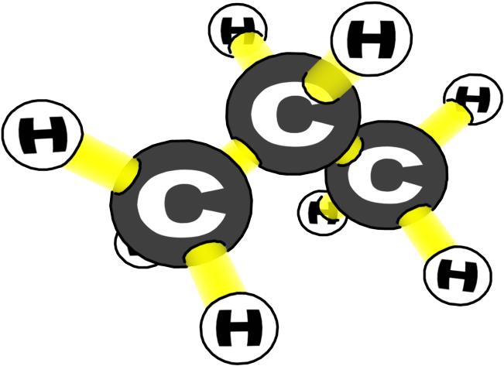
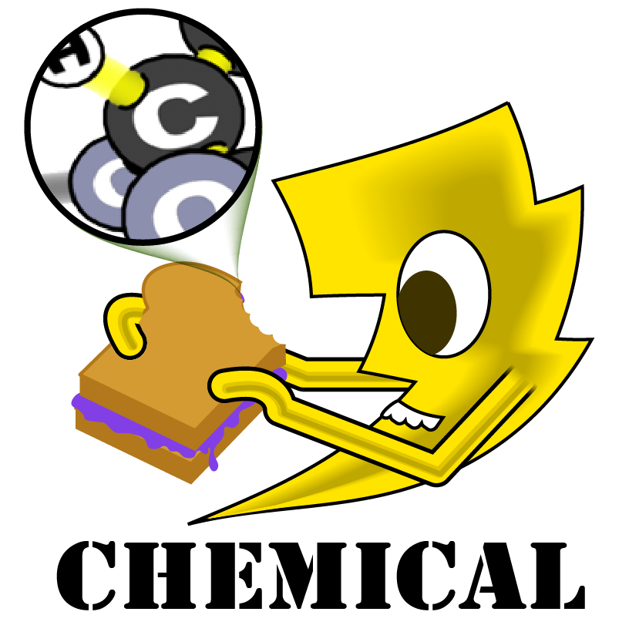
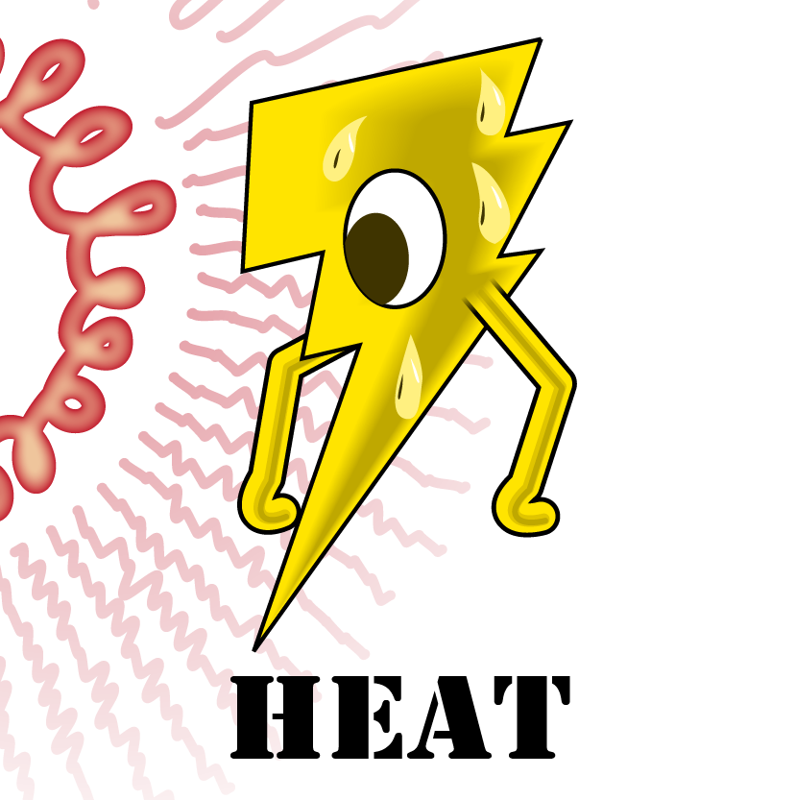
Propane burning
Carbon Dioxide
Chemical change
Water
Chemical change
Products
Propane and Oxygen
C₃H₈ + 5 O₂ --> 3 CO₂ + 4 H₂O
Reactants
Heat and light energy
Notes:
Photo Credit: Craig Douglas, Michigan State University
Have students discuss the similarities and differences between the organic materials.
Display slide 6-7 of the 5.4 Other Examples of Combustion PPT.
Show the for the combustion of propane and octane (note: there is not an animation for cellulose).
Have a class discussion about the similarities and differences between the combustion of octane, propane, and cellulose. Students should recognize that the chemical change is similar in each cases and that the rules about atoms and energy always apply.

Slide 7
Octane burning
Carbon Dioxide
Chemical change
Water
Chemical change
Products
Octane and Oxygen
C₈H₁₈ + 12.5 O₂ --> 8 CO₂ + 9 H₂O
Reactants
Heat and light energy
Notes:
Photo Credit: Craig Douglas, Michigan State University
Have students discuss the similarities and differences between the organic materials.
Display slide 6-7 of the 5.4 Other Examples of Combustion PPT.
Show the for the combustion of propane and octane (note: there is not an animation for cellulose).
Have a class discussion about the similarities and differences between the combustion of octane, propane, and cellulose. Students should recognize that the chemical change is similar in each cases and that the rules about atoms and energy always apply.

Slide 8
Class Explanation
Develop an explanation for what happens when any organic material burns.
Matter movement: How do fuel and oxygen molecules move into the flame?
Matter change: How are atoms in the fuel and oxygen molecules rearranged into different molecules?
Energy change: What happens to energy?
Matter movement: How do product molecules move out of the flame?
Notes:
Have students write a class explanation for how organic materials burn.
Display slide 8 of the 5.4 Other Examples of Combustion PPT.
Have students construct a class explanation for what happens when organic materials burn.
Make sure students address the key numbered questions of the Three Questions Poster in their organic materials explanations. Additionally, have students include how combustion is alike for all organic materials and is possibly different for other organic materials.
Students can use the Three Questions Explanation Checklist on the back of the Three Questions Handout to check that the class explanation includes each of the parts (matter movement, matter change, energy change, and matter movement) and answers the prompt in a cohesive way.

Slide 9
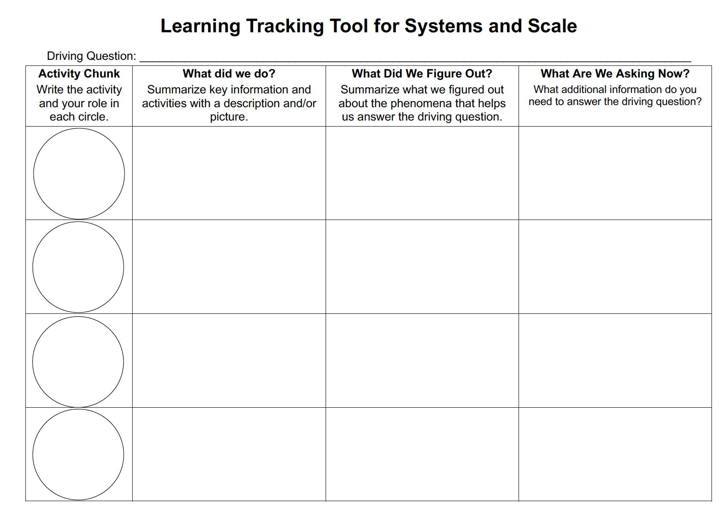
Learning Tracking Tool
For the activity “Other Examples,” discuss with your classmates what you figured out will help you to answer the unit driving question, “what happens when ethanol burns?” Record your ideas in the column “What We Figured Out.”
Discuss questions you now have related to the unit driving question and record them in the column “What We are Asking Now.”
Notes:
Have a discussion to complete the Learning Tracking Tool for this activity.
Show slide 9 of the 5.4 Other Examples of Combustion PPT.
Have students write the activity name, "Explaining Other Examples" and their role “Explainer” in the first column.
Have a class discussion about what students did during the activity. When you come to consensus as a class, have students record the answer in the second column of the tool.
Have a class discussion about what students figured out during the activity that will help them in answering the unit driving question. When you come to consensus as a class, have students record the answer in the third column of the tool.
Have a class discussion about what students are wondering now that will help them move towards answering the unit driving question. Have students record the questions in the fourth column of the tool.
Have students review their Learning Tracking Tool to reflect on what they figured out across the unit.
Example Learning Tracking Tool
Activity Chunk: Explaining Other Examples; Explainer
What Did We Do? Apply what was figured out about ethanol burning to explain other examples of organic materials burning.
What Did We Figure Out? The chemical change of combustion is similar for all organic materials. The organic material combines with oxygen to produce carbon dioxide and water. The chemical energy in the organic material is transformed into heat and light energy.
What Are We Asking Now? Why is combustion of organic materials important in the world?
(Optional) Have students complete the Big Idea Probe: Fill 'Er Up for the final time.
If you decided to use the Big Idea Probe: Fill 'Er Up, have students complete it and share their ideas again. Have students discuss how their ideas have changed throughout the unit. See Assessing the Big Idea Probe: Fill 'Er Up for suggestions about how to use the Big Idea Probe.

