Slide 1
Systems and Scale Unit Activity 4.4 Molecular Models for Ethanol Burning
Carbon: Transformations in Matter and Energy
Environmental Literacy Project Michigan State University
Notes:
Image Credit: Craig Douglas, Michigan State University

Slide 2
Unit Map
You are here
Notes:
Use the instructional model to show students where they are in the course of the unit.
Show slide 2 of the 4.4 Molecular Models for Ethanol Burning PPT.

Slide 3
Molecular Models for Ethanol Burning
Your investigation left some unanswered questions.
Read to find out about a tool scientists use to explain things they cannot see using the Questions, Connections, Questions Reading Strategy.
Notes:
Have students read A Tool for Explaining: Molecular Modeling.
Display slide 3 of the 4.4 Molecular Models for Ethanol Burning PPT. Give each student a copy of 4.4 Molecular Models for Ethanol Burning Reading.
Remind students that the investigation left them with unanswered questions (students can refer back to 4.3 Evidence-Based Arguments Tool for Ethanol Burning).
Have students read 4.4 Molecular Models for Ethanol Burning Reading to learn about molecular modeling using the Questions, Connections, Questions Reading Strategy. See the Question, Connections, Questions Reading Strategy document for information about how to engage students with this strategy and for student versions of the strategy.
Have a class discussion about why scientists use molecular models and about why they need to use molecular modeling to answer their unanswered questions.

Slide 4
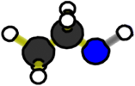
What’s the hidden chemical change when ethanol burns?
?
Oxygen
Carbon Dioxide
Water
Ethanol
Notes:
Credit: Craig Douglas, Michigan State University
Zoom into a flame.
Display slides 4 the 4.4 Molecular Models for Ethanol Burning PPT to explain molecular bonding to students.
Pose the question: “What’s the hidden chemical change when ethanol burns?” Explain to students that both ethanol and O₂ enter the flame at the bottom. Ethanol enters the flame through evaporation. Define or review the word evaporation with your students. Emphasize that evaporation is a physical change and not a chemical change. Write the chemical formula for ethanol on the board, “C₂H₅OH”. This means each ethanol molecule has two carbons, six hydrogens and one oxygen atom.
Show slides 5 and 6 to contrast the molecules at the bottom and top of a flame.

Slide 5
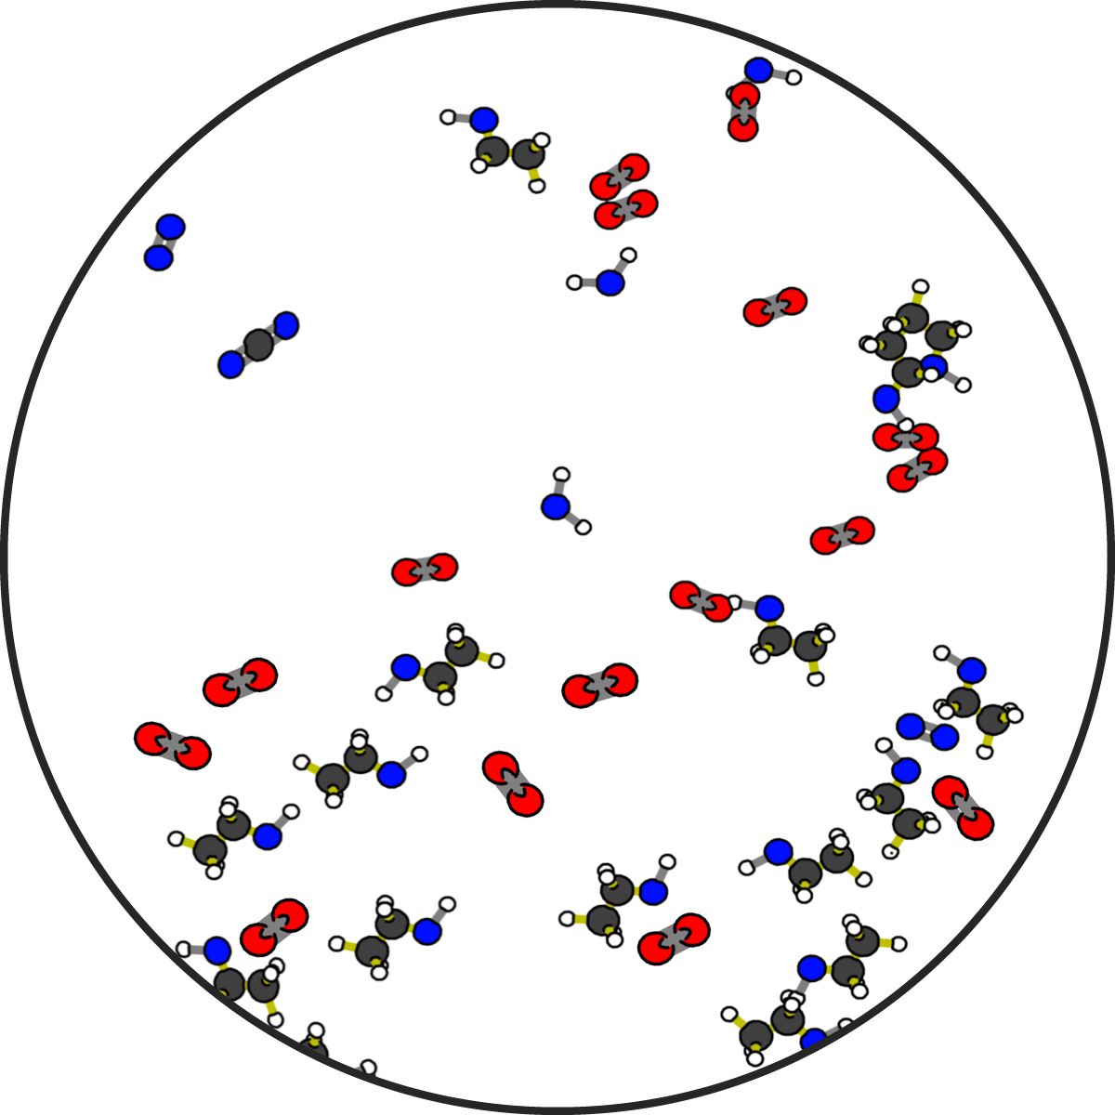
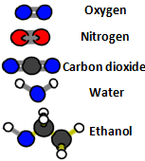
The bottom of flame at atomic-molecular scale
Notes:
Credit: Craig Douglas, Michigan State University
Show slides 5 and 6 to contrast the molecules at the bottom and top of a flame.

Slide 6
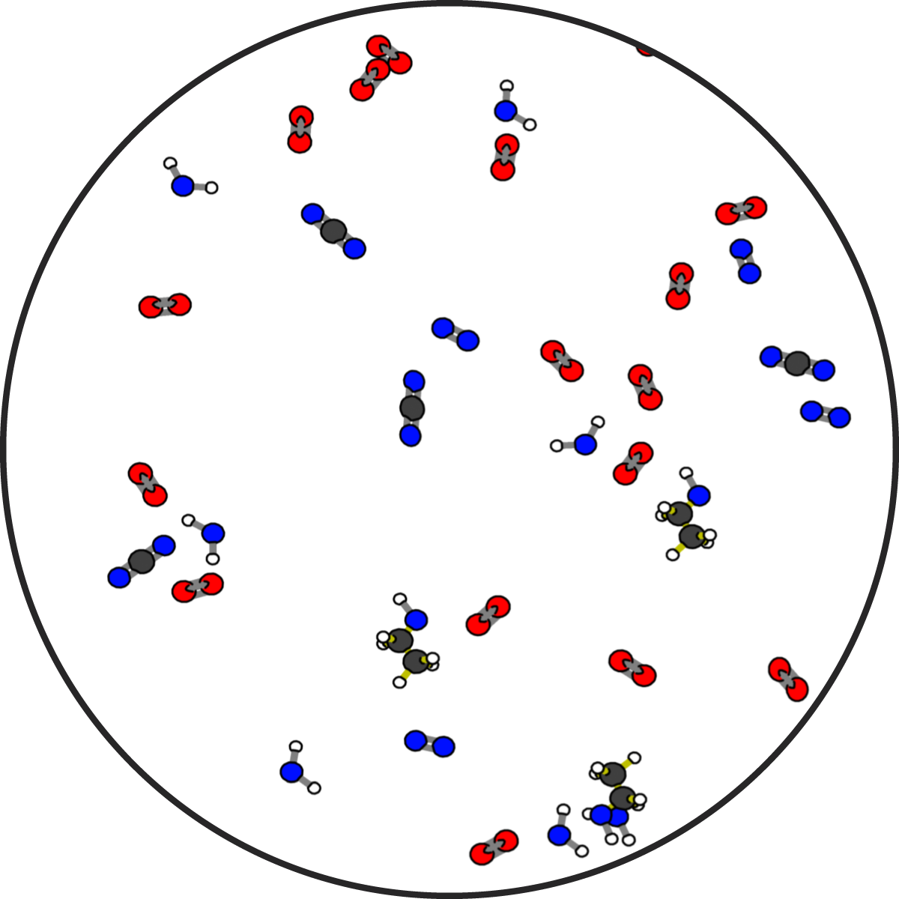
The top of flame at atomic-molecular scale
Notes:
Credit: Craig Douglas, Michigan State University
Show slides 5 and 6 to contrast the molecules at the bottom and top of a flame.

Slide 7
How Atoms Bond Together in Molecules
Atoms in stable molecules always have a certain number of bonds to other atoms:
Oxygen atoms do NOT bond to other oxygen atoms if they can bond to carbon or hydrogen instead.
Chemical energy is stored in bonds between atoms
C-C and C-H bonds are high energy bonds
C-O and H-O bonds are low energy bonds
Notes:
Have students use the molecular model kits to make one ethanol and three oxygen molecules.
Divide the class into pairs and give each pair a molecular model kit, a set of Forms of Energy Cards, and a Molecular Models 11 x 17 Placemat. Pass out one copy of 4.4 Molecular Models for Ethanol Worksheet to each student.
Show students slide 7 to remind them of how atoms bond in molecules. These rules apply to all molecules that they will make in all Carbon TIME units.
Accommodations: Arrange the molecules along with students so they have a step-by-step model of what the molecules should look like.
Use the Carbon TIME: Molecular Modeling Ethanol Video if doing in-person molecular modeling is not possible, or to support absent students.

Slide 8
Making the Reactant Molecules: Ethanol and Oxygen
Complete Steps 1-3 in Part B of your worksheet.
Notes:
Use slide 8 to show instructions to construct oxygen and ethanol molecules. Students can also follow instructions in Part B of their worksheet.
Accommodations: Arrange the molecules along with students so they have a step-by-step model of what the molecules should look like.
Use the Carbon TIME: Molecular Modeling Ethanol Video if doing in-person molecular modeling is not possible, or to support absent students.

Slide 9
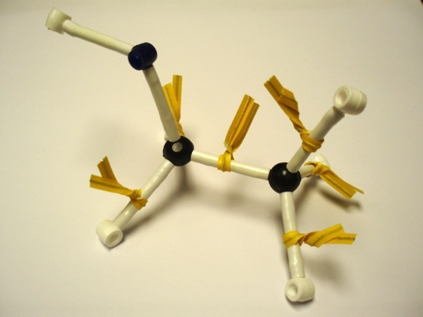
Photo of reactant molecules: C₂H₅OH (ethanol) and O₂ (oxygen) Start by making the molecules and energy units of the reactants and putting them on the reactants side, then rearrange the atoms and energy units to show the products.
Chemical change
Ethanol
Oxygen
Reactants
Products
Remember: Atoms last forever (so you can rearrange atoms into new molecules, but can’t add or subtract atoms). Energy lasts forever (so you can change forms of energy, but energy units can’t appear or go away)
Notes:
Credit: Michigan State University
Use slide 9 to instruct students to compare their own molecule with the picture on the slide.
Accommodations: Arrange the molecules along with students so they have a step-by-step model of what the molecules should look like.
Use the Carbon TIME: Molecular Modeling Ethanol Video if doing in-person molecular modeling is not possible, or to support absent students.

Slide 10
Important:
When you are finished constructing the reactants, put all extra pieces away.
Notes:
Slide 10 shows an important message: after students create their reactant molecules, make sure they put away all unused pieces of their molecule kits. This helps reinforce that the matter and energy in the reactants are conserved through the chemical change, and that only the materials from the reactants are used to build the products.
Accommodations: Arrange the molecules along with students so they have a step-by-step model of what the molecules should look like.
Use the Carbon TIME: Molecular Modeling Ethanol Video if doing in-person molecular modeling is not possible, or to support absent students.

Slide 11
Rearranging the atoms to make product molecules: Carbon Dioxide and Water
Complete Steps 4 and 5 in Part B of your worksheet.
Notes:
Have students construct a model of the chemical change.
Tell students to follow the instructions the worksheet to construct their products.
Show slide 11 of the PPT and have students re-arrange the atoms to make molecules of CO₂ and H₂O. To do this, they will need to move their molecules from the reactants side to the products side of the 11 x 17 Placemat. Explain to students that atoms last forever, so they should not add or subtract atoms when they change the reactant molecule into product molecules.
Accommodations: Arrange the molecules along with students so they have a step-by-step model of what the molecules should look like.
Use the Carbon TIME: Molecular Modeling Ethanol Video if doing in-person molecular modeling is not possible, or to support absent students.

Slide 12
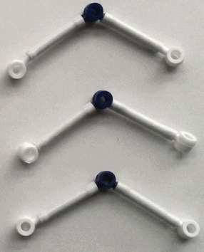
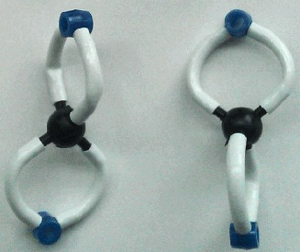
Photo of product molecules: CO₂ (carbon dioxide) and H₂O (water) Start by making the molecules and energy units of the reactants and putting them on the reactants side, then rearrange the atoms and energy units to show the products.
Water
Chemical change
Carbon
dioxide
Reactants
Products
Remember: Atoms last forever (so you can rearrange atoms into new molecules, but can’t add or subtract atoms). Energy lasts forever (so you can change forms of energy, but energy units can’t appear or go away)
Notes:
Credit: Michigan State University
Show students Slide 12 to make a comparison between the reactants and the products.
Accommodations: Arrange the molecules along with students so they have a step-by-step model of what the molecules should look like.
Use the Carbon TIME: Molecular Modeling Ethanol Video if doing in-person molecular modeling is not possible, or to support absent students.

Slide 13
Comparing photos of reactant and product molecules
Start by making the molecules and energy units of the reactants and putting them on the reactants side, then rearrange the atoms and energy units to show the products.
Water
Chemical change
Carbon
dioxide
Ethanol
Oxygen
Reactants
Products
Remember: Atoms last forever (so you can rearrange atoms into new molecules, but can’t add or subtract atoms). Energy lasts forever (so you can change forms of energy, but energy units can’t appear or go away)
Notes:
Credit: Michigan State University
Show students Slide 13 to make a comparison between the reactants and the products.
Accommodations: Arrange the molecules along with students so they have a step-by-step model of what the molecules should look like.
Use the Carbon TIME: Molecular Modeling Ethanol Video if doing in-person molecular modeling is not possible, or to support absent students.

Slide 14
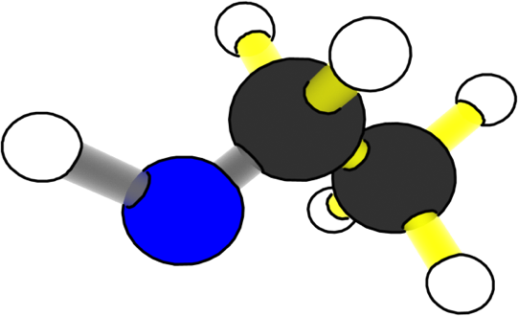
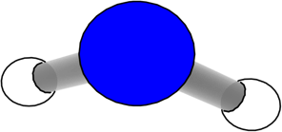
What happens to atoms and energy when ethanol burns?
Carbon Dioxide
Ethanol
Reactants
Chemical change
Water
Products
Oxygen
Heat and light energy
Notes:
Credit: Craig Douglas, Michigan State University
Have students watch an animation of the chemical change.
Show slides 14-19 in the PPT to help students make connections between what is happening in the animation and the molecular models they made.
For each slide, focus on different atoms and forms of energy and how they change. The animation draws attention to where they atoms begin and end in the reaction.

Slide 15
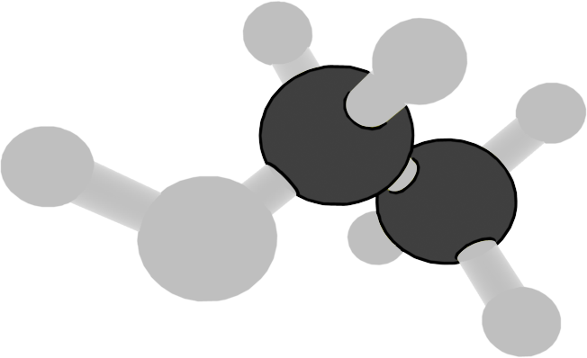
What happens to carbon atoms when ethanol burns?
Carbon Dioxide
Ethanol
Reactants
Chemical change
Water
Products
Carbon atoms in ethanol become part of carbon dioxide molecules.
Oxygen
Heat and light energy
Notes:
Credit: Craig Douglas, Michigan State University
Show slides 14-19 in the PPT to help students make connections between what is happening in the animation and the molecular models they made.
For each slide, focus on different atoms and forms of energy and how they change. The animation draws attention to where they atoms begin and end in the reaction.
Focus on carbon atoms.
15

Slide 16
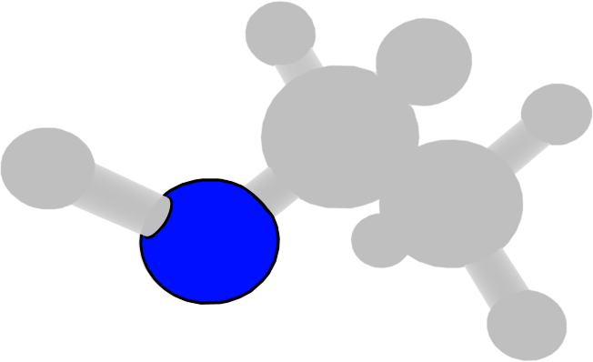
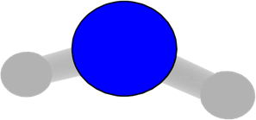
What happens to oxygen atoms when ethanol burns?
Carbon Dioxide
Ethanol
Reactants
Chemical change
Water
Products
Oxygen atoms become part of carbon dioxide and water molecules.
Oxygen
Heat and light energy
Notes:
Credit: Craig Douglas, Michigan State University
Show slides 14-19 in the PPT to help students make connections between what is happening in the animation and the molecular models they made.
For each slide, focus on different atoms and forms of energy and how they change. The animation draws attention to where they atoms begin and end in the reaction.
Focus on oxygen atoms.

Slide 17
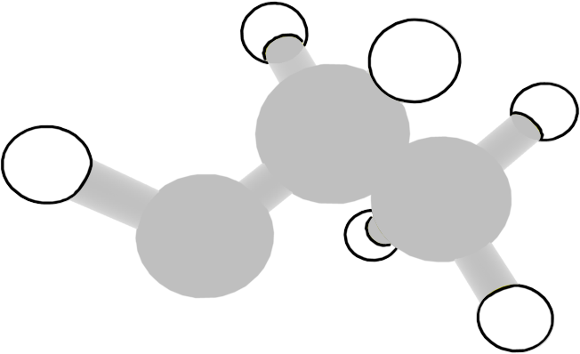
What happens to hydrogen atoms when ethanol burns?
Carbon Dioxide
Ethanol
Reactants
Chemical change
Water
Products
Hydrogen atoms become part of water molecules.
Oxygen
Heat and light energy
Notes:
Credit: Craig Douglas, Michigan State University
Show slides 14-19 in the PPT to help students make connections between what is happening in the animation and the molecular models they made.
For each slide, focus on different atoms and forms of energy and how they change. The animation draws attention to where they atoms begin and end in the reaction.
Focus on hydrogen atoms.

Slide 18
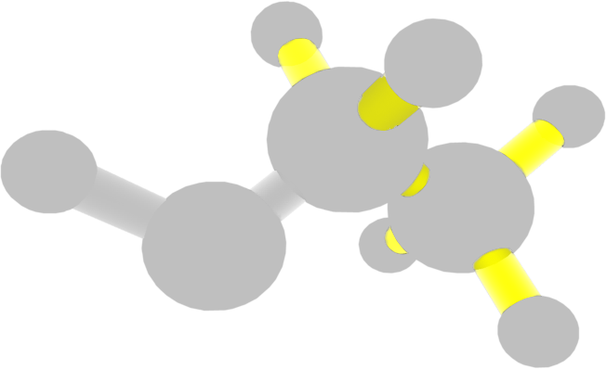
What happens to chemical energy when ethanol burns?
Carbon Dioxide
Ethanol
Reactants
Chemical change
Water
Products
Chemical energy is transformed into heat and light energy.
Oxygen
Heat and light energy
Notes:
Credit: Craig Douglas, Michigan State University
Show slides 14-19 in the PPT to help students make connections between what is happening in the animation and the molecular models they made.
For each slide, focus on different atoms and forms of energy and how they change. The animation draws attention to where they atoms begin and end in the reaction.
Focus on chemical energy.

Slide 19
What happens to atoms and energy when ethanol burns?
Carbon Dioxide
Ethanol
Reactants
Chemical change
Water
Products
Atoms last forever! Energy lasts forever!
Oxygen
Heat and light energy
Notes:
Credit: Craig Douglas, Michigan State University
Show slides 14-19 in the PPT to help students make connections between what is happening in the animation and the molecular models they made.
For each slide, focus on different atoms and forms of energy and how they change. The animation draws attention to where they atoms begin and end in the reaction.
Focus on the rules that “Atoms last forever!” and “Energy lasts forever!”

Slide 20
Atoms last forever!
Compare the atoms in the reactants and the products.
Notes:
Have students record their results.
Show slide 20 in the PPT.
Tell students to complete Part C of their worksheet to trace the atoms during the chemical change.

Slide 21
Energy lasts forever!
Compare the energy before and after the reaction
Notes:
Have students record their results.
Show slide 21 in the PPT.
Tell students to complete Part D of their worksheet to trace the energy during the chemical change.

Slide 22
Discuss with the class
Did the number and type of atoms stay the same at the beginning and end of the chemical change? ____
Did the number of twist ties (representing energy) stay the same at the beginning and end of the chemical change? ____
Why do the numbers of atoms and twist ties have to stay the same?
Notes:
Discuss results with the class.
Show slide 22 in the PPT.
Complete the “check yourself” questions with the class in Part E.

Slide 23
Writing a Chemical Equation
Chemists use chemical equations to show how atoms of reactant molecules are rearranged to make product molecules.
Writing the equation in symbols. Chemists use an arrow to show how reactants change into products.
Equations must be balanced. Remember: Atoms last forever.
Try it: Can you write a balanced chemical equation to show the chemical change when ethanol burns?
Notes:
Help students write a balanced chemical equation on the worksheet.
After the discussion, tell students that now that they have represented a chemical change using molecular models and in animations, they will represent chemical change by writing the chemical equation.
Show Slide 23 of the presentation to guide students through the process of writing a balanced chemical equation for the combustion of ethanol. Tell students that these rules apply to all chemical reactions.
Tell students to write their equations in Part F of their worksheet.
Have students write their own chemical equations before comparing them with the one on Slide 24.

Slide 24
Chemical equation for ethanol burning
C₂H₅OH + 3O₂ → 2 CO₂ + 3 H₂O
(in words: ethanol reacts with oxygen to yield carbon dioxide and water)
Notes:
Help students write a balanced chemical equation on the worksheet.
Have students write their own chemical equations before comparing them with the one on Slide 24.

