Slide 1
Systems and Scale Unit Activity 4.3 Evidence-Based Arguments Tool for Ethanol Burning
Carbon: Transformations in Matter and Energy
Environmental Literacy Project Michigan State University
Notes:
Image Credit: Craig Douglas, Michigan State University

Slide 2
Unit Map
You are here
Notes:
Use the instructional model to show students where they are in the course of the unit.
Show slide 2 of the 4.3 Evidence Based Arguments Tool for Ethanol Burning PPT.

Slide 3
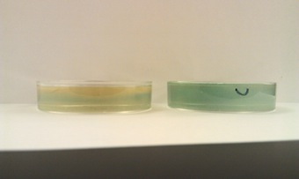
Reviewing Class Results
What patterns did we observe in mass change?
What patterns did we observe in BTB color change?
Notes:
Image Credit: FableVision
Have students review their results from the investigation.
Display slide 3 of the 4.3 Evidence-Based Arguments Tool for Ethanol Burning PPT. Draw students’ attention to the 4.2 Ethanol Burning Class Results 11 x 17 Poster from the investigation and students’ own 4.2 Observing Ethanol Burning Worksheet, section D, “results for the whole class.” Ask the students to find a partner, and in their own words, review what happened during the investigation. Tell them to discuss:
What patterns they observed in the mass change
What patterns they observed in the BTB color change
Tell students that when scientists construct arguments for what happened, using evidence from observations is important, so today’s activity is designed to help them use the evidence from the investigation to construct an argument for “What happens when ethanol burns” and come to class consensus.

Slide 4
A. Your Ideas about the chemical change when ethanol burns
Complete and discuss Part A of the Evidence-based Arguments Tool
How have your ideas changed since you wrote about ethanol burning on the Predictions and Planning Tool?
Notes:
Have students share ideas about the chemical change with ethanol burns
Display slide 4 of the 4.3 Evidence Based Arguments Tool. Pass out the 3.3 Evidence Based Arguments Tool Worksheet. Have students complete and discuss part A of the tool. Have students discuss how their ideas have changes since they wrote about ethanol burning on the predictions tool.

Slide 5
Evidence-Based Arguments
Refer to your Three Questions handout for:
Prompting about what type of information to include in each row, and
Suggestions about what kind of evidence you might use for each of the Three Questions.
Notes:
Have students develop arguments for what happened as individuals.
Display slide 5 of the 4.3 Evidence-Based Arguments Tool for Ethanol Burning PPT. Pass out one copy of 4.3 Evidence-Based Arguments Tool for Ethanol Burning to each student. Review Tool directions. Also, have students take out their Three Questions Handout and be ready to refer to their class results.
Instruct students to complete their evidence, conclusions, and unanswered questions as individuals for the Three Questions.
Give students about 5-10 minutes to complete the process tool.

Slide 6
Comparing ideas with a partner
Compare your evidence, conclusions, and unanswered questions for each of the Three Questions.
How are they alike?
How are they different?
Consider making revisions to your argument based on your conversation with your partner.
Notes:
Have students compare and revise arguments in pairs.
Display slide 6 of the 4.3 Evidence-Based Arguments Tool for Ethanol Burning PPT. Divide students into pairs.
Have each pair compare their evidence, conclusions, and unanswered questions for the Matter Movement Question.
Have partners discuss how their ideas are alike and different. Have students change or add to their responses, based on partner input.
Have students repeat this step for the Matter Change Question and the Energy Question.
As students are sharing, circulate through the groups. Consider asking questions such as, How does this (refer to students’ evidence and/or conclusions) help us better understand the Matter Movement Question (or substitute one of the other Three Questions)? What questions do you still have at the atomic-molecular level to better understand this phenomenon?
Pay attention to patterns in students’ ideas. You will want to begin moving towards class consensus in this activity.
Partner work should take about 10 minutes.

Slide 7
What are your arguments about the Matter Movement Question?
Evidence | Conclusions | Unanswered Questions
Notes:
Have a class discussion of the Matter Movement Question; move toward class consensus.
Display slide 7 of the 4.3 Evidence-Based Arguments Tool for Ethanol Burning PPT.
Have students/pairs share their evidence and conclusions for the Matter Movement question. Keep a class record, using the PPT slides or board. Ask students to update their answers by using a different colored writing utensil. Discussions should move toward class consensus. Use class conversation to correct student ideas. Use the Three Questions Handout to help guide towards consensus by following the established rules.
Have students share unanswered questions. Discussions should move toward class consensus. Use the 4.3 Assessing the Evidence-Based Arguments Tool for Ethanol Burning to guide your goals for consensus. Note that students may contribute unanswered questions that align with rules on the Three Questions Handout, but may not closely align with those on the Assessing worksheet. You may still choose to record those unanswered questions. These may be answered in other parts of this unit or even in other units during the school year. However, at this point in this unit, though there may be several viable paths of inquiry moving forward, you will begin to more closely guide the path of inquiry in one direction – in this case towards molecular modeling of combustion.
Class discussion should take about 10 minutes.

Slide 8
What are your arguments about the Matter Change Question?
Evidence | Conclusions | Unanswered Questions
Notes:
Repeat step 5 with the Matter Change Question; move toward class consensus.
Display slide 8 of the 4.3 Evidence-Based Arguments Tool for Ethanol Burning PPT.
Class discussion may take another 10 minutes.

Slide 9
What are your arguments about the Energy Change Question?
Evidence | Conclusions | Unanswered Questions
Notes:
Repeat step 5 with the Energy Change Question; move toward class consensus.
Display slide 9 of the 4.3 Evidence-Based Arguments Tool for Ethanol Burning PPT.
Class discussion may take another 10 minutes.

Slide 10
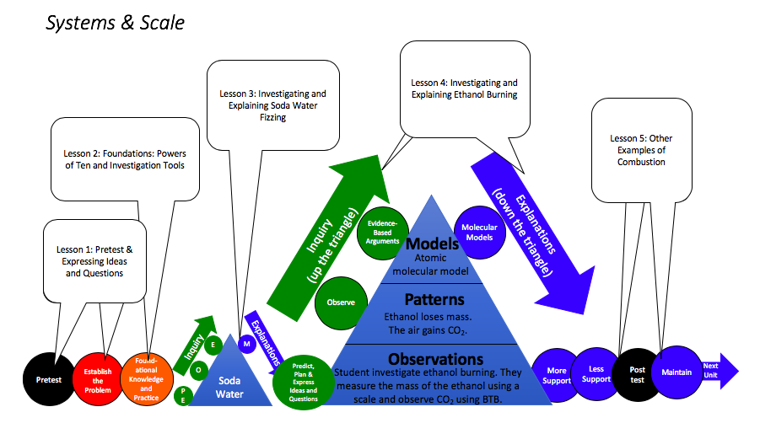
Unanswered Questions
Notes:
Discuss how the Unanswered Questions shape our next steps, and the transition from inquiry to application.
Display slide 10 of the 4.3 Evidence-Based Arguments Tool for Ethanol Burning PPT.
Use the Unanswered Questions to set the stage for students’ next steps, specifically the need to know what’s happening at the atomic-molecular scale.
Take a moment to show students that you have arrived at the “top of the triangle” on the instructional model poster. This means they will be making a transition. When they went “up the triangle,” they conducted an investigation and collected evidence based on what they could observe using their own eyes and also tools (e.g., macroscopic observations). Now they are preparing to go “down the triangle,” when they will figure out how to explain what happened in the investigations at an atomic-molecular scale by being provided and practicing with a model for scientifically-accurate thinking.

Slide 11
Save for Later
Later, you will revisit your unanswered questions to see which ones you’ve learned to answer.
Notes:
Save the Evidence-Based Arguments Tools for later.
Display slide 11. Tell students that they will revisit their unanswered questions later in the unit to see which questions they can now answer.

Slide 12
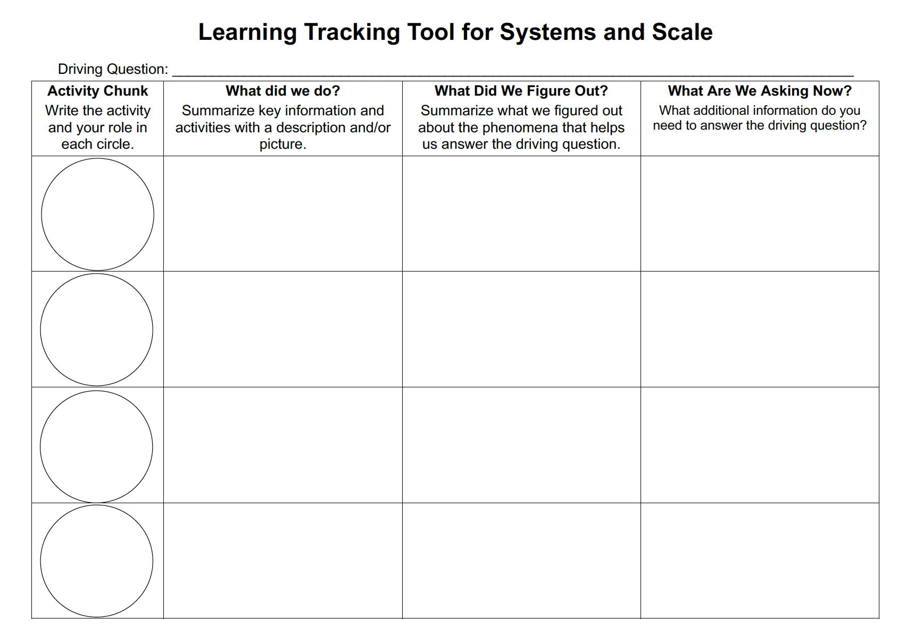
Learning Tracking Tool
For the activity “Investigating Ethanol Burning” discuss with your classmates what you figured out will help you to answer the unit driving question, “what happens when ethanol burns?”
Record what you did in the column “What Did We Do?”
Record your ideas in the column “What Did We Figure Out?”
Discuss questions you now have related to the unit driving question and record them in the column “What We are Asking Now.”
Notes:
Have a discussion to complete the Learning Tracking Tool for this activity.
Show slide 12 of the 4.3 Evidence-Based Arguments Tool for Ethanol Burning PPT.
Have students take out their Learning Tracking Tool for Systems and Scale.
Have students write the activity name, "Investigating Ethanol Burning" and their role “investigator” in the first column.
Have a class discussion about what students did during the activity. When you come to consensus as a class, have students record the answer in the second column of the tool.
Have a class discussion about what students figured out during the activity that will help them in answering the unit driving question. When you come to consensus as a class, have students record the answer in the third column of the tool.
Have a class discussion about what students are wondering now that will help them move towards answering the unit driving question. Have students record the questions in the fourth column of the tool.
Have students keep their Learning Tracking Tool for future activities.
Example Learning Tracking Tool
Activity Chunk: Investigating Ethanol Burning; Investigator
What Did We Do? Conduct an investigation to explore what happens when ethanol burns and use the Predictions and Planning Tool and the Evidence-Based Arguments Tool.
What Did We Figure Out? Ethanol burning lost mass and made the BTB change from blue to yellow. There was evidence of heat and light energy at the end of the chemical change.
What Are We Asking Now? What happens to the molecules of ethanol as it burns?

Slide 13
Exit Ticket
Conclusions
What is our conclusion for the energy change question from the investigation?
Predictions
Where do you think the CO₂ that turned the BTB yellow came from?
Notes:
Have students complete an exit ticket.
Show slide 13 of the 4.3 Evidence-Based Arguments Tool for Ethanol Burning PPT.
Conclusions: What is our conclusion for the energy change question from the investigation?
Predictions: Where do you think the CO₂ that turned the BTB yellow came from?
On a sheet of paper or a sticky note, have students individually answer the exit ticket questions. Depending on time, you may have students answer both questions, assign students to answer a particular question, or let students choose one question to answer. Collect and review the answers.
The conclusions question will provide you with information about what your students are taking away from the activity. Student answers to the conclusions question can be used on the Driving Question Board (if you are using one). The predictions question allows students to begin thinking about the next activity and allows you to assess their current ideas as you prepare for the next activity. Student answers to the predictions question can be used as a lead in to the next activity.

