Slide 1
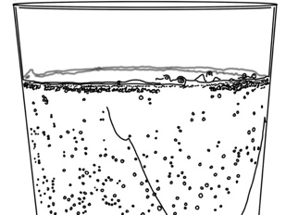
Systems and Scale Unit Activity 3.5: Explaining Soda Water Fizzing
Carbon: Transformations in Matter and Energy
Environmental Literacy Project Michigan State University
Notes:
Image Credit: Craig Douglas, Michigan State University

Slide 2
Unit Map
You are here
Notes:
Use the instructional model to show students where they are in the course of the unit.
Show slide 2 of the 3.5 Explaining Soda Water Fizzing PPT.

Slide 3
Revisit your evidenced-based arguments and modeling
Think about what you know now that you didn’t know before. What have you learned?
Notes:
Revisit students’ arguments about soda water.
Show slide 3 of the 3.5 Explaining Soda Water Fizzing PPT.
Tell students that this activity’s purpose is to develop explanations for what happens when soda water fizzes.
Return each student’s copy of 3.3 Evidence-Based Arguments Tool for Soda Water Fizzing and have them review their arguments before they completed the molecular modeling activity.
Ask them to think about what they know now that they didn’t know then.

Slide 4
Completing the Front of Your Explanations Tool
Consider the following as you complete the front:
Evidence from the investigation
What you learned from the molecular modeling activity
Notes:
Have students complete the front of the Explanations process tool.
Show slide 4 of the 3.5 Explaining Soda Water Fizzing PPT. Give each student one copy of 3.5 Explanations Tool for Soda Water Fizzing.
Make sure students understand that they will use the information from the front of the explanations tool help them construct their explanations paragraphs on the back.
Give students about 10 minutes to complete the front of the Explanations Process Tool.
Display slide 5. Then, have students compare their responses with a partner, with the goal of confirming that their responses are the same.

Slide 5
Comparing Ideas with the Class
Compare your arrows and responses for each of the questions.
How are they alike?
How are they different?
Revise your arrows and responses based on your conversations with the class.
Notes:
Have students complete the front of the Explanations process tool.
Show slide 4 of the 3.5 Explaining Soda Water Fizzing PPT. Give each student one copy of 3.5 Explanations Tool for Soda Water Fizzing.
Make sure students understand that they will use the information from the front of the explanations tool help them construct their explanations paragraphs on the back.
Give students about 10 minutes to complete the front of the Explanations Process Tool.
Display slide 5. Then, have students compare their responses with a partner, with the goal of confirming that their responses are the same.

Slide 6
Matter Movement
Do you have:
A label showing Carbonic acid in the Soda Water
H₂CO₃
Notes:
Have students check the front of the explanations tool using the PPT.
Display slides 6-8 of the PPT. Have students compare their answers to the Matter Movement Question with the answers on the slide. Have students use a different colored writing utensil to make any needed changes to their answers. Allow students to ask questions if they do not understand why their ideas are incorrect.

Slide 7
Matter Movement
Do you have:
An arrow showing carbon dioxide or CO₂ moving through the soda water in the bubbles and a label showing water or H₂O in the soda water
H₂O
CO₂
H₂CO₃
Notes:
Have students check the front of the explanations tool using the PPT.
Display slides 6-8 of the PPT. Have students compare their answers to the Matter Movement Question with the answers on the slide. Have students use a different colored writing utensil to make any needed changes to their answers. Allow students to ask questions if they do not understand why their ideas are incorrect.

Slide 8
Matter Movement
Do you have:
An arrow showing carbon dioxide or CO₂ leaving the soda water
CO₂
H₂O
CO₂
H₂CO₃
Notes:
Have students check the front of the explanations tool using the PPT.
Display slides 6-8 of the PPT. Have students compare their answers to the Matter Movement Question with the answers on the slide. Have students use a different colored writing utensil to make any needed changes to their answers. Allow students to ask questions if they do not understand why their ideas are incorrect.

Slide 9
Matter Change
Write the chemical equation for the change that happens when soda water fizzes:
H₂CO₃→ CO₂ + H₂O
Notes:
Have students check the front of the explanations tool using the PPT.
Display slide 9-10 of the PPT for the Matter Change Question and repeat the process above.

Slide 10
Matter Change
What molecules are carbon atoms in before the chemical change?
Carbonic Acid or H₂CO₃
What molecules are carbon atoms in after the chemical change?
Carbon dioxide or CO₂
What other molecules are produced?
Water or H₂O
Chemical Change
Notes:
Have students check the front of the explanations tool using the PPT.
Display slide 9-10 of the PPT for the Matter Change Question and repeat the process above.

Slide 11
Constructing Explanations
Write an explanation: What happens to soda water when it fizzes?
Use your:
Front of the Explanations Tool
Notes:
Have students write paragraph explanations of the process of soda water fizzing.
Display slide 11. Ask students to write paragraphs explaining the process of soda water fizzing on the second page of the 3.5 Explanations Tool for Soda Water Fizzing.
Remind students that they have the information they need in their responses to the questions on the front of the Explanations Tool.
Remind students that the graphic organizer on the front has the information they need to write their explanations paragraphs.

Slide 12
Comparing Ideas with a Partner
Compare your explanations for the questions.
How are they alike?
How are they different?
Consider making revisions to your explanation based on your conversation with your partner.
Notes:
Have students share explanations with each other.
Show slide 12 of the 3.5 Explaining Soda Water Fizzing PPT. Divide students into pairs and have them compare explanations.

Slide 13
Telling the Whole Story
Question: What happens to soda water when it fizzes?
Does your story include these parts?
Matter movement: Carbonic acid is in the soda water before it fizzes.
Matter change: Carbonic acid separates into carbon dioxide and water.
Matter movement: The carbon dioxide in bubbles moves through and leaves the soda water. The water molecules remain in the soda water.
Notes:
Have students critique and improve their full explanations.
Display slide 13 of the PPT for the full explanation. Have students check that their story includes each of the parts (matter movement, matter change and matter movement) and answers the prompt in a cohesive way.
If students don’t have all three parts in their explanation, instruct them to add to their explanation using a different colored writing utensil.
If students have model explanations to share, display student work and discuss. If students have common areas of weakness in their explanations, ask for a volunteer to share, display student work, and discuss ways of strengthening the response.

Slide 14
How have your ideas changed?
Gather together your process tools for the unit (Predictions Tool, Evidence-Based Argument Tool).
How have your ideas changed related to:
Scale?
Movement?
Carbon?
What do you know about soda water now that you didn’t know before the investigation?
Notes:
Discuss how ideas have changed
Show slide 14. Have students Gather together their process tools for the unit (Predictions and Planning Tool, Evidence-Based Argument Tool). Have a discussion about how their ideas have changed related to:
Scale?
Movement?
Carbon?
Ask students what do they know about soda water now that they didn’t know before the investigation? Record responses.

Slide 15
Question
Where are molecules moving?
How do molecules move to the location of the chemical change?
How do molecules move away from the location of the chemical change?
Evidence We Can Observe
Moving solids, liquids, and gases are made of moving molecules.
A change in mass shows that molecules are moving.
Rules to Follow
All materials (solids, liquids, and gases) are made of atoms that are bonded together in molecules.
Scale: The matter movement question can be answered at the atomic-molecular, cellular, or macroscopic scale.
Question
How are atoms in molecules being rearranged into different molecules?
What molecules are carbon atoms in before and after the chemical change?
What other molecules are involved?
Evidence We Can Observe
BTB can indicate CO₂ in the air.
Organic materials are made up of molecules containing carbon atoms:
• fuels • foods
• living and dead plants and animals
decomposers
Rules to Follow
Atoms last forever in combustion and living systems.
Atoms can be rearranged to make new molecules, but not created or destroyed.
Carbon atoms are bound to other atoms in molecules.
Scale: The matter change question is always answered at the atomic-molecular scale.
Question
What is happening to energy?
What forms of energy are involved?
What energy transformations take place during the chemical change?
Evidence We Can Observe
We can observe indicators of different forms of energy before and after chemical changes:
• light energy • heat energy
• chemical energy stored in organic materials
• motion energy
Rules to Follow
Energy lasts forever in combustion and living systems.
Energy can be transformed, but not created or destroyed.
C-C and C-H bonds have more stored chemical energy than C-O and H-O bonds.
Scale: The energy change question can be answered at the atomic-molecular, cellular, or macroscopic scales.
Notes:
Use Three Questions to look ahead.
Show slide 15 of the 3.5 Explaining Soda Water Fizzing PPT. Tell students that in this lesson they focused on two of the Three Questions: The Matter Movement Question and the Matter Change Question. For the rest of the Carbon TIME lessons, we will also be discussing the third question: The Energy Change Question.

Slide 16
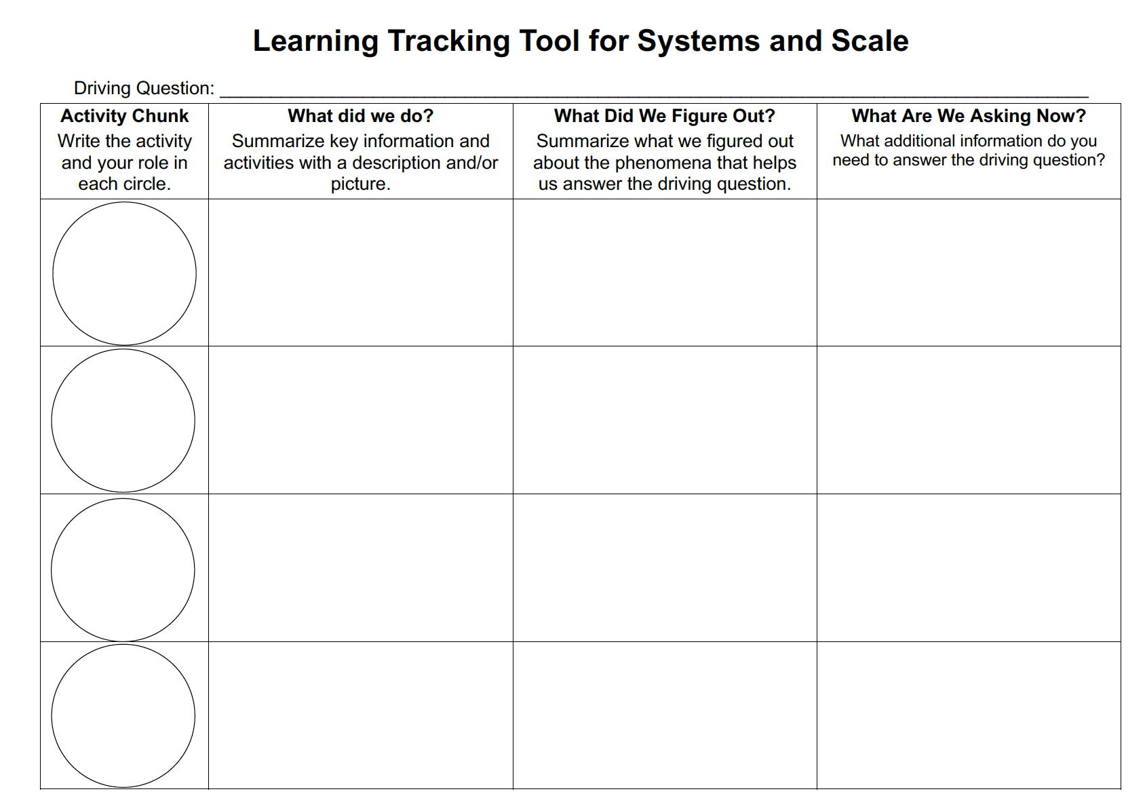
Learning Tracking Tool
For the activity “Molecular Models for Soda Water Fizzing” discuss with your classmates what you figured out will help you to answer the unit driving question, “what happens when ethanol burns?”
Record what you did in the column “What Did We Do?”
Record your ideas in the column “What Did We Figure Out?”
Discuss questions you now have related to the unit driving question and record them in the column “What We are Asking Now.”
Notes:
Have a discussion to complete the Learning Tracking Tool for this activity.
Show slide 16 of the 3.5 Explaining Soda Water Fizzing PPT.
Have students take out their Learning Tracking Tool for Systems and Scale.
Have students write the activity name "Explaining Soda Water Fizzing" and their role “Explainer” in the first column,
Have a class discussion about what students did during the activity. When you come to consensus as a class, have students record the answer in the second column of the tool.
Have a class discussion about what students figured out during the activity that will help them in answering the unit driving question. When you come to consensus as a class, have students record the answer in the third column of the tool.
Have a class discussion about what students are wondering now that will help them move towards answering the unit driving question. Have students record the questions in the fourth column of the tool.
Have students keep their Learning Tracking Tool for Systems & Scale for future activities.
Example Learning Tracking Tool
Activity Chunk: Explaining Soda Water Fizzing; Explainer
What Did We Do? Model the chemical change that occurs as soda water fizzes using molecular model kits and use the Explanations Tool to explain what happens when soda water fizzes.
What Did We Figure Out? The carbonic acid in soda water decomposes into carbon dioxide and water as it fizzes. No atoms are created or destroyed during the chemical change.
What Are We Asking Now? What happens to ethanol when it burns?

Slide 17
Exit Ticket
Conclusions
What should be included in a good explanation?
Predictions
How do you think what you learned about soda water fizzing will apply to ethanol?
Notes:
Have students complete an exit ticket.
Show slide 17 of the 3.5 Explaining Soda Water Fizzing PPT.
Conclusions: What should be included in a good explanation?
Predictions: How do you think what you learned about soda water fizzing will apply to ethanol?
On a sheet of paper or a sticky note, have students individually answer the exit ticket questions. Depending on time, you may have students answer both questions, assign students to answer a particular question, or let students choose one question to answer. Collect and review the answers.
The conclusions question will provide you with information about what your students are taking away from the activity. Student answers to the conclusions question can be used on the Driving Question Board (if you are using one). The predictions question allows students to begin thinking about the next activity and allows you to assess their current ideas as you prepare for the next activity. Student answers to the predictions question can be used as a lead into the next activity.

