Slide 1
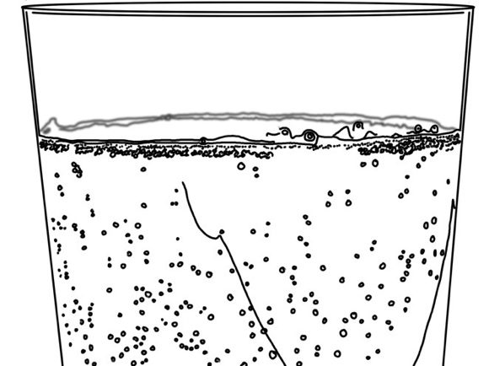
Systems and Scale Unit Activity 3.2 Observing Soda Water Fizzing
Carbon: Transformations in Matter and Energy
Environmental Literacy Project Michigan State University
Notes:
Image Credit: Craig Douglas, Michigan State University

Slide 2
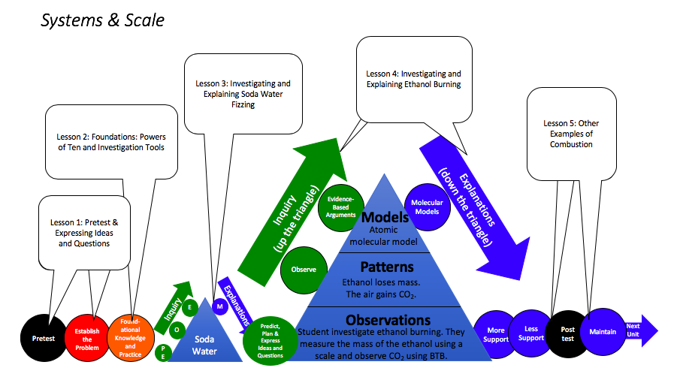
Unit map
You are here
Notes:
Use the instructional model to show students where they are in the course of the unit.
Show slide 2 of the 3.2 Observing Soda Water Fizzing PPT.

Slide 3
Materials for the Investigation
How will you measure mass changes?
How will you observe changes in the color of BTB?
Notes:
Photo Credit: FableVision
Have students set up the investigation.
Display slide 3 of the PPT. Divide students into groups of four.
Pass out one copy of 3.2 Observing Soda Water Fizzing Worksheet to each student. Walk through the steps in Part A of the worksheet that overview how to set up and conduct the investigation.

Slide 4
Let’s do the investigation!
Follow the steps in Part A of your worksheet.
Wait at least 20 minutes to observe your results.
Notes:
Photo Credit: FableVision
Have students conduct the investigation.
Display slide 4 while students are conducting the investigation. The students will need to wait 20 minutes to see color change in the BTB.

Slide 5
What Are Your Ideas about the Matter Movement Question?
What do you think we will see? (macroscopic scale) | What might it mean? (atomic-molecular scale) | What should we be paying attention to?
Notes:
Have students discuss their predictions about the Matter Movement Question as a class.
While waiting for the soda water to lose some fizz, display slide 5 of the PPT. Ask students to retrieve their completed tools from the previous activity: 3.1 Predictions Tool for Soda Water Fizzing.
Ask pairs of students to share their ideas for the Matter Movement Question. Ask students what they expect to see in the investigation and what that might mean.
Record students’ ideas on the slide.
Help the students look for similarities and differences in the predictions in the class. Try to get a range of ideas on the slide.

Slide 6
What Are Your Ideas about the Matter Change Question?
What do you think we will see? (macroscopic scale) | What might it mean? (atomic-molecular scale) | What should we be paying attention to?
Notes:
Have students discuss their predictions about the Matter Change Question as a class.
While continuing to wait for the soda water to lose more fizz, display slide 6 of the PPT and ask pairs of students to share their ideas for the Matter Change Question.
Lead a discussion by asking students what they expect to see in the investigation and what that might mean.
Record students’ ideas on the slide.
Help the students look for similarities and differences in the predictions in the class. Try to get a range of ideas on the slide.

Slide 7
Class Results for Soda Water
Group | Start Time | End Time | Initial Mass | Final Mass | Change in Mass | BTB before | BTB after | Notes
1
2
3
Average
Notes:
Have students record data and observations.
Display slide 7 of the PPT. Have students record their group’s data and observations about the mass change and BTB color on their worksheet.
Next, have students select a recorder to input their group’s results on the 3.2 Soda Water Fizzing Class Results 11 x 17 Poster, or in the 3.2 Soda Water Fizzing Class Results Spreadsheet.

Slide 8
Possible BTB Colors
Notes:
Photo Credit: FableVision
Have students’ groups compare and identify patterns in BTB Color.
Display slide 8 of the PPT.
Lead a discussion to help students compare results across groups and identify patterns in the data. Have students discuss how BTB has a gradient of colors depending on how much CO₂ is absorbed.
Optionally, have them use the BTB Color Handout to interpret the color of the BTB.

Slide 9
Comparing Group Results
Results for mass changes
What patterns are there in measurements made by all the groups?
Do the patterns match your predictions?
Results for BTB changes
What patterns are there in observations made by all the groups?
Do the patterns match your predictions?
Notes:
Have students’ groups discuss patterns in class results.
Show students slide 9 to discuss patterns that students see in the class results.
Ask students to identify patterns in the data for both the mass change and also the BTB color change, and discuss any outliers or unexplained data points.
If you input data into the spreadsheet, the software will construct a graph of the students’ data. Use the graph to elicit more interpretation of their observations.

Slide 10
Results for Ms. Hach’s Class
Group Name | Initial mass of soda water (g) | Final mass of soda water (g) | Change in mass of soda water (g) | start BTB color | end BTB color
1 | 30.64 | 30.55 | -0.09 | blue | yellow
2 | 50.22 | 50.13 | -0.09 | blue | yellow
3 | 43.40 | 43.30 | -0.10 | blue | yellow
4 | 32.61 | 32.47 | -0.14 | blue | yellow
5 | 43.26 | 43.19 | -0.07 | blue | yellow
6 | 34.11 | 34.03 | -0.08 | blue | yellow
How do your results compare with the results for Ms. Hach’s class?
Notes:
Have students compare their class’s data with data from another class.
Show slides 10 of the PPT to view data from Ms. Hach’s class. Ask students to compare the patterns they observed with the patterns from Ms. Hach’s class. What similarities or differences do they notice?

Slide 11
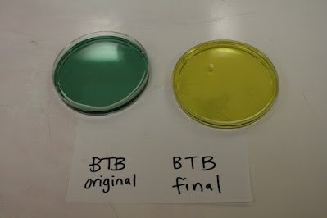
Results for Ms. Hach’s Class
How do your results compare with the results for Ms. Hach’s class?
Notes:
Photo Credit: Michigan State University
Have students compare their class’s BTB color with data from another class.
Show slide 11 of the PPT to view BTB from Ms. Hach’s class. Ask students to compare the colors they observed with the colors from Ms. Hach’s class. What similarities or differences do they notice?

Slide 12
Revisit Your Predictions
What did we see? What does it mean?
Which predictions were correct?
Which predictions were incorrect?
What questions do you still need to answer?
Notes:
Revisit predictions from the previous activity.
Use slide 12 to revisit students’ predictions from Activity 3.1.
Have them compare the predictions they made with the results of the investigation.
Which predictions were correct? Which predictions were incorrect? What questions do they still need to answer?

Slide 13
Exit Ticket
Conclusions
What did you observe during the investigation?
Predictions
What do you think is one conclusion you can make from the investigation?
Notes:
Have students complete an exit ticket.
Show slide 13 of the 3.2 Observing Soda Water PPT.
Conclusions: What did you observe during the investigation?
Predictions: What do you think is one conclusion you can make from investigation?
On a sheet of paper or a sticky note, have students individually answer the exit ticket questions. Depending on time, you may have students answer both questions, assign students to answer a particular question, or let students choose one question to answer. Collect and review the answers.
The conclusions question will provide you with information about what your students are taking away from the activity. Student answers to the conclusions question can be used on the Driving Question Board (if you are using one). The predictions question allows students to begin thinking about the next activity and allows you to assess their current ideas as you prepare for the next activity. Student answers to the predictions question can be used as a lead in to the next activity.

