Slide 1
Systems and Scale Unit Activity 2.5 Investigation Tools
Carbon: Transformations in Matter and Energy
Environmental Literacy Project Michigan State University
Notes:
Image Credit: Craig Douglas, Michigan State University

Slide 2
Unit Map
You are here
Notes:
Use the instructional model to show students where they are in the course of the unit.
Show slide 2 of the 2.5 Investigation Tools PPT.
Introduce students to the two investigation tools.
Introduce the investigation tools to students and explain that since atoms are too small to see, scientists have developed special methods to investigate things about the world they can’t know from using their eyes only. Today they will explore two of these tools: a digital balance and Bromothymol Blue (BTB).

Slide 3
Investigation Tool: Digital Balance
Determine the mass of:
A large paper clip
A straw
Your cup of BTB solution
A pencil
Each member of your group should weigh one object.
Notes:
Photo Credit: FableVision
Have students practice using the digital balance in small groups.
Show students slide 3 of the PPT.
Divide students into groups of four. Tell students to follow the instructions on the slide, and to determine the mass of at least four different items: a paper clip, a straw, a cup of BTB, and a pencil.
Accommodation: Print out slide 3 so each group has a copy of the instructions.
Tell students to record their results on the 2.5 Class Results for Investigation Tools 11 x 17 Poster or the 2.5 Class Results for Investigation Tools Spreadsheet.
Have students compare their results across groups for the digital balance.

Slide 4
Investigation Tool: BTB
What does your breath do to BTB solution?
Use the soda straw to blow gently through the BTB solution.
What change do you see?
What substance in your breath might be causing this change?
Notes:
Photo Credit: FableVision
Have students practice using BTB in small groups.
Show students slide 4 of the PPT and tell one student in each group to use the soda straw to blow through BTB while the other students watch and record their observations.
Have each group record results on the 2.5 Class Results for Investigation 11 x 17 Poster or the 2.5 Class Results for Investigation Tools Spreadsheet.
Have students compare their results across groups for the BTB using the (optional) BTB Color Handout as a reference guide.

Slide 5
Comparing Group Results
What mass did each group find for each item?
A large paper clip
An empty Petri dish
Your cup of BTB solution
A pencil
How different are your results?
Why do you think they are different?
What changes did you see in the BTB solution?
How were the group results alike or different?
What substance in your breath might be causing this change?
Notes:
Show students slide 5 to help students compare results of mass and color from different groups. Have them answer the questions on the slide. Have students compare and discuss the results from different groups, look for patterns, and identify possible sources of error. This activity will be the first time they do this, and you can judge the sophistication of their thinking.
If students are discussing…
…how the last digit on the balance (.01 g) is sensitive to slight movements and wind currents, and therefore it may not be reliable, then students are discussing levels of precision.
…the differences between the objects that are similar for all groups (paper clip and straw) and the objects that vary from one group to another (pencil and cup of BTB), then the students are discussing real variation in objects.
…that the balances themselves may be inconsistent, then they are discussing variation among balances. One way to check this is to mass the same object on different balances.
…variations in BTB color depending on how long and how hard different students blew through the solution, then they are discussing time dependence.
Accommodation: Create a slide with the discussion points and descriptions mentioned above to help facilitate the discussion about error.

Slide 6
Possible BTB Colors
Notes:
Photo Credit: FableVision
Discuss key conclusions about digital balances and BTB
Discuss key conclusions about using digital balances and BTB for investigations:
Digital balances measure mass very accurately. The last decimal place (.01 g) shows tiny differences that can be affected even by air currents.
Use Slide 6 and the optional BTB Color Handout to remind students that BTB detects concentrations of CO₂ in the air. They can keep the handout to use in future investigations

Slide 7
Digital balance: a tool to measure matter movement
How can you use a digital balance to measure matter moving into or out of a system?
Measure the mass of the system before and after a change happens in the system.
Possible conclusions:
If the mass of the system increases, then matter must have moved into the system (remember the facts about atoms)
If the mass of the system decreases, then matter must have moved out of the system.
Notes:
Photo Credit: FableVision
Discuss matter movement question as it relates to a digital balance
Show slide 7 of the 2.5 Investigation Tools PPT. Discuss with students how a digital balance can be used to measure matter moving into or out of a system. Highlight that the mass of the system can be measured before and after a change happens in a system. Discuss the two possible conclusions students can draw from their observations:
If the mass of the system increases, then matter must have moved into the system (remember the facts about atoms)
If the mass of the system decreases, then matter must have moved out of the system.

Slide 8
BTB: a tool to detect matter change
How can you use BTB to detect a matter change in a system?
Put BTB in a closed container with the system, then observe the color before and after a change happens in the system.
Possible conclusions:
If the BTB changes from blue to yellow, then a chemical change may be producing CO₂
If the BTB changes from yellow to blue, then a chemical change may be using CO₂ as a reactant.
Notes:
Photo Credit: FableVision
Discuss matter change question as it relates to BTB
Show slide 8 of the 2.5 Investigation Tools PPT. Discuss with students how BTB can be used to measure matter change in a system. Highlight that the BTB in a closed container can be observed before and after a change happens in the system. Discuss the two possible conclusions students can draw from their observations:
If the BTB changes from blue to yellow, then a chemical change may be producing CO₂
If the BTB changes from yellow to blue, then a chemical change may be using CO₂ as a reactant.

Slide 9
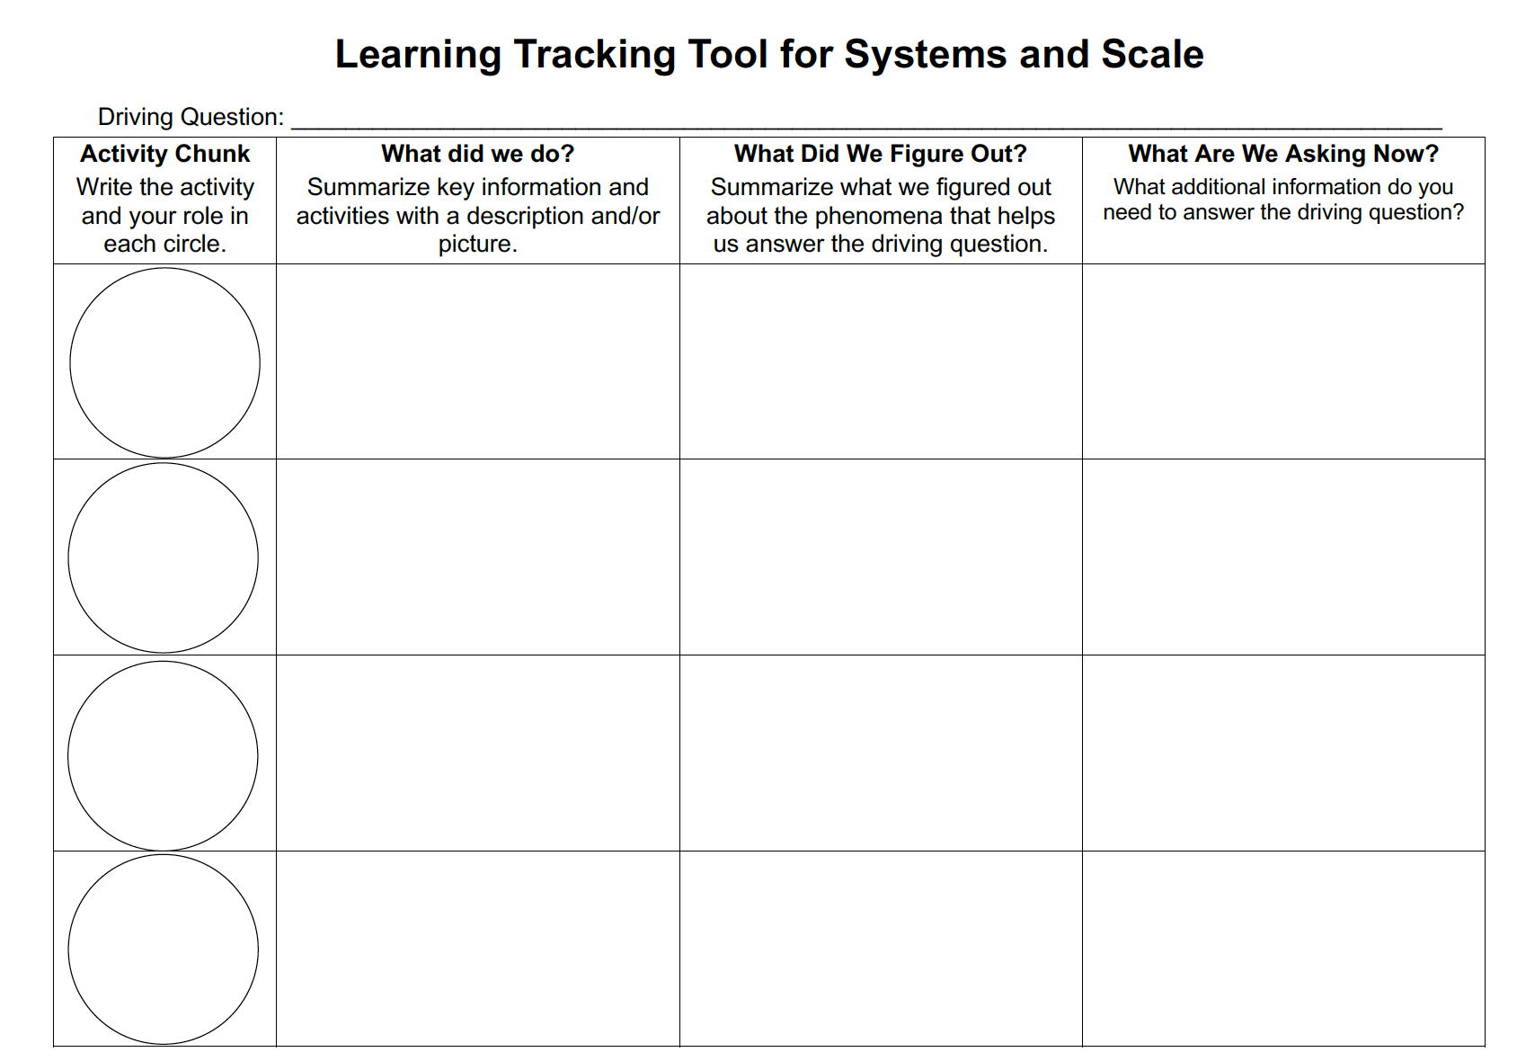
Learning Tracking Tool
For the activity chunk “Zooming Into Air” discuss with your classmates what you figured out will help you to answer the unit driving question, “what happens when ethanol burns?”
Record what you did in the column “What Did We Do?”
Record your ideas in the column “What Did We Figure Out?”
Discuss questions you now have related to the unit driving question and record them in the column “What We are Asking Now.”
Notes:
Have a discussion to complete the Learning Tracking Tool for this activity.
Show slide 9 of the 2.5 Investigation Tools PPT.
Have students take out their Learning Tracking Tool.
Have students write the activity name in the first column, "Zooming Into Air."
Have a class discussion about what students did during the activity. When you come to consensus as a class, have students record the answer in the second column of the tool.
Have a class discussion about what students figured out during the activity that will help them in answering the unit driving question. When you come to consensus as a class, have students record the answer in the third column of the tool.
Have a class discussion about what students are wondering now that will help them move towards answering the unit driving question. Have students record the questions in the fourth column of the tool.
Have students keep their Learning Tracking Tool for Systems & Scale for future activities.
Example Learning Tracking Tool
Activity: Zooming Into Air
What Did We Do: "Zoom into" air and explore how the world can be studied at multiple scales, including the atomic-molecular scale.
What We Figured Out:
We can learn about the world at different scales.
Three facts about atoms are: 1) Atoms last forever, 2) Atoms make up the mass of all materials, 3) Atoms are bonded to other atoms in molecules.
A digital balance can be used to determine if atoms have moved, because atoms have mass. BTB can be used to detect changes in the CO₂ concentration in the air.
What We are Asking Now: How can we use atoms and molecules to explain ethanol burning?

Slide 10
Exit Ticket
Conclusions
What information can a digital balance and BTB provide?
Predictions
How do you think you could use a digital balance and BTB to figure out what happens when ethanol burns?
Notes:
Have students complete an exit ticket.
Show slide 10 of the 2.5 Investigation Tools PPT.
On a sheet of paper or a sticky note, have students individually answer the exit ticket questions. Depending on time, you may have students answer both questions, assign students to answer a particular question, or let students choose one question to answer. Collect and review the answers.
The conclusions question will provide you with information about what your students are taking away from the activity. Student answers to the conclusions question can be used on the Driving Question Board (if you are using one). The predictions question allows students to begin thinking about the next activity and allows you to assess their current ideas as you prepare for the next activity. Student answers to the predictions question can be used as a lead into the next activity.

