Slide 1



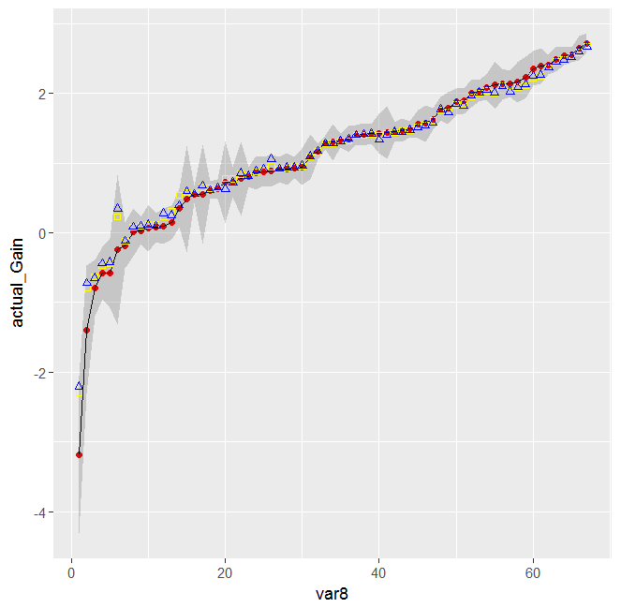

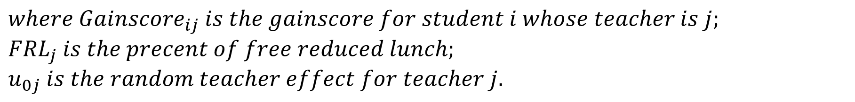


Teacher Effectiveness and Their Carbon TIME Practices and Knowledge
Qinyun Lin¹, JinHo Kim², Ellen Holste¹, Shruti Bathia², Karen Draney² & Kenneth A. Frank¹
1: Michigan State University; 2: University of California, Berkeley
Abstract
2. Who Is the Best Teacher? Different Models to Estimate Teachers’ Effectiveness
With pretest and posttest scores estimated from item response theory (IRT), we applied hierarchical linear models to investigate several factors affecting students’ success, including the students’ grade levels (middle or high school), affluence of their schools (measured by percent free and reduced lunch), prior knowledge (measured by pretest scores), and the identities of their teachers. We also discussed different approaches to evaluate teachers’ effectiveness in terms of their students’ 3D learning of the Carbon TIME curriculum. Finally, we introduced some teacher-level variables measured by surveys and discussed how these variables correlated to their students’ learning gains.
Value-added models have gained much popularity recently. We conducted several models (M1,
M2 and M3 shown as follows) to measure teachers’ effectiveness in students’ learning. The
correlations are quite high among effectiveness estimates generated by different models (all
above 0.86). However, there could be sizable differences if we look at teacher rankings across
different models for some specific teachers. This result is generally consistent with previous
literature. (Goldhaber et al, 2014) Figure 3 represents our case study teachers’ rankings among
67 teachers across three models.
M1 Pretest as a covariate (fixed teacher effect)
M2 Gain score as the outcome variable (fixed teacher effect)
M3 Two-level model (random teacher effect)
${Pretest}_{i}$ and ${Posttest}_{i}$ are the full pretest and posttest for student $i$;
${\overline{Pretest}}_{j}$ is the average pretest of all students taught by teacher j;
${FRL}_{j}$ is the percentage of free reduced lunch in teacher j’s school.
Discussion:
The change in rankings from M1 and M2 to M3 is as expected. For teachers who were assigned with better students, their rankings get lower once we add control variables related to students’ background. For example, Mr. Solomon gets a much lower ranking in M3 and his students were accelerated students. For teachers who taught special education students (such as Ms. Estabrook), their rankings get improved when FRL is added into the model to take into account students’ background.
The changes in rankings across models indicated the sensitivity of teacher effectiveness estimates to different models. The changes from M1 and M2 to M3 exactly represent possible bias we may get if we omit some crucial factors (such as students’ background measured as percent of free and reduced lunch here). In this context, it is clear that M3 is better than M1 and M2. But how can we know that M3 is good enough and there is no other important factors that are omitted from the model?
In general, it is problematic to claim cause-effect relationships for learning in classrooms of individual teachers just based on pre-post test scores. When we compare our rankings here to our classroom observation data, we find some inconsistencies. For example, Ms. Nolan has been recognized as the very top teacher among case study teachers in terms of classroom discourse. However, her ranking based on pre-post scores is only in the middle of case study teachers. This is probably because she is not as serious as other teachers about test preparation. Therefore, it might be unfair if teachers are only evaluated by pre-post test scores. There could be many factors that are not observed in the test scores but should be appreciated.
1. Teachers DO Make a Difference Among Other Factors.
$${Posttest}_{i}={γPretest}_{i}+{Teacher}_{i}β+u_{i}$$
Data: We used the estimated latent proficiency scores from our IRT analysis as students’ test scores. These scores provide as measures of students’ proficiency in the Carbon dimension in Full Tests. For each student, we have their scores both at the beginning (pretest) and end (posttest) of a school year. For 2016-17, we have 67 teachers and 3642 students. We also collected teacher-level variables including affluence of schools measured by percent of free reduced lunch (FRL), grade levels measured as high school or middle school (Gradeband), percent of minority students (Minority) and school average standardized test scores (School scores).
Participating in Carbon TIME
As we can see in Figure 1 which shows the distribution of all students’ gain scores, most of students improved from pretests to posttests (the gain score is bigger than 0). A paired t-test shows that the increase from pretest (Mean = -0.654)
to posttest (Mean = 0.704) is statistically
significant (p < 0.001) from 0 and the effect
size is about 0.7.
However, we can tell from Figure 1,
students differ greatly from each other in
terms of how much learning growth they
gained from participating in Carbon TIME.
This is because different teachers and many
other factors could lead to variation in
learning through Carbon TIME. Therefore,
we applied multilevel models to study what
factors are most important and how important
they are in affecting the learning students
could gain from participating in Carbon TIME.
Teachers Do make a difference in helping student learn from Carbon TIME
We ran following two models:
Model A: Model B:
The difference between these two models is the
${FRL}_{j}$. We use this variable to control classroom
characteristics. (In fact, once we control this
variable, the other variables such as grade level,
percent of minority and school test scores do not
make significant contributions to explaining the
variance in gain scores.) In the Figure 2, we can
tell that there are great variance in observed
classroom average gain scores. This variance
decreases a little bit once we account for the
classroom characteristic measured by FRL (blue
triangles show small variance compared to
yellow circles). In other words, after removing
the factor of FRL, there are still quite sizable
differences in terms of classroom average
learning gains, which indicates the key role of
teachers in helping students learn from Carbon TIME. In fact, the intra-class correlation in Model A is 24%, indicating a considerable amount of between-teacher variation. The conditional ICC in Model B is still as high as 22.4%, which represents a between-teacher variation even after removing the effect of classroom characteristics. This is a quite high ICC among other research. (Frank, 1998) Therefore, teachers do make a difference in students’ learning in Carbon TIME.
$${Posttest}_{i}−{Pretest}_{i}={Gainscore}_{i}={Teacher}_{i}β+u_{i}$$
$$Level1: {Posttest}_{ij}=β_{0j}+{β_{1j}∗(Pretest}_{ij}−\overline{{Pretest}_{j}})+r_{ij}$$
$$Level2: β_{0j}=γ_{00}+{γ_{01}∗{FRL}_{j}+γ_{02}∗\overline{{Pretest}_{j}}+u}_{0j}$$
$$β_{1j}=γ_{10}$$
3. Science-teaching Practices, Knowledge and Grading:
How Do Teachers’ Teaching Affect Their Students’ 3D Learning?
4. Future Research
$$Level1: {Gainscore}_{ij}=β_{0j}+r_{ij}$$
$$Level1: {Gainscore}_{ij}=β_{0j}+r_{ij}$$
  Though we have a rough idea about teachers’ classroom discourse based on our classroom observation data, we are still working on how to figure out reliable ways of coding key variables and fully use our case study data. By doing this, we could separate robust cause-effect relationships from statistical noise in measuring teachers’ effectiveness.
  As we discussed in Part 3, the correlation between teachers teaching (practice, knowledge and grading) and students’ learning growth is still ambiguous. There are some inconsistencies between the 2015-16 and the 2016-17 findings. Currently, we cluster the survey items into composite scores based on our theories. We may explore how some single survey items correlate to students’ learning growth.
  We will have more students’ test scores and teachers’ survey data in the next two years, which will allow us to test our current findings. And the data presented here is only from the Carbon dimension in our assessments. We also have other two dimensions which would be important to study.
$$Level2: β_{0j}=γ_{00}{+u}_{0j}$$
$$Level2: β_{0j}=γ_{00}+{γ_{01}∗{FRL}_{j}+u}_{0j}$$
  We conducted teacher surveys every year to measure teachers’ science knowledge, science-teaching knowledge, grading students’ responses and science-teaching practices. (See sample items on the fliers.)
  Teachers’ science knowledge: teachers are asked to answer five knowledge questions. These questions are also included in student tests. We have computer models for four questions. (alpha = 0.51 for 2016-17)
  Teachers’ science teaching knowledge: teachers are asked questions about how they would deal with some students’ misunderstandings in specific contexts. (correlation = 0.27 for two questions for 2016-17)
  Teachers’ grading students’ answers: we provided three students’ responses for four items. For each item, we evaluate how far the teacher’s ranking of different responses from the correct ranking. The grading for FATLOSS and BIOMASS item has a correlation of 0.29 for 2016-17.
  Teachers’ science teaching practices: teachers are asked about how frequently they do each practice listed in the survey. We identify three groups of practices. The first group include 13 Carbon TIME featured practices. These practices are highly emphasized in our project (alpha = 0.87 for 2016-17). The second group include 12 practices that are generally encouraged but not specifically highlight in Carbon TIME (alpha = 0.84 for 2016-17). The final group include 11 practices that Carbon TIME encourage teachers NOT to do in their teaching (alpha = 0.62 for 2016-17).
  We tried several models to study how these teacher-level variables help explain the variation in their students’ learning gains. However, there are some inconsistencies between the results from 2015-16 and 2016-17. For example, the 2015-16 data showed that Carbon TIME featured practices have a positive effect on students’ learning (p = 0.057). However, this effect is not statistically significant anymore in the 2016-17 data. Instead, the 2016-17 data showed some significant interaction effect between teachers’ Carbon TIME featured practices and the effect of students’ prior knowledge (measured by students’ pre-tests). Specifically, the positive effect of Carbon TIME featured practices is significantly greater for low-score students. There are also some findings for which we are still working on possible explanations. For both 2015-16 and 2016-17, we find there is a statistically significant interaction effect between teachers’ grading responses and students’ prior knowledge. The interaction effect is saying that teachers who graded very precisely tend to favor more with better students (students with higher pretests) in terms of learning growth. We have some potential explanation for this but need to validate that reasoning further.
$$where {Gainscore}_{ij} is the gainscore for student i whose teacher is j;$$
$${FRL}_{j} is the precent of free reduced lunch;$$
$u_{0j} is the random teacher effect for teacher j.$
Figure 2
Average gain score for each teacher
Actual/Observed average gain score
Model A predicted average gain score
Model B predicted average gain score
Note: the grey area shows a 68% confidence interval for the average gain score
Acknowledgements
  Thank you to the entire Carbon TIME team. This research is supported by grants from the National Science Foundation: A Learning Progression-based System for Promoting Understanding of Carbon-transforming Processes (DRL 1020187), and Sustaining Responsive and Rigorous Teaching Based on Carbon TIME (NSF 1440988 ). Any opinions, findings, and conclusions or recommendations expressed in this material are those of the author(s) and do not necessarily reflect the views of the National Science Foundation.
  References
  Frank, K. A. (1998). Chapter 5: Quantitative Methods for Studying Social Context in Multilevels and Through Interpersonal Relations. Review of Research in Education, 23(1), 171–216. https://doi.org/10.3102/0091732X023001171.
  Goldhaber, D., Walch, J., & Gabele, B. (2014). Does the model matter? Exploring the relationship between different student achievement-based teacher assessments. Statistics and Public Policy, 1(1), 28-39.

