Slide 1
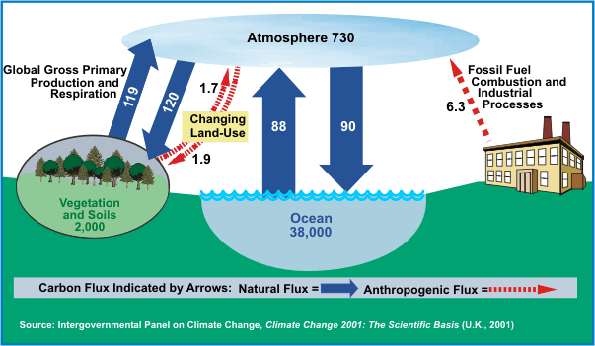
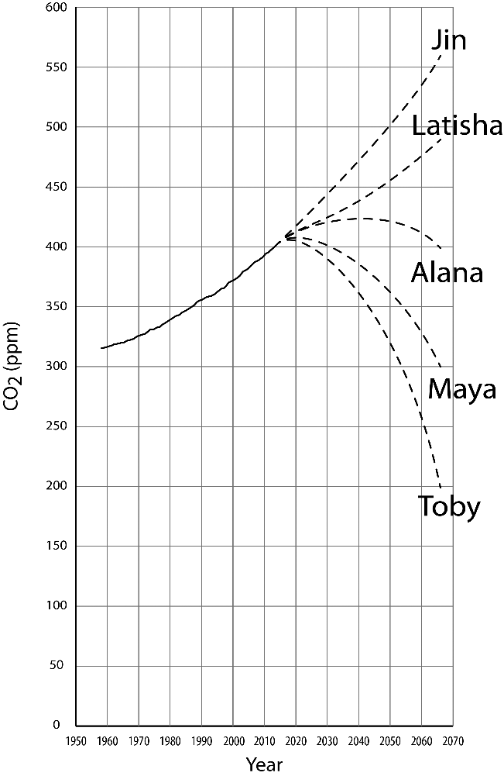
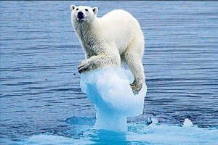
An Initial Learning Progression Describing Students’ Understanding of Large-scale Data and the Global Carbon Cycle
Joyce Parker^{1,2}, Craig Kohn^{1,3}, Beth Covitt⁴, May Lee³, and Charles Anderson^{1,3}
¹Great Lakes Bioenergy Research Center, ²Department of Earth and Environmental Sciences, ³Department of Teacher Education – Michigan State University
⁴spectrUM Discovery Area – University of Montana
Overview
Graphs of atmospheric CO₂ levels and pool-and-flux diagrams of the global carbon cycle and are two important representations students need to be able to use to understand global climate change scenarios. How do students’ ability to interpret and use these representations of large-scale data develop?
Learning Progression Framework
Level | Interpretation | Prediction (bridge) | Explanation
Quantitative Modeling (4) | Identifies quantitative patterns in data that can be compared with predictions from quantitative pool-and-flux models | Quantitative use of pool-and-flux model. Uses/identifies appropriate fluxes to calculate a net flux and uses net flux to predict reasonable changes in pool size. Atmospheric CO₂ would begin to decrease because net flux into the atmosphere would be -1, meaning that the ocean and vegetation would be able to remove more CO₂ from the atmosphere than fossil fuels would add. (S5 WI) | Includes quantitative pools and fluxes.
High (3) | Generalizability. Indicates awareness of full geographic area represented by data and mechanism (e.g., atmospheric circulation) that determines size of that area. So the atmosphere is one unit that… like a change in one area isn’t just going to change that area, it has to like diffuse or spread out over the entire area. And you’ll see small gradual changes more likely than… over the large-scale entire big picture, then smaller changes in specific areas. (MI1) Identification of Trends. Accurately describes short-term variation and long-term trends. Distinguishes between random and periodic short-term variation. The changes in concentration of carbon dioxide in the atmosphere are similar each year. There is an annual cycle. CO₂ concentration is highest around May and lowest in October. (ISB S18) There is a steady overall increase in CO₂ concentration w/time (years). (ISB S24) Interpretation of Y-axis. Clear distinction btw position on Y-axis as representing concentration/amount, and slope of line as representing rate of change. The pattern shows that the monthly average carbon dioxide concentration is increasing every year from 1960-2015 reaching from about 310 ppm to about 400 ppm. (ISB S21) | Qualitative or partial quantitative use of pool-and-flux model. Correctly connects changes in flux with changes in slope of CO₂ concentration line, but does not calculate a net flux. So we’re still using them, so I would say we would still expect it to increase but at a much slower rate.... yeah. So we’re still using fossil fuels, still contributing to carbon emissions in the environment, but if we are using less, and half of that, we should expect to see slower increases in the CO₂ of the environment. (MI1 before) Applies a pool-and-flux model without calculating overall net flux. Considers multiple fluxes, but does not relate them. I think that it takes time for like trees to the like photosynthesis process like taking in carbon… It’ll take time because 120 goes in and 119 goes out. It’s only is like one less gigaton, and that would take time to get to narrow it down. (UI8 after) | Qualitative explanation using pool-and-flux model. Includes appropriate fluxes and pools. Fluxes and pools are part of mechanism included in explanation. Explanation is qualitative. If plants are starting to grow and really start vegetating around… let’s say they are sprouting around May and getting larger from May and onward, and they’re going to start consuming more and more CO₂, and so possibly that’s why CO₂ levels are going down and creating more oxygen. (MI1 Annual Cycle before)
Middle (2) | Generalizability. Determines generalizability of data by reasoning about similarities and differences among locations. Yeah, I think they [trends in atmospheric CO₂ concentrations] happen in Michigan, and they’re probably different numbers, given the different seasons of the year. (sigh) (pause) I don’t really think Hawaii has harsh winters like Michigan does. (UI10) Identification of trends. Uses vague language to describe reasonable patterns. May not distinguish between periodic and random short-term variation. Makes mistakes with units when describing trend. Every year the CO₂ concentration goes up at least 5 and comes down at least 5. (ISB S5) Interpretation of Y-axis. Specifically interprets Y-axis and line as referring to CO₂, BUT no clear distinction among measures of concentration, amount, and rate (e.g. does not label CO₂ units). The pattern of the annual cycle stays very much the same throughout each year, CO2 is high in the spring and low in the fall. (ISB S13) | Predictions based on factors that affect CO₂ concentrations or incorrect mathematical models. Based on reasoning about some but not all factors that affect CO₂ concentrations. C, because fossil fuels help to produce CO₂ so if we cut it in half it would decrease. (AOP 21) Based on quantitative reasoning about incorrect models (e.g., conflates flux and pool size). I guess it would definitely be down here, like 200. I: Why do you say down by 200? M: Because we’re at 400 right now, so in half. (UI1 before) | Explanation identifying some factors that affect CO₂ concentrations. Explanation includes a subset of factors that affect CO₂ concentrations. Mechanism does not explain all aspects of phenomenon. Well a lot of CO₂ concentration comes from industrialization such as factories, cars, etc., and if it’s in Hawaii I would guess that it has something to do with the amount of people that are there, and then the points in the year at which industrialization is sort of booming and going through their busy time. And you know a lot of tourists come in and drive around and stuff, so that would be my guess, specifically for Hawaii. (UI9 Annual Cycle before)
Lower (1) | Generalizability. Interprets data as either local or global without explicit reasoning about generalizability. I don’t think [that the Hawaiian data tell us about Michigan] so. I mean, certainly you could assume that they might be connected, but there’s no way of knowing without investigating that more. (UI3) Identification of trends. Makes errors identifying trends, because misinterprets variability as a trend, fails to identify a trend (often because of variability), misreads graph, or draws on small number of inappropriate points (cherry picking). Trend described in such a way that could apply to a number of different graphs. The CO₂ concentration increases in summer months and decreases in winter months. (ISB S32) Interpretation of Y-axis. Students can read numbers on Y-axis and label, but do not offer specific interpretations of its meaning or conflate CO₂ with other forms of pollution. The graph may have almost the same change each year. (ISB S24) | Does not take a mathematical approach and explanation suggests a particular state. Explanations may include: (1) presence of certain good/bad factors (covering law or force dynamic relationship), (2) suggest some type of inertia, or (3) suggestions of return to a normal or natural state. [The level of CO₂ would decrease] because the air will be cleaner and plants will be taking in more CO₂. (S60 AOP) [The level of CO₂ would increase] because I think we’ve reached a point where we’ve done too much damage to earth, personally. And I don’t think we can come back from that. (MI3 before) Explanation is a description of graph and does not offer information beyond what was provided in question. In time, CO₂ levels would decrease. It would not be an immediate decrease. (S5 AOP) | Explanation without a mechanism. Explanation is a covering law or is force dynamic (identifying good and bad factors affecting pollution) without a mechanism. The cold air cleanses and freezes a lot of the air pollutants. (FISB S8) Wrong cause, no mechanism. Maybe the cause has to do with weather temperatures. (FISB S13) Cause is change in data. This is caused from taking measurements at different times during the year. (FISB S124)
Data Sources
Interviews: MSU second year medical students (5), MSU non-science major undergraduate students (9)
Written responses: MSU incoming freshman during summer orientation (98), MSU non-science major undergraduate students in a lab course (224), University of Wisconsin freshman in human energy systems course (18)
Interpretation of Data
What trends do you see?
Do the data [taken on Mauna Loa in Hawaii] tell us anything about how carbon dioxide concentrations in Michigan might be changing? Why or why not?
Explanation of Data
What is the cause of the long term increase in atmospheric CO₂?
What is the cause of the annual cycle of atmospheric CO₂?
What do you think is included in each carbon pool? Can you think of three things/substances that you would find in each carbon pool?
What process is represented by each arrow?
Prediction (bridge)
If the world were suddenly and miraculously able to cut its use of fossil fuels in half tomorrow, what would be the effect on the level of atmospheric CO₂? Circle the line that best describes what you think would happen to CO₂ levels: A, B, C, D, or E. Explain your answer.
People are concerned about the increasing concentration of CO₂ in the atmosphere due to the burning of fossil fuels. This increase in CO₂ levels contributes to global climate change. Use the information in the diagram to suggest three ways we might be able to reduce the levels of atmospheric CO₂.
A
B
C
D
Conclusions and Next Steps
An important part of environmental literacy is the bridge task presented here – using the carbon cycle pool-and-flux diagram to predict the effects of people’s actions on atmospheric CO₂ levels. However, this work shows that most students are not reaching this goal, probably because of it’s complexity. To be successful, students must be able interpret data that represents large portions of the earth. These data are not data that students are likely to have experience measuring. Students need to understand how local measurements can represent conditions over wide areas. They need to interpret the y-axis and identify trends in the data. The latter may be obscured by short term variation.
In addition to these quantitative reasoning skills, students must be able to use a pool-and-flux model to explain events related to climate change which often involve multiple pools and fluxes. Finally, students must use their quantitative reasoning and explanatory skills in concert.
While few students are reaching this ultimate goal, we do see students who are able to use the pool-and-flux model to improve their explanations of events. These students often use a subset of the fluxes to formulate explanations with reasonable mechanisms. The diagram often reminds of fluxes or pools that they might initially have ignored. Sometimes students balance a subset of the fluxes indicated on the diagram. This would appear to be a first step towards calculating net fluxes.
Our findings indicate that students need scaffolded support interpreting unfamiliar data and using a pool-and-flux model. The latter includes understanding the net effects of larger and larger subsets of fluxes.
E
This research is supported by grants from the National Science Foundation: A Learning Progression-based System for Promoting Understanding of Carbon-transforming Processes (DRL 1020187), and Sustaining Responsive and Rigorous Teaching Based on Carbon TIME (NSF 1440988). Additional support comes from the Great Lakes Bioenergy Research Center (DOE Office of Science BER DE-FC02‐07ER64494), funded by the United States Department of Energy, from Place-based Opportunities for Sustainable Outcomes and High-hopes, funded by the United States Department of Agriculture. Any opinions, findings, and conclusions or recommendations expressed in this material are those of the author(s) and do not necessarily reflect the views of the National Science Foundation, the United States Department of Energy, or the United States Department of Agriculture.
Carbon: Transformations in Matter and Energy
http://www.transitionburnie.com.au/category/climate-change/

