Slide 1





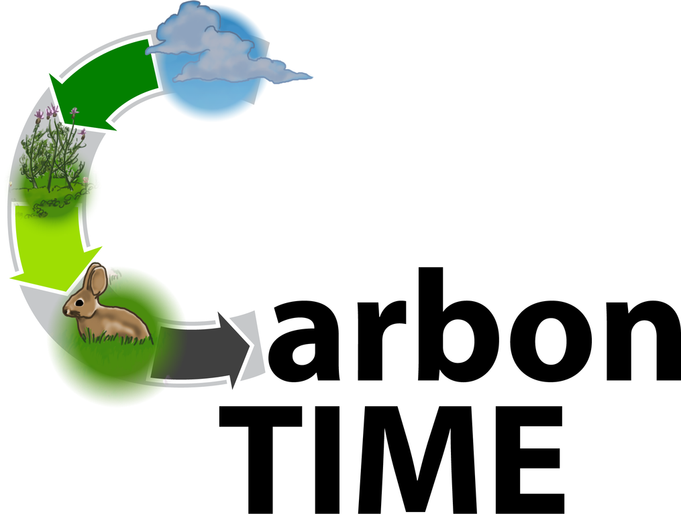


Designing a Three-Dimensional Curriculum for Climate Change Education Informed by Learning Progression Research
Hannah K. Miller, Johnson State College (hannah.miller@jsc.edu)
Wendy R. Johnson, Michigan State University (john3062@msu.edu)
Charles W. (Andy) Anderson, Michigan State University (andya@msu.edu)

Slide 2
Three-dimensional science learning
What scientists know
What scientists do
Natural
Phenomena
How scientists think
“Learning to explain phenomena and solve problems is the central reason students engage in the three dimensions of the NGSS” (NGSS, 2016).

Slide 3
Environmental Science Literacy
Capacity to participate in evidence-based discussions about socio-ecological issues and to make decisions about issues that are informed by science.
ESL requires both 3D learning and preparation for future learning (Bransford & Schwartz, 2001) because…
  Students cannot learn all science they will need while in school
  Knowledge in science continues to grow and change
Notes:
The overarching science education goal that guides our work is ESL, which we define as the capacity to participate in evidence-based discussion about socio-ecological issues and to makes decisions about those issues that are informed by science.
While we’ve boiled down our central goal into one sentence, thinking about what’s required to help students attain ESL is much more difficult to summarize. Recently we’ve begun thinking about ESL as requiring a combination of 3D learning as represented in the NGSS plus preparation for future learning. Preparation for future learning is important for several reasons including that its not possible for students to learn science relevant to every important socioecologal issue while in the K-12 system and because our understanding of science relevant to socioecological issues continues to grow and change all the time.

Slide 4
Learning Progression Process
WHO?
Teachers
Students
Experts
Novices
College Students
High School Students
WHAT?
Big Ideas
Central Questions
“What do students need to be more informed citizens?”

Slide 5

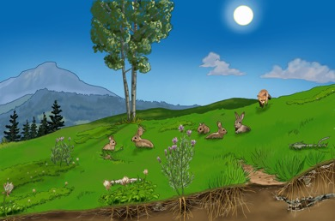

Macroscopic Scale Units
Large-Scale Units
Notes:
Carbon TIME is a design-based research project, which uses a Learning Progression framework and an iterative design and revision process to study how people teach and learn about climate change.

Slide 6
Students struggle to distinguish between matter and energy, often suggesting that matter can turn into energy or vice versa. (p. 181)
Macroscopic Scale Units
Students struggle to account for where matter and energy come from before chemical changes, and where matter and energy go after chemical changes. (p. 181)
Learning Progressions
This evidence indicates that before students can develop explanations for the causes of increasing global concentrations of atmospheric CO2—a key driver of climate change—they need to understand carbon-transforming processes at macroscopic and atomic-molecular scales (e.g., photosynthesis, cellular respiration, and combustion).
Notes:
Carbon TIME is a design-based research project, which uses a Learning Progression framework and an iterative design and revision process to study how people teach and learn about climate change.

Slide 7
Macroscopic Scale Units
Large-Scale Units
Notes:
Carbon TIME is a design-based research project, which uses a Learning Progression framework and an iterative design and revision process to study how people teach and learn about climate change.

Slide 8
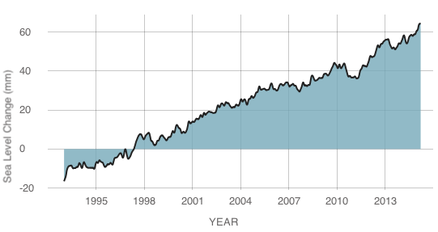
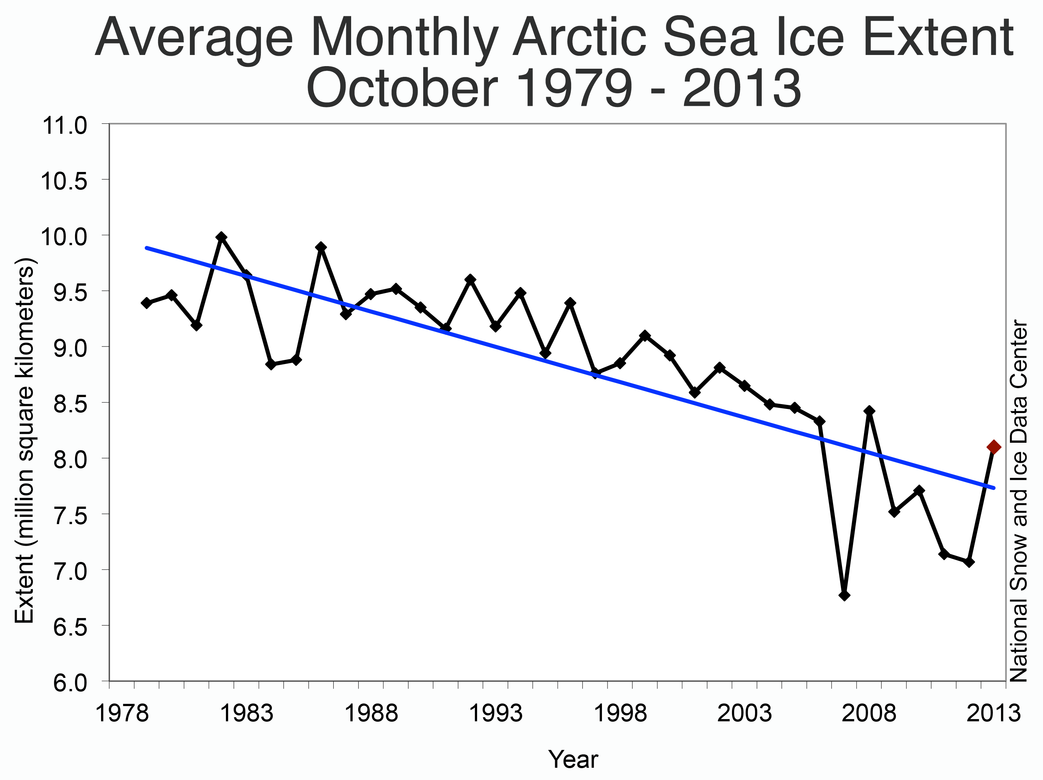
Human Energy Systems Data
Atmospheric CO₂
Change in Sea Level Height
Notes:
To respond to the challenge of scale, we do 2 things. One is that we have students examine data sets that demonstrate global patterns. Instead of tracing matter and energy through a local system (like a plant) that they can collect data on themselves over a period of hours, days, and weeks, we have them examine large-scale data sets that tell us about global patterns.

Slide 9




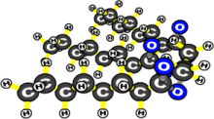
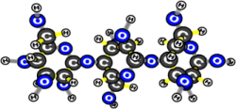




Compare: What is the overall movement of carbon atoms among pools during the spring and summer?
Beginning of spring (April)
End of summer (October)
400
700
800
600
Biomass
Biomass
Atmosphere
Atmosphere
1000
900
Soil Carbon
Fossil Fuels
Soil Carbon
Fossil Fuels

Slide 10
Current Findings & Challenges
Iterative Design-Based Research

Slide 11



Acknowledgements
Carbon TIME team at Michigan State: Andy Anderson, Sam Baruah, Sarah Bodbyl, Emily Scott, Christa Haverly, Marcos Gonzalez, Craig Kohn, Kirsten Edwards, Elizabeth De los Santos, Brian Hancock, Stefanie Marshall
Hannah Miller, Johnson State College/Northern Vermont U
Jennifer Doherty, University of Washington
Beth Covitt, University of Montana
Jenny Dauer, University of Nebraska
MaryMargaret Welch & Jenny Newell, Seattle Public Schools
Deb Jordan, Colorado School of the Mines
This research is supported by grants from the National Science Foundation: A Learning Progression-based System for Promoting Understanding of Carbon-transforming Processes (DRL 1020187), and Sustaining Responsive and Rigorous Teaching Based on Carbon TIME (NSF 1440988). Any opinions, findings, and conclusions or recommendations expressed in this material are those of the author(s) and do not necessarily reflect the views of the National Science Foundation.

