Slide 1
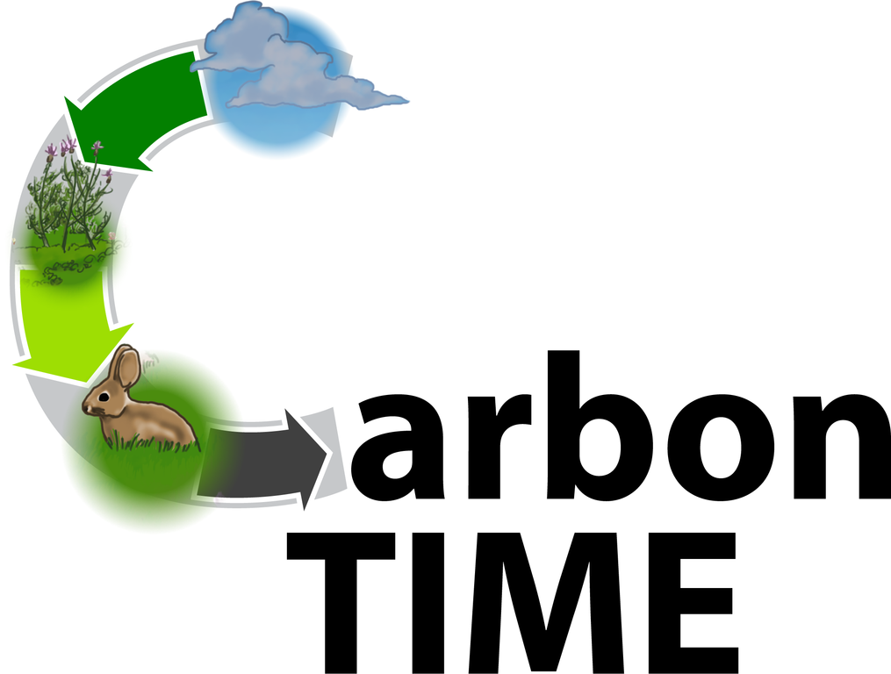
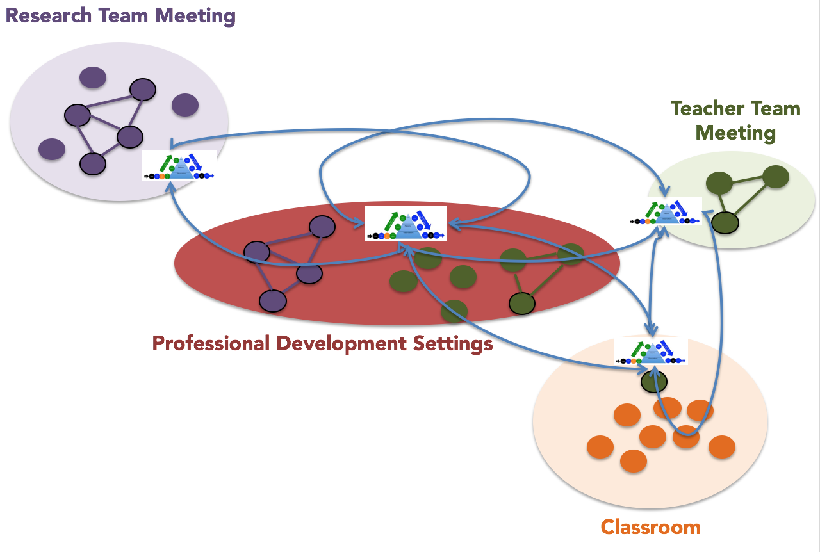
The Influence of Social Networks and Context on Teacher Agency
Stefanie Marshall¹ and William R. Penuel²
¹Michigan State University, ²University of Colorado Boulder
Introduction & Background
Teacher Categories
This study examines the agency enacted by teachers when implementing Carbon TIME as reflected in their interaction with curricular materials as boundary objects (Star, 2010). Teachers’ approaches to using Carbon TIME tools depends on specific facets of agency, which promoted teacher’s capacity to act. Konopasky and Sheridan (2016) define this as “internal causation,” or how teachers viewed themselves as “the one who is causing or generating the action.” We found that agency is demonstrated through the appropriation of tools to scaffold student learning, and one’s orientation to their collegial network.
Research Questions:
In what ways is teacher agency exercised through process tools and formative assessments. What factors may limit teachers from exercising agency?
How does one’s social network enable or constrain teacher agency, as demonstrated through Carbon TIME tools and assessments in combination with other available resources and obligations?
Categories | Description | Agency Applied
Fluid Appropriation: MS. NOLAN | Before involvement with Carbon TIME, teacher was engaged in responsive and rigorous practices. Teacher immediately perceived Carbon TIME tools as congruent with their own goals and implemented them with integrity. | The teacher strategically utilized their network and drew from past experiences with 3-Dimensional instruction to engage with the Carbon TIME curriculum, employing various scaffolds. The teacher utilized knowledge of students’ needs (e.g. based on relationships, formative and summative assessments, etc.) and discussions with network members (Carbon TIME and non-Carbon TIME) to guide modifications made.
Successful Learning: MS. CALLAHAN | The teacher started with Carbon TIME with differing goals. However, professional development as well as working with their case study coaches led to changes in goals and therefore practice. | Once teacher goals and those of Carbon TIME were aligned, discussions in PD, assessments and with their coach were instrumental in supporting the teacher as they made decisions on how to modify the tools. The network was then found to be more meaningful in helping address challenges of practice.
Distracted Teaching: MR. ROSS | The teacher struggled with limited human and social resources in their classrooms and schools, trying to manage difficult classrooms and multiple demands on their time and attention. Carbon TIME became another thing to employ. | The teacher either 1.) implemented curriculum with unmodified tools or were modified by other teachers, or 2.) made modifications in light of the goals of their network. The Carbon TIME tools were sometimes useful, but were not solutions to their challenges. Largely, modifications to tools did not result in improved student outcomes.
One-Dimensional Teaching: MS. APOL | The teacher was not expected to utilize practices beyond one-dimensional teaching in their school setting, and therefore did not. Carbon TIME tools are therefore incorporated into the teacher’s practice, rather than altering practice significantly. | The teacher made minimal changes to the Carbon TIME tools. They also did not view student performance on the tools or assessments as evidence of what students knew or did not know. Therefore the teacher did not believe their actions would result in a change.
Interview Excerpts
Agency here is a form of choice related to appropriation of tools and orientation to one’s social network
Facet 1: Appropriation of tools to scaffold student learning
Choose tools to fit existing goals for students | Choose tools that can expand goals for student learning
Description: The teacher has notions of the capacities and interests of students which guide their evaluations of tools’ appropriateness. They therefore use the tools in ways that conflict with the aims and assumptions of Carbon TIME. | Description: Teacher uses and modifies tools in ways that scaffold students’ engagement in three-dimensional science practices.
Example: SABRINA T.: Does it seem like …Carbon TIME engages the students in a way that some of the other stuff doesn’t, or not so much? MS. APOL: I think the hands-on activities do, the worksheets don’t. I can look at these and can even tell that they’re just writing stuff to write stuff to be done with it. His unanswered question was his conclusion. He just (laughter). It doesn’t even make sense…I think the hands-on activities which all kids - You know, almost all kids like that. | Example: MS. NOLAN: Yeah. So then they could write a sentence. The first one is: Where are the atoms moving?” So they could flip back onto this side, and they’re like “Oh this is the movement question; atoms moving.” And they could look at this here, and they could say “Oh, the atoms are moving from the ethanol into the air.” Or whatever it is that they were going to say, or into the flame. Then when they wrote that sentence, they could go check, and check it off. Then the next one: What evidence do you have? They could flip back and see, “Okay, what was my evidence there?” This just sort of fell out really easily if they did a good job on the front side, so I liked that. I haven’t graded them yet, so I don’t know how awesome they are. (chuckle)
Data & Analysis
Participants: 4 first year cohort members and case study teachers, 3 from the Michigan, 1 from Washington
Data: Teacher interviews, field notes from professional development, network survey data
Analysis: The data was coded by two researchers. These codes (networks, concerns, and reasons) were examined for themes to establish the facets of agency relevant to the implementation of the Carbon TIME curriculum.
Facet 2: Orientation to one’s school professional network
Choose to align practices with existing colleagues where they strive to belong (conformity) | Choose colleagues who support my vision (homophily)
Description: The teacher makes curricular decisions on modifications based on the established goals of the network. Teacher decides what to do based on the existing school curriculum or school initiatives without seeking to modify them in response to Carbon TIME. | Description: The teacher connects with other teachers within their network who have similar visions. These colleagues then support the teacher in thinking critically of resources, to refine Carbon TIME tools, and practice in order to meet the specific needs of their students.
Example: SABRINA T.: How does Carbon Time fit in with your usual curriculum and see that you teach it straight through ever year, do you add all your lessons in between, what does that look like, are you trying to maintain similarity with what other people are teaching? MS. APOL: Yes, all of the above. I think it fits in very well that’s why I did it with seventh grade. I think the only thing that would really match with my eight grades is the energy unit, which I would love to do but I don’t. The animals, the plants and the molecular systems and scale all fit in with seventh grade curriculum. I do like the fact that I started with systems and scale this year, which I hadn’t done in the past, so that gave them that background knowledge. We share textbooks, which is a problem. That might be the problem with next year too, if we’re trying to do this all at once. So, I got the sixth grade teachers to allow me to start with Physical Science this year so I could start off with systems and scale and keep going through that; then Life Science is the winter so we did animals and plants. Now, we’re moving on to Earth Science next frame. So, we do share textbooks with sixth grade because they do parts of what we don’t do. So that might be another problem. I mean, textbooks aren’t that great. So I teach the Carbon TIME within the units that I’m teaching and then add additional materials to them. | Example: MACKENZIE T: The other question is, who were you talking to about Carbon TIME? In your department, or in the district, or like anybody; me. MS. NOLAN: (chuckle) All the time, you. The other two teachers in my departments, Rob and Linda who are not formal Carbon TIME teachers, they are working very closely with me on this, which has been great. At first I was really nervous about it because I was worried that – I don’t know why I thought this; they are such nice people. But I was worried that they weren’t going to go to any of the trainings; they wouldn’t know what was going on, and then it would fall on me to try and like learn it myself…information on to them, or to them, and then have them just get it and just complain about it. But the way that’s actually worked out, it’s been really awesome, where I come to them; I bring them the resources; I talk them through it as much as I can. They look at it critically instead of just complaining, they make the changes. And they point things out, and together we work on – I can’t think of any specific examples right not, which I know is not helpful.
Selected References
Konopasky, A. W., & Sheridan, K. M. (2016). Towards a diagnostic toolkit for the language of agency. Mind, Culture, and Activity, 23(2), 108-123.
Remillard, J. T. (2005). Examining key concepts in research on teachers’ use of mathematics curricula. Review of Educational Research, 75(2), 211-246.
Star, S. (2010). This is not a boundary object: Reflections on the origin of a concept. Science, Technology, & Human Values, 35(5), 601-617.
This research is supported by grants from the National Science Foundation: A Learning Progression-based System for Promoting Understanding of Carbon-transforming Processes (DRL 1020187), and Sustaining Responsive and Rigorous Teaching Based on Carbon TIME (NSF 1440988). Any opinions, findings, and conclusions or recommendations expressed in this material are those of the author(s) and do not necessarily reflect the views of the National Science Foundation.

