Slide 1
Unpacking the NGSS Climate Change Performance Expectations
Wendy R. Johnson & Charles W. Anderson
Natural
Phenomena
“Learning to explain phenomena and solve problems is the central reason students engage in the three dimensions of the NGSS” (NGSS, 2016).
Notes:
Climate change is an important phenomena to study which naturally lends relevance and authenticity to science learning.
The climate change PEs are among the most complex and challenging goals in NGSS

Slide 2
Performance Expectation | DCI | SEP | CCC | Connections to Other DCIs
MS-ESS3-5. Ask questions to determine the factors that have caused the rise in global temperatures over the past century. | ESS3.D Global climate change | Asking questions & defining problems | Stability & change | MS.PS3.A, HS.PS3.B, HS.PS4.B, HS.ESS2.A, HS.ESS2.D, HS.ESS3.C
HS-ESS2-2. Analyze geoscience data to make the claim that one change to Earth’s surface can create feedbacks that cause changes to other Earth systems. | ESS2.D Weather and climate (also ESS2.A) | Analyzing & interpreting data | Stability & change | HS.PS3.B, HS.PS4.B, HS.LS2.B, HS.LS2.C, HS.LS4.D, HS.ESS3.C, HS. ESS3.D, MS.PS3.D, MS.PS4.B, MS.LS2.B, MS.LS2.C, MS.LS4.C, MS.ESS2.A, MS.ESS2.B, MS.ESS2.C, MSESS2.D, MS.ESS3.C, MS.ESS3.D
HS-ESS2-4. Use a model to describe how the variations in the flow of energy into and out of Earth systems results in changes in climate. | ESS2.D Weather and climate (also ESS2.A & ESS1.B) | Developing & using models | Cause & effect | HS.PS3.A, HS.PS3.B, HS.LS2.C, HS.ESS1.C, HS.ESS3.C, HS.ESS3.D, MSPS3.A, MSPS3.B, MSPS3.D, MSPS4.B, MSLS1.C, MSLS2.A, MSLS2.C, MSESS2.A, MSESS2.B, MSESS2.C, MSESS2.D, MSESS3.C, MSESS3.D
HS-ESS2-6. Develop a quantitative model to describe the cycling of carbon among the hydrosphere, atmosphere, geosphere, and biosphere. | ESS2.D Weather and climate | Developing & using models | Energy & matter | HS.PS1.A, HS.PS1.B, HS.PS3.D, HS.LS1.C, HS.LS2.B, HS.ESS3.C, HS.ESS3.D, MS.PS1.A, MS.PS3.D, MS.PS4.B, MS.LS2.B
HS-ESS3-5. Analyze geoscience data and the results from global climate models to make an evidence-based forecast of the current rate of global or regional climate change and associated future impacts to Earth systems. | ESS3.D Global climate change | Analyzing & interpreting data | Stability & change | HS.PS3.B, HS.PS3.D, HS.LS1.C, HS.ESS2.D, MS.PS3.B, MS.PS3.D, MS.ESS2.A, MS.ESS2.D, MS.ESS3.B, MS.ESS3.C, MS.ESS3.D
HS-ESS3-6. Use a computational representation to illustrate the relationships among Earth systems and how those relationships are being modified due to human activity. | ESS3.D Global climate change (also ESS2.D) | Using Mathematics & computational thinking | Systems & system models | HS.LS2.B, HS.LS2.C, HS.LS4.D, HS.ESS2.A, MS.LS2.C, MS.ESS2.A, MS.ESS2.C, MS.ESS3.C, MS.ESS3.D
Notes:
Six climate-change specific PEs within the Earth Science DCI (1 MS, 5 HS level) require integrating life, physical, and Earth science topics
The 2012 National Survey of Science and Mathematics Education found that only 48% of high schools offered an Earth/space science course (Banilower et al, 2013, p. 55). We think they fit well in a biology course.
Highlight practices/CCC/connections to other DCIs

Slide 3
Unpacking the climate change PEs
Looking back – what prior knowledge is required?
Identifying learning challenges – what do students struggle with and why?
Looking forward – are students prepared for future learning and citizenship?
Notes:
Preparation for future learning

Slide 4
The PEs can be arranged into a storyline
Human combustion of fossil fuels has altered the Earth’s natural carbon cycling, leading to a steady buildup of CO₂ in the atmosphere (HS-ESS2-6).
CO₂ and other greenhouse gases affect the movement and transformations of solar energy through Earth systems, leading to increases in temperature (HS-ESS2-4).
The changes in climate lead to changes in other Earth systems, including the hydrosphere and the geosphere (HS-ESS3-6).
The nature and rates of these changes can be projected into the future (HS-ESS3-5).
Rates of change may be altered by positive or negative feedback loops (HS-ESS2-2).
Notes:
Achieving the PEs requires that students analyze and interpret large-scale data and connect these to multiple scientific models (global carbon cycle, greenhouse effect, and global climate models).
We are going to focus just on the first PE and show how difficult that is

Slide 5
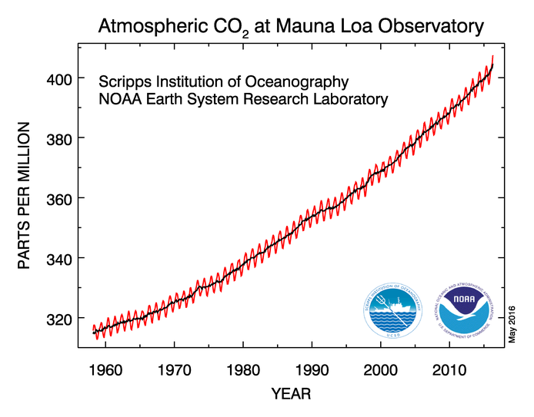
The Keeling Curve: Starting point for HS-ESS2-6
Challenges
Representation
Patterns & trends
Generalizability
Notes:
Representation – understanding what the data is and how it is represented graphically
Patterns and trends – identifying and distinguishing among random noise, short-term variation, and longer-term trends
Generalizability – determining whether a trend can be generalized to different locations or timescales

Slide 6
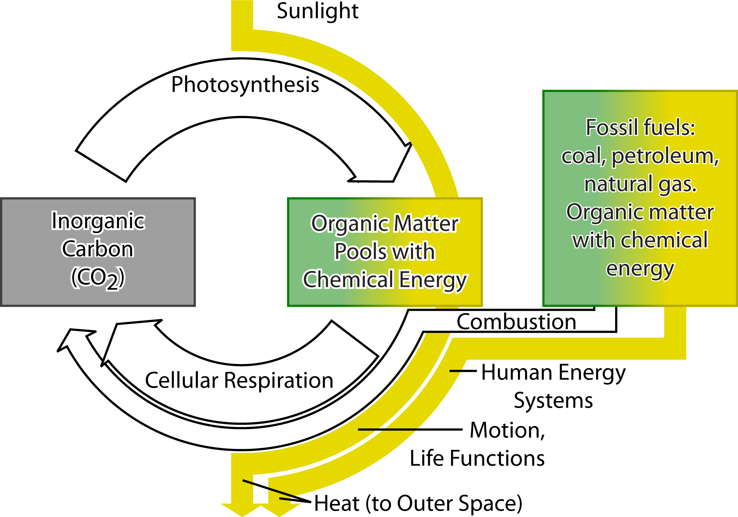
How do we explain the Keeling Curve?
Balance of photosynthesis and respiration explains the yearly cycle
unbalanced flux of CO₂ from fossil fuels explains the overall trend
Connecting the organismal processes of photosynthesis & respiration to large scale changes CO₂ in the atmosphere is very difficult for ALL students
Notes:
Explaining Keeling curve involves connecting the yearly cycle to the role of photosynthesis and respiration in carbon cycling and the long-term trend to the unbalanced flux from burning fossil fuels.
Our research has found this is VERY challenging for students.

Slide 7
Multiple challenges in the NGSS Performance Expectations
Explaining the Keeling Curve requires connecting two kinds of complex performances:
Interpreting quantitative data representations, including graphs, tables, quantitative models, etc.
Constructing explanations of processes in systems using scientific models
And this is the easy one! The other performance expectations are even more difficult and challenging.
Notes:
And this is just one small piece! Students then have to connect the increasing atmospheric CO2 to rising temperature (greenhouse effect) and then understand how Earth’s systems are connected, feedback mechanisms, and how climate models predict future conditions

