Slide 1






Supporting Three-dimensional Science Teaching and Learning with a Comprehensive, Learning Progression-based System
Interactive Poster Session
NARST Annual Meeting
April 23, 2017
San Antonio, Texas
Notes:
Welcome to our session with a long complicated title.
SLIDE

Slide 2
Session Overview
20 minutes: Introduction: Overview and a brief introduction to each poster.
40 minutes: Participants circulate, view, and discuss posters.
30 minutes: Discussion led by Bill Penuel will address:
  What contribution does each poster make to our understanding of how young people can develop environmental science literacy?
  What are implications for supporting the learning of teachers and school and district leaders?
Notes:
Here’s the general plan for the session
SLIDE

Slide 3
Three-dimensional science learning
What scientists know
What scientists do
Natural
Phenomena
How scientists think
“Learning to explain phenomena and solve problems is the central reason students engage in the three dimensions of the NGSS” (NGSS, 2016).
Notes:
I’m assuming that this will be a famliar figure to most of you in the audience. We’ll just say that the work we do is aligned with the general goal of 3D science learning, and with the notion that Learning to explain phenomena and solve problems is the central reason students engage in the three dimensions of the NGSS

Slide 4
Environmental Science Literacy
We define environmental Science Literacy as the capacity to participate in evidence-based discussions about socio-ecological issues and to make decisions that are informed by science.
Environmental Science Literacy requires 3D science learning, and
Environmental Science Literacy also requires preparation for future learning (Bransford & Schwartz, 2001) because…
  Students cannot learn all science they will need while in school
  Knowledge in science continues to grow and change
Notes:
The overarching science education goal that guides our work is environmental science literacy, which focuses on a subset of the Disciplinary Core Ideas in NGSS, but perhaps a more expansive view of practice. I’ll make three points about environmental science literacy.
SLIDE

Slide 5

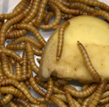
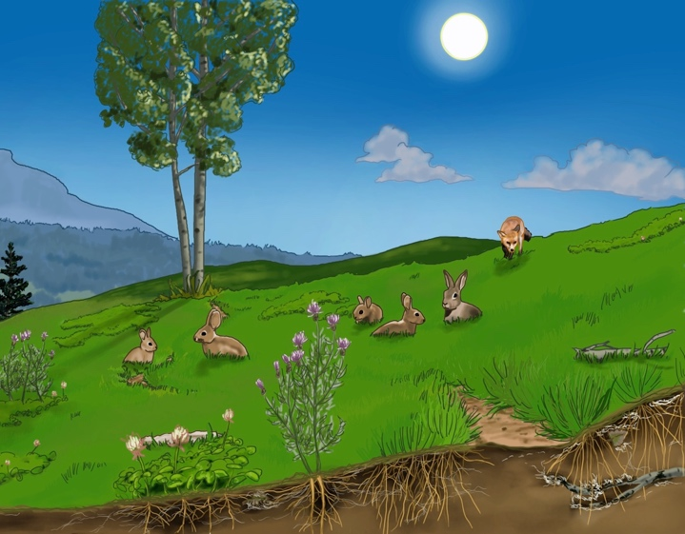
Carbon TIME Curriculum
Four units on carbon-transforming processes at the macroscopic scale
Systems & Scale Animals Plants Decomposers
Two units on carbon-transforming processes at the large scale
Ecosystems Human Energy Systems
Notes:
Six units – around 3 weeks of instructions each, addressing key ideas in life, earth, and physical science
We are specifically concerned with environmental science literacy and preparation for future learning around carbon cycling at multiple scales and climate change
We have both macroscopic scale and large scale units

Slide 6
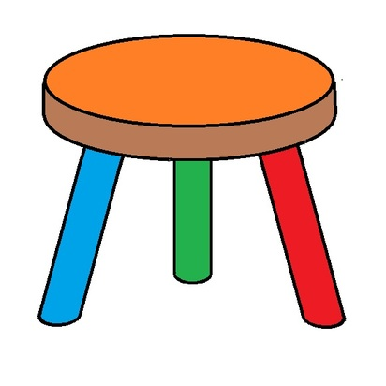
Carbon TIME and the “three legs of the stool”
Teacher Support Networks
Curriculum & Assessments
Professional Development
Notes:
Enacting these units in ways that truly accomplish 3D learning is complex and challenging for teachers, so we see successful enactment of these units as requiring “three legs of the stool,” each necessary but not sufficient.
SLIDE
All are part of our project, and we have posters on each leg here today.

Slide 7
Data Sources for Posters
Data Source | Baseline Year | First Year | Additional Data* | Posters Using These Data
Full Data Set (34 participating teachers: 7 middle school,27 high school)
Student tests (~8/student during first year) | 2920 | 21,058 | 244 | 1, 2, 4
Teacher surveys (~3/teacher each year) | 104 | 169 |  | 5, 6, 7
PD videos & field notes (3 days/teacher) |  | 48 hours |  | 5
Online PD (~10 hours/teacher)** |  | 300 hrs
Case Study Data Set (8 participating teachers: 3 middle school, 5 high school)
Student interviews (~4 focus students/class) | 23 | 40 | 37 | 4
Teacher interviews (~4/teacher) | 4 | 22 |  | 5, 6
Classroom videos (~10 lessons/teacher, 2 videos/lesson) | 56 | 195 |  | 3, 4
Student work (~10/focus student) |  | 472 |  | 4
* Papers 1 and 2 use additional data from tests and interviews of college students ** We collected video, field notes, assignments, and discussion threads from 3 days of face-to-face and ~10 hours of online PD for the first year.
Notes:
So I’m mostly putting this up to impress you, and I won’t give you time to actually read it.
The point is that we have been busy collecting data on all 3 legs of the stool, and we’re reporting on a subset of those data in these posters.

Slide 8
Posters in this Session
A. Learning progressions that define three-dimensional learning
  Poster 1: The Relationship between Students’ Explanations and their Interpretation of Inquiry Investigations, by Emily Scott, Kirsten D. Edwards, and Charles W. Anderson
  Poster 2: An Initial Learning Progression Describing Students’ Understanding of a Model of the Global Carbon Cycle by Joyce M. Parker, Beth A. Craig Kohn, Covitt, May Lee, and Charles W. Anderson
B. Classroom discourse the scaffolds three-dimensional learning
  Poster 3: An Examination of Discourse in Carbon TIME Classrooms, by Wendy Johnson, Hannah Miller, and Charles W. Anderson
  Poster 4: Routines of Interaction around Carbon TIME Tools that Enhance Student Learning, by Christa Haverly, Marcos Gonzalez, MaryMargaret Welch, and Jennifer Newell
C. Scaffolding teacher learning
  Poster 5: The Influence of Social Networks and Context on Teacher Agency, by Stefanie Marshall and William R. Penuel
  Poster 6: Teachers’ Sensemaking About Innovative Curriculum Materials, by Elizabeth Xeng de los Santos and Charles W. Anderson
  Poster 7: Using Survey Data to Measure Teaching Practices and Network Effects in Carbon TIME, by Qinyun Lin, William R. Penuel, and Kenneth A. Frank.
Notes:
The posters are divided into 3 groups, focusing on learning progression research, classroom discourse, and teacher learning and networks
We’ll briefly introduce you to each group.

Slide 9
Representing relationships among the three dimensions
of student performance
NGSS
Carbon TIME
Models
Inquiry
(up the triangle)
A few key models
explain why the patterns happen.
Application
(down the triangle)
Patterns
We identify patterns
in our data and observations.
Observations
We make observations and collect data using numbers or words or pictures.
New questions, new data
Notes:
We have our own interpretation of 3D learning
The orange triangle represents the structure of scientific knowledge, which corresponds to the disciplinary core ideas (DCIs). The triangle has a wide base and narrows as you move upward which represents how many observations are used to identify patterns which are then explained by a few key scientific models/theories.
The arrows represent the science and engineering practices (SEPs). We group them into inquiry practices (up the triangle), application practices (down the triangle) and general tool practices
The green line around the triangle represents the crosscutting (CCCs) that bound and constrain scientific ideas and practices.
This representation of the three dimensions is the link between the NGSS 3 dimensions and the Carbon TIME instructional model, which I’ll discuss in just a minute.

Slide 10
Learning progression research
“Learning progressions are descriptions of the successively more sophisticated ways of thinking about a topic that can follow one another as students learn about and investigate a topic over a broad span of time.” (NRC, 2007)
Notes:
The foundation of all our work is work learning progression research.

Slide 11
Iterative Learning Progression Development
Assessments
Interpretation
Model of Cognition:
Learning Progression Framework
(NRC, 2006)
Notes:
The development of the LPs has involved design based research and iterative cycles of framework development; design and implementation of assessment; and interpretation of data to inform revisions to the framework. We then use our LPs to inform curricular development and professional development.

Slide 12
Learning Progression Frameworks
Framework | Practices | Core Ideas | Crosscutting Concepts
Macroscopic explanation (carbon) | Explanation, using models | Carbon-transforming processes (combustion, photosynthesis, cellular respiration, digestion, biosynthesis) at multiple scales | Conservation, flows, cycles, of matter and energy Connecting systems at different scales
Macroscopic inquiry | Asking questions, analyzing data, arguments from evidence
Large-scale systems | Data & model interpretation, explanation, prediction | Ecosystem & global carbon cycling & energy flow, climate change
Notes:
We have been working on 3 related learning progressions. The one that is best developed focuses on explanations of macroscopic carbon-transforming processes, such as flames burning, plants growing, animals moving, and organic materials decaying.
Our posters today focus on the other two learning progressions, focusing on inquiry practices and on how students interpret data and make predictions about large-scale systems.
Before introducing those posters, though, I’ll say just a word about the macroscopic explanation learning progression.

Slide 13
Learning Progression Levels of Achievement for Macroscopic Explanations
Level 4: Correct qualitative tracing of matter and energy through processes at multiple scales.
Level 3: Attempts to trace matter and energy, but with errors (e.g., matter-energy confusion, failure to fully account for mass of gases).
Level 2: Informal accounts relying on force-dynamic (actors and enablers) reasoning
Level 1: Simple force-dynamic accounts.
Notes:
Our research has focused on developing detailed descriptions of these levels of achievement. Here are the descriptions in very broad terms.
SLIDE

Slide 14
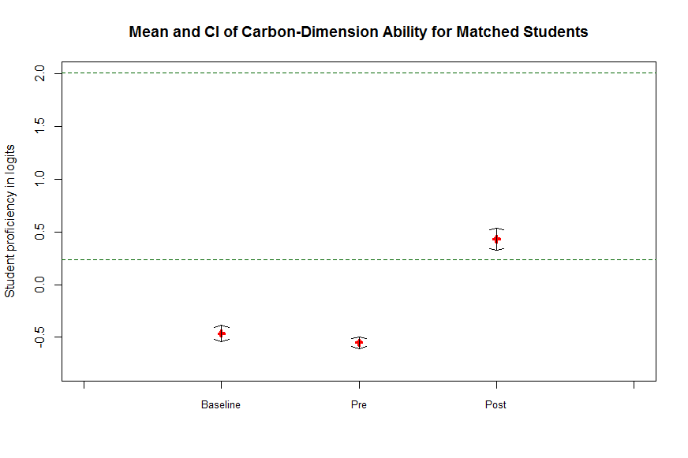
LP Level 3.5
LP Level 3.0
LP Level 2.5
Carbon TIME 1 (2012-3, n=574)
Carbon TIME 2 (2015-6, n=1727)
Learning Progression Levels
Pre-post effect size:
Carbon TIME 1: +0.94
Carbon TIME 2: +1.34
Notes:
Here is an attempt to summarize the “bottom line” about the effects of our units on a single slide.
Blue line represents data from our previous project, in the 2012-3 school year.
Red line is early data from this project, in 2015-6 school year.
Key comparisons:
Performance on postttests is far above both pretests and baseline tests, which were administered by the same teachers teaching the same classes the year before without Carbon TIME tools
Significantly higher learning gains for Carbon TIME 2
NGSS performance expectations are basically learning progression Level 4, so we still have room to improve.

Slide 15
Special thanks to:
Jay Thomas of ACT for developing automated scoring models for Carbon TIME 2 data
Karen Draney and JinHo Kim of the Berkeley Evaluation and Assessment Research (BEAR) Center for IRT Analyses
For more information on assessment development and validation, see “Validation of a Learning Progression-based Monitoring Assessment” on the Carbon TIME Website: http://carbontime.bscs.org/library.
Notes:
They aren’t here today, but I want to recognize some key people responsible for the statistical analyses.
SLIDE

Slide 16
Inquiry and large-scale frameworks: “Building the bridge” between quantitative data and scientific models
Both inquiry and reasoning about large-scale systems require two kinds of performances that students struggle to connect:
Constructing model-based explanations of processes in systems
Interpreting quantitative data representations, including graphs, tables, animated data representations, etc.
Learning progression frameworks describe students’ proficiencies both in individual dimensions and in making connections between them
Notes:
Our learning progression posters today focus on inquiry and large-scale systems. I’ll mention one key feature that these learning progressions have in common.
SLIDE

Slide 17
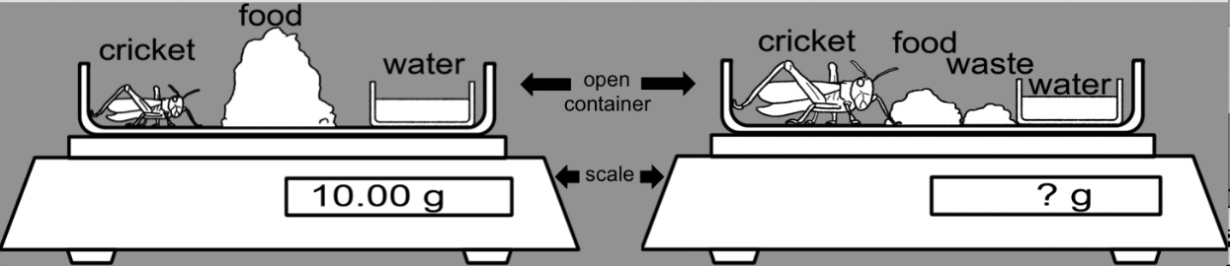
Poster 1:
Inquiry Learning Progression
Presenters: Emily Scott and Kirsten Edwards
Research questions
How do students make use of mass balance data to trace matter through systems in inquiry investigations? Specifically:
How are students’ explanatory practices related to their ability to construct arguments from evidence in mass balance investigations?
Plant Claim Question
Animal Claim Question
Notes:
EMILY: Measuring mass before and after process; to interpret results
Students need to connect changes in mass w/ movmt of matter;
To find out what, come to poster!

Slide 18
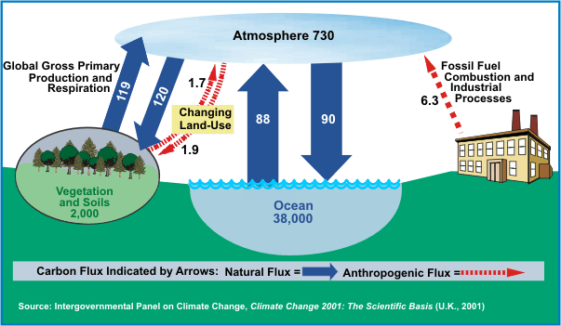
Poster 2:
Large-scale Learning Progression
How do students use these representations in making sense of and in making predictions about the effects of human activities?
How do students make sense of the connection between these two representations?
Notes:
CRAIG AND MAY

Slide 19
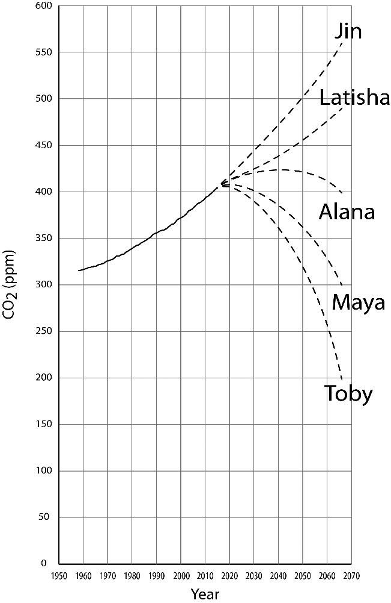
An important prediction question…
If we were to suddenly and miraculously cut fossil fuel use in half, which of the following would be the most likely outcome? Choose a trend (from the graph) and explain your answer.
Visit Craig Kohn & May Lee to learn more.
Notes:
CRAIG AND MAY

Slide 20
Posters in this Session
A. Learning progressions that define three-dimensional learning
  Poster 1: The Relationship between Students’ Explanations and their Interpretation of Inquiry Investigations, by Emily Scott, Kirsten Edwards, and Charles W. Anderson
  Poster 2: An Initial Learning Progression Describing Students’ Understanding of a Model of the Global Carbon Cycle by Joyce M. Parker, Beth A. Covitt, May Lee, and Charles W. Anderson
B. Classroom discourse the scaffolds three-dimensional learning
  Poster 3: An Examination of Discourse in Carbon TIME Classrooms, by Wendy Johnson, Hannah Miller, and Charles W. Anderson
  Poster 4: Routines of Interaction around Carbon TIME Tools that Enhance Student Learning, by MaryMargaret Welch, Jennifer Newell, Christa Haverly, Marcos Gonzalez, and Charles W. Anderson
C. Scaffolding teacher learning
  Poster 5: The Influence of Social Networks and Context on Teacher Agency, by Stefanie Marshall, William R. Penuel, and Qinyun Lin
  Poster 6: Teachers’ Sensemaking About Innovative Curriculum Materials, by Elizabeth Xeng de los Santos and Charles W. Anderson
  Poster 7: Using Survey Data to Measure Teaching Practices and Network Effects in Carbon TIME, by Qinyun Lin, William R. Penuel, and Kenneth A. Frank.
Notes:
Posters 3 and 4 focus on our observations of teachers and students in classrooms

Slide 21
Posters 3 and 4:
Focus on Classroom Discourse Using Learning Progression Curriculum and Assessments
Teacher Support Networks
Curriculum & Assessments
Professional Development
Notes:
So here we’re looking in particular at how the curriculum and assessments are used in Carbon TIME classrooms.

Slide 22
Carbon TIME groups NGSS practices
in the instructional model
NGSS Inquiry Practices
Asking questions
2a. Developing models
3. Investigations
Analyzing &
interpreting data
7. Argument from
evidence
NGSS Application Practices
2b. Using models
Constructing explanations
Models
Inquiry
(up the triangle)
A few key models
explain why the patterns happen.
Application
(down the triangle)
Patterns
We identify patterns
in our data and observations.
Observations
We make observations and collect data using numbers or words or pictures.
New questions, new data
NGSS General Practices
5. Using mathematics and computational thinking
8. Obtaining, evaluating, and communicating information
Notes:
The arrows represent the science and engineering practices (SEPs). We group them into inquiry practices (which move up the triangle by asking questions, collecting & analyzing data, and developing arguments from evidence and models) and application practices (which move down the triangle by using scientific models to predict or explain new patterns and observations). Two other NGSS practices (mathematics & computational thinking, and obtaining, evaluating, and communicating information) we think of as general use tools that are used throughout inquiry and application (always in conjunction with another practice).

Slide 23
Carbon TIME Annotated Instructional Model
Atomic-molecular model of
carbon-transforming processes
OR large-scale pool-and-flux model
Abstract &
general
Concrete & specific
Nature of knowledge
Direction of learning: Students move to higher learning progression levels

Slide 24
“By centering science education on phenomena that students are motivated to explain, the focus of learning shifts from learning about a topic to figuring out why or how something happens” (NGSS, 2016).
Notes:
Carbon TIME units are tool kits designed to support a different kind of practice from what many participating teachers are used to, summarized by this quote from NGSS.
SLIDE

Slide 25
Student Roles in the Instructional Model
Students as questioners: Exploring driving question
Students as investigators: Developing evidence-based arguments
Students as explainers:
Constructing model-based explanations
Notes:
All of the units are organized around an instructional model that is built around our triangle representing 3D learning.
They start with a driving question which students discuss and elaborate on. (For example: What happens when alcohol burns? How do you think a plant grows?)
They then move to an investigation that provides partial answers to the driving question but still leaves some questions unanswered.
They then move to a cognitive apprenticeship sequence where they master scientific model-based explanations and use the models to explain other phenomena.
BUT THERE IS A KEY PROBLEM: Students don’t know how to play these roles.
It takes teaching that is both responsive and rigorous to scaffold students successfully—a huge demand on teachers.

Slide 26
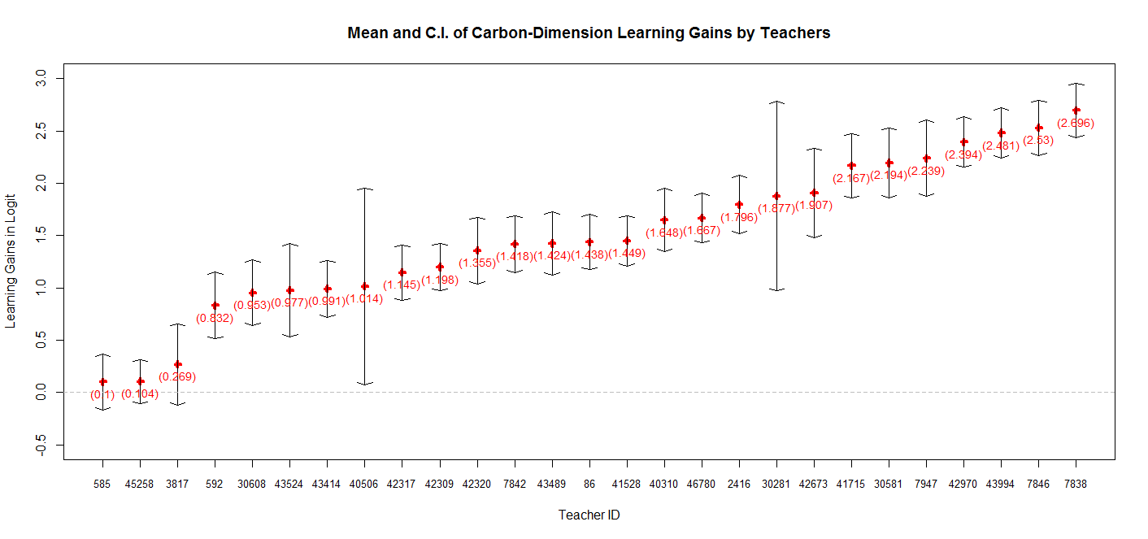
Comparing Average Learning Gains for Individual Teachers
Notes:
We saw large differences in how successfully the teachers enacted the units—responding to the students’ need for responsive and rigorous teaching.
Though I would want to be very cautious in using pre-post gain scores to label individual teachers, this graph shows the range.
Dotted line shows no gain from pre to post.
Most successful teachers were getting close to ceiling effects on posttest.

Slide 27
Focus Teachers for Posters 3, 4, 5, 6
Ms. Nolan: Urban high school 10th grade students 7 years teaching experience 55% White, 14% Asian, 12% Black, 11% Hispanic 34% free & reduced lunch | Ms. Callahan: Science and math center 9th grade students 13 years teaching experience 78% White, 18% Asian, 4% Black & Hispanic free & reduced lunch data not available
Mr. Ross: Small city high school 9th grade students 8 years teaching experience 49% White, 20% Asian, 18% Black, 8% Hispanic 19% free & reduced lunch | Ms. Apol: Rural middle school 7th grade students 28 years teaching experience 91% White, 1% Asian, 1% Black, 5% Hispanic 35% free & reduced lunch
Notes:
Posters 3, 4, 5, and 6 all rely on our case study data. For 8 teachers in quite different teaching situations in 3 different states, we collected classroom videos, examples of student work, and interviews with both teachers and focus students in addition to student test data and teacher survey data. The posters focus on 4 teachers who represent the range of approaches and teaching practices that we saw.
Ms. Nolan is actually here with us today. She is our pseudonym for Jenny Newell, who is a co-author of Poster 4. You’ll need to visit the poster to guess which city her urban high school is in.
Ms. Callahan taught in a science and math center that pulled selected students from their locals schools for a morning-only program.
Mr. Ross taught in a small-city high school
Ms. Apol taught in a rural middle school

Slide 28
“By centering science education on phenomena that students are motivated to explain, the focus of learning shifts from learning about a topic to figuring out why or how something happens” (NGSS, 2016).
Task-Driven Discourse
Goal is completing activities to learn facts & skills
Positions students as learning authoritative knowledge
Teacher scaffolds students in procedural display
Curiosity-Driven Discourse
Goal is answering questions about phenomena
Positions students as epistemic agents
Teacher scaffolds students in sensemaking

Slide 29
Poster 3: Teachers Scaffolding Classroom Discourse
Wendy Johnson & Hannah Miller
Supporting students in figuring out phenomena requires scaffolding both curiosity and principled-based reasoning.
Analysis of classroom videos to characterize orientation toward curiosity and principles.
Curiosity-Driven
Rigor-Driven
Principles
Content
Task-Driven
Scale
Precision
Notes:
WENDY AND HANNAH

Slide 30



Poster 4: Students Participating in Classroom Discourse
Routines of Interactions Around Carbon TIME Tools That Enhance Student Learning
What in each of these students’ classroom experiences resulted in variations in movement across each student’s
ZPD (zones of proximal development)?
Notes:
Change

Slide 31
Posters in this Session
A. Learning progressions that define three-dimensional learning
  Poster 1: The Relationship between Students’ Explanations and their Interpretation of Inquiry Investigations, by Emily Scott, Kirsten Edwards, and Charles W. Anderson
  Poster 2: An Initial Learning Progression Describing Students’ Understanding of a Model of the Global Carbon Cycle by Joyce M. Parker, Beth A. Covitt, May Lee, and Charles W. Anderson
B. Classroom discourse the scaffolds three-dimensional learning
  Poster 3: An Examination of Discourse in Carbon TIME Classrooms, by Wendy Johnson, Hannah Miller, and Charles W. Anderson
  Poster 4: Routines of Interaction around Carbon TIME Tools that Enhance Student Learning, by MaryMargaret Welch, Christa Haverly, Marcos Gonzalez, and Jennifer Newell
C. Scaffolding teacher learning
  Poster 5: The Influence of Social Networks and Context on Teacher Agency, by Stefanie Marshall and William R. Penuel
  Poster 6: Teachers’ Sensemaking About Innovative Curriculum Materials, by Elizabeth Xeng de los Santos and Charles W. Anderson
  Poster 7: Using Survey Data to Measure Teaching Practices and Network Effects in Carbon TIME, by Qinyun Lin, William R. Penuel, and Kenneth A. Frank.
Notes:
Our final 3 posters focus on teacher knowledge and teacher learning

Slide 32
Posters 5, 6, and 7:
Focus on PD and Networks Scaffolding Rigorous and Responsive Teaching
Teacher Support Networks
Curriculum & Assessments
Professional Development
Notes:
These posters focus on the other 2 legs of the stool—professional development and teacher support networks.
So if students need rigorous and responsive teaching to scaffold their roles as successful 3D learners,
then teachers need rigorous and responsive PD and networks to scaffold rigorous and responsive teaching.
BUT as with the students there’s a problem here: We’re talking about very different classroom practices from the ones that many teachers are used to.

Slide 33
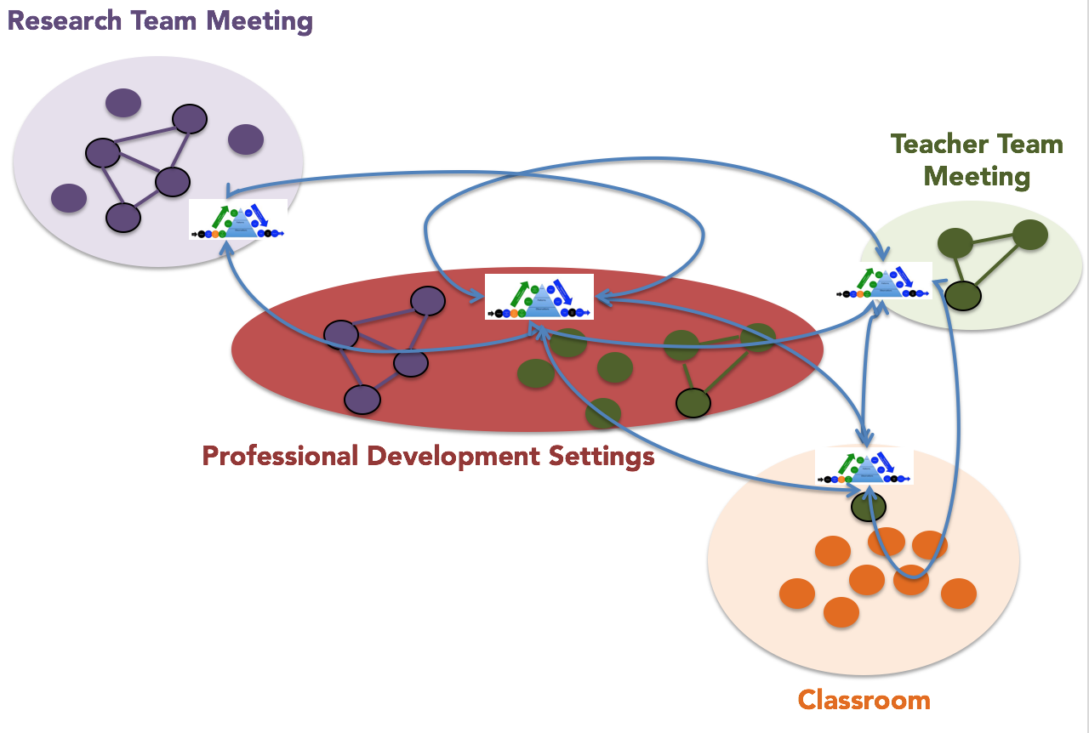
Intersecting communities of practice
Work is coordinated around boundary objects.
Meanings and objects transform as they move with people across settings, over time.
Notes:
And teachers have lots on their minds besides enacting Carbon TIME.
The teachers are boundary crossers, moving among multiple communities of practice, especially the Carbon TIME PD settings, their school professional communities, and their classrooms. Posters 5, 6, and 7 report on our investigations of how different teachers navigate their way through these complex environments.

Slide 34
Poster 5: Teachers’ Agency in Networks and Classrooms: Stefanie Marshall and Bill Penuel
Teacher agency presented as a form of choice related to appropriation of tools and orientation to one’s social network
Teacher’s School Professional Network
Classroom
Notes:
STEFANIE

Slide 35
Poster 6: Teachers’ Sensemaking in Networks and Classrooms: Elizabeth de los Santos
The influence of his school community on Mr. Ross’s occasion of sensemaking about the Carbon TIME Pre- and Post-Tests
Notes:
ELIZABETH

Slide 36
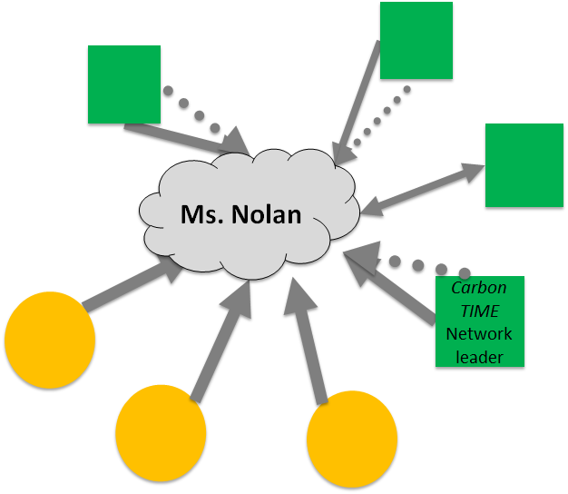
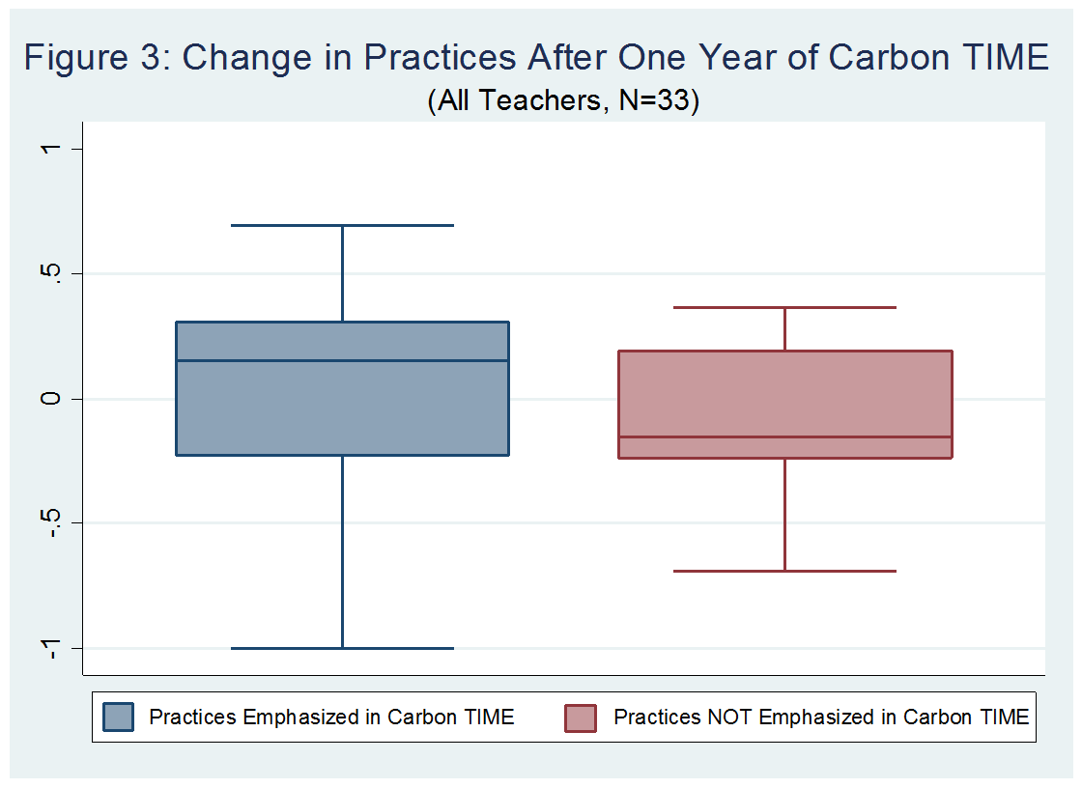
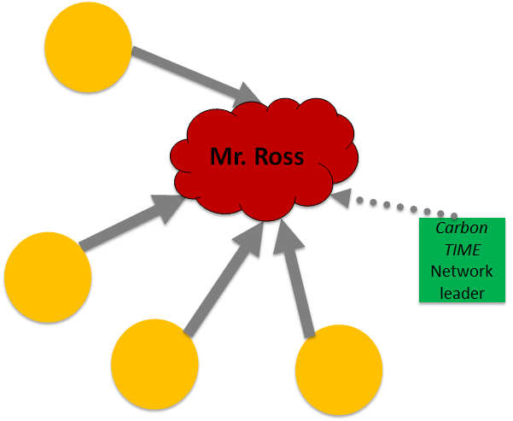
Poster 7: Using Survey Data to Measure Teaching Practices and Network Effects: Qinyun Lin
Notes:
QINYUN

Slide 37

Thanks to our funders
This research is supported by grants from the National Science Foundation: Sustaining Responsive and Rigorous Teaching Based on Carbon TIME (NSF 1440988 ). Additional support comes from the Great Lakes Bioenergy Research Center (DOE Office of Science BER DE-FCO2-07ER64494), funded by the United States Department of Energy, and from Place-based Opportunities for Sustainable Outcomes and High-hopes, funded by the United States Department of Agriculture. Any opinions, findings, and conclusions or recommendations expressed in this material are those of the author(s) and do not necessarily reflect the views of the National Science Foundation, the United States Department of Energy, or the United States Department of Agriculture.
Notes:
I’ll just add thanks to our funders….

Slide 38
Thanks to Contributors to this Research (not including authors)
Christie Morrison Thomas, Brian Hancock, Nick Verbanic, Ellen Holste, Alex Walus, Liz Tompkins, Michigan State University
Jennifer Doherty, University of Washington
Karen Draney, JinHo Kim, Berkeley Evaluation and Assessment Research Center
Notes:
…and to contributors who aren’t here today. Enjoy visiting the posters.

