Slide 1
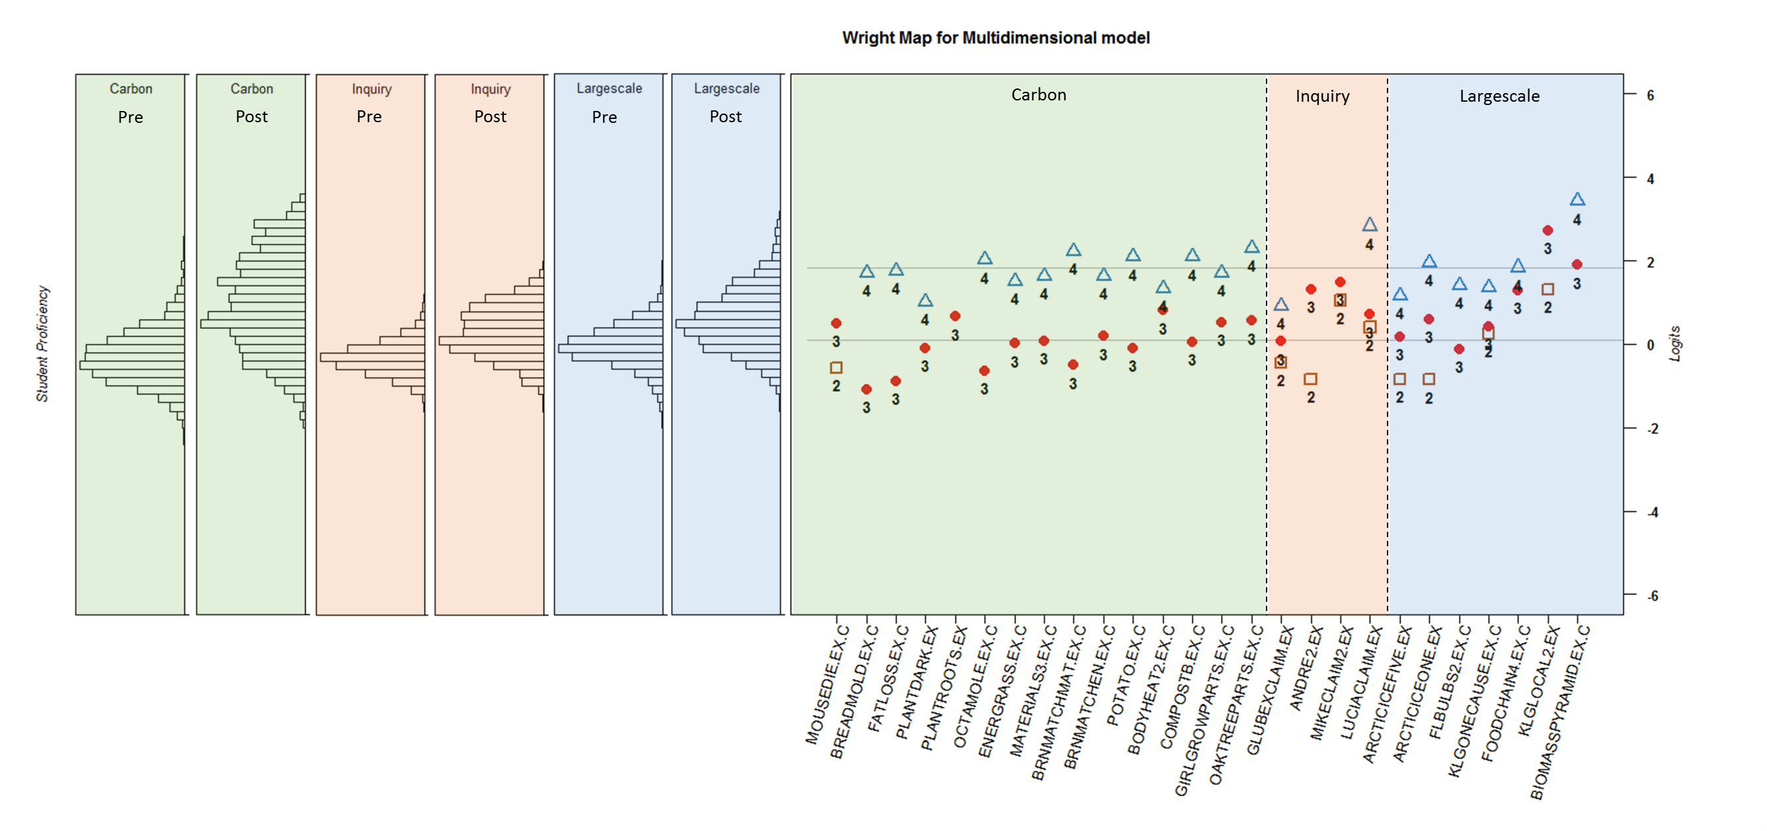
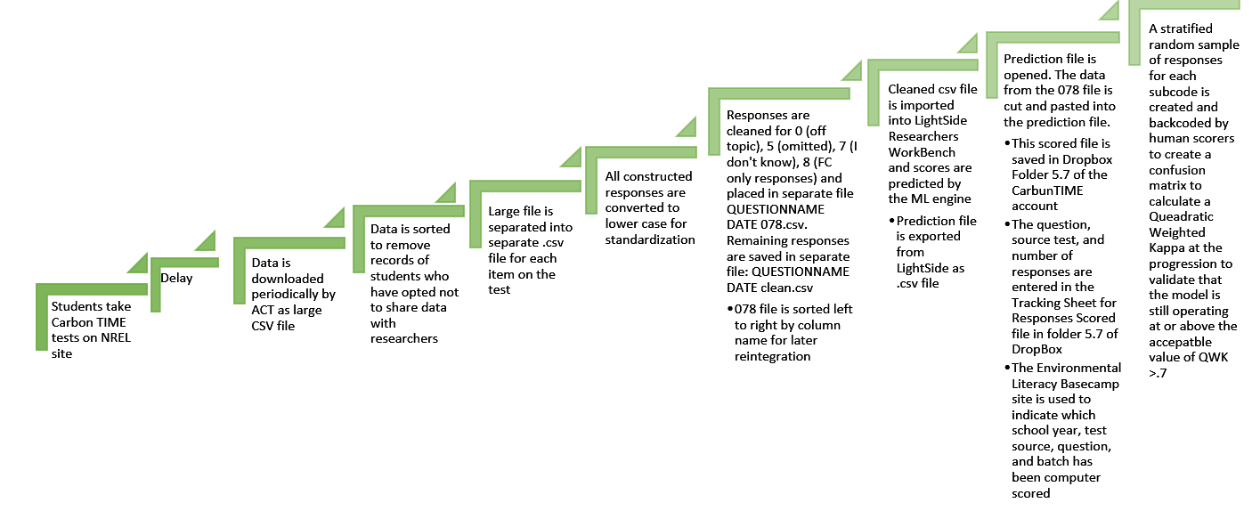
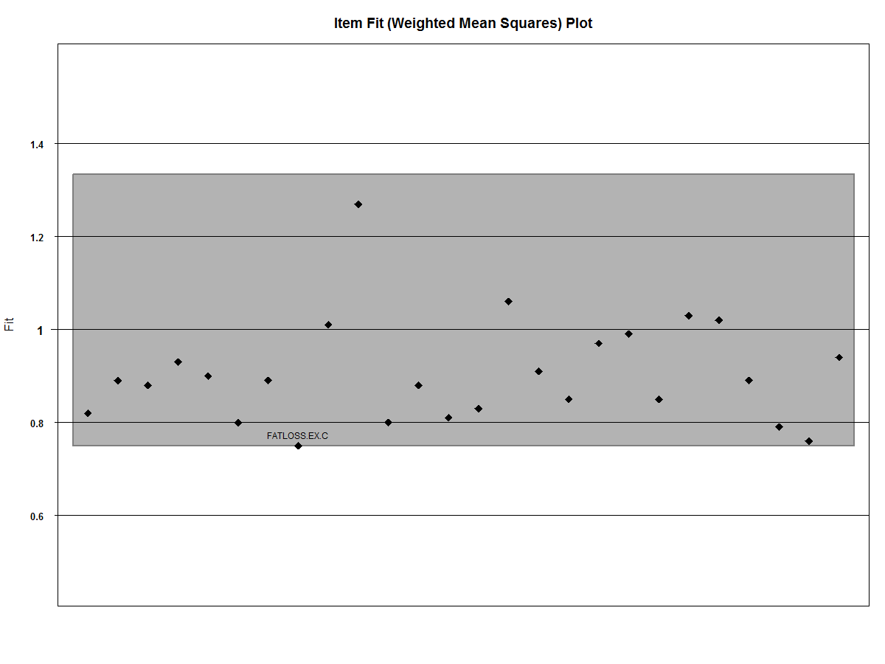
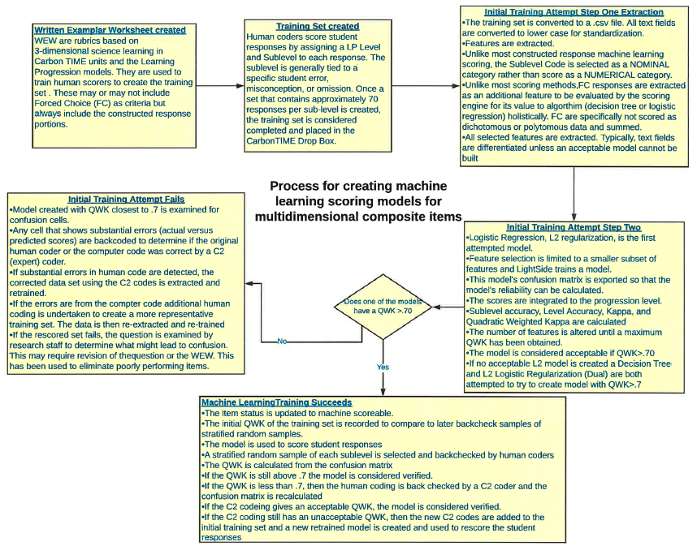
Machine Scoring and IRT Analysis
Jay Thomas, JinHo Kim, and Karen Draney
ACT, BEAR Center, and BEAR Center
Problems with scoring 3-D Composite Science items based on NGSS
Composite test questions have traditionally been scored as a string of 0/1 data. This does not permit the scoring of 3-dimensional science learning as traditional methods assume that each item measures only one construct. Furthermore, scoring composite items that include both forced choice (FC) and constructed response (CR) components is extremely expensive and time consuming requiring human coders to read each CR component and make judgements as to which level and sublevel of the Carbon TIME Learning Progression (LP) that the student response corresponds to. This limitation allowed for only a small subset of student responses to be scored during the initial states of the CarbonTIME program. This also limited the ability to apply large scale psychometrics such as MIRT to the data sets because the number of available of responses was too small, which generally require at least 1,000 participants in the sample and fairly long tests. (Reckase, 1997)
Proposed Solution Using Machine Learning (ML) to Score 3-D Composite Science Items Holistically
Figure 2
Results of ML Scoring
In an attempt to show scalability of using composite items to measure 3D science learning, machine learning was explored as a way to increase the usefulness of the collected data for teachers and researchers. Initially, we used traditional techniques of scoring the composite items at the LP Level. This was based on the idea that ML generally requires that the scoring categories have large, usually hundreds or thousands, of examples that are alike in some overall capacity. This approach did not work.
In an attempt to improve scoring, we had the ML engine (LightSide Researcher’s Workbench) extract information at the SUBLEVEL category as it was theorized that composite response patterns at the sublevel would have more in common with each other than would responses at the same LEVEL in different sublevels. This approach allowed for the use of both FC and CR components to be used by the ML engine as potential features in the best model. The ML engine was able to notice patterns in FC responses that were not part of the human scoring rubric (WEW). The engine was using far more data to discover patterns in the responses than a human coder could possibly process.
This methodology was first piloted on the small number of items that had substantial human codes available. A model was considered acceptable if it produced a quadratic weighted kappa(Fleiss & Cohen, 1973) (QWK) greater than .7 with the training set. If an acceptable model could not be built, then problematic answers were back checked by an expert coder (C2) to determine if the error was of human or computer origin. Once the C2 codes replaced the problematic codes, the model was rebuilt and tested. If the corrected training set still did not produce an acceptable model, it generally indicated that there was a problem either in the wording or the item or the application of the rubric that led to the confusion. This allowed an iterative loop for question evaluation to be added to the overall process. An overview of the process is shown in Figures 1 and 2.
For the 15-16 data, 30 of 31 models had at least marginal QWK of 0.6 or greater when backcoded by human scorers with a stratified random sample. The remaining model, was rebuilt using the original data and the backcoded set as a new training set. The best updated model included 730 features compared to 400 features of the smaller original training set. (See Table 1)
School Year | ML Scoreable | Total Items | Percent Items Machine scoreable | Responses scored
15-16 | 32 | 38 | 84.2% | 175,265
16-17 | 38 | 38 | 100% | 514,191
17-18 |  |  |  | 128,253
Table 1
Models Created | Models validated with QWK>.7 by computer scoring | Models validated after C2 coding of human scores | Models that needed to be rebuilt and rescored
31 | 17 | 13 | ARCTICEICEFIVE (1)
1 Rebuilt model | 1 | 1 (QWK revised 0.738) | None
Figure 3
IRT Analysis
Item Fit Plot for overall difficulty parameters
The multidimensional Partial Credit Model was used to calibrate the 15-16 data for 3-dimensional science learning. This model is an extension of the original unidimensional Partial Credit Model (PCM; Masters, 1982). In the multidimensional PCM, the probability of a person $p$ responding in category score $m$ to item $i$ is a function of the person ability parameter for dimension $d$ ($θ_{pd}$) and item parameters associated with overall difficulty ($δ_{i}$) and category deviation ($τ_{im}$), as formulated below.
$$Pr\left(y_{pi}=m | θ_{p}\right)=\frac{\exp\left[\sum_{l=0}^{m}{(\sum_{d=1}^{D}{{w_{di}θ}_{pd}}−δ_{i}−τ_{il})}\right]}{\sum_{h=0}^{M_{i}}{exp\left[\sum_{l=0}^{h}{(\sum_{d=1}^{D}{{w_{di}θ}_{pd}}−δ_{i}−τ_{il})}\right]}} ,$$
$where m=0, 1,…, M_{i}$, $τ_{i0}=0,$ $\sum_{l=0}^{0}{(∙)=0}$, and $w_{di}$ is an indicator for the person ability dimension associated with item i, equal to 1 if item i is associated with dimension d, and 0 otherwise. As the model we have used is a between-item multidimensional model, only one $w_{di}$ is nonzero for each item.
Since this model is a special case of the multidimensional random coefficients multinomial logit model (MRCML model; Adams et al., 1997), the analysis was done using the ConQuest software program (Wu et al., 2007).
In addition to item difficulty and person proficiency, IRT models can provide indicators of individual item and person fit to a particular model. This is done by comparing observed to expected responses for each response in the database, and then summing across individual items or persons. This is then compared to a standard range of variability expected in a probabilistic model (such as the M-PCM); items with overly high fit indices show more randomness in responses than would be expected; items with overly low fit indices show very regular response patterns. In Figure 5, we show the overall item fit for each of the items used in these analyses.
Figure 5
Wright Maps for 3-Dimensional Model across Pre and Post tests
The results of our IRT analyses are displayed using a graphical representation known as a Wright map (Wilson, 2005). This map shows both item step transitions and person proficiency distributions on the same scale (known as a logit scale, displayed on the far right) – in this scale, higher proficiency persons, and more difficult item transitions, are higher on the scale. The top display shows the pretest results, the bottom display the posttest. In these displays, the three panels on the far left represent the three distributions of person proficiency (one for each dimension).
Although the three dimensions are displayed side by side (Figure 3), they cannot be directly compared, as each was centered separately on zero for identification purposes; however, the corresponding panels between the pre-test (left) and post-test (right) results may be compared (i.e. it can be seen that students in the Carbon dimension made significant progress toward higher LP levels between pre and post).
The panels on the right side show the transition points (known as Thurstonian thresholds) between the various LP levels: the blue triangles show the transition from LP3 to LP4, the red circles the transition from LP2 to LP3, and the orange square the transitions from LP1 to LP2 (LP1 for the Carbon dimension was not assessed in this data collection).
Future Research
Examining probabilities of sub-code scoring beyond currently assigned plurality code to potentially classify students
Updating marginal computer models by integrating training and backcode sets for more robust model. Verify reliability of new model with 17-18 data.
IRT and HLM analysis of 2016-17 and 2017-18 data.
Analysis of differences in growth in Carbon dimension relative to both Inquiry and Large scale dimensions
Use of other IRT models to examine sub-code classification system.
References
Fleiss, J. L., & Cohen, J. (1973). The equivalence of weighted kappa and the intraclass correlation coefficient as measures of reliability. Educational and psychological measurement, 33(3), 613-619.
Masters, G.N. (1982). A Rasch model for partial credit scoring. Psychometrika, 47(2), 149-174.
Reckase, M. D. (1997). The past and future of multidimensional item response theory. Applied Psychological Measurement, 21(1), 25-36.
Wilson, M. (2005). Constructing measures: An item response modeling approach. New York, NY: Taylor and Francis Group.
Wu, M.L., R.J. Wilson, Haldane, S.A. (2007). ACERConQuest 2.0 Manual [computer program]. Hawthorn, Austalia: ACER.
Figure 1

