Slide 1
Paper 1: Designing Curriculum to Support the Literacy Aspects of Science Literacy
Kirsten D. Edwards & Charles W. Anderson (With acknowledgement to Carly Seeterlin)
Michigan State University
Prepared for NARST Annual Meeting, 2020

Slide 2
Key Points
Interpreting science literacy as a linguistic performance
Scaffolding linguistic aspects of students’ explanation performances
Assessing linguistic aspects of students’ explanation performances
Analyzing an example

Slide 3
Defining Science Literacy
Science literacy can include (NRC, 2016, p. 32):
Foundational literacies
Content knowledge
Understanding of scientific practices
Epistemic knowledge
Identifying and judging scientific expertise
Cultural understanding of science
Disposition and habits of mind
“For science literacy, the production or consumption of science knowledge depends on the ability to access text, construct meaning, and evaluate newly encountered information in the specific domain of science” (NRC, 2016, p. 16-17).

Slide 4
Defining Environmental Science Literacy
We define Environmental Science Literacy as the capacity
to participate in evidence-based discussions about social and environmental issues.
to make decisions that are informed by science.
for engagement and sense-making with uncurated phenomena and uncurated media/texts that people encounter in their lives.
Environmental Science Literacy requires:
3D science learning
Preparation for future learning (Bransford & Schwartz, 2001) because…
Students cannot learn all science they will need while in school
Knowledge in science continues to grow and change

Slide 5
Interpreting science literacy as a linguistic performance (Gee, 2005)
Vernacular or lifeworld social language: These are some of the things that are lost: concrete things like hornworms and empathy for them; changes and transformations as dynamic on-going processes; and telos and appreciation. | Science social language: What is gained are: abstract things and relations among them; traits and quantification and categorization of traits; evaluation from within a specialized domain.
The crucial question, then, is this: Why would anyone—most especially a child in school—accept this loss?

Slide 6
Learning progression framework for scientific explanations (Miller et al., 2018)
Crosscutting concepts as “scientific rules of grammar,” capturing key conventions of science social language

Slide 7
Scaffolding science literacy as a linguistic performance
Language acquisition crucially involves access to and simulations of the perspectives of more advanced users of the language in the midst of practice. (Gee, 2005; Sharma & Anderson, 2009)
Bohr: The task of science is extending our experience and reducing it to order
This includes:
Extending students’ experience into systems that are too small, or too large, or too distant in time for them to observe directly
Using the linguistic resources of scientific social languages to reduce this new experience to order when vernacular or lifeworld social languages are inadequate
Challenge: doing this while making sure that this new social language is personally meaningful to students

Slide 8
Questions, Connections, Questions Reading Strategy
Engages students in sensemaking around the readings with their peers.
Serves as a scaffold because it decomposes the complex task of making sense of a science-related reading into its component steps (Quintana, 2004).
Moreover, it aligns with the theoretical idea of situated learning as students will engage in the reading strategy with their peers (Lave & Wenger, 1991).

Slide 9
Partnership with Teachers to Co-design Scaffolds and Assessments
2 secondary science teachers with experience teaching the Carbon TIME units engaged in co-design work to better support students with the literacy aspects of science learning, including writing explanations.
Ms. Walker: 6th grade, 21 years teaching experience
Dr. James: 9th grade, 7 years teaching experience
Joined in Fall 2018:
Ms. Bird, 9th grade, 10 years teaching experience
Joined in Fall 2019
Ms. Callahan, 9th grade, 10 years teaching experience

Slide 10
Partnership Design Work
Began with 2-day summer professional development workshop in 2018 and subsequent biweekly design meetings throughout the summer
Design work informed by
Reading scholarly work related to literacy in science instruction
Analyzing transcripts of think-aloud interviews with students while writing explanations
Writing an “ideal” explanation
Discussions about the teachers’ experiences with student reading and writing in the units
Work continued during school years through discussions and planning as the teachers taught the Carbon TIME units

Slide 11
Initial Ideas about Explanations
For Learning
For Assessment
The teachers did not share ideas in initial interviews about written explanations as tools for learning.
Ms. Walker:
"When they actually have to explain, you can figure out what level they’re at in their understanding"
For Meeting an Objective
Dr. James:
"I say, ‘Our learning target…written on the wall says, Explain how the reactants of photosynthesis are changed into the products.’ That that’s the goal of science, to be able to explain.”

Slide 12
Think-Aloud Example Explaining How a Cell in a Potato Plants Uses Food to Move and Function
Kahlil: [thinking aloud] The carbon dioxide should go out and the oxygen goes in, and glucose also goes in. Then the chemical equation, so the chemical equation is C₆H₁₂O₆, and carbon dioxide, it changes to oxygen and water….What forms of energy do - what forms of energy go into this chemical change? Chemical energy, it changes to, I think motion and light.
Kahlil’s Written Explanation: The chemical equation of cellular respiration is C₆H₁₂O₆ + 6O₂→ CO₂ + H₂O. The glucose and oxygen goes is while the CO₂ and water goes out. The chemical energy goes in and motion and heat goes out. The molecules that are needed is hydrogen and water is produce. Before the chemical change is CO₂ and after also CO₂.
This example demonstrates how different information about a students’ understanding is revealed through their speech compared to their writing.

Slide 13
Think-Aloud Analysis
In analyzing Kahlil’s think-aloud, Dr. James recognized:
He put CO₂ going in and out…but he wrote the correct equation…He was confused……I don’t think this [equation] makes any sense [to him]...What the equation really really stands for I think is like missing. How could you have an equation and have CO₂ on both sides?
In looking for patterns, Ms. Walker and Dr. James discussed:
Dr. James: What do we want them to say?...What makes a good explanation in science?
Ms. Walker: Yeah.
---
Dr. James: What’s most useful for them to actually know?...I don’t know what I want.

Slide 14
Writing the “Ideal” Explanation
Ms. Walker and Dr. James engaged in writing their own “ideal” explanations of charcoal burning.
The teachers were able to write a list of what students should include in their written explanations.
This activity allowed Ms. Walker and Dr. James to formulate their goals for students’ written explanations and allowed them to see how constructing a written explanation promotes learning.

Slide 15
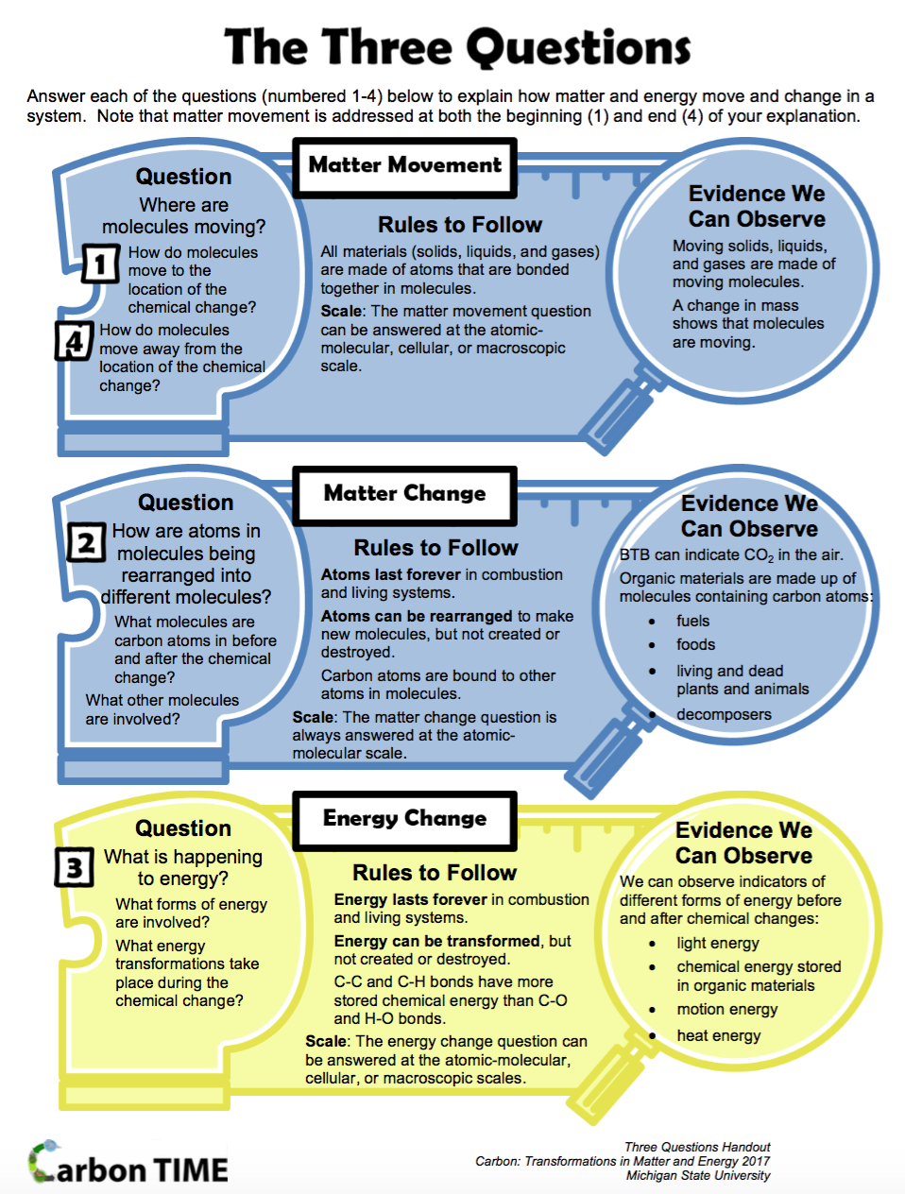
Scaffolding with the Carbon TIME Three Questions
Heuristic questions in first column
Energy and matter conservation rules in second column
Connecting scales rules in third column

Slide 16
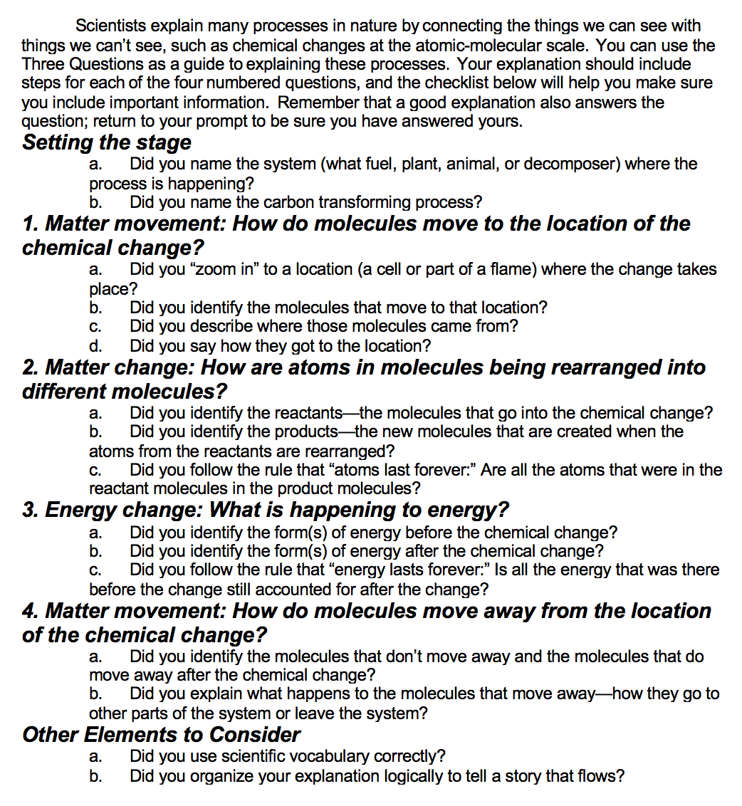
Revised Explanation Checklist
The teachers wrote “ideal” explanations. The checklist was revised based on what the teachers determined to be components of “ideal” explanations.
The components include attention to both science and literacy aspects of the performance of writing explanations.
The checklist serves to provide structure for the practice of constructing an explanation by decomposing it into smaller parts (Quintana et al., 2004)

Slide 17
Potential Value of Scaffolding Writing in the Science Classroom
Researcher: So, you’ve talked about the checklist a lot of times. Did you find that particularly helpful?
Megan: Yes.
Researcher: Was that a new way of thinking about writing for you?
Megan: …now it’s like a picture in my brain and I’m like, “Okay, I got to do this, this, this, this, and keep it in line.” I mean, it’s just really helpful and I think it helps a lot of kids, not just me.
Researcher: How did you feel about writing before you had that tool to use?
Megan: I was scared because I have really bad anxiety. When I get randomly called on in class and I say something wrong, I feel like everyone’s going to make fun of me. So, in class when I would write, I would get all sweaty and nervous. But then I got the checklist and it honestly helped me. So, it made more sense and it just helped me figure out what I was doing.
Notes:
Megan is a 9th grade student in Ms. Bird’s class

Slide 18
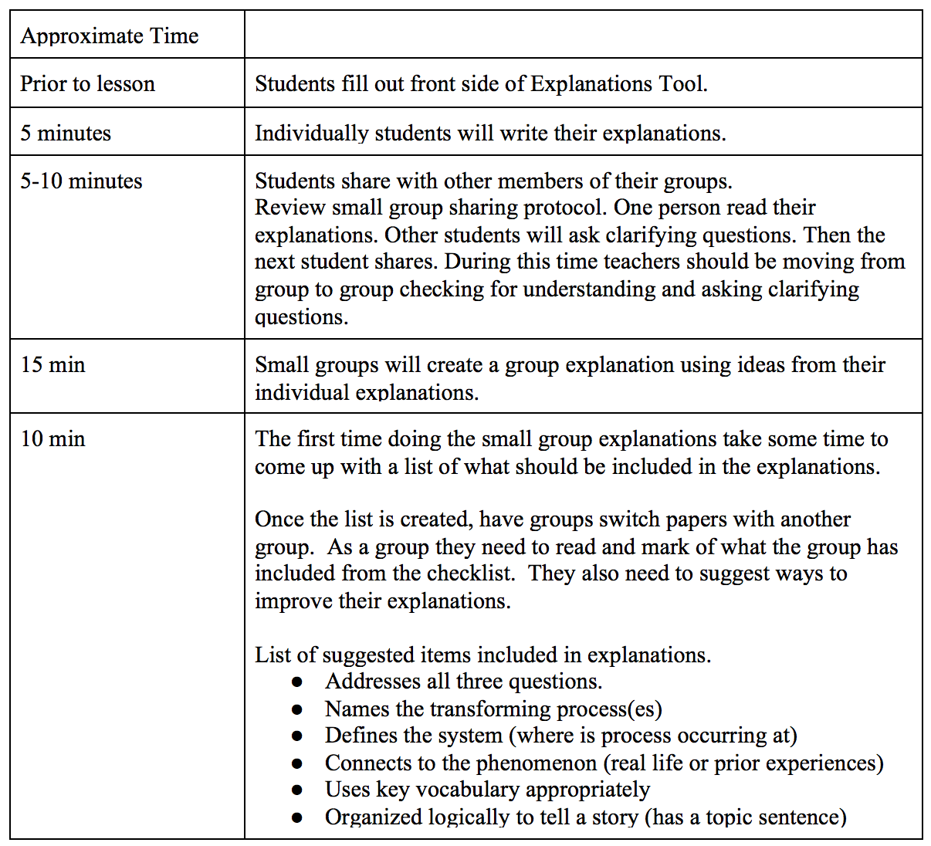
Collaborative Writing Protocol
We co-designed a protocol for collaborative explanation writing to support students in refining their ideas.
This aligns with the theoretical idea of situated leaning in which learning occurs through practice within community (Lave & Wenger, 1991).

Slide 19
Collaborative Explanations from 6th Grade Students in Ms. Walker’s Classroom

Slide 20
Teachers’ Ideas of Why Writing in Science Matters
Ms. Walker:
"I think when you write things you understand it better…When you actually have to think about what is it that I have to write, now where are those connections kind of trying to pull those pieces together?...So, I think it’s just their reflecting more as they’re writing than if you do speak it out loud…"

Slide 21
Teachers’ Ideas of Why Writing in Science Matters
Dr. James:
"I’ve noticed that most teachers will say…‘they can say it, they just can’t write it’…when somebody is saying something, you’re interpreting what you think they mean. When they say one sentence and then the next, your mind is going…‘those two things are connected and here’s the connection they’re making.’ That’s not always what they’re doing. They might just be remembering different things…We might be making all of these assumptions about this deep understanding that they don’t actually have.”

Slide 22
Assessing linguistic aspects of students’ explanation performances
Theoretical and empirical
Genre theory (Rose, 2020)
Carbon TIME
Miller et al. (2018) framework
Three Questions Checklist
Practical: Working with science teachers
Issue: attention to writing performance
Issue: combining or distinguishing between explanation and evidence-based arguments

Slide 23
Analyzing an Example
Adapted Reading to Learn Writing Assessment Criteria (Rose, 2020)
Purpose
Staging
Phases
Field
Mode
Lexis
Conjunction & reference
Grammar & punctuation
Spelling
Criteria for scientific quality:
Included in Carbon TIME and teachers’ scaffolds
Criteria for quality of communication: Not
emphasized in Carbon TIME and teachers’ scaffolds

Slide 24
Lila’s Explanation
The process that is happening is Ethanol Burning or combustion. Ethanol and oxygen are entering the process. Ethanol was in the dish and the oxygen came from the air. the Ethanol and oxygen are both moving into the flam. The fire pulled in O2 for fuel. Once the molecules got into the flam the molecules then broke apart, forming 2 CO2 and 3 h2O. The forms of energy that are present befor the chemical change is Ethanol energy. After the energy change there is heat and light. After all the molecules are formed CO2 and h2O go into the air.
Criteria for scientific quality:
Pretty good
Criteria for quality of communication: Not so good
Question: How much should we care?

Slide 25
Thanks to our funders
This research is supported by a grant from the National Science Foundation: Sustaining Responsive and Rigorous Teaching Based on Carbon TIME (NSF 1440988 ). Any opinions, findings, and conclusions or recommendations expressed in this material are those of the author(s) and do not necessarily reflect the views of the National Science Foundation.
Notes:
And thanks to the National Science Foundation for funding this research.

