Slide 1
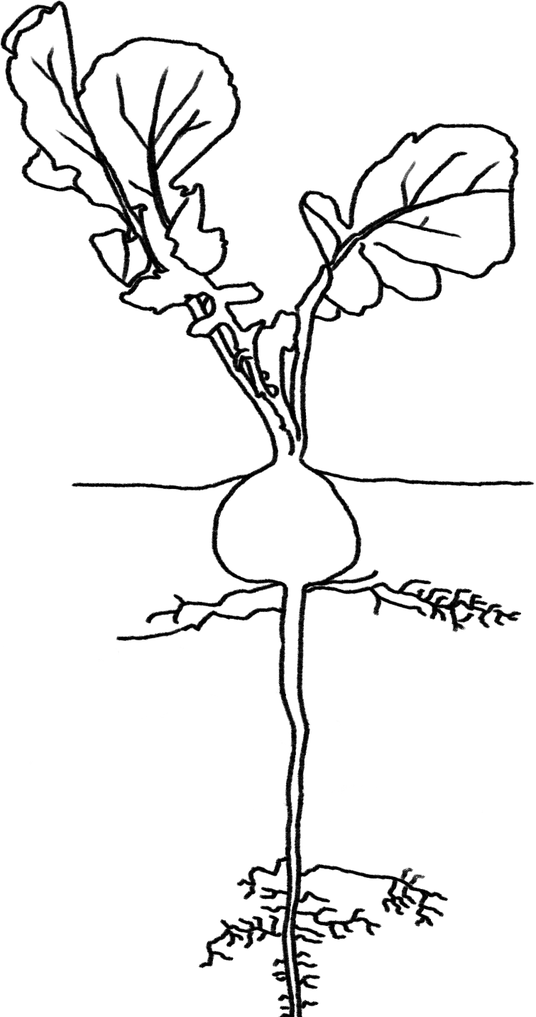
Plants Unit Pre-Activity 0.2GL: Plant Growth Investigation Set Up
Carbon: Transformations in Matter and Energy
Environmental Literacy Project Michigan State University
Notes:
Image Credit: Craig Douglas, Michigan State University

Slide 2
The Plants Unit
You are here
Lesson 3: Investigating Plants
Lessons 4 and 5: Explaining How Plants Make Food, Move, Function, and Grow
Lesson 2: Foundations: Zooming into Organisms
Lesson 6: Explaining Other Examples of Plants Growing, Moving, and Functioning
Lesson 6: Explaining Other Examples of Plants Growing, Moving, and Functioning
Lesson 1: Pretest and Expressing Ideas and Questions
Inquiry
(up the triangle)
Molecular Models
Evidence-Based Arguments
Application
(down the triangle)
Models
Pre-Lesson: Investigation Set Up
Atomic-molecular
model of chemical
change to explain photosynthesis, biosynthesis, and cellular respiration.
Observe
Patterns
Plants gain mass (more).
Gel/Paper towel loses mass (less).
Plants take in CO₂ in the light.
Plants release CO₂ in the dark.
Observations
Pre- Lesson
Pretest
Establish the Problem
Found-ational
Knowledge and Practice
Predict, Plan, & Express Ideas and Questions
Students investigate radishes growing and radishes in the light and dark. They measure the mass of the seeds, gel/paper towel, and radish plants using a scale and observe CO₂ using BTB.
More Support
Less Support
Post test
Maintain
Next Unit
Notes:
Use the instructional model to show students where they are in the course of the unit.
Show slide 2 of the Pre-Activity 0.1GL Plant Growth Investigation Set Up PPT.
Have students work in groups of four.
Each student will plant one radish seed in the plant gel.
Four plants will allow each group to do at least one of the experimental treatments in Activity 3.2 Plants in the Light and Dark and have multiple measures to compare for Activity 3.4GL Observing Plants’ Mass Changes.

Slide 3
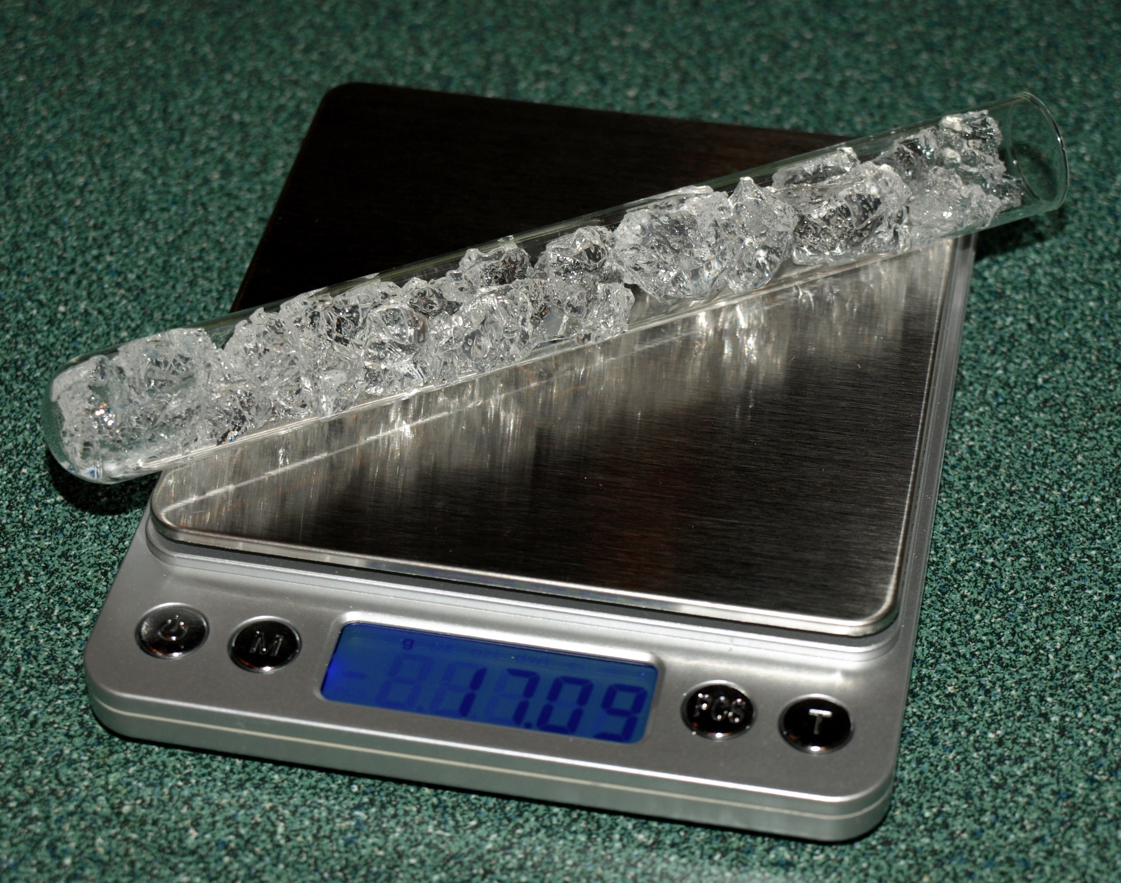
Massing the gel
Materials to prepare
Steps to follow
Hydrated gel
One radish seed
A test tube
A balance to measure masses
Measure and record the mass of your empty test tube.
Fill your tube most of the way to the top with gel (too much and it will fall out!).
Measure and record the mass of your tube with the gel.
Calculate and record the mass of only the gel in your tube.
Calculate and record the solid mass in your gel with the dry mass percentage shared with you in class.
Notes:
Have students calculate the mass of the solid plant gel in their test tubes.
Have students follow the steps in Part A of their Pre-Lesson 0.2GL Plant Growth Investigation Setup Worksheet.
Show students slide 3 of Pre-Lesson 0.2GL Plant Growth Investigation Setup PPT.
Students should use the percentage they calculated from Pre-Activity 0.1 for how much solid is in the hydrated gel (should be ~1.4%). Students should understand that very little solid matter is added to the system through the addition of the Ionic Grow nutrient mixture. Following are our calculations through which you may choose to walk students or which you may just use as your own background knowledge.
Each gram of gel crystals absorbs 70 grams of water, so hydrated crystals are about 1.4% solid mass and 98.6% water. Each gram of water contains 0.015% Ionic Grow solids, so 1 gram of rehydrated gel contains 0.0089 grams of Ionic Grow dry mass.
There are 0.25 grams dry gel crystals + 0.0038 grams dry Ionic Grow = ~0.25 grams dry mass in each 37 mL test tube
Note that radish seeds and the solids in the Ionic Grow mixture turn out to have tiny masses—less than 0.01 grams. Even though the scales show 0.01g precision, they aren’t really that accurate, so the best way to deal with masses less than 0.01 g is to treat them as 0, or too small to measure. Otherwise, students will have a sense of false precision. For the purposes of this activity, when students are recording a mass that is less than 0.01g, they should be writing, “<0.01g.” When doing calculations with this number, they should treat it as a zero.
Tell students the dry mass calculations will be important later as they measure how their plants grow and try to determine where the mass of the growing plants comes from.

Slide 4
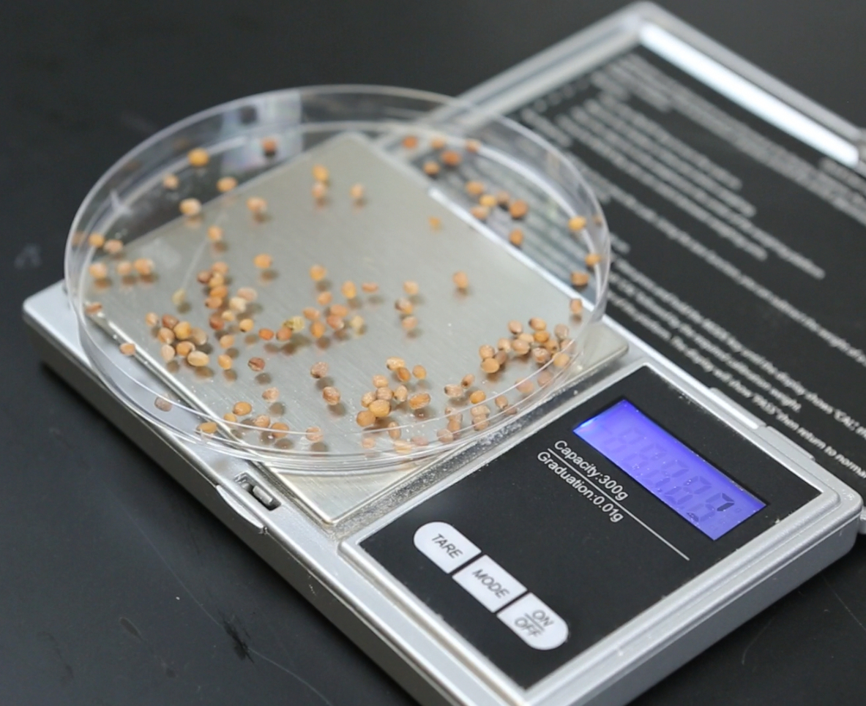
Massing all the solids
Steps to follow:
Mass your radish seed; record your data.
Place 1 seed in the top of your test tube. You do not need to bury it in the gel.
Add the mass of your radish seed to the dry mass estimate of the gel in your tube. Record your data.
Place your labeled and planted test tube in a rack under grow lights (recommended) or in a sunny windowsill.
Notes:
Have students calculate the mass of all solids in their test tubes.
Have students follow the steps in Part B of their Pre-Lesson 0.2GL Plant Growth Investigation Setup Worksheet.
Show students slide 4 of Pre-Lesson 0.2GL Plant Growth Investigation Setup PPT.
Remind students that the plants will need 3-4 weeks to grow before they are large enough to begin the rest of the Plants unit.
Place the test tubes about 12-16 inches under the grow lights or in a sunny windowsill.

Slide 5
Ongoing observations and data collection
Over the course of the next 3-4 weeks, while your radish plants are growing, you will occasionally need to give your plants more minerals (nutrient solution). Optional: record each time this happens in order to keep track of how much mass you are adding to your plant.
Also, record observations of your plant as you go.
Notes:
Plant maintenance
Use the table in Part C in the Pre-Lesson 0.2GL Plant Growth Investigation Setup Worksheet for students to track their observations and ongoing watering of their radish plants.
Show students slide 5 of the Pre-Lesson 0.2GL Plant Growth Investigation Setup PPT.
The gel is designed to water the plants for at least a week (probably 2) prior to needing additional nutrient mixture input.
Prepare another gallon of nutrient mixture (4 teaspoons Ionic Grow to 1 gallon distilled water) to add if needed to the tubes once most of the mixture has been extracted from the gel by the plants. Add nutrient mixture to the test tubes when the gel has subsided enough (~50% from initial volume) that the plants are in danger of wilting. Ketchup bottles (with the nozzles) work well for adding water. Only add an inch or two of the mixture at a time. Adding to much risks drowning the plants or creating an optimal environment for algal growth.
The percentage of Ionic Grow dry mass in the nutrient mixture is 0.015%. Walk students through the appropriate calculation to determine the dry mass added each time to each system when the radish plants are watered. Note: the dry mass added to the tubes via the nutrient solution will be negligible

