Slide 1
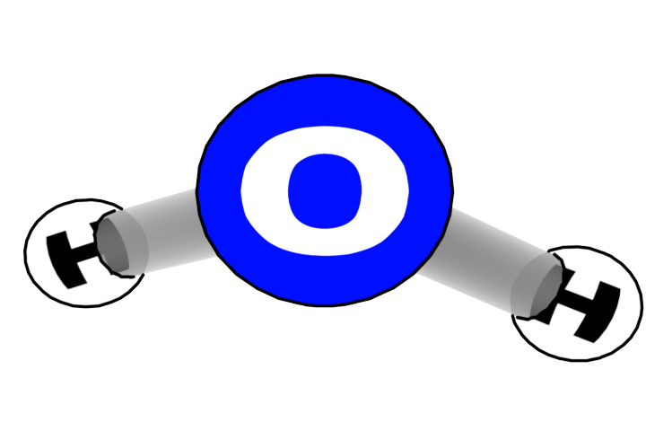
Plants Unit Pre-Activity 0.1GL Measuring the Mass of Solids in Mixtures
Carbon: Transformations in Matter and Energy
Environmental Literacy Project Michigan State University
Notes:
Image Credit: Craig Douglas, Michigan State University

Slide 2
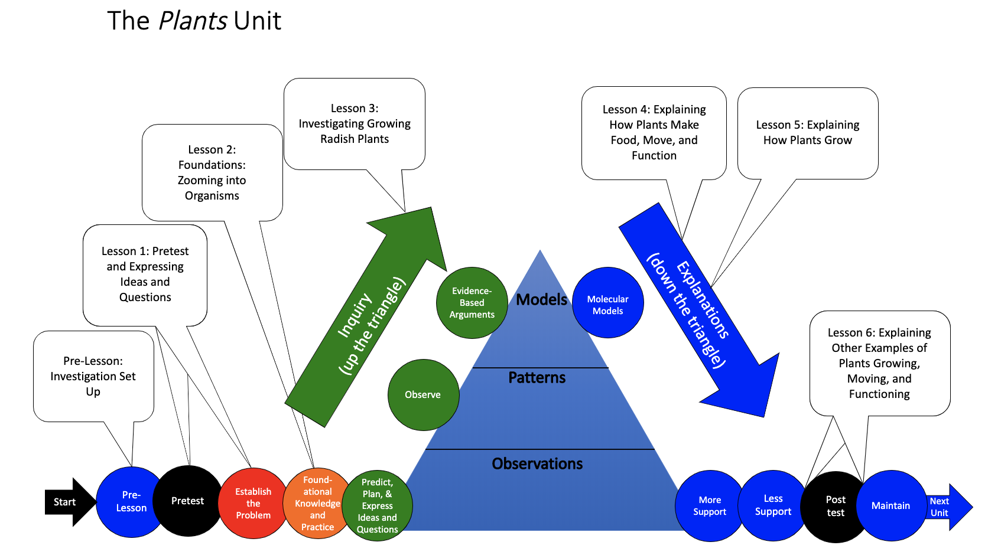
You are here
Notes:
Use the instructional model to show students where they are in the course of the unit.
Show slide 2 of the Pre-Activity 0.1GL Measuring the Mass of Solids in Mixtures PPT.

Slide 3
How can we figure out the mass of just the solids?
Method 1:
Measure the mass of the solids before you make the mixture.
Method 2:
Measure the mass of the solids after you take the water out of the mixture.
Notes:
(Day 1) Tell students that today they will practice finding the dry mass of mixtures.
This will help prepare students to find the dry mass of the materials they will use to plant their radish seeds in Pre-Activity 0.2 as well as to make calculations in Lesson 4 to prepare for explaining biosynthesis.
Pass out one copy of Pre 0.1 Measuring the Mass of Solids in Mixtures Worksheet to each student.
Show students slide 3 of Pre 0.1 Measuring the Mass of Solids in Mixtures PPT.
Discuss the two methods for determining the mass of a solid in a mixture.

Slide 4
Part A: Measuring the mass of solids before you make the mixture
Prepare the materials
Follow the steps
Dry sponge
Salt
Gel crystals
Bowl or small container for each
Water
Digital scale
Measure the mass of the dry solids; record the data in the table in Part C of your worksheet.
Make the mixtures.
Measure the mass of the mixtures; record the data.
Calculate the percentage of the mixture that is solid. Record your results.
Notes:
(Day 1) Part A
(NOTE: MIXTURE AMOUNTS AND SETUP STEPS OUTLINED IN THE LESSON PLAN ON THE 0.1 GL webpage: http://carbontime.bscs.org/plants/pre-lesson-activity-0.1GL)
Using the worksheet and the PPT, walk through the steps together in order to find the dry mass of the solids before mixing them with water.
Show students slide 4 of the PPT.
If students are working in pairs, have them label the bowls for each of their materials as well as with their names.
Measure the masses of the two bowls you will use for the mixtures. Add the solids to the bowls. Have students subtract the mass of the bowls and enter the masses of the solids in the first column of the table in Part C of their worksheets.
Add water to each bowl. Have students subtract the mass of the bowls and enter the masses of the mixtures in the second column of the table in Part C of their worksheets.

Slide 5
Part B: Measuring the mass of solids after you take the water out
Prepare the materials
Follow the steps
Carrot
Salt water
Ionic grow mixture
Petri dish or small container for drying each
Digital scale
Scissors (for cutting carrot if needed)
Measure the mass of the mixtures; record the data.
Evaporate the water (in an oven or over several days)
Measure the mass of the dry solids; record the data.
Calculate the percentage of the mixture that is solid. Record the data.
Notes:
(Day 1) Part B
(NOTE: MIXTURE AMOUNTS AND SETUP STEPS OUTLINED IN THE LESSON PLAN ON THE 0.1 GL webpage: http://carbontime.bscs.org/plants/pre-lesson-activity-0.1GL)
Using the worksheet and the PPT, walk through the steps together in order to find the dry mass of the solids after removing the water.
Show students slide 5 of the PPT.
If students are working in pairs, have them label the glass Petri dishes for each of their materials as well as with their names.
Measure the masses of the three glass Petri dishes
Add the solid/water mixtures to the Petri dishes. Have students subtract the mass of the Petri dishes and enter the masses of the mixtures in the second column of the table in Part C of their worksheets.
Cut the carrots into thin strips so that they will dry more quickly and thoroughly.
Allow the mixtures to dry over several days or in an oven overnight.
Leave the mixtures in a visible place in the classroom, and allow them to dry over several days. Alternatively, place the mixtures in a low-heated oven (<200 degrees) and allow them to dry over several hours. Caution: plastic petri dishes may melt in an oven!

Slide 6
Part C: Mass percentage table
Why is it important to calculate dry mass without including the weight of the water?
Keep these numbers handy. They will help you to make calculations later in the unit.
Notes:
(Day 2) Parts B and C
Finish the steps in the worksheet and Slide 6 of the PPT to calculate the percentage of the mixtures that are solids. Note that when dehydrated, 1 teaspoon of Ionic Grow (out of the bottle) with a mass of 4.22 liquid grams is reduced to 0.14 grams of dry mass. In the Ionic Grow nutrient mixture, 4 teaspoons (17 liquid grams with 0.57 grams of dry mass) will be added to 1 gallon (3.79 L) of water, which has a mass of 3785 grams. The percentage of dry mass in this liquid mixture is 0.015%, which can be considered 0 for all calculation further on, although it is important for students to understand this magnitude of dry mass for when they later consider where the mass of their growing plants could have come from.

Slide 7
Part D: Practice calculating solid mass
Later in the unit, you will be asked to calculate solid masses of mixtures. Use this section to practice these calculations.
You will use the hydrated gel crystals with nutrient mixture to grow your plants. How much solid matter is in the gel? (See your answer to Worksheet Question D5.)
Notes:
(Day 2) Part D.
Have students complete Part D of the worksheet and discuss the questions on Slide 7 of the PPT.
Tell students that when scientists measure plant growth, they use dry mass as an indicator of growth.

Slide 8
Hydrating the plant gel crystals
Pour the gallon of nutrient water into a large tub or bowl.
Add the gel crystals to the water and let sit overnight.
After the gel has fully expanded, pour the mixture into a colander in a sink and allow the extra water to drain away.
Transfer the drained gel back into a large tub or bowl for planting. Store excess in a closed container.
Notes:
(Day 2) As a class, hydrate the plant gel crystals.
Follow the steps in slide 8 of the PPT.
Add 4 teaspoons of Ionic Grow to a gallon jug of distilled water to make the nutrient mixture. NOTE: 4 tsp = 17 g and a gallon of distilled water ~3,800 g so the total amount of the mixture is 3817 g.
To show this, either measure the mass of the entire mixture or have students use the above estimates (also in the Estimating the Mass of Solids Mixed with Water handout), and calculate what percentage of this mixture is dry Ionic Grow nutrients.
Measure the mass of the dry gel crystals. Place the gel crystals in a large bowl and pour the nutrient mixture on top of the crystals.
Let the crystals hydrate overnight into gel.
Ask students at this point to share their ideas on what plants need to grow. Ask students to predict whether or not plants will grow without soil in the gel. Ask students if they think the nutrient solution will explain plant growth.
Note that 1 gram of plant gel crystals absorbs about 70 grams of water. This results in a 1.4% dry mass contained in hydrated gel.

