Slide 1
Plants Unit Activity 6.2: Functions of All Plants
Carbon: Transformations in Matter and Energy
Environmental Literacy Project Michigan State University
Notes:
Image Credit: Craig Douglas, Michigan State University

Slide 2
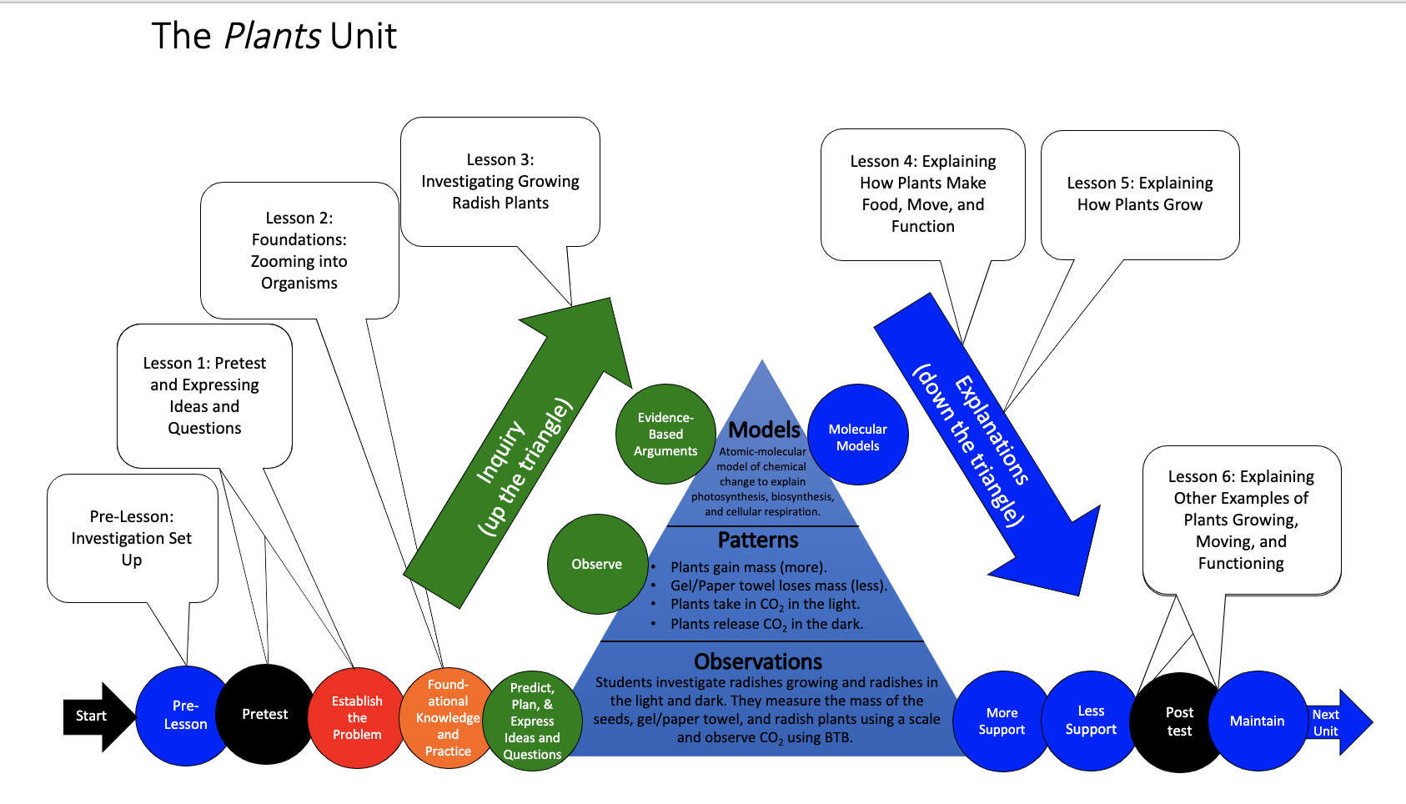
You are here
Notes:
Use the instructional model to show students where they are in the course of the unit.
Display slide 2 of the 6.2 Functions of All Plants PPT.

Slide 3
Explaining What Plants Have in Common
Here are three functions that all plants have in common. For each function, explain how animal cells work to accomplish that function.
All plants make glucose. How do their cells do that?
All plants grow. How do their cells do that?
All plants use energy to move and function. How do their cells do that?
Notes:
Have students explain the primary functions that animals have in common.
Display slide 3 of the 6.2 Functions of All Plants PPT. Tell students they will be constructing explanations that answer three questions about the functions of plants that are shared by all plants.
Option 1: Have students construct their explanations on 6.2 Functions of All Plants Worksheet in pairs. Students’ explanations can include words, illustrations, diagrams, and/or charts. Students may need additional sheets to answer each of the questions.
Option 2: Have students construct their explanations in a PowerPoint presentation in pairs for each of the questions.
Option 3: Have students construct their explanations on a poster in pairs or small groups.
For all options, display slide 4 of the PPT and remind students that good answers to questions about plant cells should address each of the four numbered questions of the Three Questions Poster (or Handout).

Slide 4
Good answers to questions about plant cells
Answer each of the questions (numbered 1-4) below to explain how matter and energy move and change in a system. Note that matter movement is addressed at both the beginning (1) and end (4) of your explanation.
Question
Where are molecules moving?
How do molecules move to the location of the chemical change?
How do molecules move away from the location of the chemical change?
Evidence We Can Observe
Moving solids, liquids, and gases are made of moving molecules.
A change in mass shows that molecules are moving.
Rules to Follow
All materials (solids, liquids, and gases) are made of atoms that are bonded together in molecules.
Scale: The matter movement question can be answered at the atomic-molecular, cellular, or macroscopic scale.
Question
How are atoms in molecules being rearranged into different molecules?
What molecules are carbon atoms in before and after the chemical change?
What other molecules are involved?
Evidence We Can Observe
BTB can indicate CO₂ in the air.
Organic materials are made up of molecules containing carbon atoms:
• fuels • foods
• living and dead plants and animals
decomposers
Rules to Follow
Atoms last forever in combustion and living systems.
Atoms can be rearranged to make new molecules, but not created or destroyed.
Carbon atoms are bound to other atoms in molecules.
Scale: The matter change question is always answered at the atomic-molecular scale.
Question
What is happening to energy?
What forms of energy are involved?
What energy transformations take place during the chemical change?
Evidence We Can Observe
We can observe indicators of different forms of energy before and after chemical changes:
• light energy • heat energy
• chemical energy stored in organic materials
• motion energy
Rules to Follow
Energy lasts forever in combustion and living systems.
Energy can be transformed, but not created or destroyed.
C-C and C-H bonds have more stored chemical energy than C-O and H-O bonds.
Scale: The energy change question can be answered at the atomic-molecular, cellular, or macroscopic scales.
Notes:
Allow students to share their explanations with the class.
Display slide 5 of the 6.2 Functions of All Plants PPT. Provide students an opportunity to share their explanations with the class.
Decide how you will have students present depending on the option you chose in step 2 and the needs of your students and classroom.
If students did option 1, they could verbally share their explanations or share them with the class using a document camera.
If student did option 2, they could present their PPT to the class.
If students did option 3, they could share their posters with the whole class or you could organize a gallery walk in which students circulate the classroom and view the posters.
Have students share feedback on their classmates’ explanations as to if the explanations addressed each of the Three Questions.

Slide 5
Share Your Answers
How did you explain each of the three functions?
Do your explanations answer the Three Questions?
How do your answers compare to your classmates?
Notes:
Allow students to share their explanations with the class.
Display slide 5 of the 6.3 Functions of All Plants PPT. Provide students an opportunity to share their explanations with the class.
Decide how you will have students present depending on the option you chose in step 6 and the needs of your students and classroom.
If students did option 1, they could verbally share their explanations or share them with the class using a document camera.
If student did option 2, they could present their PPT to the class.
If students did option 3, they could share their posters with the whole class or you could organize a gallery walk in which students circulate the classroom and view the posters.
Have students share feedback on their classmates’ explanations as to if the explanations addressed each of the Three Questions.

Slide 6
How have your ideas changed?
Gather together your process tools for the unit (Expressing Ideas and Questions Tool, Predictions and Planning Tool, & Evidence-Based Argument Tool, Explanations Tools).
How have your ideas changed related to:
Scale?
Movement?
Carbon?
What do you know now about how plants grow, move, and function that you didn’t know before this unit?
Notes:
Lead a discussion about how student ideas have changed over time.
Display slide 6 of the PPT. Have students consider how their ideas changed with regard to scale, movement, and carbon. What do they know about how plants grow and move now that they didn’t know before this unit?

