Slide 1
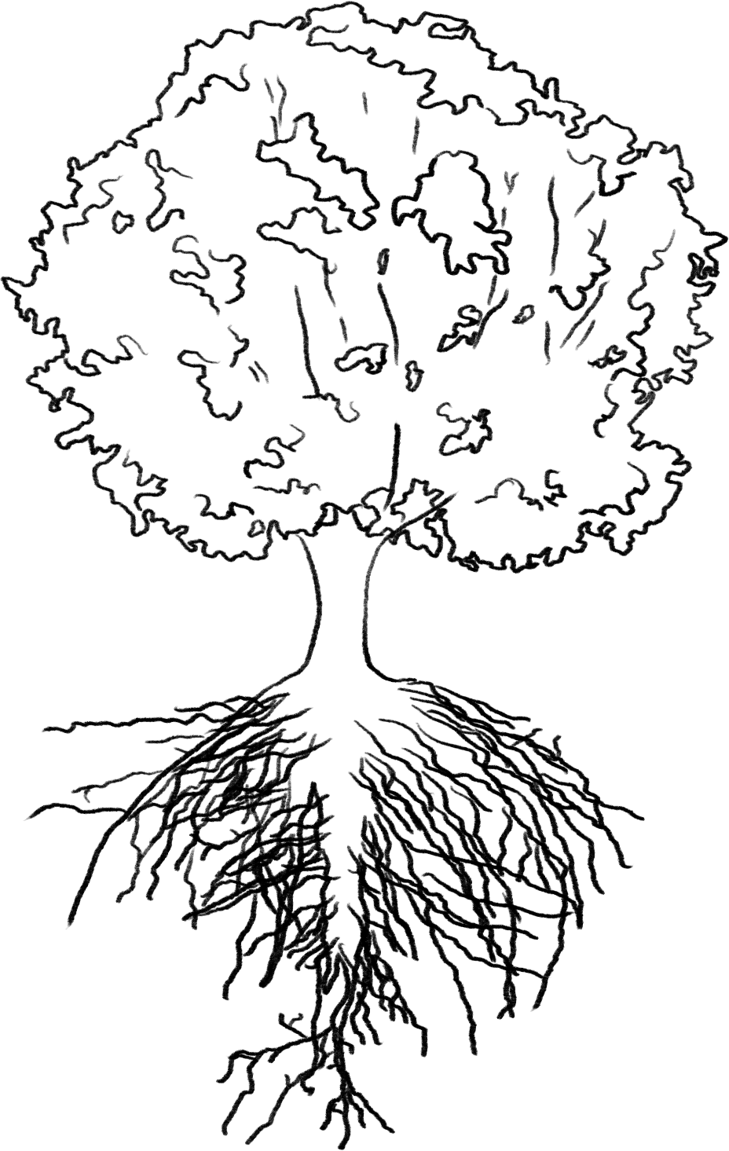
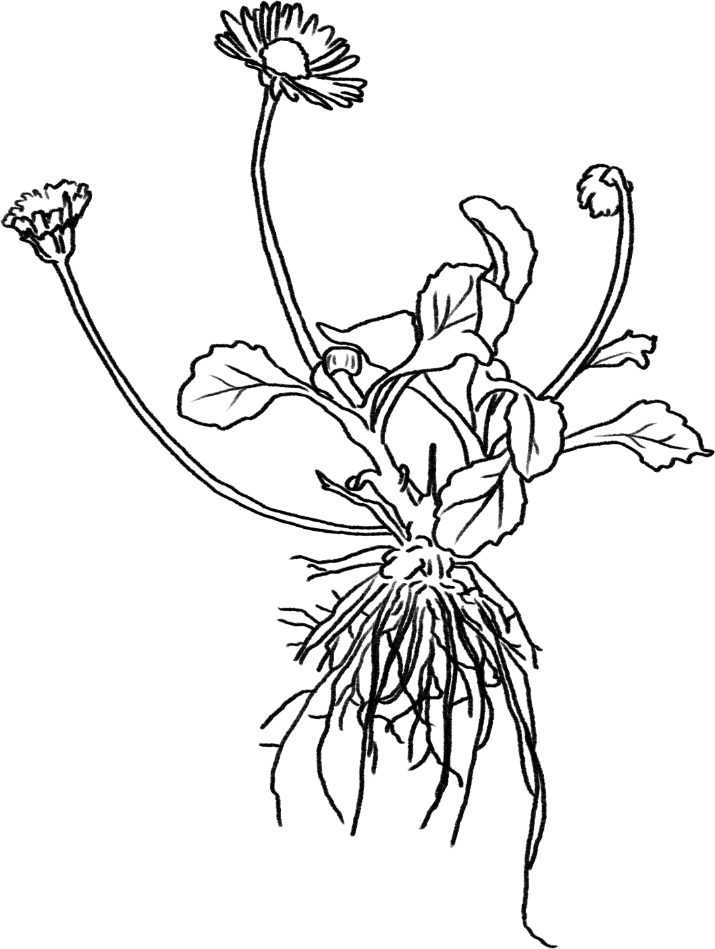
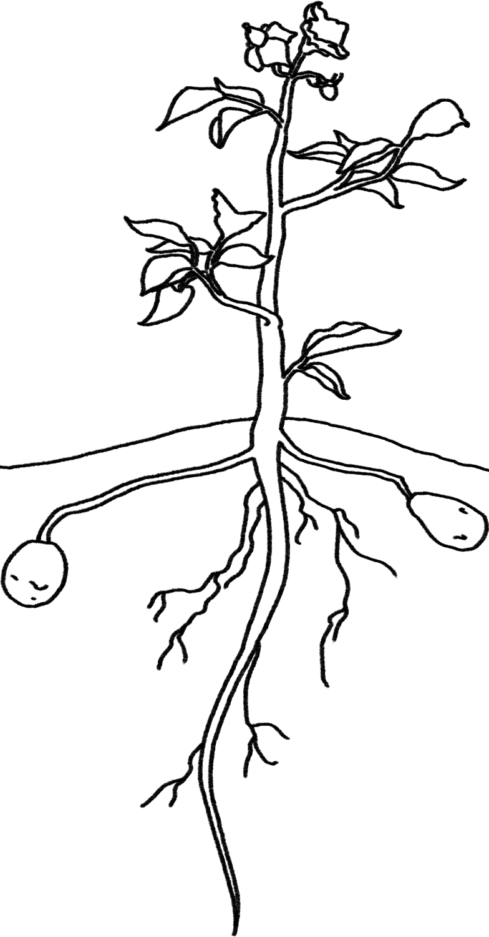
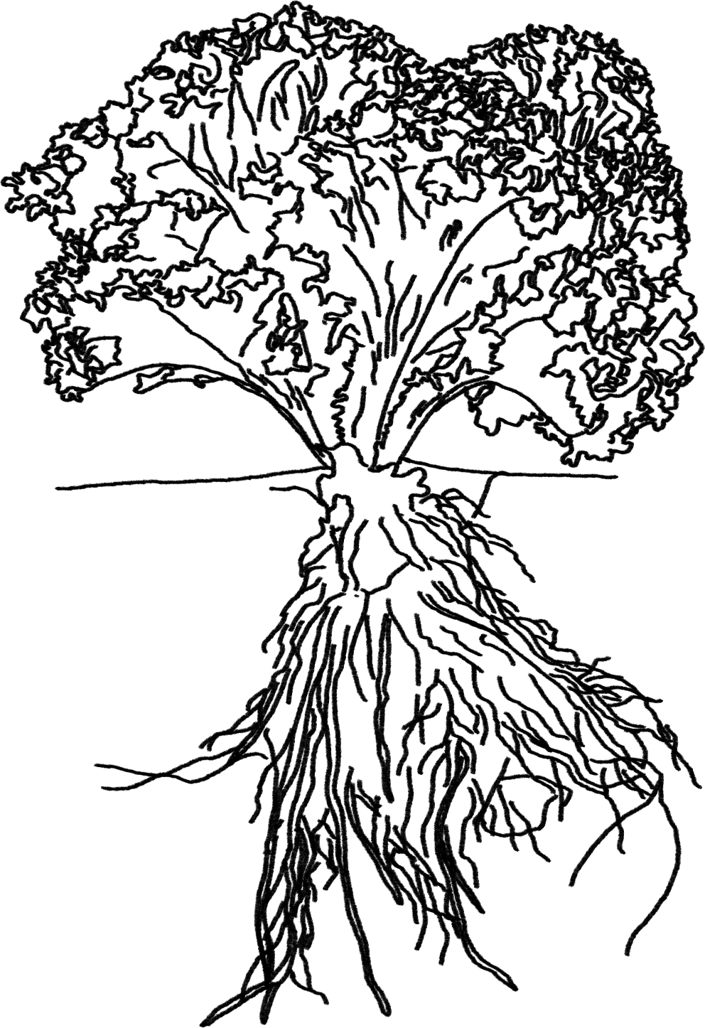
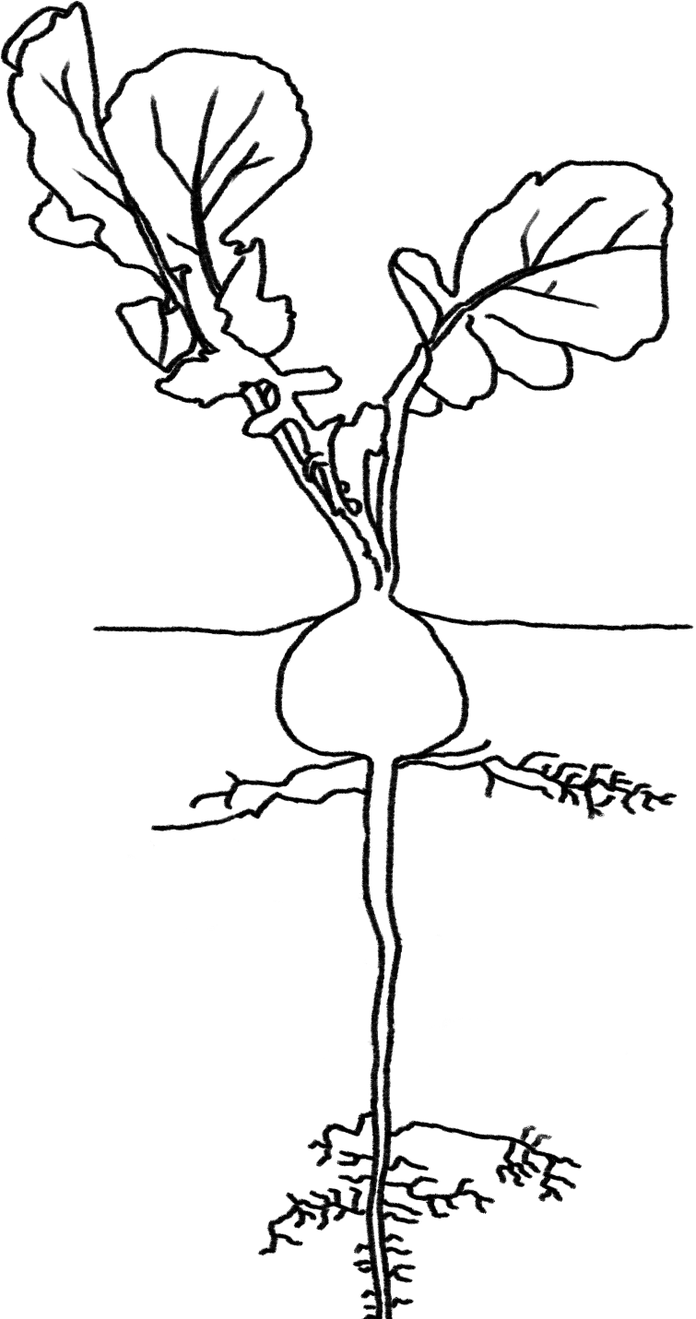
Plants Unit Activity 6.1: Explaining Other Examples of Plants Growing, Moving, and Functioning
Carbon: Transformations in Matter and Energy
Environmental Literacy Project Michigan State University
Notes:
Image Credit: Craig Douglas, Michigan State University

Slide 2
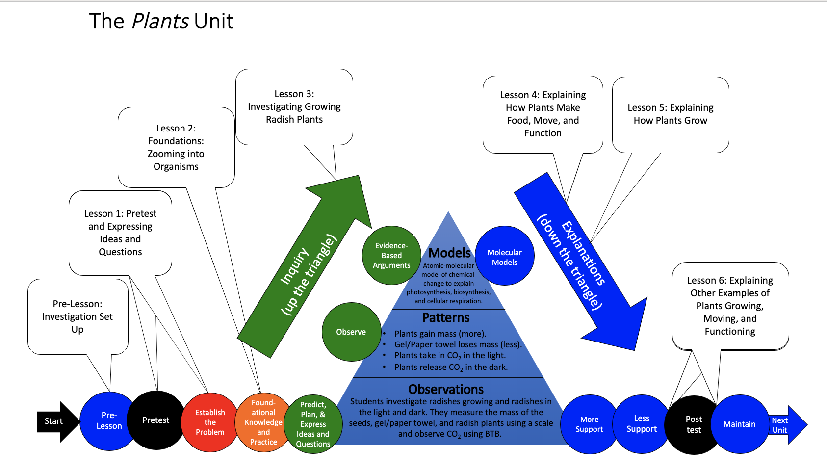
You are here
Notes:
Use the instructional model to show students where they are in the course of the unit.
Show slide 2 of the 6.1 Explaining Other Examples of Plants Moving and Growing PPT.

Slide 3
Explaining Movement, Growth, and Functioning in Other Plants
Notes:
Image Credit: Craig Douglas, Michigan State University
Review the ways in which plans use food.
Use Slides 3-5 of the PPT to review what students have learned about how plants use food.
Slide 3 reminds students that the unit is about all kinds of plants.
Slide 4 reminds students of structures that all plants have in common at different scales: cells that are made of molecules that are made of atoms.
Slide 5 reminds students that molecules can either be used for growth through biosynthesis or energy through cellular respiration.
Tell students that their explanations today will be to tell this whole story.

Slide 4
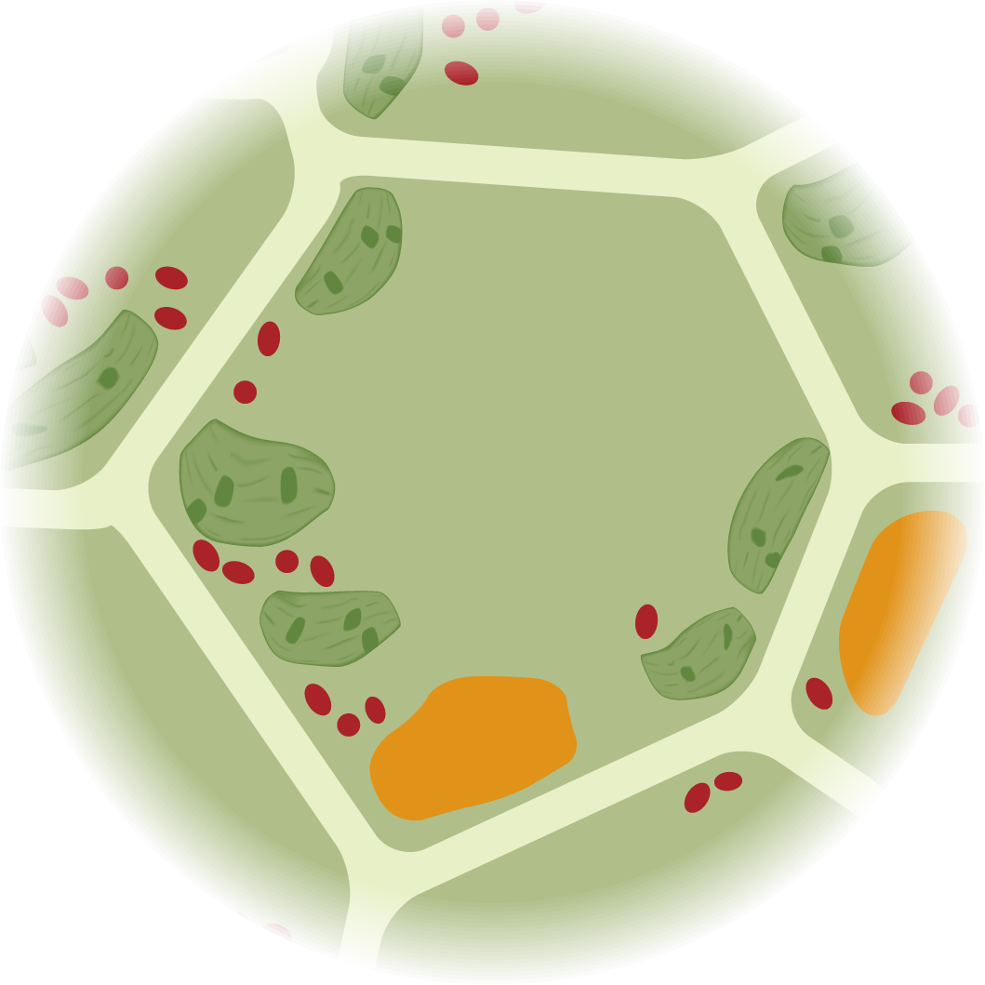
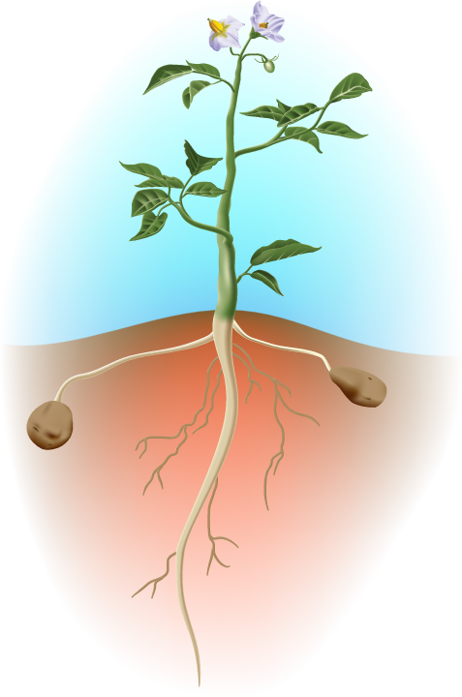
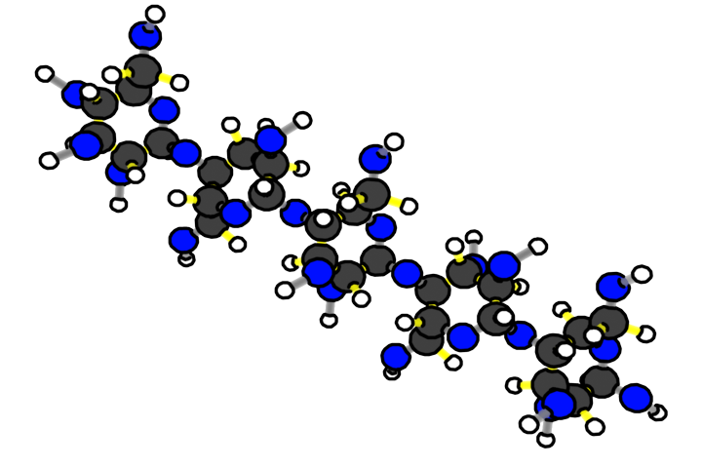
Plants are made of cells
Plant cells are made of molecules
Plant molecules are made of atoms
Benchmark Scale | Power of Ten | Decimal Style
Large scale | Larger 10⁵ 10⁴ 10³ | Larger 100,000 10,000 1,000
Macroscopic | 10² 10¹ 10⁰ 10⁻¹ 10⁻² 10⁻³ | 100 10 1 meter 0.1 0.01 0.001
Microscopic | 10⁻⁴ 10⁻⁵ 10⁻⁶ 10⁻⁷ | 0.0 001 0.00 001 0.000 001 0.0 000 001
Atomic-molecular | 10⁻⁸ 10⁻⁹ Smaller | 0.00 000 001 0.000 000 001 Smaller
Scale: 10⁻⁸ meters = 0.00 000 001 meters
Scale: 10⁻⁹ meters = 0.000 000 001 meters
Scale: 10⁻⁶ meters = 0.000 001 meters
Scale: 10⁻⁷ meters = 0.0 000 001 meters
Scale: 10⁻⁵ meters = 0.00 001 meters
Scale: 10⁻⁴ meters = 0.0 001 meters
Scale: 10⁻³ meters = 0.001 meters
Scale: 10⁻² meters = 0.01 meters
Scale: 10⁰ meters = 1 meters
Scale: 10⁻¹ meters = 0.1 meters
Notes:
Review the ways in which plans use food.
Use Slides 3-5 of the PPT to review what students have learned about how plants use food.
Slide 3 reminds students that the unit is about all kinds of plants.
Slide 4 reminds students of structures that all plants have in common at different scales: cells that are made of molecules that are made of atoms.
Slide 5 reminds students that molecules can either be used for growth through biosynthesis or energy through cellular respiration.
Tell students that their explanations today will be to tell this whole story.

Slide 5
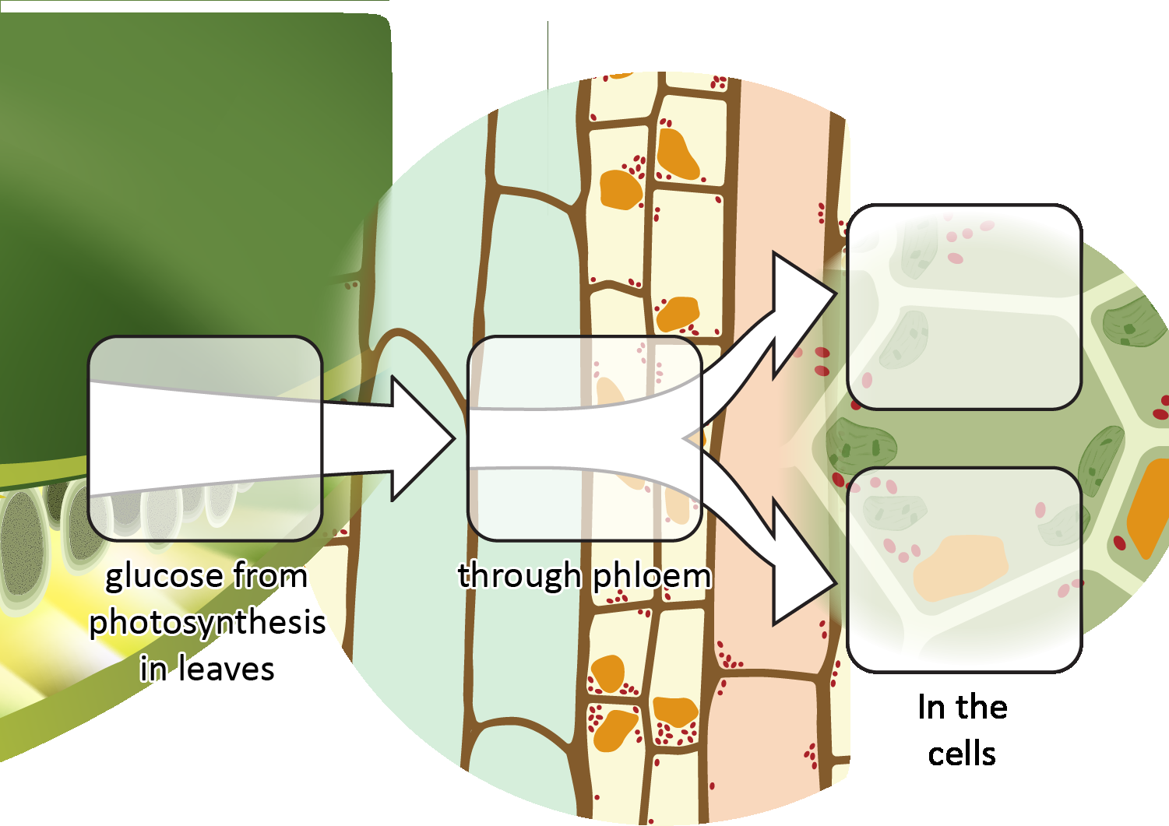
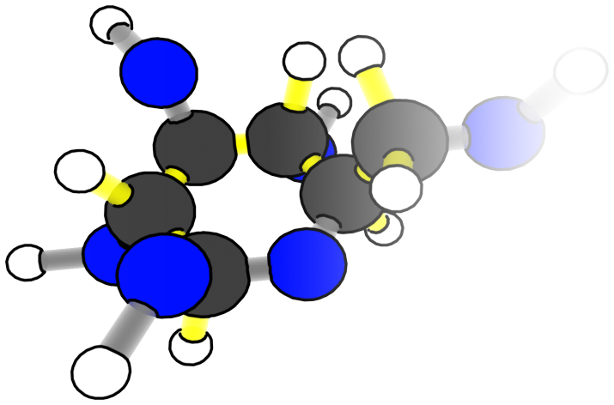
Plants use food in two ways
Materials for growth: Biosynthesis
Food
To Cells
Energy: Cellular respiration
Notes:
Review the ways in which plans use food.
Use Slides 3-5 of the PPT to review what students have learned about how plants use food.
Slide 3 reminds students that the unit is about all kinds of plants.
Slide 4 reminds students of structures that all plants have in common at different scales: cells that are made of molecules that are made of atoms.
Slide 5 reminds students that molecules can either be used for growth through biosynthesis or energy through cellular respiration.
Tell students that their explanations today will be to tell this whole story.

Slide 6
Explaining a Different Plant
You will now explain how a different plant uses food to grow, move and function. Here are the plants:
Lodgepole Pine
Prickly Pear
Spartina
Notes:
Have students complete the reading and corresponding explanation worksheet for one other plant.
Display slide 6 of the 6.1 Explaining Other Examples of Plants Growing and Moving PPT.
Give each student a copy of one of the 6.1 Other Plants Readings. About 1/3 of the students should read about each plant.
Have students complete the 6.1 Lodgepole Pine/Prickly Pear/Spartina Worksheet for the animal they read about.
Modifications: Students can work in pairs or groups with those who have the animal.

Slide 7
Comparing Ideas with a Group
Compare your ideas with someone who has the same animal
How are they alike?
How are they different?
Consider making revisions to your work based on your conversation with your partner or group.
Notes:
Have students who focused on the same plant form a group.
Display slide 7 of the 6.1 Explaining Other Examples of Plants Moving and Growing PPT.
In their groups, have students discuss their answers and come to consensus about their explanations and answers to the questions.

Slide 8
Sharing Ideas with the Class
Notes:
Have students share about how their plant grows, moves, and functions.
Display slide 8 of the 6.1 Explaining Other Examples of Plants Moving and Growing PPT.
Decide how to have students share the explanation for their plant.
Students who focused on the same plant can present to the whole class. They could make a poster to share.
Students can form groups of three with students who focused on each of three plants.

Slide 9
Similarities and Differences
What are differences between the different plants you read about?
What are similarities between the plants you read about?
Notes:
Have students discuss the similarities and differences between the plants.
Display slide 9 of the 6.1 Explaining Other Examples of Plants Moving and Growing PPT.
Have a class discussion about the similarities and differences between the three plants. Students should recognize that the chemical changes are similar in each case and that the rules about atoms and energy always apply.

Slide 10
Revisit Your Initial Ideas
Look back at your initial ideas about how a radish grows from Lesson 1.2.
What were your initial ideas?
How have your ideas changed?
What questions did you have?
Notes:
Have students revisit their initial ideas from Lesson 1.
Display slide 10. Have students look back at their initial ideas on 1.2 Expressing Ideas and Questions Tool about Plants Growing.
Ask them to share some of their initial ideas, their thinking about how their ideas have changed, and what their initial questions were.
Ask them how they would now answer their initial questions.

Slide 11
Revisit the Radish Investigation
Look back at the Radish Investigation Results and your Evidence-Based Arguments.
How do radishes grow, move, and function?
Notes:
Have students revisit their data and unanswered questions from the Radish Investigation.
Display slide 11. Have students review their data from 3.3 Plants in the Light and Dark Class Results 11 x 17 Poster.
Have students review their evidence-based arguments and unanswered questions from their 3.5 Evidence-Based Arguments Tool for Plants.
Have them consider how they would now answer their unanswered questions.

