Slide 1
Plants Unit Activity 5.1: Tracing the Process of Potatoes Growing: Biosynthesis
Carbon: Transformations in Matter and Energy
Environmental Literacy Project Michigan State University
Notes:
Image Credit: Craig Douglas, Michigan State University
Have students start to think about how plants grow.
Tell students that in today’s activity we will use molecular modeling to think about how plants grow through biosynthesis.
Open 5.3 Tracing the Process of Plants Growing: Biosynthesis PPT.

Slide 2
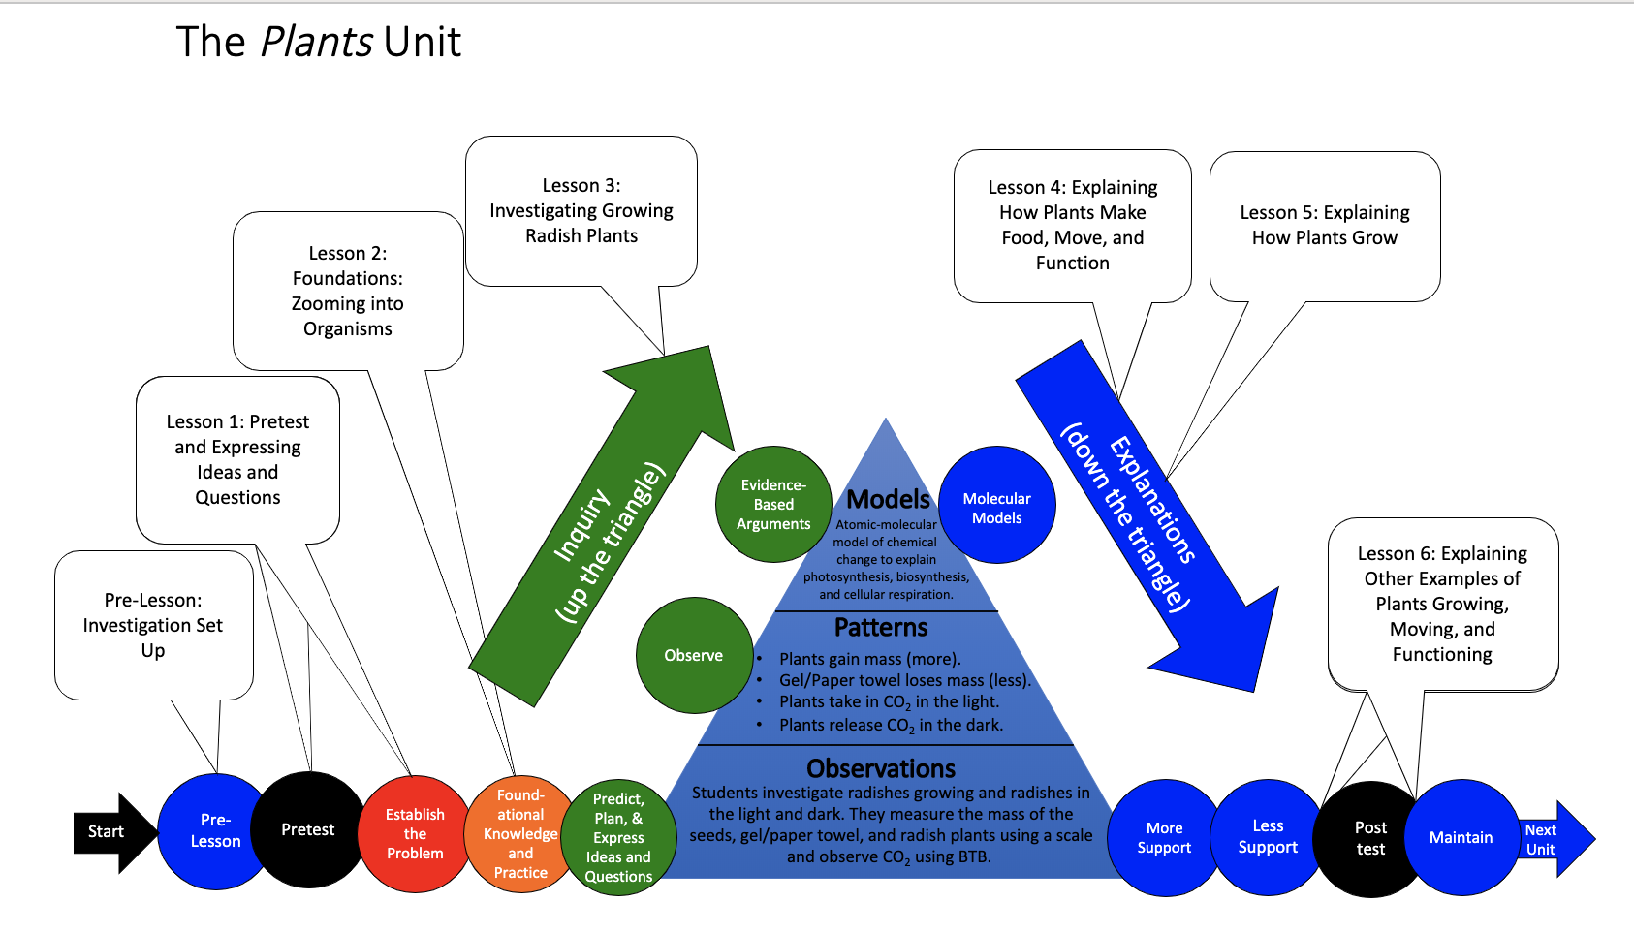
You are here
Notes:
Use the instructional model to show students where they are in the course of the unit.
Show slide 2 of the 5.1 Tracing the Process of Potatoes Growing Biosynthesis PPT.

Slide 3
Connecting Questions about Processes at Different Scales: Biosynthesis
Scale | Unanswered Questions
Macroscopic Scale | How do potatoes grow?
Microscopic Scale | How do potatoes’ cells use food grow?
Atomic-Molecular Scale | How are molecules from photosynthesis used for growth?
Notes:
Discuss Connecting Questions about Processes at Different Scales for Biosynthesis
Display slide 3 in the PPT.
Show students the short clip of a potato plant growing. Follow the link in the PPT, in the materials list, or here (https://www.youtube.com/watch?v=YbTFCh_XdYI).
Introduce students to the new driving question: How do potatoes grow?
Connect this question at the macroscopic scale to an unanswered question at the microscopic scale: How do potatoes’ cells use food to grow?
Connect this question at the microscopic scale to an unanswered question at the atomic-molecular scale: How are molecules from food used for growth? Where do the glucose molecules used in cellular respiration come from?
Assure students that we will be able to answer several of their unanswered questions by the end of today’s activity.

Slide 4
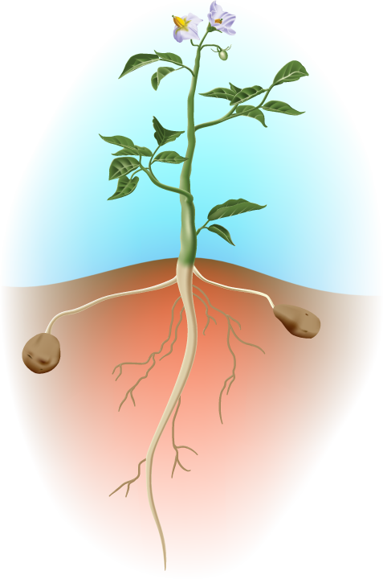
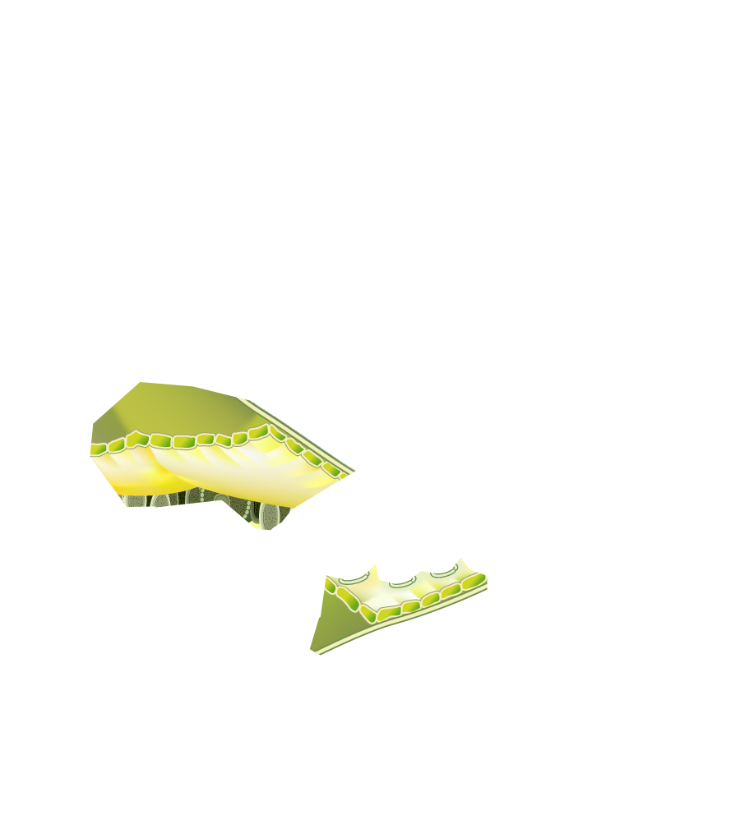
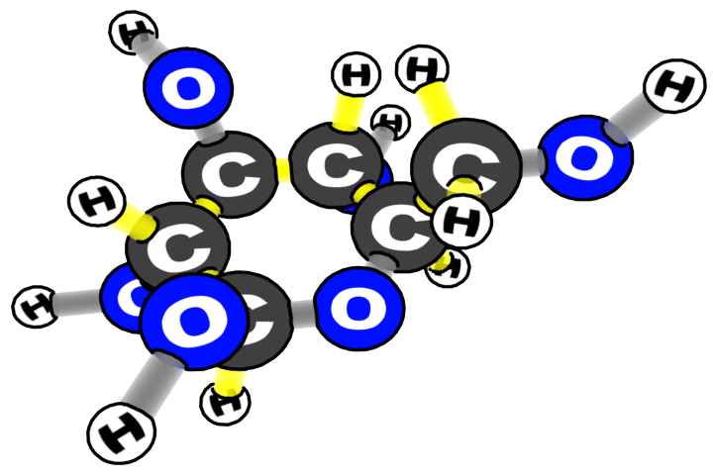
Plants make glucose from carbon dioxide and water in their leaves.
Notes:
Image Credit: Craig Douglas, Michigan State University
Have students discuss how atoms enter the plant get to plant cells in order for cells to get bigger and grow.
Use slides 4-6 to lead a discussion about how atoms enter the plant and get to plant cells.
Use slides 4-5 to ask students where glucose made from carbon dioxide and water in photosynthesis goes.
Use slide 6 to remind students that glucose moves from the leaves to all the cells of the plant to be used for growth or energy. They have already learned how plants use glucose for energy. In this activity, they will trace the chemical processes involved in growth.

Slide 5
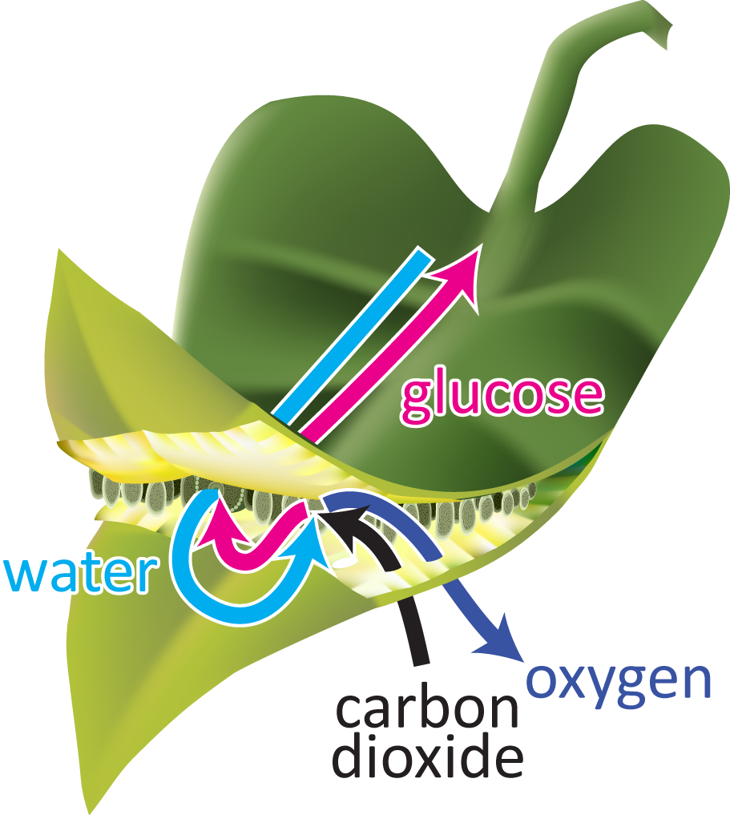
After CO₂ and H₂O go through photosynthesis to make glucose.
Where does the glucose go?
Notes:
Image Credit: Craig Douglas, Michigan State University
Have students discuss how atoms enter the plant get to plant cells in order for cells to get bigger and grow.
Use slides 4-6 to lead a discussion about how atoms enter the plant and get to plant cells.
Use slides 4-5 to ask students where glucose made from carbon dioxide and water in photosynthesis goes.
Use slide 6 to remind students that glucose moves from the leaves to all the cells of the plant to be used for growth or energy. They have already learned how plants use glucose for energy. In this activity, they will trace the chemical processes involved in growth.

Slide 6
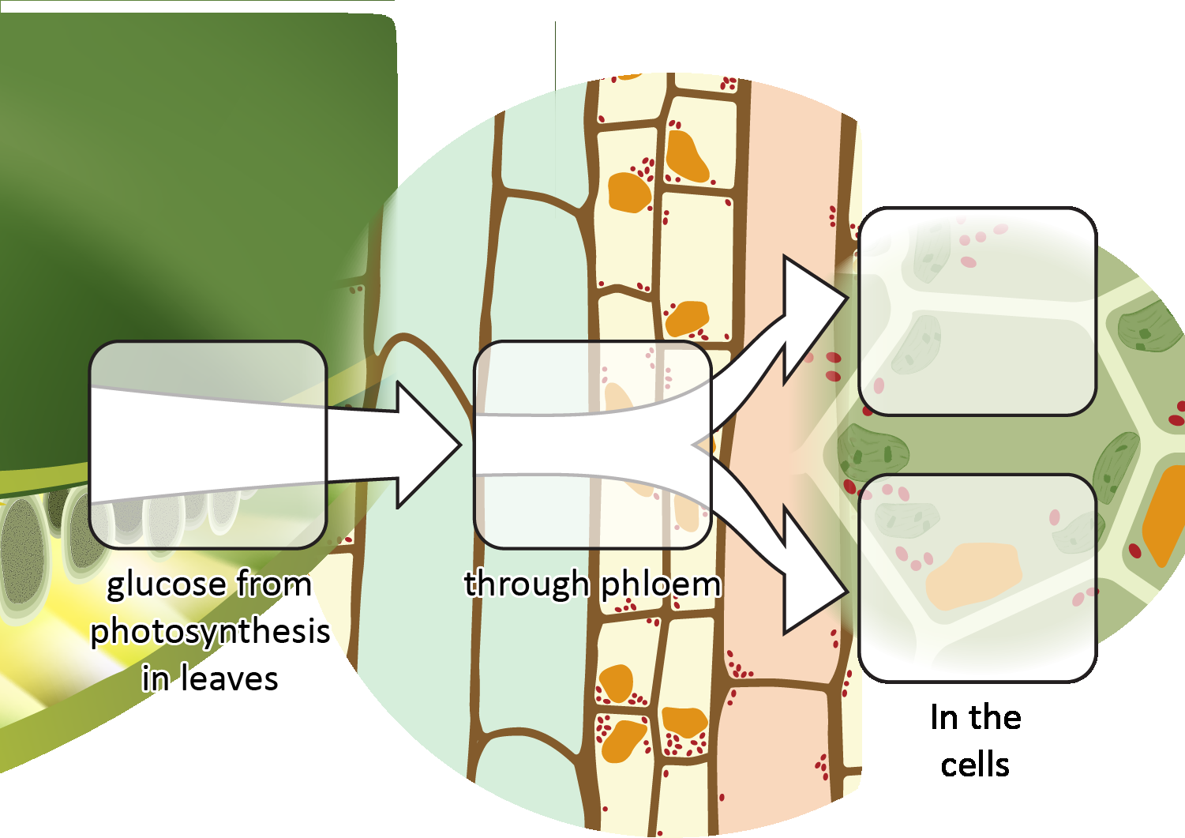
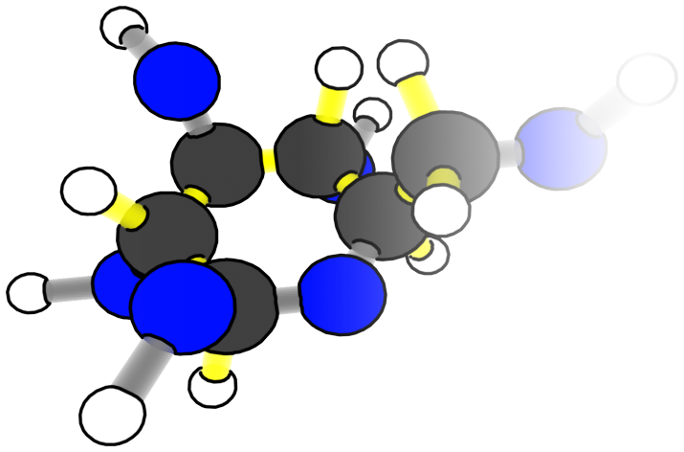
Plants use food in two ways
Materials for growth: Biosynthesis
Food
To Cells
Energy: Cellular respiration
Notes:
Image Credit: Craig Douglas, Michigan State University
Have students discuss how atoms enter the plant get to plant cells in order for cells to get bigger and grow.
Use slides 4-6 to lead a discussion about how atoms enter the plant and get to plant cells.
Use slides 4-5 to ask students where glucose made from carbon dioxide and water in photosynthesis goes.
Use slide 6 to remind students that glucose moves from the leaves to all the cells of the plant to be used for growth or energy. They have already learned how plants use glucose for energy. In this activity, they will trace the chemical processes involved in growth.

Slide 7
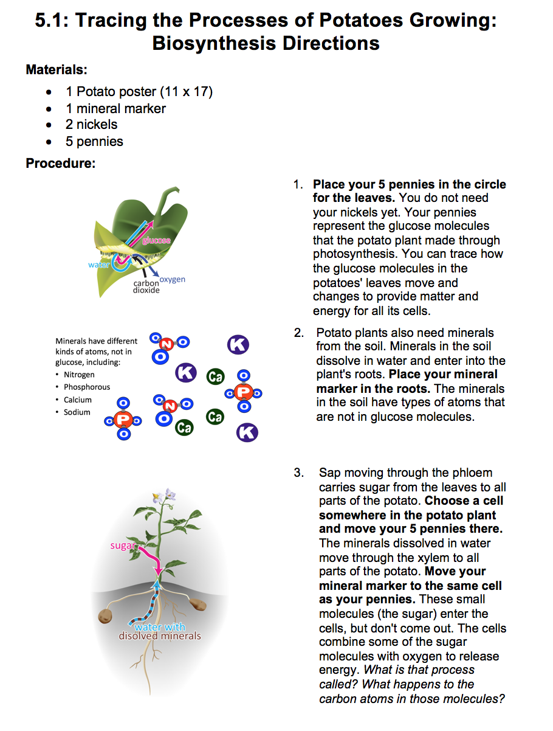
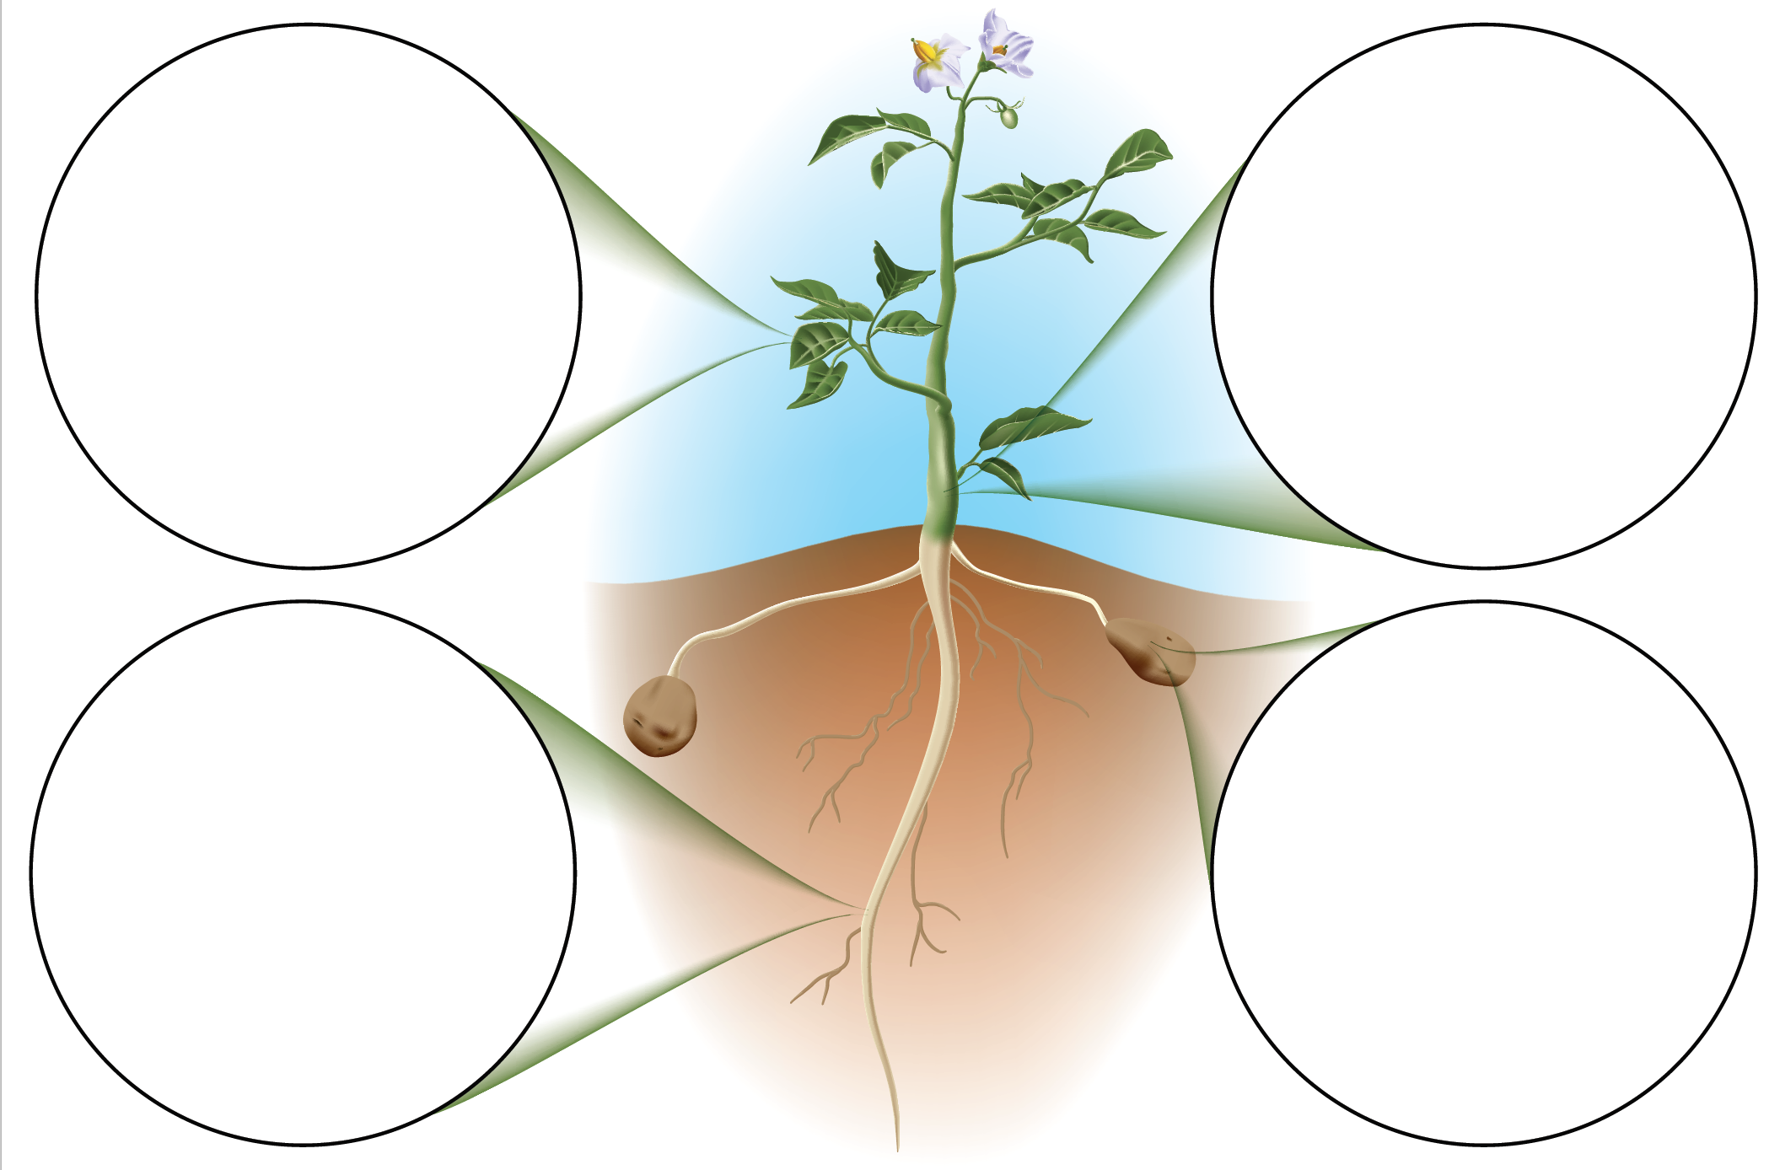
Trace the Process
Notes:
Have students trace the process of biosynthesis on the potato poster.
Display slide 7. Give each pair of students a Potato 11 x 17 Poster, a copy of the 5.1 Tracing the Process of Potatoes Growing: Biosynthesis Directions, 5 pennies, a nickel and several soil minerals (cut out from 5.1 Soil Minerals for Tracing the Process of Plants Growing). Explain that they will follow the directions to use their nickels and pennies to trace the path of how matter moves and changes in plants for growth.

Slide 8
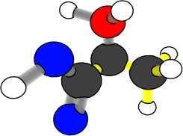
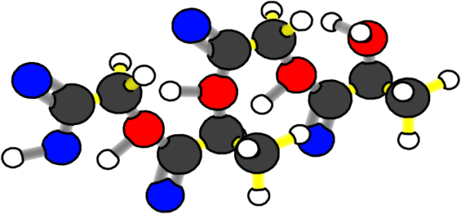
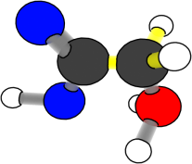
What happens to carbon atoms and chemical energy in biosynthesis?
Chemical change
Small organic molecules
Large organic molecules (+ water)
Reactants
Products
Notes:
Image Credit: Craig Douglas, Michigan State University
Show students an animation of biosynthesis and discuss the process.
Use slide 8-9 to show students what happens to carbon atoms and chemical energy when plants make large organic molecules.
Ask students what is happening to energy during biosynthesis. Listen to see if they notice that chemical potential energy is conserved in the C-C and C-H bonds through the chemical change.
Refer to the Digestion and Biosynthesis 11 x 17 Posters in your classroom to help students visualize the biosynthesis of small organic molecules to large organic molecules. You do not need to focus on what small organic molecules are combined to produce the large organic molecules (carbohydrates, fat, and proteins).
Make sure students understand that cells increase in size as they perform biosynthesis, because atoms enter the cells and do not leave. Eventually, the cells grow large enough to divide. The growth and division of cells results in plant growth.

Slide 9
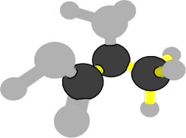
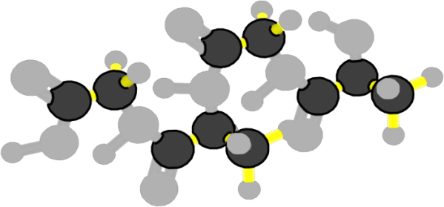
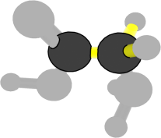
What happens to carbon atoms and chemical energy in biosynthesis?
Chemical change
Carbon atoms stay in organic molecules with high-energy bonds
Small organic molecules
Large molecules (+ water)
Reactants
Products
Notes:
Image Credit: Craig Douglas, Michigan State University
Show students an animation of biosynthesis and discuss the process.
Use slide 8-9 to show students what happens to carbon atoms and chemical energy when plants make large organic molecules.
Ask students what is happening to energy during biosynthesis. Listen to see if they notice that chemical potential energy is conserved in the C-C and C-H bonds through the chemical change.
Refer to the Digestion and Biosynthesis 11 x 17 Posters in your classroom to help students visualize the biosynthesis of small organic molecules to large organic molecules. You do not need to focus on what small organic molecules are combined to produce the large organic molecules (carbohydrates, fat, and proteins).
Make sure students understand that cells increase in size as they perform biosynthesis, because atoms enter the cells and do not leave. Eventually, the cells grow large enough to divide. The growth and division of cells results in plant growth.

Slide 10
How do plant cells use glucose?
Plant cells can combine glucose molecules with oxygen to release chemical energy in cellular respiration.
This is how all cells get the energy they need for their functions.
Plants use glucose to make large organic molecules so their cells can grow.
Plants use glucose chains to make cellulose and starch.
Starch stores energy in the plant body. When plants need energy they can use short glucose chains in starch.
Cellulose makes plants leaves and stems stronger.
Notes:
Discuss how plants use glucose molecules in other ways.
Use slides 10 to discuss the other ways plant cells use glucose molecules, which include cellular respiration and making cellulose and starch.

Slide 11
Where do the atoms in plants come from?
Work with a partner to complete the first chart about atoms.
Notes:
Transition to have students consider the atoms that make up plants.
Show slide 11 of the PPT. Pass out 5.1 Tracing the Atoms and Energy in Plants Worksheet to each student.
Tell students that now they have considered how molecules move through and are used by a plant they will now consider the atoms that make up plants.
Read the top portions of the worksheet with students.
Have students work with a partner to complete the first chart on the worksheet about atoms.

Slide 12
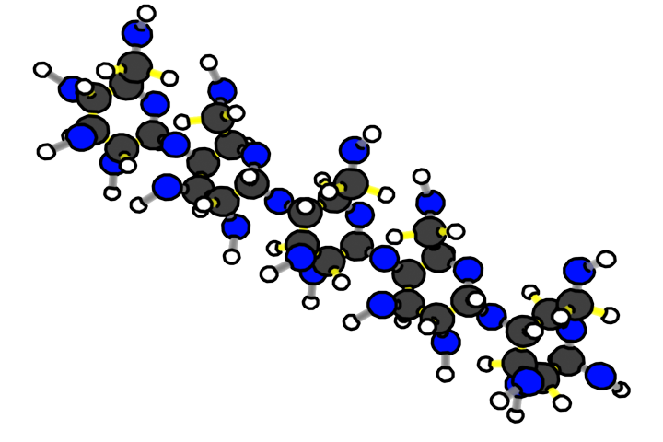
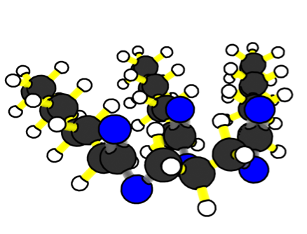
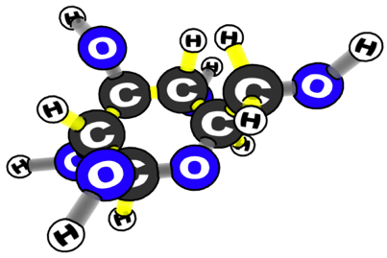
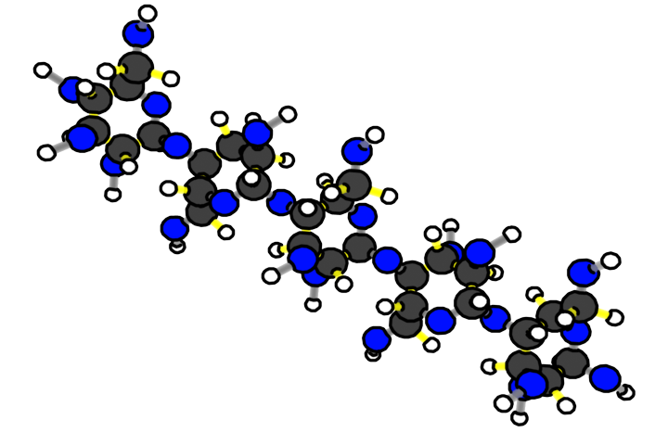
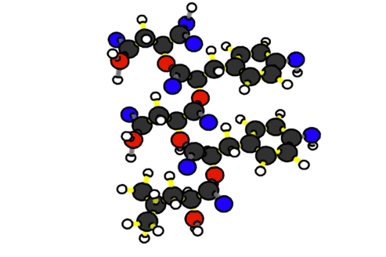
What molecules make up the dry mass of plants?
Remembering Nutrition Labels
STARCH
FATS
GLUCOSE (SUGAR)
CELLULOSE (FIBER)
PROTEIN
Garden plants are usually 85-90% water. The dry mass (10-15%) is mostly large organic molecules.
Notes:
Image Credit: Craig Douglas, Michigan State University
Have students identify where the atoms that make up plants come from.
Show slides 12-13 of the PPT.
Remind students that in Lesson 2 they learned about the molecules that make up cells and the atoms that make up the molecules.
Discuss the answers to the first chart on the worksheet. The atoms in the large organic molecules of plants all primarily come from the air. Some of the oxygen atoms do come from the soil and water, as well as air. The hydrogen atoms do come from soil and water. The other elements come from minerals in the soil.
Although some atoms come from soil, students should recognize at this point in the unit that the majority of the atoms in plants come from the air. You can remind students of the results of the plant investigation as further evidence.

Slide 13
What atoms make up the dry mass of plants?
Remembering Nutrition Labels
Molecules in plants:
STARCH
FATS
GLUCOSE (SUGAR)
CELLULOSE (FIBER)
PROTEIN
Atoms by dry mass: carbon (45%), oxygen (45%), hydrogen (6%), nitrogen (2%) and other elements (2%).
Notes:
Image Credit: Craig Douglas, Michigan State University
Have students identify where the atoms that make up plants come from.
Show slides 12-13 of the PPT.
Remind students that in Lesson 2 they learned about the molecules that make up cells and the atoms that make up the molecules.
Discuss the answers to the first chart on the worksheet. The atoms in the large organic molecules of plants all primarily come from the air. Some of the oxygen atoms do come from the soil and water, as well as air. The hydrogen atoms do come from soil and water. The other elements come from minerals in the soil.
Although some atoms come from soil, students should recognize at this point in the unit that the majority of the atoms in plants come from the air. You can remind students of the results of the plant investigation as further evidence.

Slide 14
Where does the energy in plants come from?
Work with a partner to complete the second chart about energy.
Notes:
Have students identify where the energy in plants come from.
Show slide 14 of the PPT.
Have students complete the second chart on 5.1 Tracing the Atoms and Energy in Plants Worksheet on energy with a partner.
Show slide 15. Discuss students’ answers together. Energy, in the form of light, is only found in the sunlight that plants take in. There is no energy in the water, air, or soil plants take in.

Slide 15
Energy
Does water have energy?
Does air have energy?
Does sunlight have energy?
Does soil have energy?
Notes:
Have students identify where the energy in plants come from.
Show slide 14 of the PPT.
Have students complete the second chart on 5.1 Tracing the Atoms and Energy in Plants Worksheet on energy with a partner.
Show slide 15. Discuss students’ answers together. Energy, in the form of light, is only found in the sunlight that plants take in. There is no energy in the water, air, or soil plants take in.

Slide 16
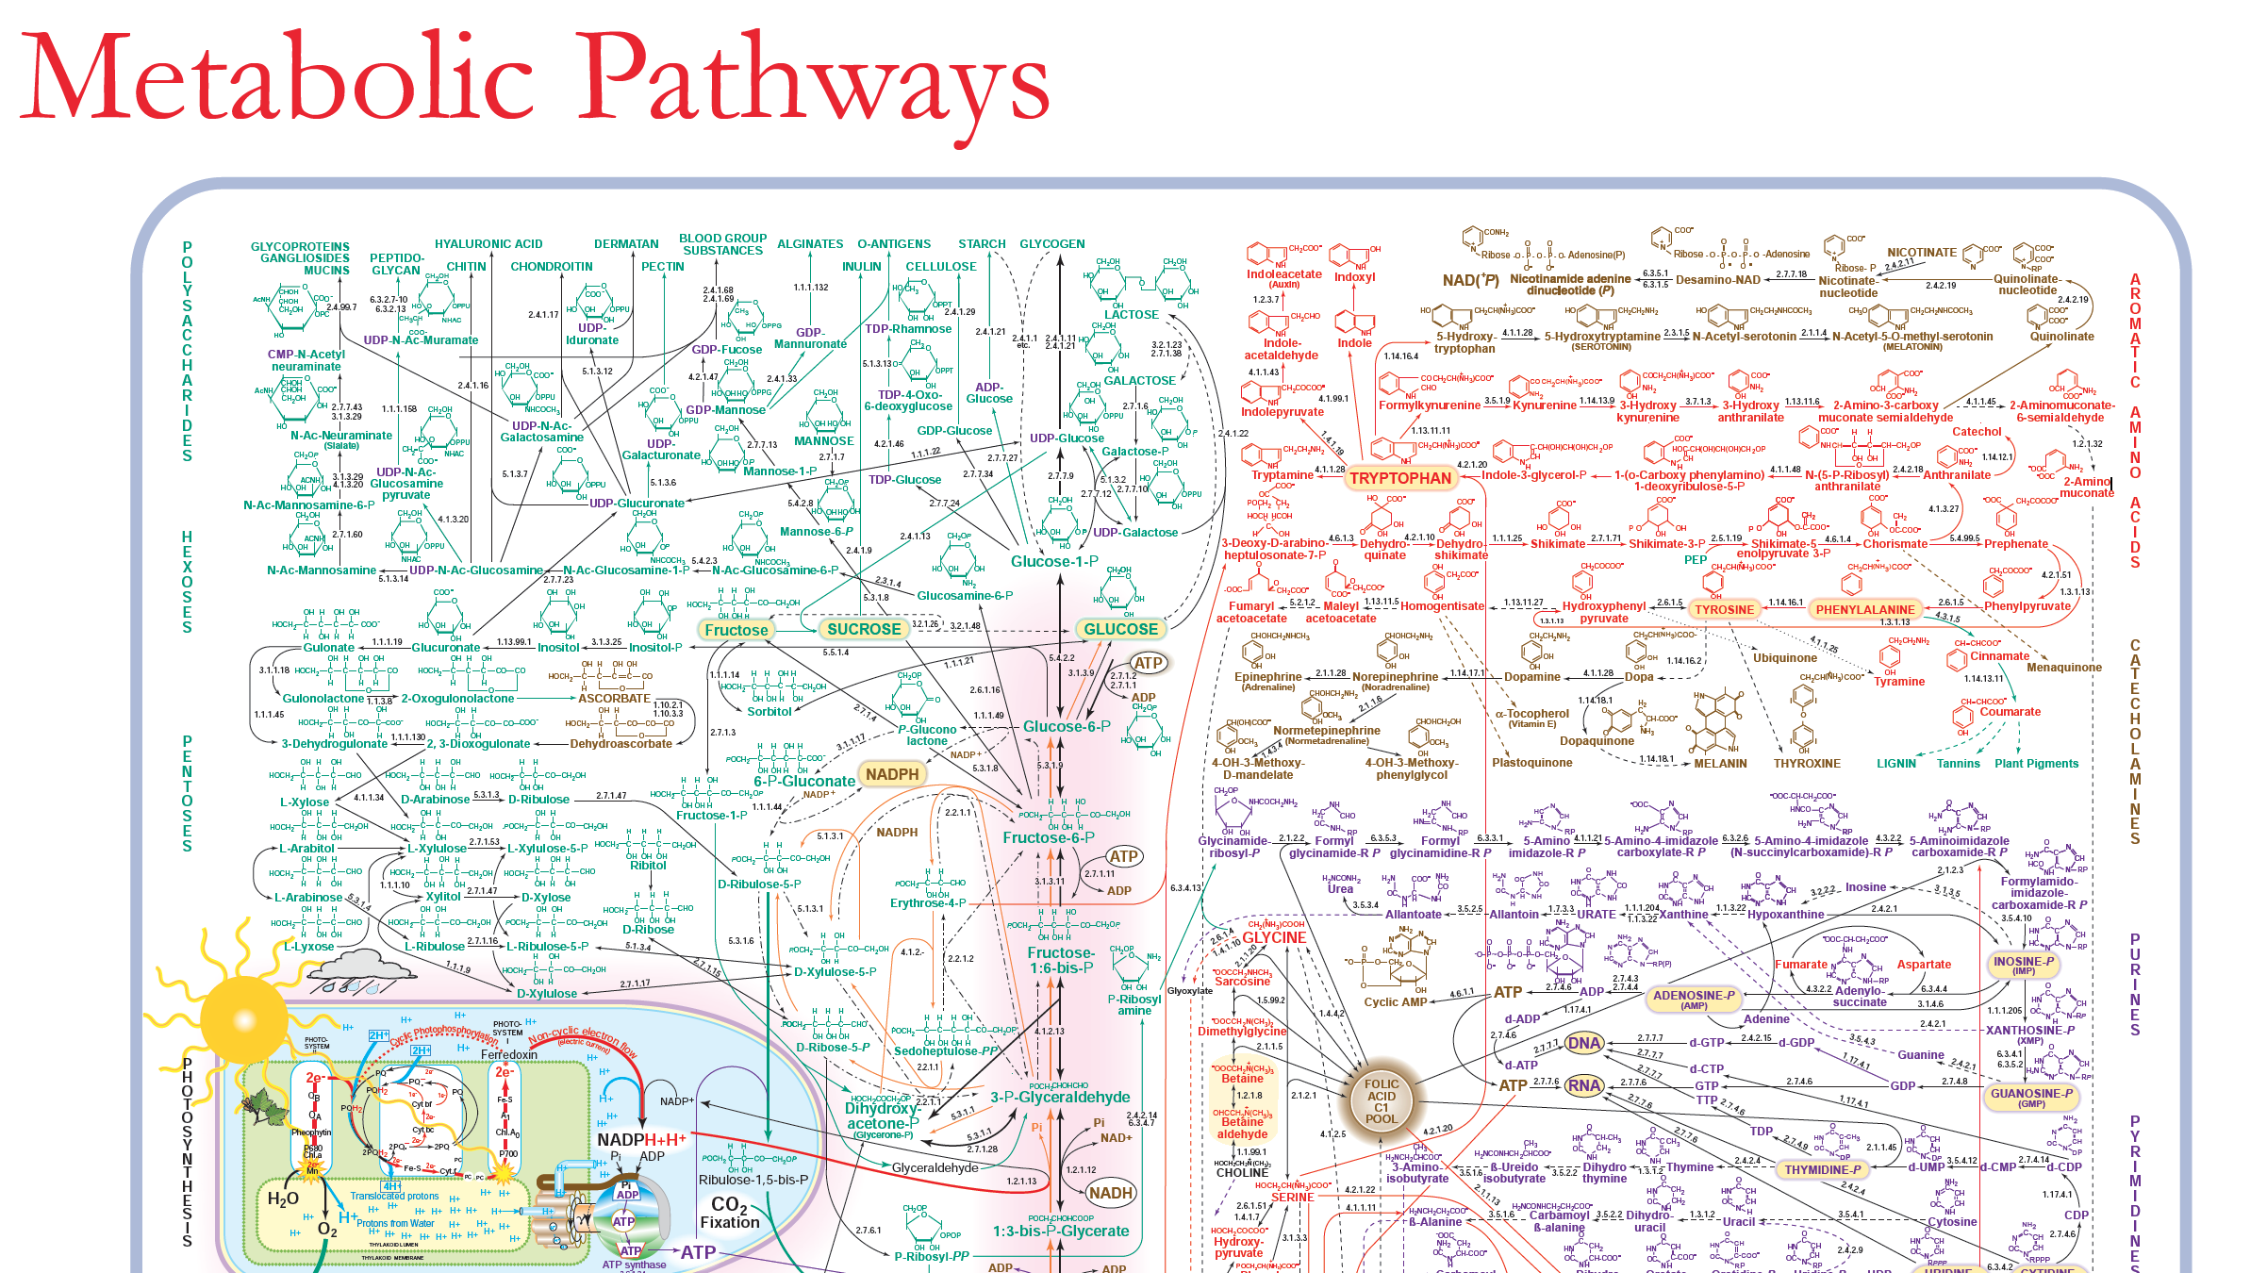
Additional Metabolic Pathways
There are many more metabolic pathways than the ones in this lesson. Look at the Metabolic Pathways poster to see some of them.
Notes:
Show students that there are many additional metabolic pathways.
Use slide 16 and the Metabolic Pathways Poster to show students that there are many more metabolic pathways besides what they learned about in this lesson.
This poster only shows pathways in which small organic molecules are changed into other small organic molecules. There are other pathways that change small organic molecules into large organic molecules.
Organisms are complex; this poster also offers students a glimpse of their complexity.

