Slide 1
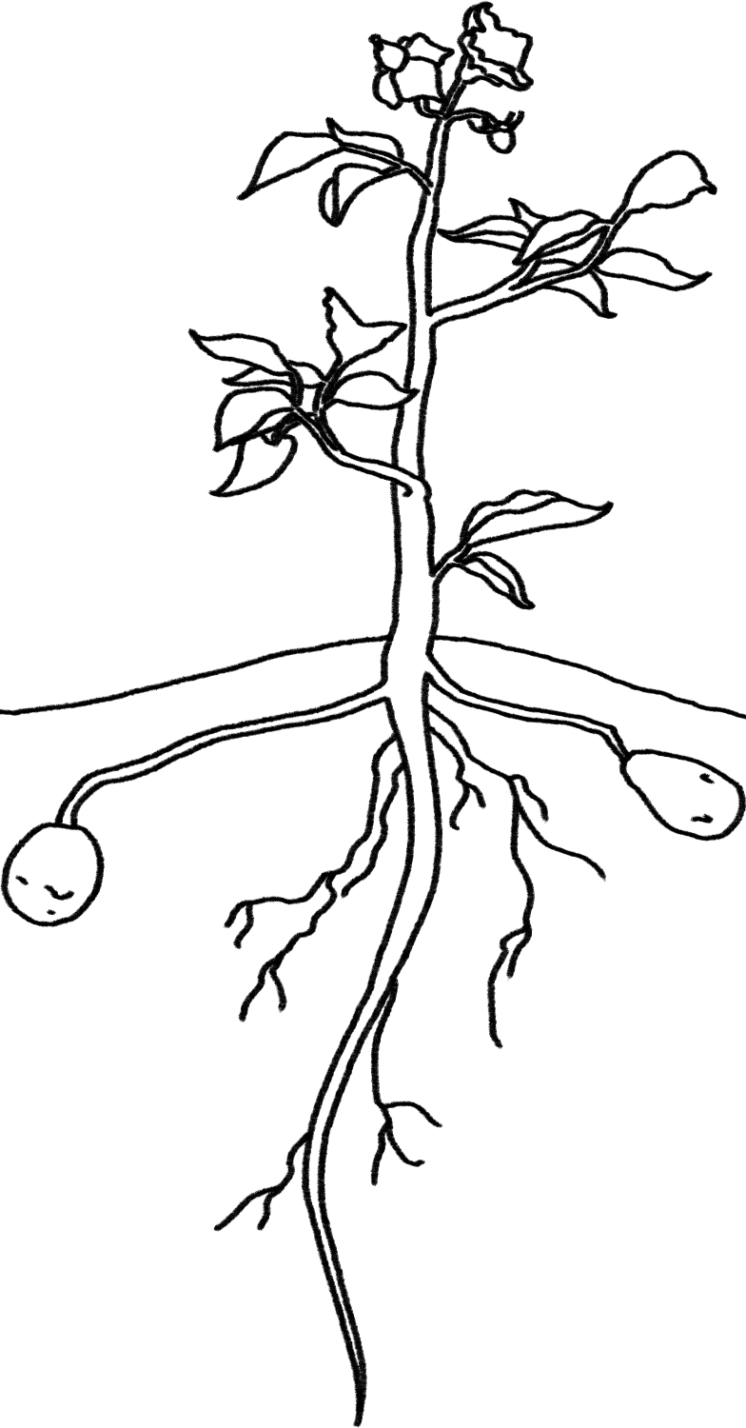
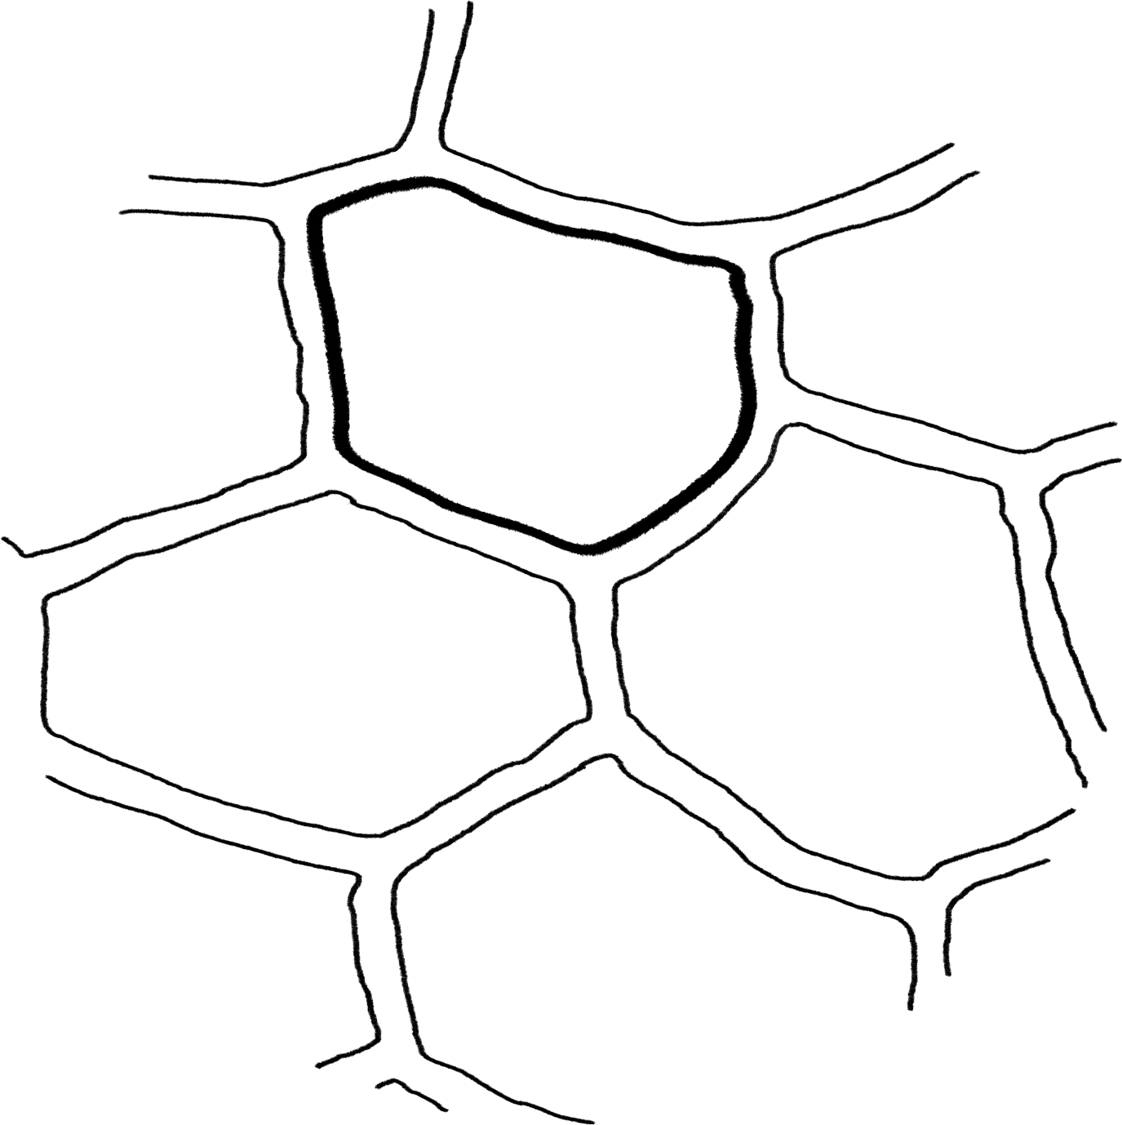
Plants Unit Activity 4.2: Explaining How Potatoes Move and Function: Cellular Respiration
Carbon: Transformations in Matter and Energy
Environmental Literacy Project Michigan State University
Notes:
Image Credit: Craig Douglas, Michigan State University

Slide 2
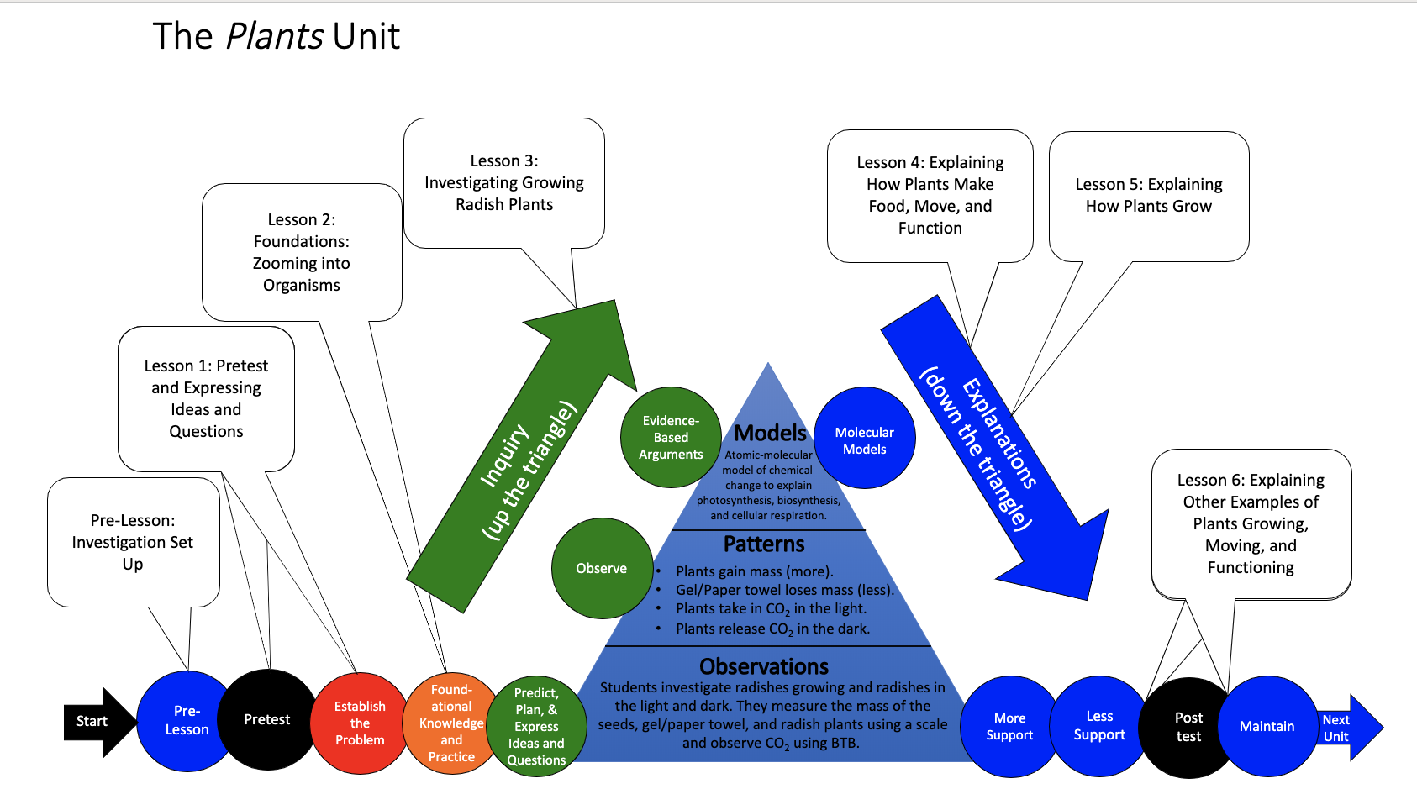
You are here
Notes:
Use the instructional model to show students where they are in the course of the unit.
Show slide 2 of the 4.2 Explaining How Potatoes Move and Function Cellular Respiration PPT.

Slide 3
Revisit your arguments
Think about what you know now that you didn’t know before. What have you learned?
Notes:
Revisit students’ arguments about what happens when plants grow.
Show slide 3 of the 4.2 Explaining How Potato Plants Move and Function: Cellular Respiration PPT.
Tell students that this activity’s purpose is to develop explanations for how plant’s use food to move and function.
Return each student’s copy of 3.5 Evidence-Based Arguments Tool for Plants and have them review their arguments before they completed the molecular modeling activity. Their arguments and unanswered questions should also apply to potato plants.
Ask them to think about what they know now that they didn’t know then.

Slide 4
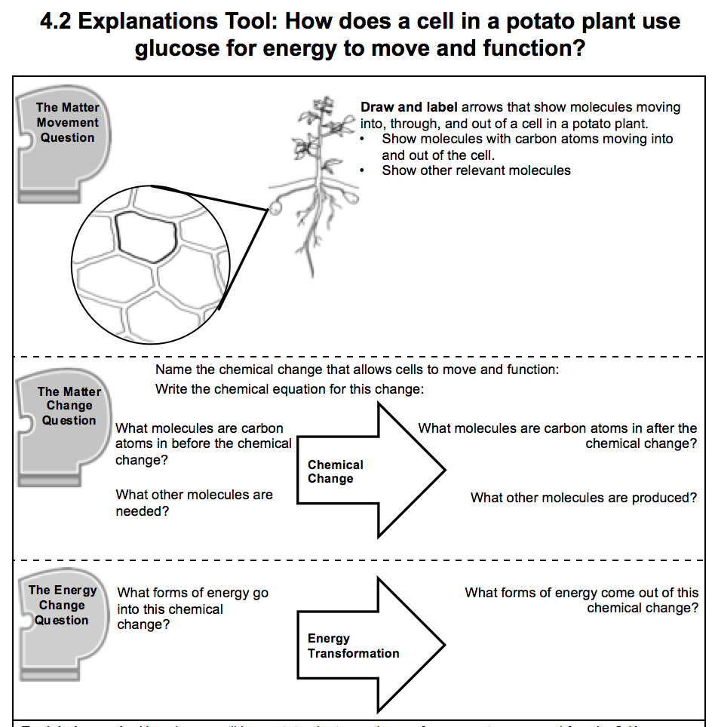
Constructing explanations
Consider the following as you construct your explanation:
Evidence from the investigation
What you learned from the molecular modeling activity
Three Questions Handout
Notes:
Have students complete the Explanations process tool.
Show slide 4 of the 4.2 Explaining How Potato Plants Move and Function: Cellular Respiration PPT. Give each student one copy of 4.2 Explanations Tool for Potato Cellular Respiration.
Tell students that in this part of the investigation, they will combine everything they learned about how plants use food to move and function into an explanation.
Remind them to consider both their evidence from the investigation as well as what they learned in the molecular modeling activity to construct their explanations.
Give students about 10 minutes to complete the Explanations process tool.

Slide 5
Comparing Ideas with a Partner
Compare your explanations for each of the Three Questions.
How are they alike?
How are they different?
Check your explanation with the middle- and right-hand columns of the Three Questions handout.
Consider making revisions to your explanation based on your conversation with your partner.
Notes:
Have students share explanations with each other.
Show slide 5 of the 4.2 Explaining How Potato Plants Move and Function: Cellular Respiration PPT. Divide students into pairs and have them compare explanations for the Three Questions and the final explanation on the process tool.
Have students use the Three Questions 11 x 17 Poster (or Handout) as a reference. Have students check their explanations with the middle and right-hand columns of the poster to make sure they are following the “rules.”

Slide 6
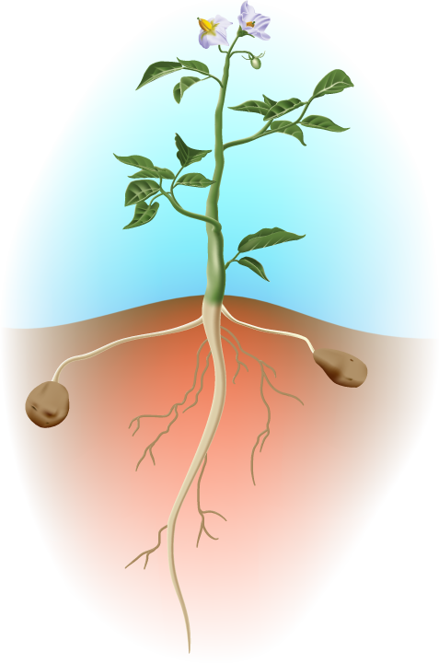
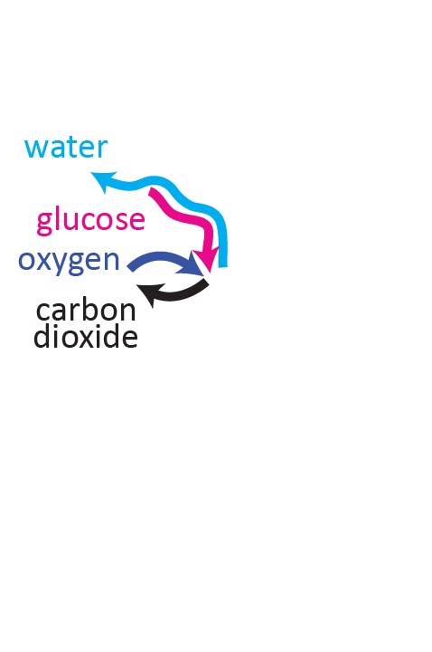
The Matter Movement Question
How do molecules move to the location of the chemical change?
How do molecules move away from the location of the chemical change?
Notes:
Image Credit: Craig Douglas, Michigan State University
Have students think about how cellular respiration answers the Matter Movement question.
Use slides 6-10 in the PPT to have the students discuss what is happening to matter during cellular respiration and to have them check their answers to the Matter Movement Question on their 4.2 Explanations Tool for Potato Cellular Respiration.
Show students slide 6-8 to have them think about where atoms are moving from and moving to during cellular respiration.
Display slides 9-10 to have students compare their answers to the Matter Movement Question with the answers on the slide. Students only need to have arrows showing the movement of molecules into and out of the cell. Have students use a different colored writing utensil to make any needed changes to their answers. Allow students to ask questions if they do not understand why their ideas are incorrect.
If students have model explanations to share, display student work and discuss. If students have common areas of weakness in their explanations, ask for a volunteer to share, display student work, and discuss ways of strengthening the response.

Slide 7
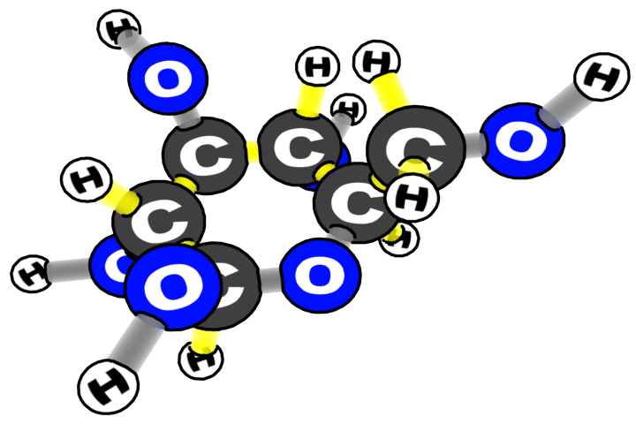
Which atoms and molecules move during cellular respiration?
water
carbon dioxide | oxygen
glucose
Notes:
Image Credit: Craig Douglas, Michigan State University
Have students think about how cellular respiration answers the Matter Movement question.
Use slides 6-10 in the PPT to have the students discuss what is happening to matter during cellular respiration and to have them check their answers to the Matter Movement Question on their 4.2 Explanations Tool for Potato Cellular Respiration.
Show students slide 6-8 to have them think about where atoms are moving from and moving to during cellular respiration.
Display slides 9-10 to have students compare their answers to the Matter Movement Question with the answers on the slide. Students only need to have arrows showing the movement of molecules into and out of the cell. Have students use a different colored writing utensil to make any needed changes to their answers. Allow students to ask questions if they do not understand why their ideas are incorrect.
If students have model explanations to share, display student work and discuss. If students have common areas of weakness in their explanations, ask for a volunteer to share, display student work, and discuss ways of strengthening the response.

Slide 8
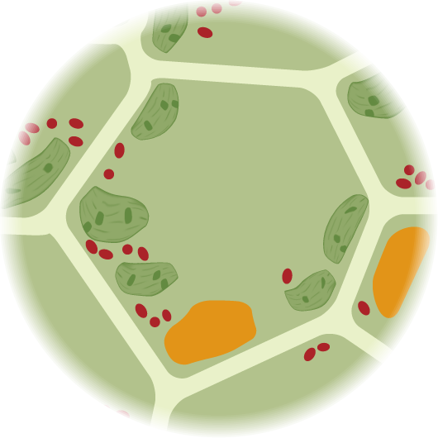
How do glucose, oxygen, water, and carbon dioxide move through the potato?
water
carbon dioxide | oxygen
glucose
Notes:
Image Credit: Craig Douglas, Michigan State University
Have students think about how cellular respiration answers the Matter Movement question.
Use slides 6-10 in the PPT to have the students discuss what is happening to matter during cellular respiration and to have them check their answers to the Matter Movement Question on their 4.2 Explanations Tool for Potato Cellular Respiration.
Show students slide 6-8 to have them think about where atoms are moving from and moving to during cellular respiration.
Display slides 9-10 to have students compare their answers to the Matter Movement Question with the answers on the slide. Students only need to have arrows showing the movement of molecules into and out of the cell. Have students use a different colored writing utensil to make any needed changes to their answers. Allow students to ask questions if they do not understand why their ideas are incorrect.
If students have model explanations to share, display student work and discuss. If students have common areas of weakness in their explanations, ask for a volunteer to share, display student work, and discuss ways of strengthening the response.

Slide 9
Matter Movement
Do you have:
an arrow showing glucose going into the plant’s cell?
Glucose
Notes:
Image Credit: Craig Douglas, Michigan State University
Display slides 9-10 to have students compare their answers to the Matter Movement Question with the answers on the slide. Students only need to have arrows showing the movement of molecules into and out of the cell. Have students use a different colored writing utensil to make any needed changes to their answers. Allow students to ask questions if they do not understand why their ideas are incorrect.
If students have model explanations to share, display student work and discuss. If students have common areas of weakness in their explanations, ask for a volunteer to share, display student work, and discuss ways of strengthening the response.

Slide 10
Matter Movement
Do you have:
an arrow showing oxygen or O₂ going into into the plant’s cell?
O₂
Glucose
Notes:
Image Credit: Craig Douglas, Michigan State University
Display slides 9-10 to have students compare their answers to the Matter Movement Question with the answers on the slide. Students only need to have arrows showing the movement of molecules into and out of the cell. Have students use a different colored writing utensil to make any needed changes to their answers. Allow students to ask questions if they do not understand why their ideas are incorrect.
If students have model explanations to share, display student work and discuss. If students have common areas of weakness in their explanations, ask for a volunteer to share, display student work, and discuss ways of strengthening the response.

Slide 11
The Matter Change Question
Chemical change
How are atoms in molecules being rearranged into different molecules inside a muscle cell during cellular respiration?
Notes:
Image Credit: Craig Douglas, Michigan State University
Have students think about how cellular respiration also answers the Matter Change Question.
Show slide 11 to have student consider the Matter Change Question.
Display slides 12-13 to have students compare their answers to the Matter Change Question on the 4.2 Explanations Tool for Potato Cellular Respiration with the answers on the slide. Have students use a different colored writing utensil to make any needed changes to their answers. Allow students to ask questions if they do not understand why their ideas are incorrect.
If students have model explanations to share, display student work and discuss. If students have common areas of weakness in their explanations, ask for a volunteer to share, display student work, and discuss ways of strengthening the response.

Slide 12
Matter Change
What is the name of the chemical change that allows cells to move and function?
Cellular Respiration
Write the chemical equation for this change:
C₆H₁₂O₆ + 6 O₂ → 6 CO₂ + 6 H₂O
Notes:
Image Credit: Craig Douglas, Michigan State University
Have students think about how cellular respiration also answers the Matter Change Question.
Show slide 11 to have student consider the Matter Change Question.
Display slides 12-13 to have students compare their answers to the Matter Change Question on the 4.2 Explanations Tool for Potato Cellular Respiration with the answers on the slide. Have students use a different colored writing utensil to make any needed changes to their answers. Allow students to ask questions if they do not understand why their ideas are incorrect.
If students have model explanations to share, display student work and discuss. If students have common areas of weakness in their explanations, ask for a volunteer to share, display student work, and discuss ways of strengthening the response.

Slide 13
Matter Change
What molecules are carbon atoms in before the chemical change?
Glucose
What other molecules are needed?
Oxygen or O₂
What molecules are carbon atoms in after the chemical change?
Carbon dioxide or CO₂
What other molecules are produced?
Water or H₂O
Chemical Change
Notes:
Image Credit: Craig Douglas, Michigan State University
Have students think about how cellular respiration also answers the Matter Change Question.
Show slide 11 to have student consider the Matter Change Question.
Display slides 12-13 to have students compare their answers to the Matter Change Question on the 4.2 Explanations Tool for Potato Cellular Respiration with the answers on the slide. Have students use a different colored writing utensil to make any needed changes to their answers. Allow students to ask questions if they do not understand why their ideas are incorrect.
If students have model explanations to share, display student work and discuss. If students have common areas of weakness in their explanations, ask for a volunteer to share, display student work, and discuss ways of strengthening the response.

Slide 14
The Energy Change Question
Scale | Unanswered Questions
Macroscopic Scale | How do potatoes move and function?
Microscopic Scale | How do potatoes’ cells get energy to help it to move and function?
Atomic-Molecular Scale | What chemical change provides energy to the potato cells?
Notes:
Image Credit: Craig Douglas, Michigan State University
Discuss how cellular respiration helps to answer the Energy Change Question.
Show slide 14 to have student consider the Energy Change Question.
Display slide 15 to have students compare their answers to the Energy Change Question on the 4.2 Explanations Tool for Potato Cellular Respiration with the answers on the slide. Have students use a different colored writing utensil to make any needed changes to their answers. Allow students to ask questions if they do not understand why their ideas are incorrect.
If students have model explanations to share, display student work and discuss. If students have common areas of weakness in their explanations, ask for a volunteer to share, display student work, and discuss ways of strengthening the response.
Have students consider how these answers address Energy Change at macroscopic, atomic-molecular, and cellular scales.

Slide 15
Energy Change
What forms of energy go into this chemical change?
Chemical energy or C-C and C-H bonds
What forms of energy come out of this chemical change?
Motion (or cellular function) and heat energy
Energy Transformation
Notes:
Discuss how cellular respiration helps to answer the Energy Change Question.
Show slide 14 to have student consider the Energy Change Question.
Display slide 15 to have students compare their answers to the Energy Change Question on the 4.2 Explanations Tool for Potato Cellular Respiration with the answers on the slide. Have students use a different colored writing utensil to make any needed changes to their answers. Allow students to ask questions if they do not understand why their ideas are incorrect.
If students have model explanations to share, display student work and discuss. If students have common areas of weakness in their explanations, ask for a volunteer to share, display student work, and discuss ways of strengthening the response.
Have students consider how these answers address Energy Change at macroscopic, atomic-molecular, and cellular scales.

Slide 16
Matter Movement
Do you have:
an arrow showing carbon dioxide or CO₂ leaving the plant’s cell?
an arrow showing water or H₂O leaving the plant’s cells?
O₂
Glucose
CO₂
H₂O

Slide 17
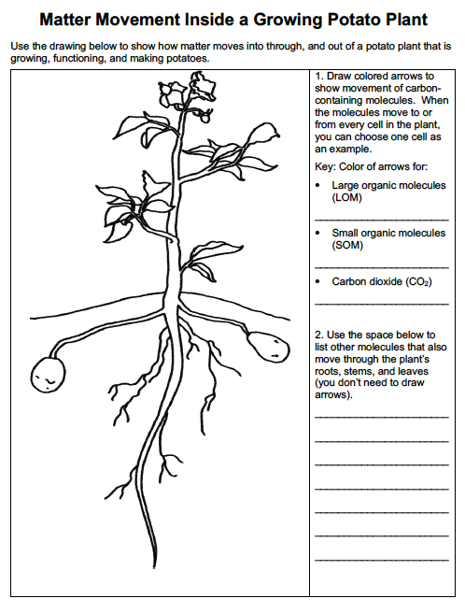
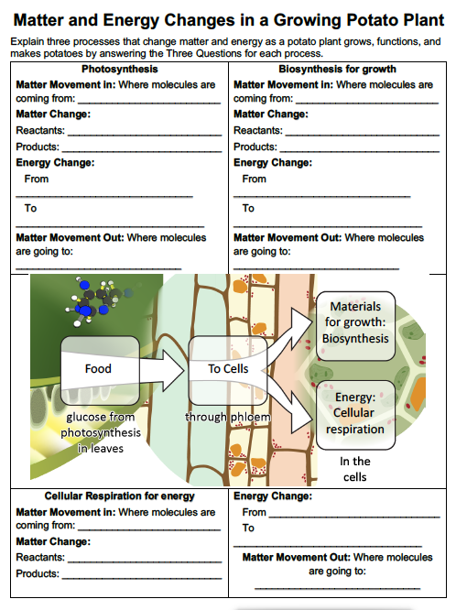
How does cellular respiration fit into the story of how plants grow and function? Using the Plants Matter Tracing Tool
Notes:
Using the Plants Matter Tracing Tool, have students answer the question: How does cellular respiration fit into the story of how plants grow and function.
Show slide 17 and have students pull out their Plants Matter Tracing Tool. Allow students to complete their tools, keeping in mind the discussion that just took place.
Display slide 18 to have students check their arrows on the Plants Matter Tracing Tool. Allow for corrections if necessary.

Slide 18
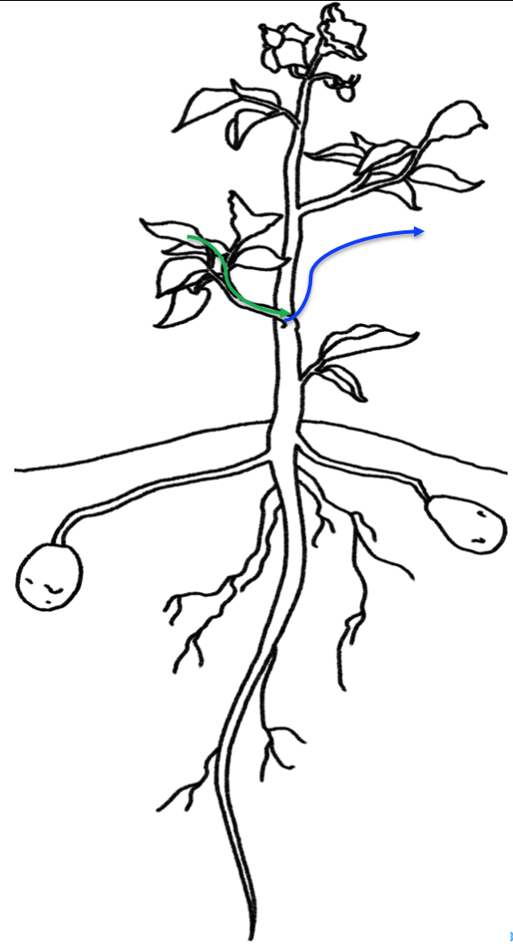
Drawing arrows to show matter movement for cellular respiration
Green arrow: Sugar moves from leaves to all plant cells (using a stem cell as an example)
Blue arrow: Carbon dioxide leaves the plant through the surfaces of its stem, roots, and leaves.
Notes:
Using the Plants Matter Tracing Tool, have students answer the question: How does cellular respiration fit into the story of how plants grow and function.
Show slide 17 and have students pull out their Plants Matter Tracing Tool. Allow students to complete their tools, keeping in mind the discussion that just took place.
Display slide 18 to have students check their arrows on the Plants Matter Tracing Tool. Allow for corrections if necessary.
(Optional) Have students critique example explanations
Have students look at two handouts: (a) the Three Questions Handout, and (b) the Plants Example Explanations Handout.
Ask students to evaluate the two example explanations of cellular respiration on the Plants Example Explanations Handout: Which explanation is better? Why?
Have students use the Three Questions Explanation Checklist on the back of the Three Questions Handout to justify their critiques of the explanations.
Have students read about photosynthesis.
Pass out 4.2 How do Plants Get the Energy They Need to Move and Function? Reading. The reading provides a summary explanation of cellular respiration and additional information about how plants absorb and reflect light. Students can complete the reading using the Questions, Connections, Questions Student Reading Strategy. See the Engaging Students with Readings and the Questions, Connections, Questions Reading Strategy Educator Resource document for information about how to engage students with this strategy.
After pairs are finished reading, have students share with the class what they found interesting and any questions they have.

Slide 19
Telling the Whole Story
Question: How does a cell in the potato plant use food to move and function?
Does your story include these parts? (Check the back of the Three Questions Handout.)
Matter movement: Glucose and oxygen enter into the cell.
Matter change: Glucose react with oxygen to produce carbon dioxide and water.
Energy change: Chemical energy in sugar or glucose is transformed into energy for motion (and cell functioning) and heat.
Matter movement: Carbon dioxide and water leave the cell.
Notes:
(Optional) Have students critique example explanations
Display Slide 19 of the PPT. Have students look at two handouts: (a) the Three Questions Handout, and (b) the Plants Example Explanations Handout.
Ask students to evaluate the two example explanations of photosynthesis on the Plants Example Explanations Handout: Which explanation is better? Why?
Have students use the Three Questions Explanation Checklist on the back of the Three Questions Handout to justify their critiques of the explanations.
Have students critique and improve their full explanations.
Display slide 19 of the PPT for the full explanation. Have students use the Three Questions Explanation Checklist on the back of the Three Questions Handout to check that their story includes each of the parts (matter movement, matter change, energy change, and matter movement) and answers the prompt in a cohesive way.
If students don’t have all four parts in their explanation, instruct them to add to their explanation using a different colored writing utensil.
If students have model explanations to share, display student work and discuss. If students have common areas of weakness in their explanations, ask for a volunteer to share, display student work, and discuss ways of strengthening the response.

Slide 20
How have your ideas changed?
Gather together your process tools for the unit (Expressing Ideas and Questions Tool, Predictions and Planning Tool, & Evidence-Based Argument Tool).
How have your ideas changed related to:
Scale?
Movement?
Carbon?
What do you know now about how plants use glucose to move and function that you didn’t know before the investigation?
Notes:
Lead a discussion about how student ideas have changed over time.
Show slide 20 of the 4.2 Explaining Potato Cellular Respiration PPT. Have students look back over their process tools for this unit.
Have students consider how their ideas changed with regard to scale, movement, and carbon.
What do they know now about how plants use food to move and function that they didn’t know before the investigation?

Slide 21
Revisit unanswered questions
Which unanswered questions can you now answer with what you understand about cellular respiration?
Which questions are left unanswered?
Do you have any new questions to add?
Notes:
Revisit unanswered questions.
Show slide 21. Have students look at their 3.5 Evidence-Based Arguments Tool for Plants. Display the class list of unanswered questions from Activity 3.5.
Ask students which of their unanswered questions they can now answer with their understanding of Cellular Respiration. Which ones are left unanswered? Do they have any new questions to add to the list?

Slide 22
Exit Ticket
Conclusions
How do matter and energy change during cellular respiration?
Predictions
Where do you think the glucose for cellular respiration comes from?
Notes:
Have students complete an exit ticket.
Show slide 22 of the 4.2 Explaining How Potato Plants Move and Function: Cellular Respiration PPT.
Conclusions: How do matter and energy change during cellular respiration?
Predictions: Where do you think the glucose for cellular respiration comes from?
On a sheet of paper or a sticky note, have students individually answer the exit ticket questions. Depending on time, you may have students answer both questions, assign students to answer a particular question, or let students choose one question to answer. Collect and review the answers.
The conclusions question will provide you with information about what your students are taking away from the activity. Student answers to the conclusions question can be used on the Driving Question Board (if you are using one). The predictions question allows students to begin thinking about the next activity and allows you to assess their current ideas as you prepare for the next activity. Student answers to the predictions question can be used as a lead in to the next activity.

