Slide 1
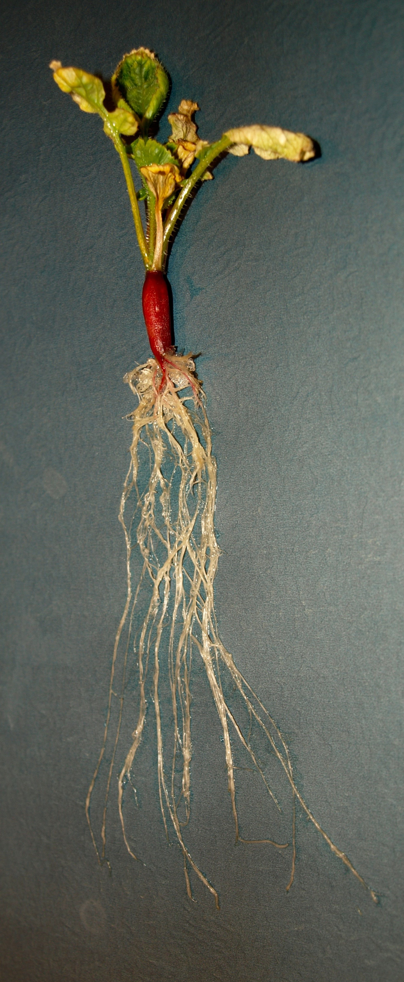
Plants Unit Activity 3.4 Observing Plants’ Mass Changes, Part 2
Carbon: Transformations in Matter and Energy
Environmental Literacy Project Michigan State University

Slide 2
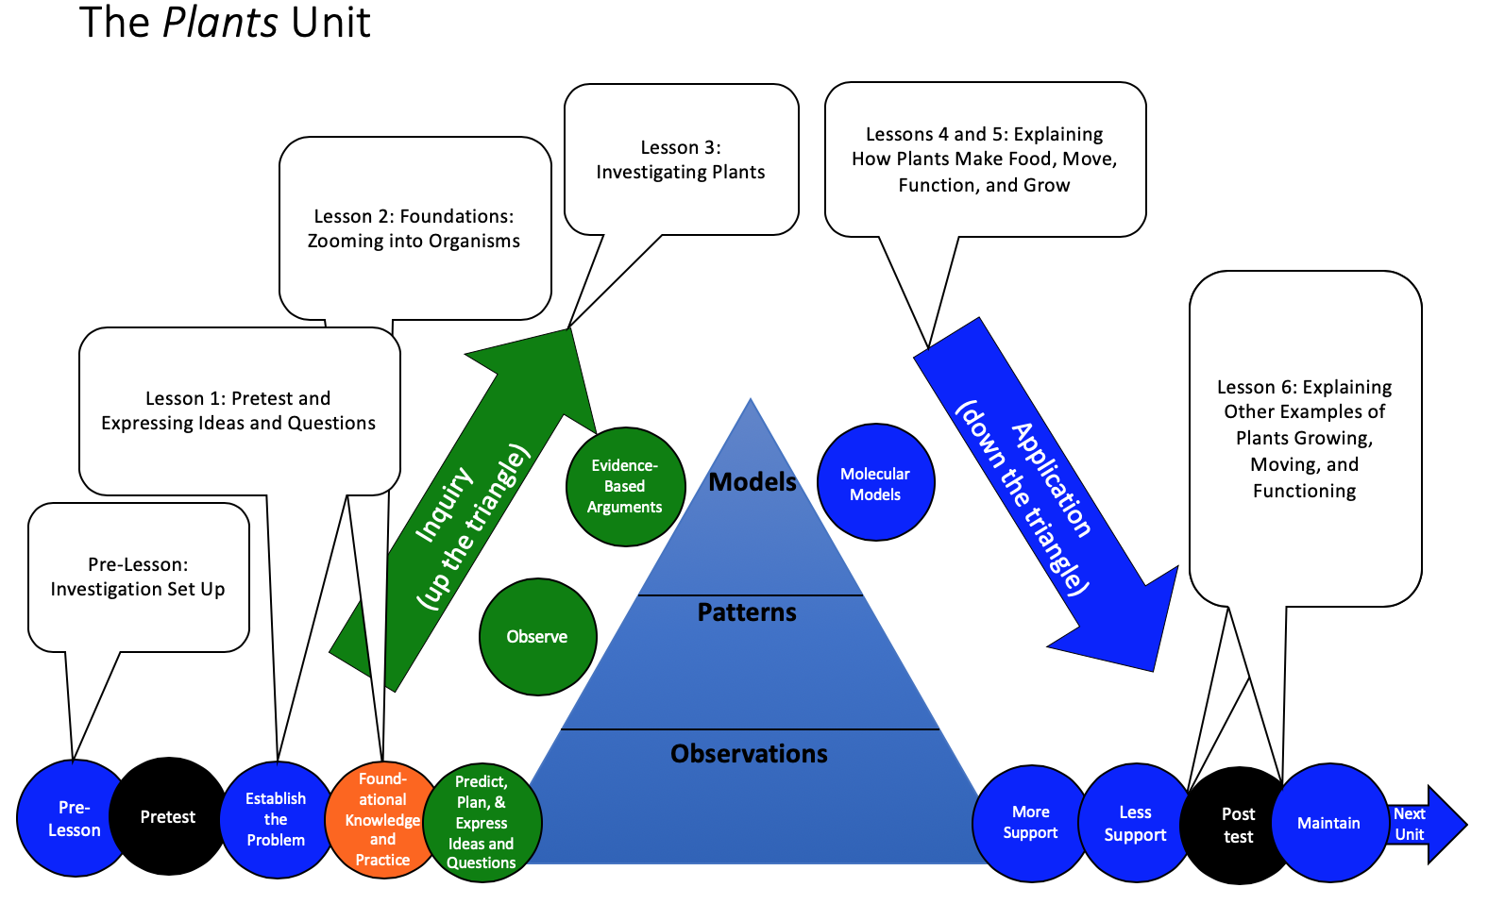
You are here
Notes:
Use the instructional model to show students where they are in the course of the unit.
Show slide 2 of the 3.4 GL Observing Plants Mass Change Part 2 PPT.

Slide 3
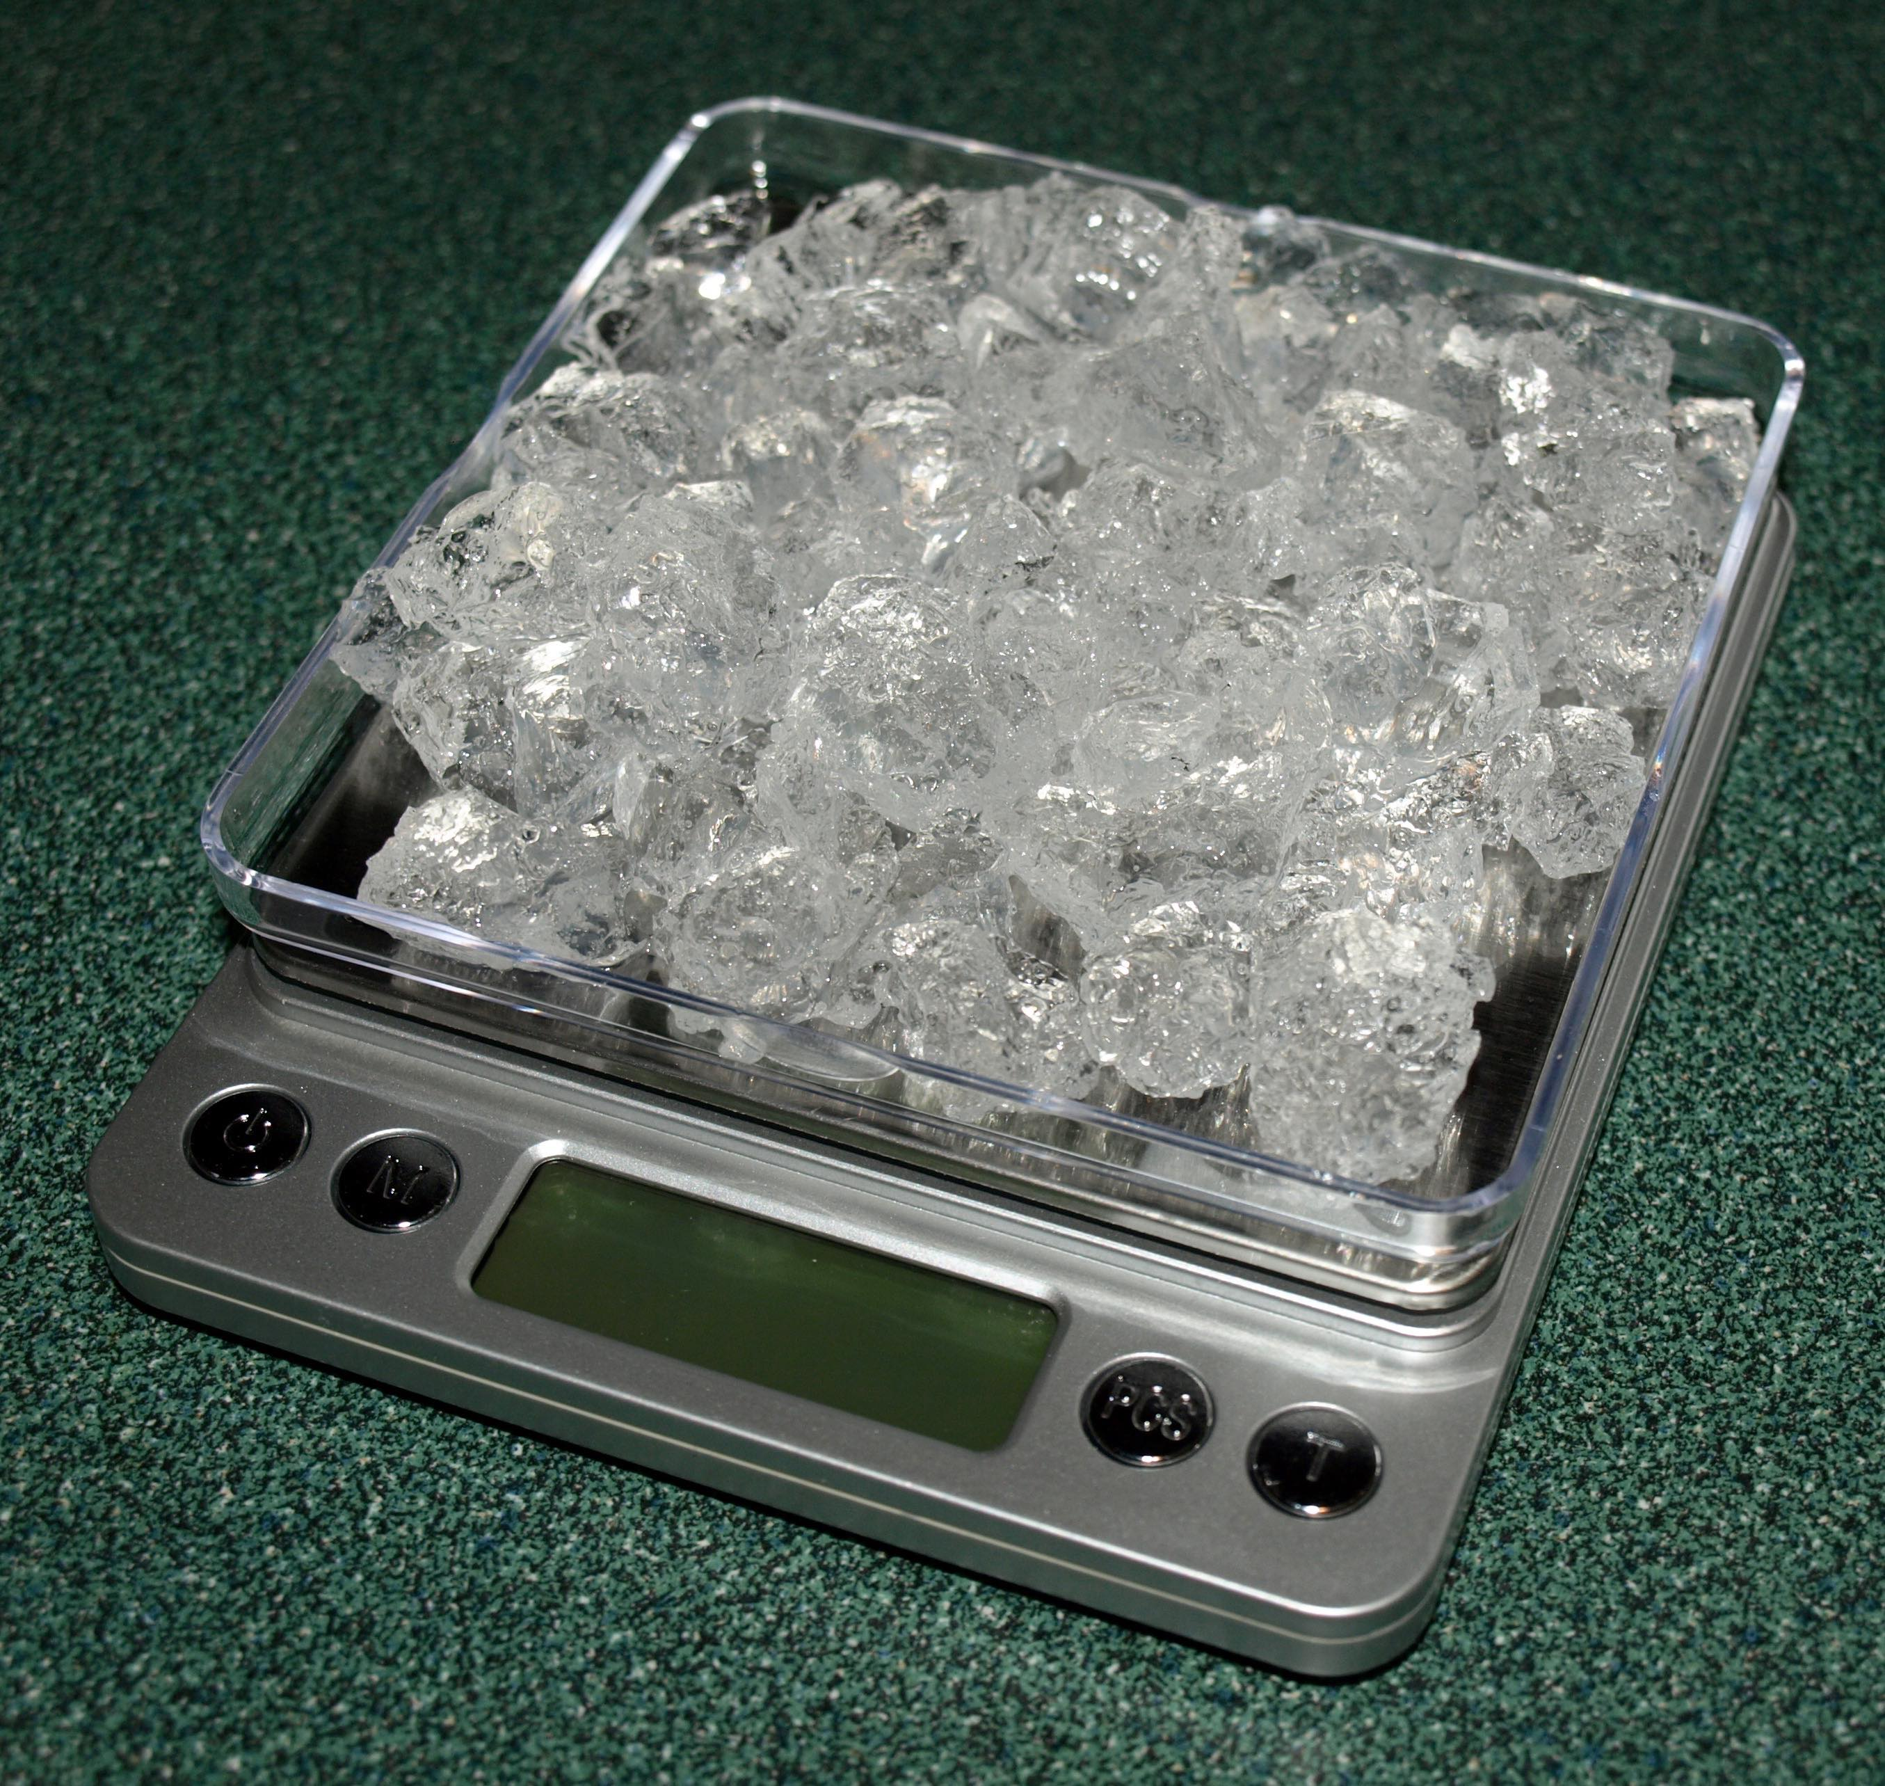
Massing your plant
Follow the steps on your 3.4GL Observing Plants’ Mass Changes, Part 2 worksheet to collect data and record results.
Don’t forget to tare the scale before you weigh the plants and before you weigh the leftover gel (optional).
Notes:
Mass the dry plants
Remind students about when they harvested their radish plants in Lesson 3.2.
Assure that students have their completed worksheets in front of them from Pre 0.2GL and 3.2.
Pass out the worksheet for today.
Show slide 3 of the 3.4GL Observing Plants’ Mass Changes, Part 2 PPT.
Remind students to tare their scales with their containers before measuring the dry mass of their radish plants (and optional dried gel).
Note: If hydrated plants were less than 0.75 grams, the dried plants (only 7% mass remaining) may not register on the scale. Options for this scenario. 1) Use the student estimates of the dry plant mass (7%) in the table and continue, or 2) Have students collectively mass their plants in groups, and modify their tables to account for mass changes in their 4 plants (remembering to sum the 4 seed masses, 4 hydrated/desiccated gel masses, etc.)
Have students record their data on their worksheets and follow the rest of the instructions on the worksheet to fill in their data table.
Remember that the radish seeds and the solids in the Ionic Grow mixture have tiny masses—less than 0.01 grams. Students should have recorded these masses as “<0.01g.” When doing calculations in this activity with this number, they should treat it as a zero.
Encourage students to compare their actual dry mass with the estimated dry mass they calculated in Activity 3.2.

Slide 4
Class data for plants’ mass changes investigation
Plant/Group | Dry Mass of Gel at the Start | Dry Mass of Gel at the End | Dry Mass Change of Gel | Dry Mass of Plant (seed) at the Start | Dry Mass of Plant at the End | Dry Mass Change of Plant | Total Change in Mass
1
2
3
4
5
6
7
Average
Notes:
Have students compare data between groups and look for patterns.
Have students select a recorder to input their group’s results on the 3.4GL Observing Plants’ Mass Changes Class Results 11 x 17 Poster. Lead a discussion to help students compare results across groups and identify patterns in the data.
Use Slide 4 of the PPT to guide students through data recording.
Have students compare the dry mass change of the plant with the dry mass change of the gel.
Show students slide 5 of the PPT. Have students discuss whether the patterns they observe in the class data match with their predictions.
Discuss any outliers or unexplained data points.

Slide 5
Comparing group results
Results for mass changes
What patterns are there in measurements made by all the groups?
Do the patterns match your predictions?
Notes:
Have students compare data between groups and look for patterns.
Have students select a recorder to input their group’s results on the 3.4GL Observing Plants’ Mass Changes Class Results 11 x 17 Poster. Lead a discussion to help students compare results across groups and identify patterns in the data.
Use Slide 4 of the PPT to guide students through data recording.
Have students compare the dry mass change of the plant with the dry mass change of the gel.
Show students slide 5 of the PPT. Have students discuss whether the patterns they observe in the class data match with their predictions.
Discuss any outliers or unexplained data points.

Slide 6
Plants’ mass changes investigation results from Ms. Hoyt’s class
Plant | Dry Mass of Gel at the Start | Dry Mass of Gel at the End | Dry Mass Change of Gel | Dry Mass of Plant (seed) at the Start | Dry Mass of Plant at the End | Dry Mass Change of Plant | Total Change in Mass
1 | 0.23 g | 0.22 g | -0.010 g | <0.01 (0)g | 0.16 g | 0.16 g | 0.15 g
2 | 0.25 g | 0.25 g | 0 g | <0.01 (0)g | 0.080 g | 0.080 g | 0.080 g
3 | 0.20 g | 0.18 g | -0.020 g | <0.01 (0)g | 0.050 g | 0.050 g | 0.030 g
4 | 0.22 g | 0.23 g | 0.010 g | <0.01 (0)g | 0.070 g | 0.070 g | 0.080 g
5 | 0.26 g | 0.25 g | -0.010 g | <0.01 (0)g | 0.080 g | 0.080 g | 0.070 g
6 | 0.18 g | 0.19 g | 0.010 g | <0.01 (0)g | 0.030 g | 0.030 g | 0.040 g
Average | 0.22 g | 0.22 g | -0.0050 (0) g | <0.01 (0)g | 0.079 g | 0.079 g | 0.087 g
Notes:
Have students compare their class’s data with data from another class to identify patterns.
Show students slide 6 from the PPT and ask them to compare their results to Ms. Hoyt’s class results (displayed as data from individual plants).
Ask students if they recognize similar patterns from their own data. Use the poster to compare. What similarities or differences do they notice? What patterns do they see?
Probe student thinking with questions such as, Where did this mass come from? Did the mass come from the gel? What evidence do we have to build our conclusions?
Use slide 7 to discuss the idea that they know from this investigation that the majority of the mass of the plant did not come from the gel, so the mass must come either from air or from water. An unknown question is, does water or air make up the mass of the dried plants? Students may have some ideas about where this mass came from. Tell students that you will discuss where this mass came from later in this lesson.

Slide 7
Plants’ mass changes investigation results from Ms. Hoyt’s class
Notes:
Have students compare their class’s data with data from another class to identify patterns.
Show students slide 6 from the PPT and ask them to compare their results to Ms. Hoyt’s class results (displayed as data from individual plants).
Ask students if they recognize similar patterns from their own data. Use the poster to compare. What similarities or differences do they notice? What patterns do they see?
Probe student thinking with questions such as, Where did this mass come from? Did the mass come from the gel? What evidence do we have to build our conclusions?
Use slide 7 to discuss the idea that they know from this investigation that the majority of the mass of the plant did not come from the gel, so the mass must come either from air or from water. An unknown question is, does water or air make up the mass of the dried plants? Students may have some ideas about where this mass came from. Tell students that you will discuss where this mass came from later in this lesson.

Slide 8
Examining group results
Examining results for mass changes
How are the mass changes connected with The Movement Question: Where are atoms moving?
What unanswered questions do you have?
Notes:
Have students complete Part D of their worksheet.
Use slide 8 and Part D of the worksheet to help students describe the patterns they observed during the observation.
Help students to recognize that the mass changes provide them with evidence that much of the plant’s mass is coming from a source other than the medium in which it is growing. However, this evidence does not show where this mass is coming from.
Revisit predictions from earlier.
Ask students to retrieve their completed 3.1 Predictions and Planning Tool for Plant Investigations. Have them compare the predictions they made with the results of the investigation. Which predictions were supported by their results? Which predictions were not supported by their results? What questions do they still need to answer?
Tell students that they will use the data that they collected here to help them to be able to answer the Matter Movement Question.

Slide 9
Exit Ticket
Conclusions
What did you observe during the investigation?
Predictions
How do you think the plants gained more mass than the gel lost?
Notes:
Have students complete an exit ticket.
Show slide 9 of the 3.4GL Observing Plants’ Mass Changes, Part 2 PPT.
Conclusions: What did you observe during the investigation?
Predictions: How do you think the plants gained more mass than the gel lost?
On a sheet of paper or a sticky note, have students individually answer the exit ticket questions. Depending on time, you may have students answer both questions, assign students to answer a particular question, or let students choose one question to answer. Collect and review the answers.
The conclusions question will provide you with information about what your students are taking away from the activity. Student answers to the conclusions question can be used on the Driving Question Board (if you are using one). The predictions question allows students to begin thinking about the next activity and allows you to assess their current ideas as you prepare for the next activity. Student answers to the predictions question can be used as a lead in to the next activity.

