Slide 1
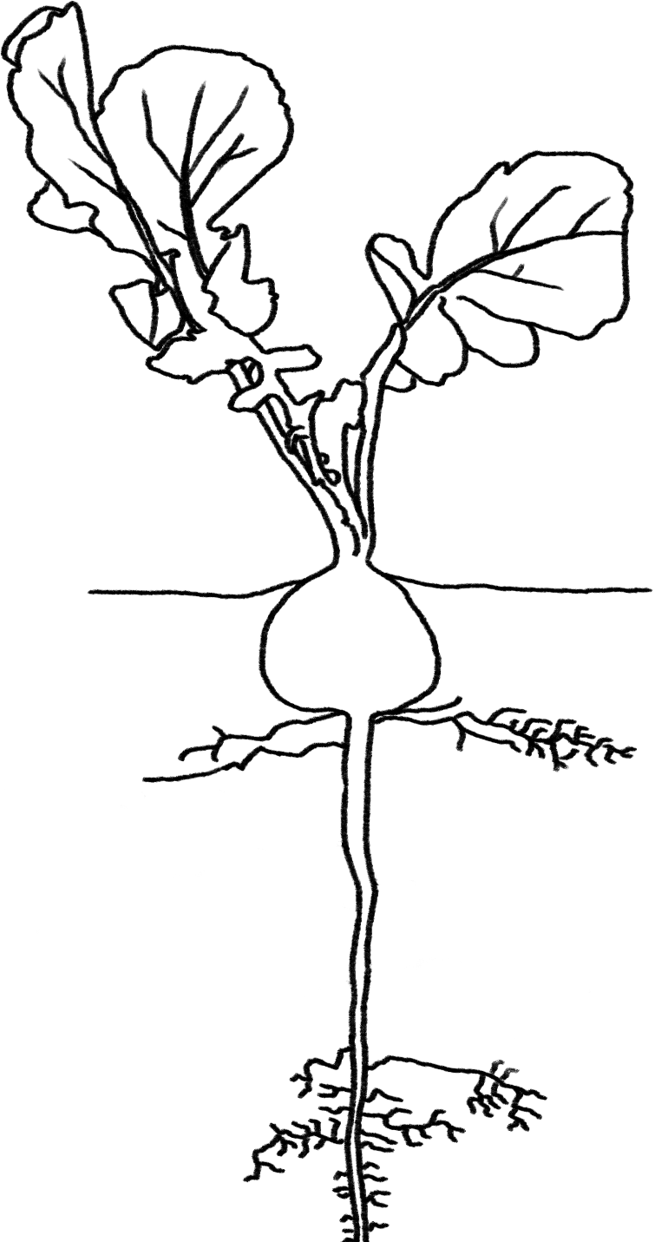
Plants Unit Activity 3.2PT: Observing Plants’ Mass Changes, Part 1
Carbon: Transformations in Matter and Energy
Environmental Literacy Project Michigan State University
Notes:
Image Credit: Craig Douglas, Michigan State University

Slide 2
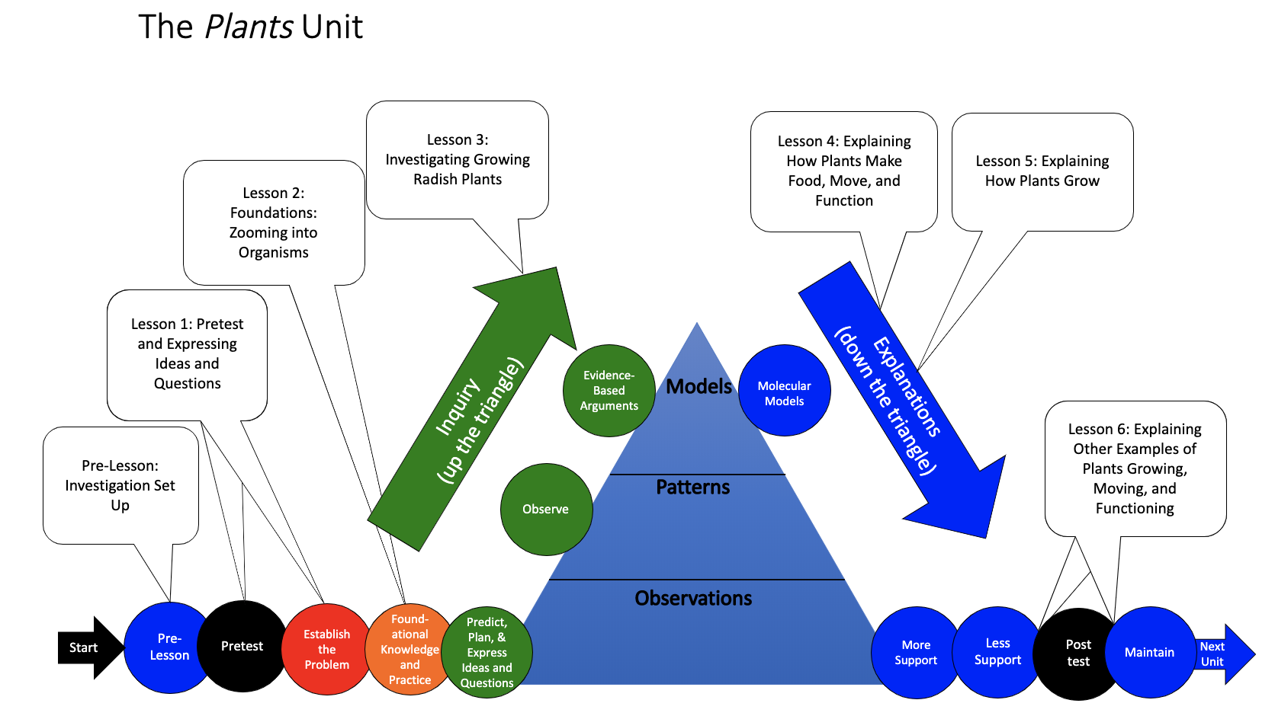
You are here
Notes:
Use the instructional model to show students where they are in the course of the unit.
Show slide 2 of the 3.2PT Observing Plants’ Mass Changes, Part 1 PPT.

Slide 3
Harvesting the plants and drying
Count and record how many plants grew and how many seeds are left in your container
Mass an empty envelope. Write your group name and the empty mass on it.
Gently pull all plant matter out of the paper towel, trying to keep the roots intact. Put it in the envelope. Do not seal the envelope.
Put the containers (with paper towel) and the envelope in a sunny windowsill or a drying oven (careful not to burn!) until plants are dry.
Notes:
Have students count and harvest the plants.
Follow the instructions in Part A of the 3.4PT Observing Plants’ Mass Changes, Part 1 Worksheet.
Show students slide 3 of the PPT and keep this up during
the first part of the activity.
Students should count and record the number of germinated plants vs. non-germinated seeds.
Students should record the mass of their drying container (plants will stick when dry, so hard to separate) and label it.
Guide students through carefully pulling their radish plants out from the wet paper towel. Try to get all the plant material (even roots and non-germinated seeds) in the envelopes or paper bags.
Dry the plants.
Follow the instructions in Part B of the 3.4PT Observing Plants’ Mass Changes, Part 1 Worksheet.
Labeled envelopes containing plants and the containers with the wet paper towel can be placed on a windowsill to dry out or can be dried overnight at the lowest temperature in a home oven. (<170 degrees) IF YOU USE AN OVEN—make sure that the material you place the plants on will not burn and start a fire! Windowsill plants will take a few days to dry if small, but may take longer if they are large.

Slide 4
Record your observations
Things to consider:
How much have your plants grown?
Which parts of the plant are the largest? Roots, stems, leaves?
What colors are your plants? Do you expect that to change as they dry?
Has the paper towel changed from when you planted the radish seeds?
Notes:
Have students record their observations
Record observations of the plants in Part C of 3.4PT Observing Plants’ Mass Changes, Part 1 Worksheet.
Show slide 4 of the PPT, which lists a few observation idea starters.
After drying the plants, continue with Activity 3.4.
Since it may take several days for the plants to dry, there are options for what to do with your students while waiting. You may move on to Activity 3.3 and conduct the Light and Dark Investigation. Or, if you started with Activity 3.3 first, you may move on to Lesson 4 which focuses on following up results from the Light and Dark Investigation (Activity 3.3) with explanations of photosynthesis and cellular respiration. Later, students will complete Evidence-Based Arguments Tool for this investigation (Activity 3.5) and explanations of biosynthesis in plants (Activities 5.1, 5.2, and 5.3). See the Plants Unit Front Matter for more information about this decision.

