Slide 1
Activity 2.1: Zooming Into Plants, Animals, and Decomposers
Carbon: Transformations in Matter and Energy
Environmental Literacy Project Michigan State University
Notes:
Image Credit: Craig Douglas, Michigan State University

Slide 2
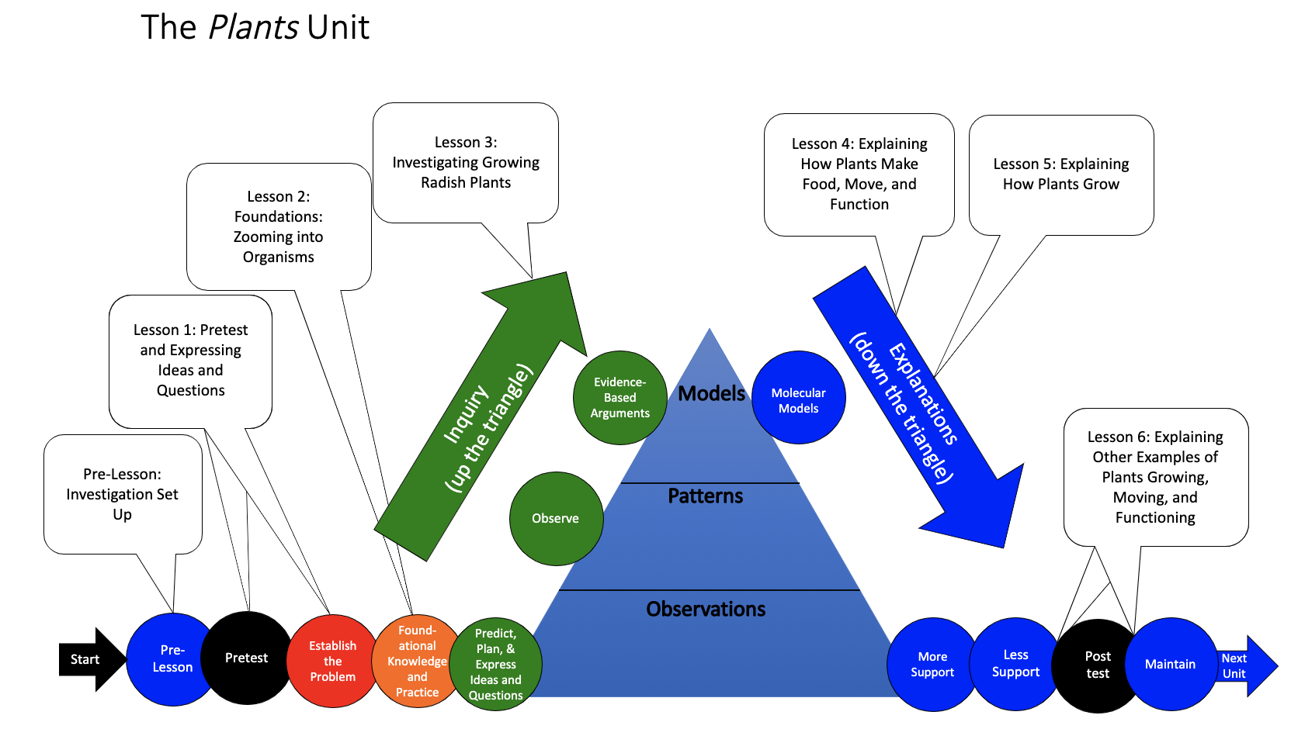
You are here
Notes:
Use the instructional model to show students where they are in the course of the unit.
Show slide 2 of the 2.1 Zooming into Plants, Animals and Decomposers PPT.

Slide 3
Three Kinds of Organisms (Living Things)
Animals
People
Cows
Mealworms
Fish
Sponges
Plants
Radishes
Potato plants
Oak trees
Algae
Grass
Decomposers
Bread mold
Mushrooms
Yeast
Soil bacteria
Notes:
Show Slides 3-4 of 2.1 Zooming Into Plants, Animals, and Decomposers PPT. Discuss how to use the Venn diagram to identify characteristics that are alike and different and practice locating one characteristic from the list on the diagram.

Slide 4
How are plants, animals, and decomposers alike and different?
Animals
Plants
Decomposers
Notes:
Show Slides 3-4 of 2.1 Zooming Into Plants, Animals, and Decomposers PPT. Discuss how to use the Venn diagram to identify characteristics that are alike and different and practice locating one characteristic from the list on the diagram.

Slide 5
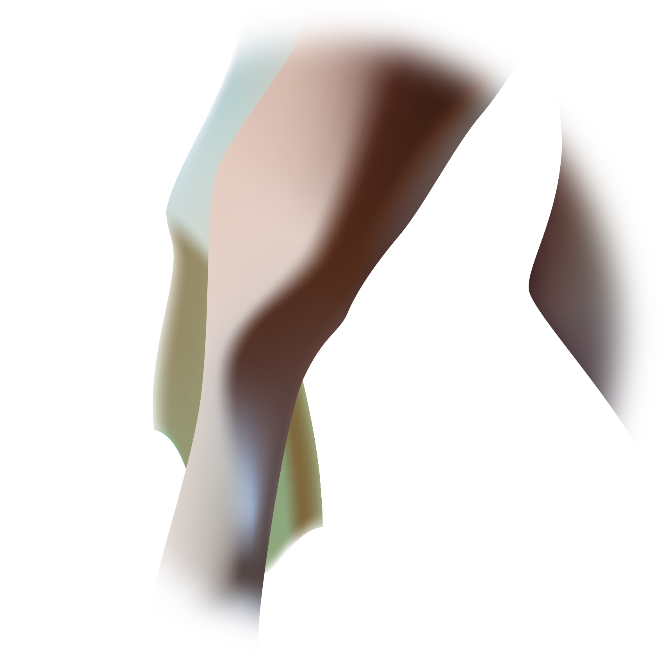
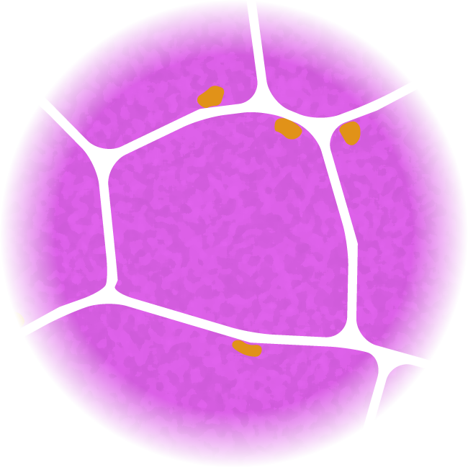
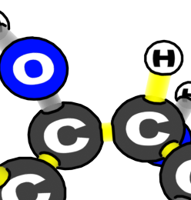
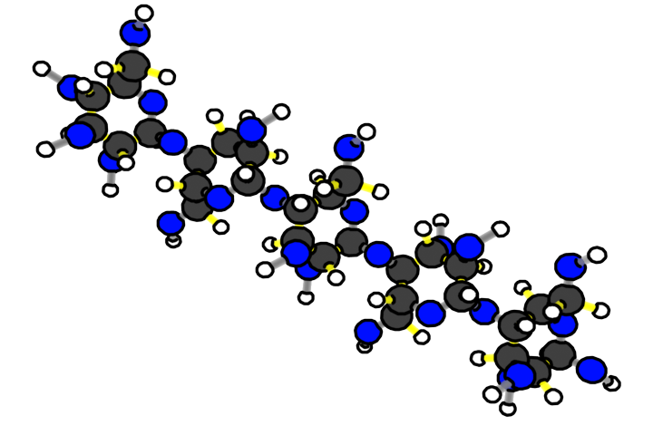
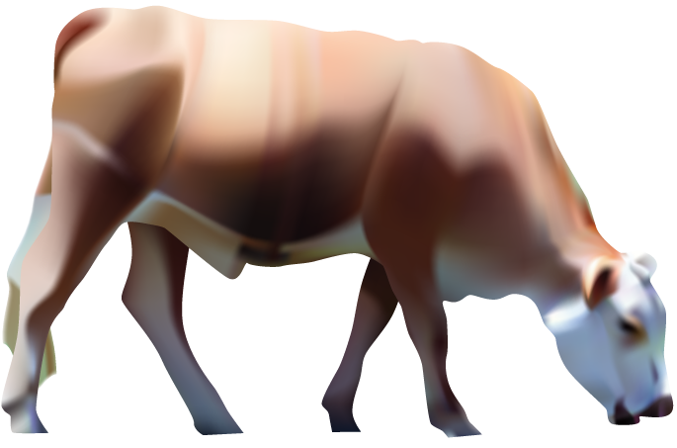
Animals are made of cells
Animal molecules are made of atoms
Animal cells are made of molecules
Benchmark Scale | Power of Ten | Decimal Style
Large scale | Larger 10⁵ 10⁴ 10³ | Larger 100,000 10,000 1,000
Macroscopic | 10² 10¹ 10⁰ 10⁻¹ 10⁻² 10⁻³ | 100 10 1 meter 0.1 0.01 0.001
Microscopic | 10⁻⁴ 10⁻⁵ 10⁻⁶ 10⁻⁷ | 0.0 001 0.00 001 0.000 001 0.0 000 001
Atomic-molecular | 10⁻⁸ 10⁻⁹ Smaller | 0.00 000 001 0.000 000 001 Smaller
Scale: 10⁻⁸ meters = 0.00 000 001 meters
Scale: 10⁻⁹ meters = 0.000 000 001 meters
Scale: 10⁻⁶ meters = 0.000 001 meters
Scale: 10⁻⁷ meters = 0.0 000 001 meters
Scale: 10⁻⁵ meters = 0.00 001 meters
Scale: 10⁻⁴ meters = 0.0 001 meters
Scale: 10⁻³ meters = 0.001 meters
Scale: 10⁻² meters = 0.01 meters
Scale: 10⁰ meters = 1 meters
Scale: 10⁻¹ meters = 0.1 meters
Notes:
Show Slides 5-7, asking students to notice how the Zooming In animations are alike and different.

Slide 6
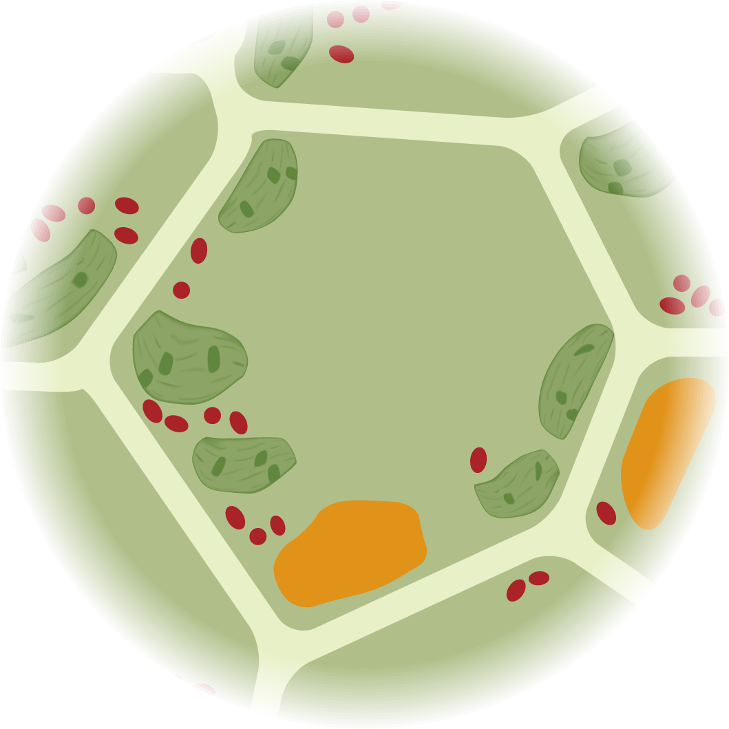
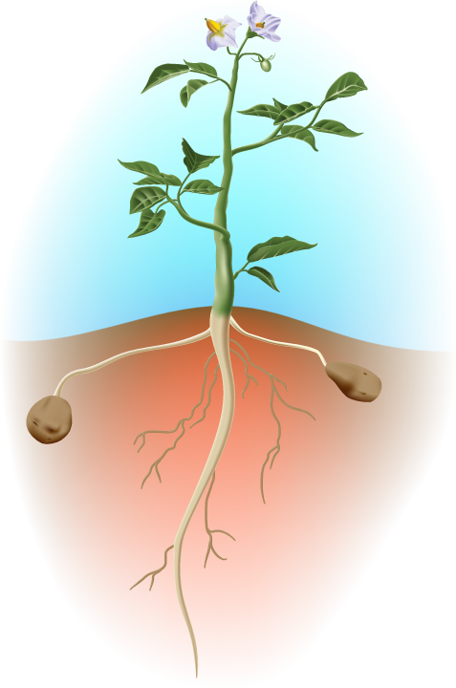
Plants are made of cells
Plant cells are made of molecules
Plant molecules are made of atoms
Benchmark Scale | Power of Ten | Decimal Style
Large scale | Larger 10⁵ 10⁴ 10³ | Larger 100,000 10,000 1,000
Macroscopic | 10² 10¹ 10⁰ 10⁻¹ 10⁻² 10⁻³ | 100 10 1 meter 0.1 0.01 0.001
Microscopic | 10⁻⁴ 10⁻⁵ 10⁻⁶ 10⁻⁷ | 0.0 001 0.00 001 0.000 001 0.0 000 001
Atomic-molecular | 10⁻⁸ 10⁻⁹ Smaller | 0.00 000 001 0.000 000 001 Smaller
Scale: 10⁻⁸ meters = 0.00 000 001 meters
Scale: 10⁻⁹ meters = 0.000 000 001 meters
Scale: 10⁻⁶ meters = 0.000 001 meters
Scale: 10⁻⁷ meters = 0.0 000 001 meters
Scale: 10⁻⁵ meters = 0.00 001 meters
Scale: 10⁻⁴ meters = 0.0 001 meters
Scale: 10⁻³ meters = 0.001 meters
Scale: 10⁻² meters = 0.01 meters
Scale: 10⁰ meters = 1 meters
Scale: 10⁻¹ meters = 0.1 meters
Notes:
Discuss ideas that students can consider in making their predictions
Use Slides 5-7 to help student connect scales and learn about atoms in plants
Slide 6 “zooms in” to plants from the macroscopic to the atomic-molecular scale
Slide 7 reminds students of rules to follow from the Movement Question and inform them about the kinds of atoms found in plants

Slide 7
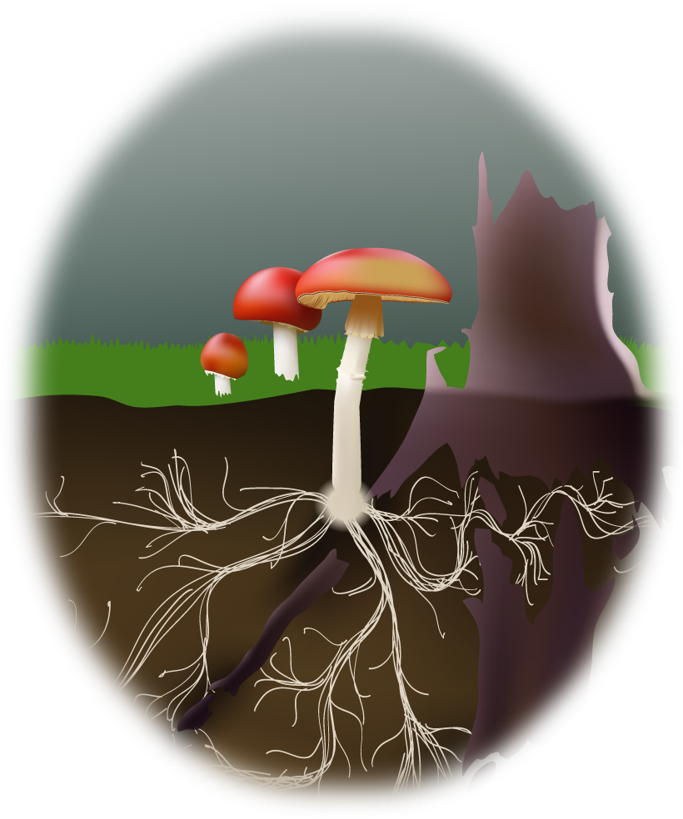
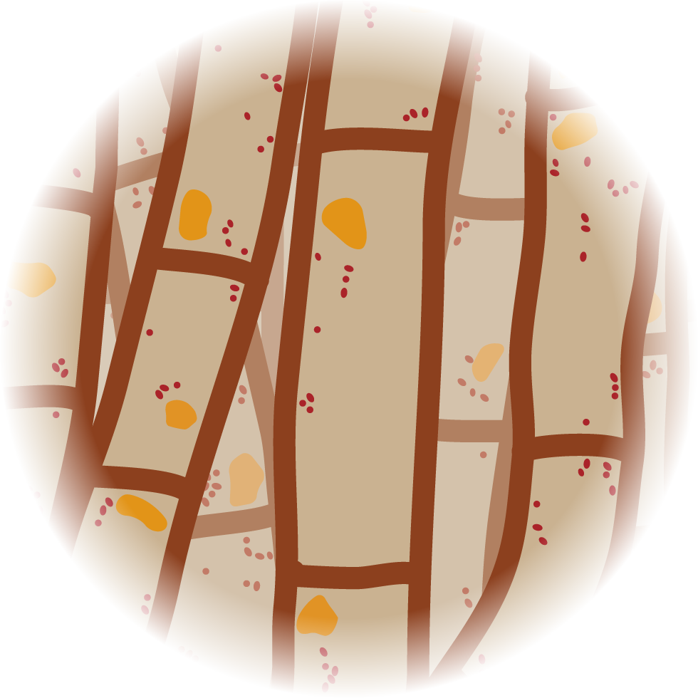
Decomposers are made of cells
Decomposer cells are made of molecules
Decomposer molecules are made of atoms
Benchmark Scale | Power of Ten | Decimal Style
Large scale | Larger 10⁵ 10⁴ 10³ | Larger 100,000 10,000 1,000
Macroscopic | 10² 10¹ 10⁰ 10⁻¹ 10⁻² 10⁻³ | 100 10 1 meter 0.1 0.01 0.001
Microscopic | 10⁻⁴ 10⁻⁵ 10⁻⁶ 10⁻⁷ | 0.0 001 0.00 001 0.000 001 0.0 000 001
Atomic-molecular | 10⁻⁸ 10⁻⁹ Smaller | 0.00 000 001 0.000 000 001 Smaller
Scale: 10⁻⁸ meters = 0.00 000 001 meters
Scale: 10⁻⁹ meters = 0.000 000 001 meters
Scale: 10⁻⁶ meters = 0.000 001 meters
Scale: 10⁻⁷ meters = 0.0 000 001 meters
Scale: 10⁻⁵ meters = 0.00 001 meters
Scale: 10⁻⁴ meters = 0.0 001 meters
Scale: 10⁻³ meters = 0.001 meters
Scale: 10⁻² meters = 0.01 meters
Scale: 10⁻¹ meters = 0.1 meters
Notes:
Show Slides 5-7, asking students to notice how the Zooming In animations are alike and different.

Slide 8
Some ways that all organisms are alike
Their structures: What they are made of
Their functions: What they do
All organisms are made of cells
All cells are made of molecules
All molecules are made of atoms
All organisms grow
All organisms need and use energy
All organisms move and change matter
Notes:
Show Slides 8 and 9 of the PPT
Have students correct their worksheets based on this slide and save their worksheets. (They will refer back to them in Activity 2.4.)
Discuss why the slide has two columns for Structure and Function. Tell the students that we will be using those words in the future, so they need to understand the distinction.

Slide 9
Some questions about cells
Structure questions
Function questions
How big are cells and what do they look like?
What are cells made of?
What do cells do?
How do cells do it?
Notes:
Show Slides 8 and 9 of the PPT
Have students correct their worksheets based on this slide and save their worksheets. (They will refer back to them in Activity 2.4.)
Discuss why the slide has two columns for Structure and Function. Tell the students that we will be using those words in the future, so they need to understand the distinction.
Slide 9 has structure and function questions that the students will answer in the rest of the unit.
(Optional) Have students read about cells.
Have middle school and lower level high school students with limited prior knowledge about cells, read the 2.1 Cells: The Building Blocks of Organisms Reading. Have students pause and discuss the italicized questions in the reading with a partner.
After students read, discuss the questions at the end as a whole class.

Slide 10
Structure: How big are cells and what do they look like?
Cells come in many different sizes and shapes.
Look for cells on these websites:
Scale of Universe: http://htwins.net/scale2/
Cell Size and Scale: http://learn.genetics.utah.edu/content/cells/scale/
What is the size range that you found for cells?
Notes:
Discuss structure questions about cells.
Slides 10 and 11 address the two structure questions about cells in Slide 9
Show the students Slide 10, then you have a choice:
Option 1: Give students time to explore the website sliders and report what they found about cells.
Option 2: Show the sliders on the display computer and look for cells with the students.
Option 3: Look back at Slides 5-7 for the approximate size of animal, plant, and decomposer cells. (A narrower range of cell sizes than cells in general.)

Slide 11
Structure: What are cells made of?
What’s inside a cell? Share your ideas and questions before we study this in the next activity.
Your ideas about what cells are made of.
Your questions about what cells are made of.
Notes:
Show students Slide 11 and ask for their ideas and questions. (Their questions will be addressed in Activity 2.2.)

Slide 12
Function: What do cells do?
Everything that organisms do is done by their cells working together! Think about some examples:
A young girl grows. What are her cells doing?
Her cells are growing larger, then dividing.
A potato plant’s leaves get water. What cells help this to happen?
Root cells absorb water from the soil. Stem cells carry water to the leaves.
A cow walks across a field. What cells help this to happen?
Brain and nerve cells send signals telling the muscle cells to contract and move the cow’s legs.
Notes:
Discuss function questions about cells
Slides 12-14 address the two function questions on Slide 8.
Slide 12 addresses how cells work together to accomplish the macroscopic functions of organisms. Pause after showing each question to get students’ ideas before showing the answer.

Slide 13
Function: How do cells do what they do?
How can cells do so many things, like growing, moving, and moving materials? Share your ideas before we study this in the rest of the unit.
Your ideas about how cells grow and function.
Your questions about how cells grow and function.
Notes:
Slide 13 elicits students’ ideas and questions about how cells grow and function

Slide 14
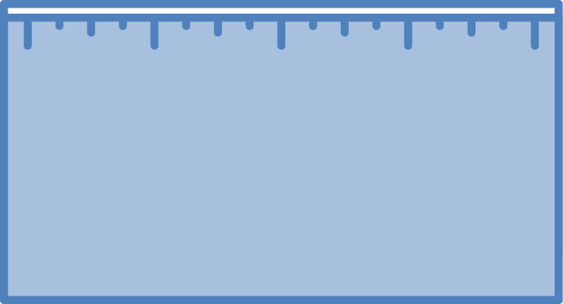
How to answer function questions about cells
Answer each of the questions (numbered 1-4) below to explain how matter and energy move and change in a system. Note that matter movement is addressed at both the beginning (1) and end (4) of your explanation.
Question
Where are molecules moving?
How do molecules move to the location of the chemical change?
How do molecules move away from the location of the chemical change?
Evidence We Can Observe
Moving solids, liquids, and gases are made of moving molecules.
A change in mass shows that molecules are moving.
Rules to Follow
All materials (solids, liquids, and gases) are made of atoms that are bonded together in molecules.
Scale: The matter movement question can be answered at the atomic-molecular, cellular, or macroscopic scale.
Question
How are atoms in molecules being rearranged into different molecules?
What molecules are carbon atoms in before and after the chemical change?
What other molecules are involved?
Evidence We Can Observe
BTB can indicate CO₂ in the air.
Organic materials are made up of molecules containing carbon atoms:
• fuels • foods
• living and dead plants and animals
decomposers
Rules to Follow
Atoms last forever in combustion and living systems.
Atoms can be rearranged to make new molecules, but not created or destroyed.
Carbon atoms are bound to other atoms in molecules.
Scale: The matter change question is always answered at the atomic-molecular scale.
Question
What is happening to energy?
What forms of energy are involved?
What energy transformations take place during the chemical change?
Evidence We Can Observe
We can observe indicators of different forms of energy before and after chemical changes:
• light energy • heat energy
• chemical energy stored in organic materials
• motion energy
Rules to Follow
Energy lasts forever in combustion and living systems.
Energy can be transformed, but not created or destroyed.
C-C and C-H bonds have more stored chemical energy than C-O and H-O bonds.
Scale: The energy change question can be answered at the atomic-molecular, cellular, or macroscopic scales.
Notes:
Use Slide 14 to remind students of the Three Questions (which they should remember from Systems and Scale). They will be learning to explain cell functions by describing movement of matter, and changes in matter and energy, at the atomic-molecular scale.
Point out the Three Questions 11x17 Poster on the wall.

Slide 15
Exit Ticket
Conclusions
What do animals, plants, and decomposers have in common?
Predictions
What do you think cells are made of?
Notes:
Have students complete an exit ticket.
Show slide 15 of the 2.1 Zooming into Plants, Animals and Decomposers PPT.
Conclusions: What do animals, plants, and decomposers have in common?
Predictions: What do you think cells are made up of?
On a sheet of paper or a sticky note, have students individually answer the exit ticket questions. Depending on time, you may have students answer both questions, assign students to answer a particular question, or let students choose one question to answer. Collect and review the answers.
The conclusions question will provide you with information about what your students are taking away from the activity. Student answers to the conclusions question can be used on the Driving Question Board (if you are using one). The predictions question allows students to begin thinking about the next activity and allows you to assess their current ideas as you prepare for the next activity. Student answers to the predictions question can be used as a lead in to the next activity.

