Slide 1
Human Energy Systems Unit Activity 5.2 Carbon Emissions Jigsaw
Carbon: Transformations in Matter and Energy
Environmental Literacy Project Michigan State University
Notes:
Image Credit: Craig Douglas, Michigan State University

Slide 2
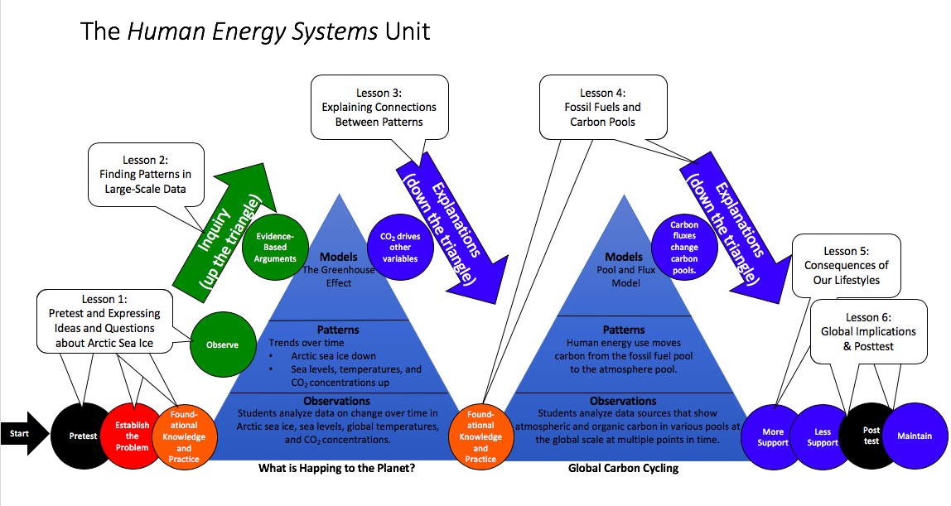
You are here
Notes:
Use the instructional model to show students where they are in the course of the unit.
Show slide 2 of the 5.2 Carbon Emissions Jigsaw PPT.

Slide 3
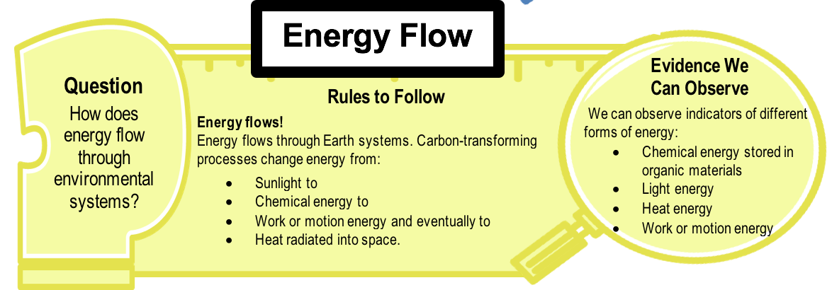
The Four Questions: The Energy Flow Question
Notes:
Activate prior knowledge about The Energy Flow Question.
Display slide 3 of the PPT. Remind students of the third rule: Energy flows! Invite students to share what they think this means.
You may want to recall the Four Questions Large Scale Handout from Lesson 4.

Slide 4
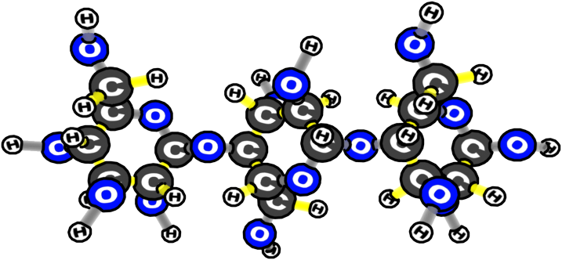
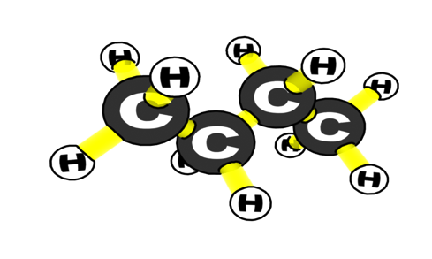
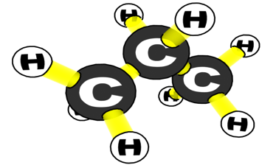
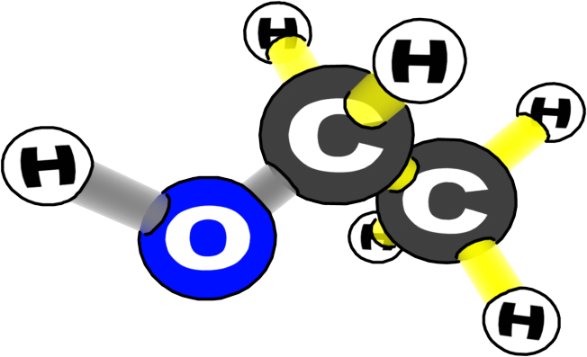
ORGANIC
INORGANIC
WATER
SALT
WOOD
CARBON DIOXIDE
BUTANE
OXYGEN
NITROGEN
PROPANE
ETHANOL
Notes:
Recall the difference between organic and inorganic carbon.
Display slide 4 of the PPT. As a review, ask students to explain the difference between organic and inorganic carbon.
This should serve as a reminder that organic carbon stores useful chemical energy in C-C or C-H bonds.
Photo Credit: Craig Douglas, Michigan State University

Slide 5
Organic Carbon Uses
How do humans use organic carbon?
Notes:
Brainstorm about how humans use organic carbon in everyday life.
Display slide 5 of the PPT. Have students think of organic carbon they use in everyday life.
If students are having a difficult time coming up with ideas, have them look around the classroom or think about things they have done or used during the day for more ideas and think back to Activity 5.1.

Slide 6
Jigsaw
First, find your home group based on the picture on your card.
Next, find your expert group based on the letter on your card.
A: electricity
B: transportation
C: buildings
D: food
Notes:
Introduce the jigsaw to the students.
Tell students they are going to participate in a jigsaw to discuss how we use fossil fuels to give us energy.
First, they will divide into home groups to discuss the task for the day.
Then, they will divide into expert groups. In their expert group, they will read a handout and complete a worksheet. They will have 30 minutes to read and complete the worksheet. They should also prepare a summary of their discussion from their expert group to share in their home group.
Then, they will return to home groups. In their home groups, they will have 15 minutes to share their expertise with the members of their home group.
Pass out jigsaw cards and divide students into home groups.
Display slide 6 of the PPT. Distribute one jigsaw card to each student. See instructions on the first page of the cards for how to work with different class sizes.
Tell students to divide into their home groups based on the image on their cards. For example, all gas cans should find other gas cans to form a home group.
Once students have found their home groups, introduce the different topics for the jigsaw readings.
Tell students that if they have a…
Letter A on their cards, they are going to become experts in how electricity use emits carbon emissions.
Letter B on their cards, they will become experts in how transportation emits carbon emissions.
Letter C on their cards, they will become experts in how buildings create carbon emissions.
Letter D on their cards, they will become experts in how food adds carbon in the atmosphere.
Give the home groups a few minutes to ask any questions they may have about the jigsaw.

Slide 7
In Expert Groups
Read the 5.2 Handout about your topic.
Complete the 5.2 Worksheet.
Prepare a summary of your work to share with your home group.
Notes:
Divide students into expert groups.
Display slide 7 of the PPT. Tell students to divide by letter to form expert groups (i.e., all students with the same letter and number on their cards should group together, etc.). They should hold onto their jigsaw cards for later.
Distribute 5.2 Group Handouts and 5.2 Group Worksheets (which will vary by group) to each expert group.
They can use the bottom of the 5.2 Group Worksheets to help them remember the ideas from their expert groups in their summary to the home groups.
Give students 30 minutes to work in their groups.
Tell students to think about how to summarize the main ideas from the handouts as they prepare to share their expertise in the next round.

Slide 8
In Home Groups
Have each member share a summary of their expert group topic.
Notes:
Reorganize students into expert groups.
Display slide 8 of the PPT. Instruct students to regroup according to the image on their jigsaw cards to form home groups (i.e., students with gas tanks should all form one group, etc.).
In their home groups, it is each student’s job to provide an expert summary or report of what s/he discussed in his/her expert group (i.e., share his/her expertise).
Give students 15 minutes to share their expertise.

Slide 9
The Lifestyle Game
Take out your 5.1 Extreme Makeover: Lifestyle Edition Worksheet.
Make another set of lifestyle choices based on lifestyle choices you would be willing to make to lower your carbon emissions.
Use 5.1 Secrets Revealed! Worksheet to calculate the carbon emissions of your new choices.
Notes:
Recall the lifestyle choices game.
Tell students that in the last activity, we learned that people who live in different geographical regions in the world use carbon in different ways, and that the way we use carbon can depend on both our individual choices and also where we live. Now students are going to make another set of lifestyle choices based on what they have learned about carbon.
Have students visit the stations and make lifestyle choices.
Display slide 9 of the PPT. Return or have each student take out their copy of 5.1 Extreme Makeover: Lifestyle Edition Worksheet.
Tell students that each station contains four different options and that it is their job to select one at each station.
They should visit each station, read each lifestyle card at each station, and select a lifestyle from each station (they should record their choices in the table)
Give students 10 minutes to visit all four stations.
Students may ask you “How should I decide what to choose?” This time they should make their decision based on what they would do to lower their carbon emissions.

Slide 10
Lifestyles and per capita emissions for different countries
The lifestyles described in the last activity were based on average lifestyles for four countries.
Which countries do you think are represented by lifestyle choices A, B, C, and D?
What information are you using to guess?
Notes:
Calculate carbon emissions associated with the students’ chosen lifestyles.
Return or have each student take out their copy of 5.1 Secrets Revealed! Worksheet to each student and tell students to use the information in Table 3 to calculate how much carbon emissions are associated with their lifestyle choices. Give them time to make calculations and share with their neighbor.
Have a class discussion about what students would need to change in their lives to live out these new lifestyles. Discuss what is possible and impossible to do based on where they live.
Ask students which countries are represented in the Activity.
Display slide 10 of the PPT.
Ask students: Which countries do you think are represented by lifestyles A, B, C, and D?
Give students an opportunity to suggest ideas about this question. You may need to remind them of the characteristics for each lifestyle.
Ask them what information or experience they used to guess the way that they did. For example: “What information did you use to guess that Lifestyle A is the United States?”

Slide 11
Carbon dioxide emissions by country
Lifestyle Choice | Country | CO₂ Emissions (lbs/yr/person) | Weight in School Buses | Volume in School Buses
A | United States | 44,000 lbs | 1.75 buses | 157 buses
B | China | 9,500 lbs | 0.4 buses | 34 buses
C | Ethiopia | 220 lbs | 0.01 buses | 0.75 buses
D | France | 14,600 lbs | 0.6 buses | 52 buses
Which country emits the most? Which emits the least?
Notes:
Reveal the answers!
Use Slide 11 to show which country is associated with which lifestyle.

Slide 12
Lifestyle Choice | Country | CO₂ Emissions (lbs/yr/person) | Weight in School Buses | Volume in School Buses
A | United States | 44,000 lbs | 1.75 buses | 157 buses
B | China | 9,500 lbs | 0.4 buses | 34 buses
C | Ethiopia | 220 lbs | 0.01 buses | 0.75 buses
D | France | 14,600 lbs | 0.6 buses | 52 buses
Why do you think these countries have different carbon emissions?
Use information you know about each country to suggest reasons for this variation.
Notes:
Ask students if this is what they were expecting.
Use Slide 12 of the presentation to ask, “Why do you think these countries have different carbon emissions?”
Invite students to share ideas with the class.
Students may notice that France has a very low emission rate associated with its electricity use, even though citizens from that country use a lot of electricity per capita. If this comes up, tell students that France generates a lot of electricity using nuclear power generators, which do not emit carbon.

Slide 13
Discussion questions For each question, think about your answer for 30 seconds. Then, take 1 minute to share your answer with a partner. Then, your teacher will ask some of your to share your answers with the class.
Lifestyle | Country
A | United States
B | China
C | Ethiopia
D | France
How do you think these numbers are different from what they would have looked like 100 years ago?
In this activity, you were allowed to make “choices” about which lifestyle you choose. Which of these things do you make “choices” about everyday, and which of these things are determined by where you live?
How much “choice” does a person living in Ethiopia have about how she or he uses carbon every day? If a person from Ethiopia could play this game, what lifestyles do you think s/he would choose?
What are the consequences for the environment if we continue with our current lifestyles in the United States? What are the consequences for people?
Carbon emissions cause an increase in global temperatures, which leads to weather hazards like drought in some areas, and heavy rain in others. How will extreme drought affect a citizen of Ethiopia differently from a citizen of the United States?
Rising sea levels are another consequence of rising temperatures. When polar ice caps melt, the water from the glaciers goes into the oceans, causing sea levels to rise. Who on the planet will be affected most by rising sea levels?
Notes:
Think-pair-share discussion.
Display Slide 13 of the PPT.
Tell students to find partners.
Display the first question. Give students 30 seconds to think about their answer, and then 1 minute to exchange their ideas with a partner.
Invite a few pairs to share their ideas for this question with the class.
Display the next question and repeat the process.
Go through the questions on the slide until you have answered all six questions.
Try to make connections between how our individual lifestyles choices can affect others around the world even though some effects of climate change (e.g. sea level) might not affect us directly.

Slide 14
Exit Ticket
Conclusions
How do lifestyles in the United States affect the size of the Earth’s atmospheric CO₂ pool?
Predictions
How can we choose to change our lifestyles?
Notes:
Have students complete an exit ticket.
Show Slide 14 of the 5.2 Carbon Emissions Jigsaw PPT.
Conclusions: How do lifestyles in the United State affect the size of the Earth’s atmospheric CO₂ pool?
Predictions: How can we choose to change our lifestyles?
On a sheet of paper or a sticky note, have students individually answer the exit ticket questions. Depending on time, you may have students answer both questions, assign students to answer a particular question, or let students choose one question to answer. Collect and review the answers.
The conclusions question will provide you with information about what your students are taking away from the activity. Student answers to the conclusions question can be used on the Driving Question Board (if you are using one). The predictions question allows students to begin thinking about the next activity and allows you to assess their current ideas as you prepare for the next activity. Student answers to the predictions question can be used as a lead into the next activity.

Slide 15
Organic Carbon That I Use
How I Use It
Notes:
Record ideas as a group.
Create a T-chart on the board, with headings “Organic carbon that I use” and “How I use it” or use slide 6 in the PPT to type the responses.
Have students take turns sharing one way they use organic carbon during their day.
Continue adding different ways students used organic carbon until there is a large variety of responses.
Spend time allowing students to discuss these questions as a whole group, probing what they already know about the uses of organic carbon in everyday life.

