Slide 1
Human Energy Systems Unit Activity 4.5 How Seasons and Oceans Affect Atmospheric CO₂
Carbon: Transformations in Matter and Energy
Environmental Literacy Project Michigan State University
Notes:
Image Credit: Craig Douglas, Michigan State University

Slide 2
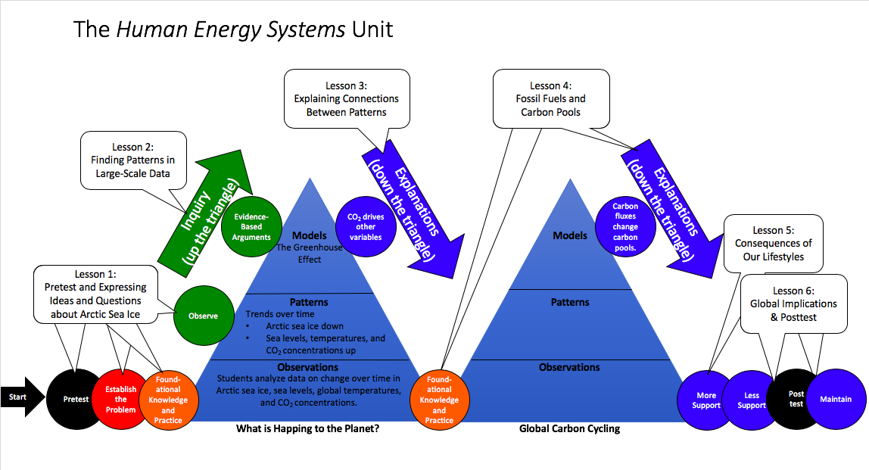
You are here
Notes:
Introduce the Activity.
Display Slide 2 of the 4.5 Seasons & Oceans PPT to show students where they are in the instructional sequence.

Slide 3
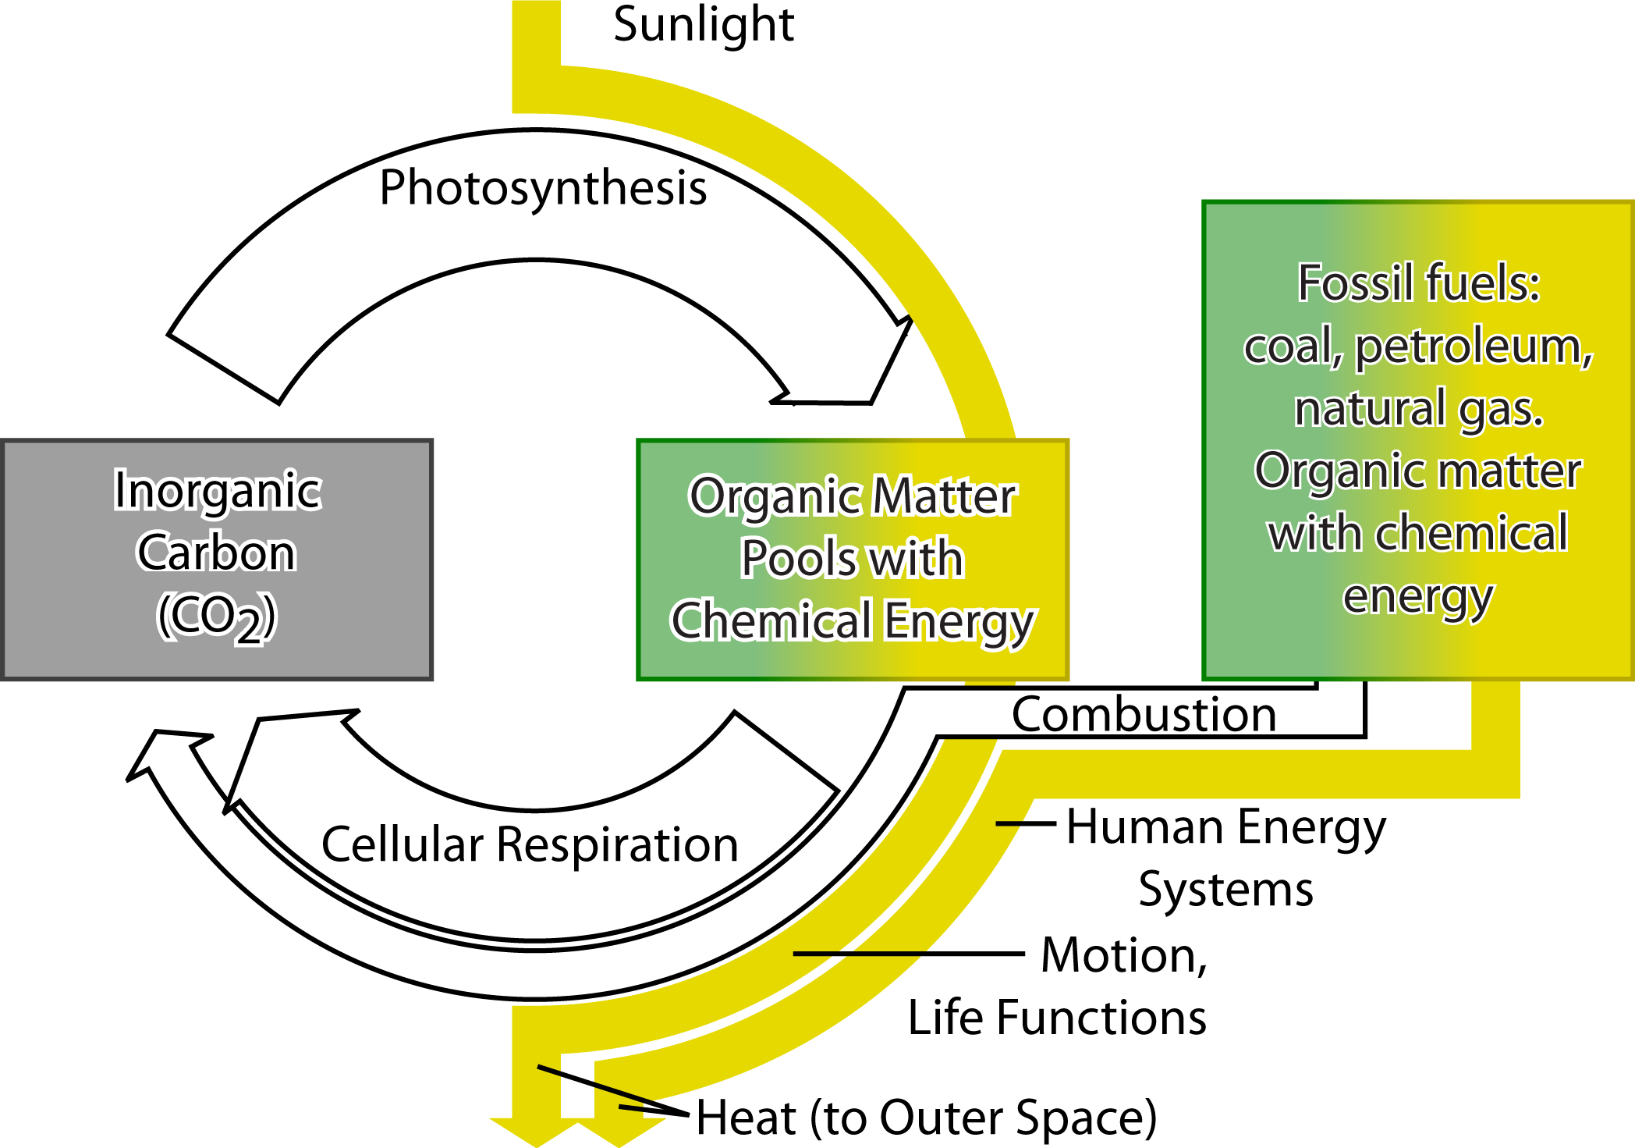
Three Carbon Pools in the Global Carbon Cycle
Notes:
Discuss the goals for this activity
Use Slides 3-5 to remind students of the pools and fluxes that they have used in previous models and how they can be used to explain the seasonal patterns and long-term trend in the Keeling Curve.

Slide 4
Three Carbon Fluxes in the Global Carbon Cycle
Notes:
Discuss the goals for this activity
Use Slides 3-5 to remind students of the pools and fluxes that they have used in previous models and how they can be used to explain the seasonal patterns and long-term trend in the Keeling Curve.

Slide 5
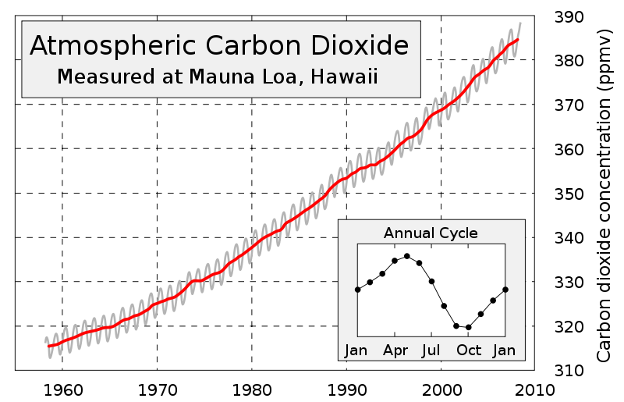
How Can We Predict CO₂ Concentrations in the Future?
Notes:
Discuss the goals for this activity
Use Slides 3-5 to remind students of the pools and fluxes that they have used in previous models and how they can be used to explain the seasonal patterns and long-term trend in the Keeling Curve.

Slide 6
Goals for Activity 4.5
We want to figure out
Why CO₂ concentrations in Hawaii are different from CO₂ concentrations at the South Pole,
How other pools and fluxes affect atmospheric CO₂
Notes:
Discuss the goals for this activity
Use Slide 6 to introduce and discuss that two goals for this lesson.

Slide 7
Questions about NOAA Video
Watch the video: https://www.esrl.noaa.gov/gmd/ccgg/trends/history.html
Questions:
Why do you think that this video is nicknamed the “Pumphandle Video?”
What does this show about the annual cycle of CO₂ concentrations in the Northern and the Southern Hemispheres?
Notes:
Compare data about the annual cycle in the Northern and Southern Hemispheres.
Show the NOAA “Pumphandle” video (https://www.esrl.noaa.gov/gmd/ccgg/trends/history.html )
Use Slide 7 to lead a discussion of different patterns that they notice in the Northern and Southern Hemispheres. See the Lesson 4 Background information for more information about this video.

Slide 8
Annual Cycle: Hawaii vs. South Pole
Hawaii Peaks: May
Why do CO₂ concentrations vary more in Hawaii than at the South Pole?
Why do they rise and fall at different times of the year?
South Pole Peaks: October
(Video: https://www.youtube.com/watch?v=UatUDnFmNTY&feature=youtu.be )
Notes:
Compare data about the annual cycle in the Northern and Southern Hemispheres.
Use Slide 8 and the associated video (https://www.youtube.com/watch?v=UatUDnFmNTY&feature=youtu.be ) to discuss the different annual patterns:
In Hawaii CO₂ concentrations rise to a peak in May, then fall during the Northern Hemisphere summer.
At the South Pole CO₂ concentrations rise to a peak in October, then fall during the Northern Hemisphere winter.

Slide 9
Movie: Global Rates of Photosynthesis
Notes:
Discuss different photosynthesis fluxes in the Northern and Southern Hemispheres.
Use Slide 9 to show students how photosynthesis fluxes in the Northern and Southern Hemispheres change across the seasons.

Slide 10
What’s the Pattern?
January
April
July
October
Notes:
Discuss different photosynthesis fluxes in the Northern and Southern Hemispheres.
Use Slide 10 to have students describe the pattern:
The Northern Hemisphere photosynthesis flux peaks in the Northern Hemisphere summer (around July).
The Southern Hemisphere photosynthesis flux peaks in the Southern Hemisphere summer (around January).

Slide 11
Putting It All Together
Several processes affect atmospheric CO₂ concentrations, including photosynthesis, cellular respiration, and combustion. Which process is most responsible for the annual cycle in the Keeling Curve? (For an explanation of how changes in sunlight drive changes in photosynthesis, see https://www.youtube.com/watch?v=WgHmqv_-UbQ )
How are the annual cycles of CO₂ concentrations in Hawaii (Keeling Curve) and the South Pole different?
Can you use these ideas to explain the differences in the annual cycles? (Remember that a good explanations answers the Four Large-scale Questions.)
Notes:
Have students write explanations of the global pattern in the annual cycle.
Pass out the 4.5: Seasons and Oceans Worksheet.
Show Slides 11 and 12 and remind students about how they can use the Four Questions to guide their writing of a good explanation.

Slide 12
Four Questions Explanation Checklist
Setting the stage
Did you name and describe the observations or patterns in data that you are explaining?
Did you explain how the system is changing (or how you predict it will change?
1. Carbon Pools: Where are the carbon pools in our environment?
Did you name and describe all the pools that are involved in the process?
Did you say what kinds of carbon molecules are in the pool (CO₂ or organic carbon)?
2. Carbon Cycling: How are carbon atoms cycling among pools?
Did you name all the fluxes that move carbon atoms from one pool to another?
Did you explain the chemical changes that go with those carbon fluxes?
3. Energy Flow: How does energy flow through environmental systems?
Did you identify the carbon pools with stored chemical energy?
Did you explain where the chemical energy in those pools comes from?
Did you explain how energy is transformed in carbon fluxes?
4. Stability and Change: How do carbon fluxes change the size of carbon pools?
Did you explain whether the fluxes going into or out of each pool are balanced or unbalanced?
Did you explain or predict how unbalanced fluxes will change the size of pools?
Other Elements to Consider
Did you use scientific vocabulary correctly?
Did you organize your explanation logically to tell a story that flows?
Notes:
Have students write explanations of the global pattern in the annual cycle.
Pass out the 4.5: Seasons and Oceans Worksheet.
Show Slides 11 and 12 and remind students about how they can use the Four Questions to guide their writing of a good explanation.

Slide 13
Spoiler alert!
Answer the questions on Part A of the 4.5 Seasons & Oceans Worksheet before you view the next five slides!
Notes:
Have students write explanations of the global pattern in the annual cycle.
Show Slide 13 and have students complete Part A of the worksheet before continuing the lesson.

Slide 14
Setting the stage: What pattern in data are we explaining?
Notes:
Discuss the students’ written explanations.
Slides 14-18 show correct answers to each of the Four Questions and to each question in Part A of the 4.5 Seasons and Oceans Worksheet. Show these slides and have students check, discuss, and revise their own answers to the worksheet questions.

Slide 15
Carbon Pools Question: Which pools change with the seasons?
Notes:
Discuss the students’ written explanations.
Slides 14-18 show correct answers to each of the Four Questions and to each question in Part A of the 4.5 Seasons and Oceans Worksheet. Show these slides and have students check, discuss, and revise their own answers to the worksheet questions.

Slide 16
Carbon Cycling Question: Which flux changes most with the seasons?
Notes:
Discuss the students’ written explanations.
Slides 14-18 show correct answers to each of the Four Questions and to each question in Part A of the 4.5 Seasons and Oceans Worksheet. Show these slides and have students check, discuss, and revise their own answers to the worksheet questions.

Slide 17
Energy Flow Question: How does energy cause changes in photosynthesis?
Notes:
Discuss the students’ written explanations.
Slides 14-18 show correct answers to each of the Four Questions and to each question in Part A of the 4.5 Seasons and Oceans Worksheet. Show these slides and have students check, discuss, and revise their own answers to the worksheet questions.

Slide 18
Stability and Change Question: Why are CO₂ concentrations different?
Northern Hemisphere
Southern Hemisphere
Winter (November to March):
Less sunlight
Less photosynthesis
CO₂ concentrations rise
Summer (May to September):
More sunlight
More photosynthesis
CO₂ concentrations fall
Summer (November to March):
More sunlight
More photosynthesis
CO₂ concentrations fall
Winter (May to September):
Less sunlight
Less photosynthesis
CO₂ concentrations rise
Notes:
Discuss the students’ written explanations.
Slides 14-18 show correct answers to each of the Four Questions and to each question in Part A of the 4.5 Seasons and Oceans Worksheet. Show these slides and have students check, discuss, and revise their own answers to the worksheet questions.

Slide 19
Goals for Activity 4.5
We want to figure out
Why CO₂ concentrations in Hawaii are different from CO₂ concentrations at the South Pole,
How other pools and fluxes affect atmospheric CO₂
Notes:
Introduce the Global Carbon Cycling Diagram.
Show Slides 19 to introduce the second goal for this activity: figuring out how other pools and fluxes affect atmospheric CO₂.

Slide 20
What carbon pools are missing from this picture?
Notes:
Introduce the Global Carbon Cycling Diagram.
Use Slide 20 to elicit students’ ideas about other pools and fluxes that are not included in the models that they have been using.

Slide 21
What are the carbon pools and fluxes in this diagram?
Notes:
Introduce the Global Carbon Cycling Diagram.
Use Slide 21 to introduce the Global Carbon Cycling Diagram (based on data from the Global Carbon Project: www.carsclimate.com blog.) Note the new pools and fluxes:
The oceans are the other major pool that was not included in the models used earlier in this lesson. There are fluxes into the ocean (when CO₂ dissolves in water) and out of the ocean (when CO₂ vaporizes from water, like soda water losing its fizz).
Land use change (such as forests being converted to farms or cities) affects fluxes into and out of vegetation and the soil organic carbon pool.

Slide 22
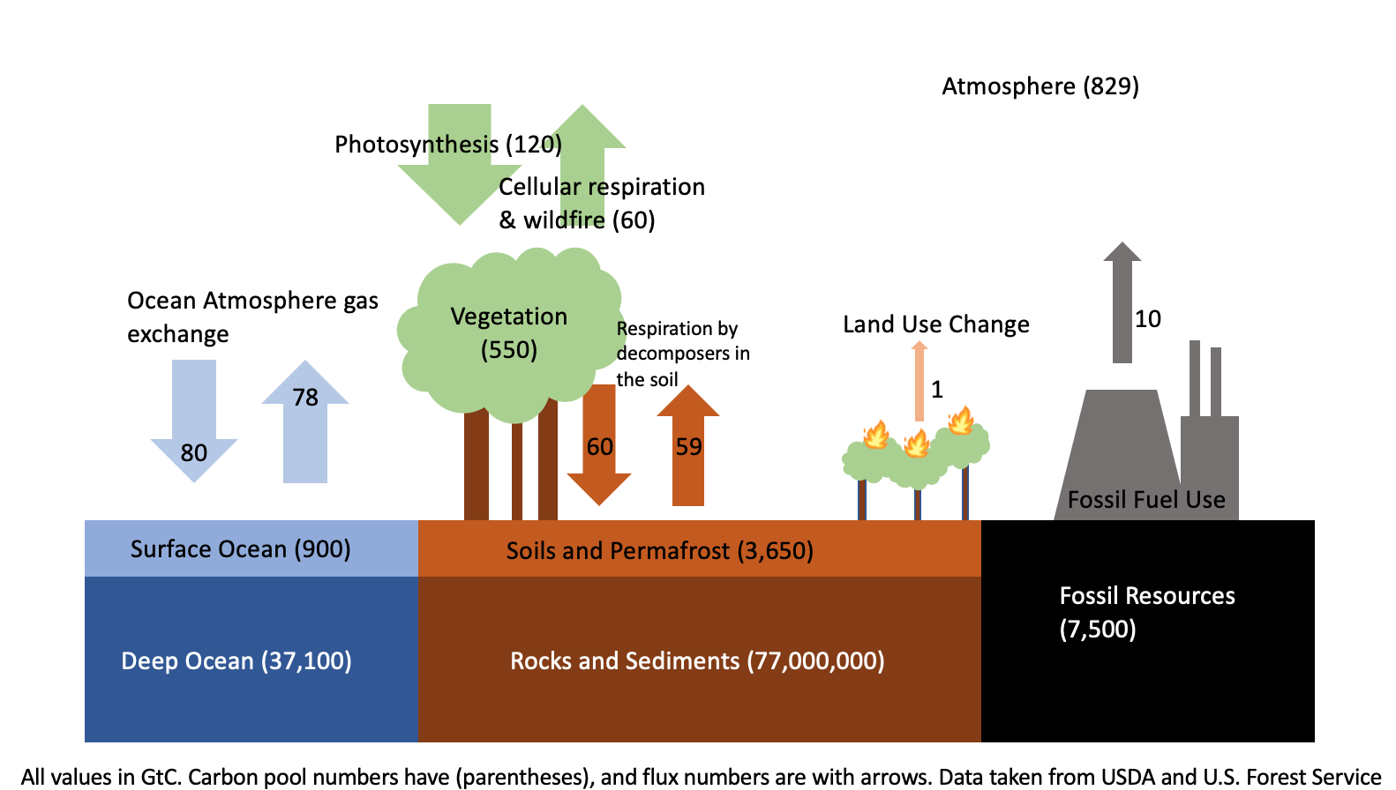
Can you use this diagram to calculate how the atmospheric carbon pool is changing?
Notes:
Work with the class to calculate how the atmospheric carbon pool is changing.
Show Slides 22 and 23 to remind students that they can use the rules for pools and fluxes (from Activity 4.3: Tiny World Modeling) to calculate how the atmospheric carbon pool is changing.

Slide 23
Rules for pools and fluxes
When fluxes into and out of a pool are balanced, pool sizes don’t change.
When fluxes into and out of a pool are not balanced, pool sizes change.
How fast the pool sizes change depends on the difference between the opposing fluxes. We call the difference the net flux.
When the incoming fluxes are bigger than the outgoing fluxes, the net flux is positive and the pool grows.
When the incoming fluxes are smaller than the outgoing fluxes, the net flux is negative and the pool shrinks.
Notes:
Work with the class to calculate how the atmospheric carbon pool is changing.
Show Slides 22 and 23 to remind students that they can use the rules for pools and fluxes (from Activity 4.3: Tiny World Modeling) to calculate how the atmospheric carbon pool is changing.

Slide 24
Can you use this diagram to calculate how the atmospheric carbon pool is changing?
Fossil fuels: 10 GtC/yr into atmosphere
Overall: 10 + 0 – 2 = 8 GtC/yr into atmosphere
Oceans: 78 GtC/yr into atmosphere – 80 GtC/yr into oceans = 2 GtC/yr out of atmosphere
Vegetation and soils: 60 + 59 + 1 GtC/yr into atmosphere – 120 GtC/yr into oceans = 0 GtC/yr overall flux
Notes:
Work with the class to calculate how the atmospheric carbon pool is changing.
After students have tried their calculations, use Slide 24 to show a way to calculate the overall net flux of carbon into the atmosphere.

Slide 25
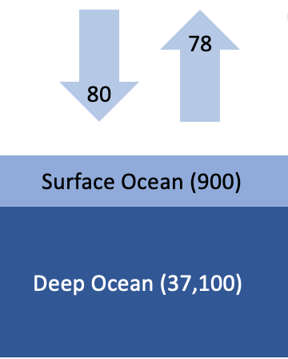
What happens when oceans absorb CO₂?
Good: Less CO₂ in the atmosphere, so slower climate change
Bad: Ocean acidification. See https://ocean.si.edu/ocean-life/invertebrates/ocean-acidification
Notes:
Work with the class to calculate how the atmospheric carbon pool is changing.
Slide 25 provides a link to more information about the effects of the carbon flux into the oceans.

Slide 26
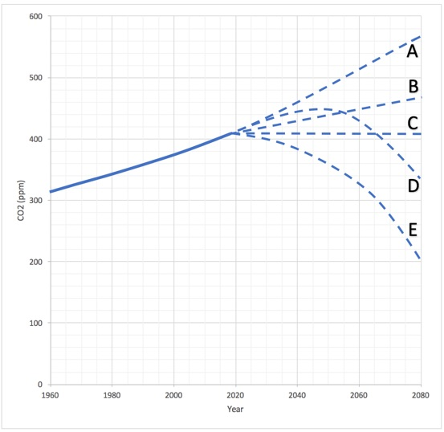
Use the Global Carbon Cycle diagram to make a more accurate prediction: What will happen to CO₂ concentrations if we cut fossil fuel use in half?
Big Idea Probe: What Would Happen If We Cut Fossil Fuel Use In Half?
Notes:
Use the Global Carbon Cycling Diagram to predict the effects of cutting fossil fuel use in half.
Slide 26 reminds students of the Big Idea probe: What Would Happen If We Cut Fossil Fuel Use In Half? Ask students if they can use the Global Carbon Cycling Diagram to calculate and answer to that question.
Have students complete Part B of 4.5: Seasons and Oceans Worksheet.
Have students check their calculations against those on Slide 28.

Slide 27
Spoiler alert!
Make your prediction in Part B of the 4.5 Seasons & Oceans Worksheet before you view the next slide!

Slide 28
Can you use this diagram to calculate how the atmospheric carbon pool is changing?
Fossil fuels: 10/2 = 5 GtC/yr into atmosphere
Overall: 5 + 0 – 2 = 3 GtC/yr into atmosphere
Oceans: 70 GtC/yr into atmosphere – 72 GtC/yr into oceans = 2 GtC/yr out of atmosphere
Vegetation and soils: 60 + 59 + 1 GtC/yr into atmosphere – 120 GtC/yr into oceans = 0 GtC/yr overall flux
Notes:
Use the Global Carbon Cycling Diagram to predict the effects of cutting fossil fuel use in half.
Have students check their calculations against those on Slide 28.

Slide 29
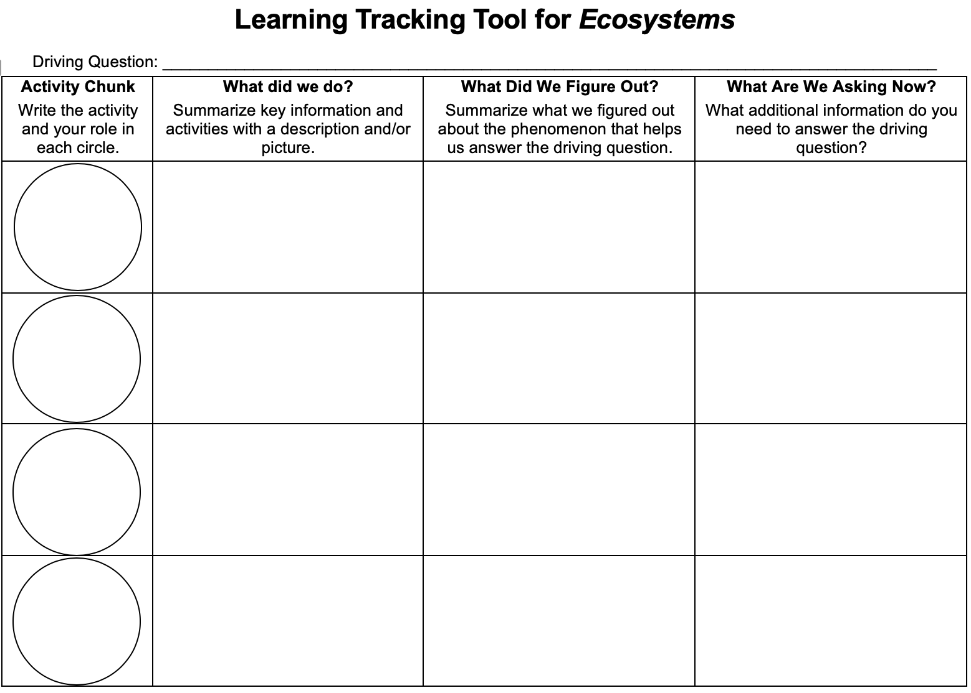
Learning Tracking Tool
Record the activity chunk name “Fossil Fuels and Carbon Pools” and their role as “Explainer.”
Discuss what you did during the activity chunk and record your ideas in the column, “What Did We Do?”
Discuss with your classmates what you figured out will help you to answer the unit driving question. Record your ideas in the column “What Did We Figure Out?”
Discuss questions you now have related to the unit driving question and record them in the column “What Are We Asking Now?”
Notes:
Have a discussion to complete the Learning Tracking Tool for this activity.
Show Slide 29 of the 4.5 Effects of Seasons and Oceans PPT.
Have students take out their Learning Tracking Tool from the previous lesson.
Have students write the activity name in the first column, "4.5 Effects of Seasons and Oceans."
Have a class discussion about what students figured out during the activity that will help them in answering the lesson driving questions:
What causes the annual cycle: CO₂ concentrations in Hawaii to go down every summer and up every winter?
What causes the long-term trend: CO₂ concentrations to go up every year?
How can we predict what will happen to CO₂ concentrations in the future?
When you come to consensus as a class, have students record the answer in the second column of the tool.
Have a class discussion about what students are wondering now that will help them move towards answering the unit driving question. Have students record the questions in the third column of the tool.
Have students keep their Learning Tracking Tool for future activities.
Example Learning Tracking Tool
Activity: Optional Activity 4.5: Effects of Seasons and Oceans
What We Figured Out: Fluxes into and out of the atmospheric CO₂ pool are mostly balanced except for one: fossil fuel combustion.
What We are Asking Now: How do we use organic carbon and emit CO₂ in our lives?

