Slide 1
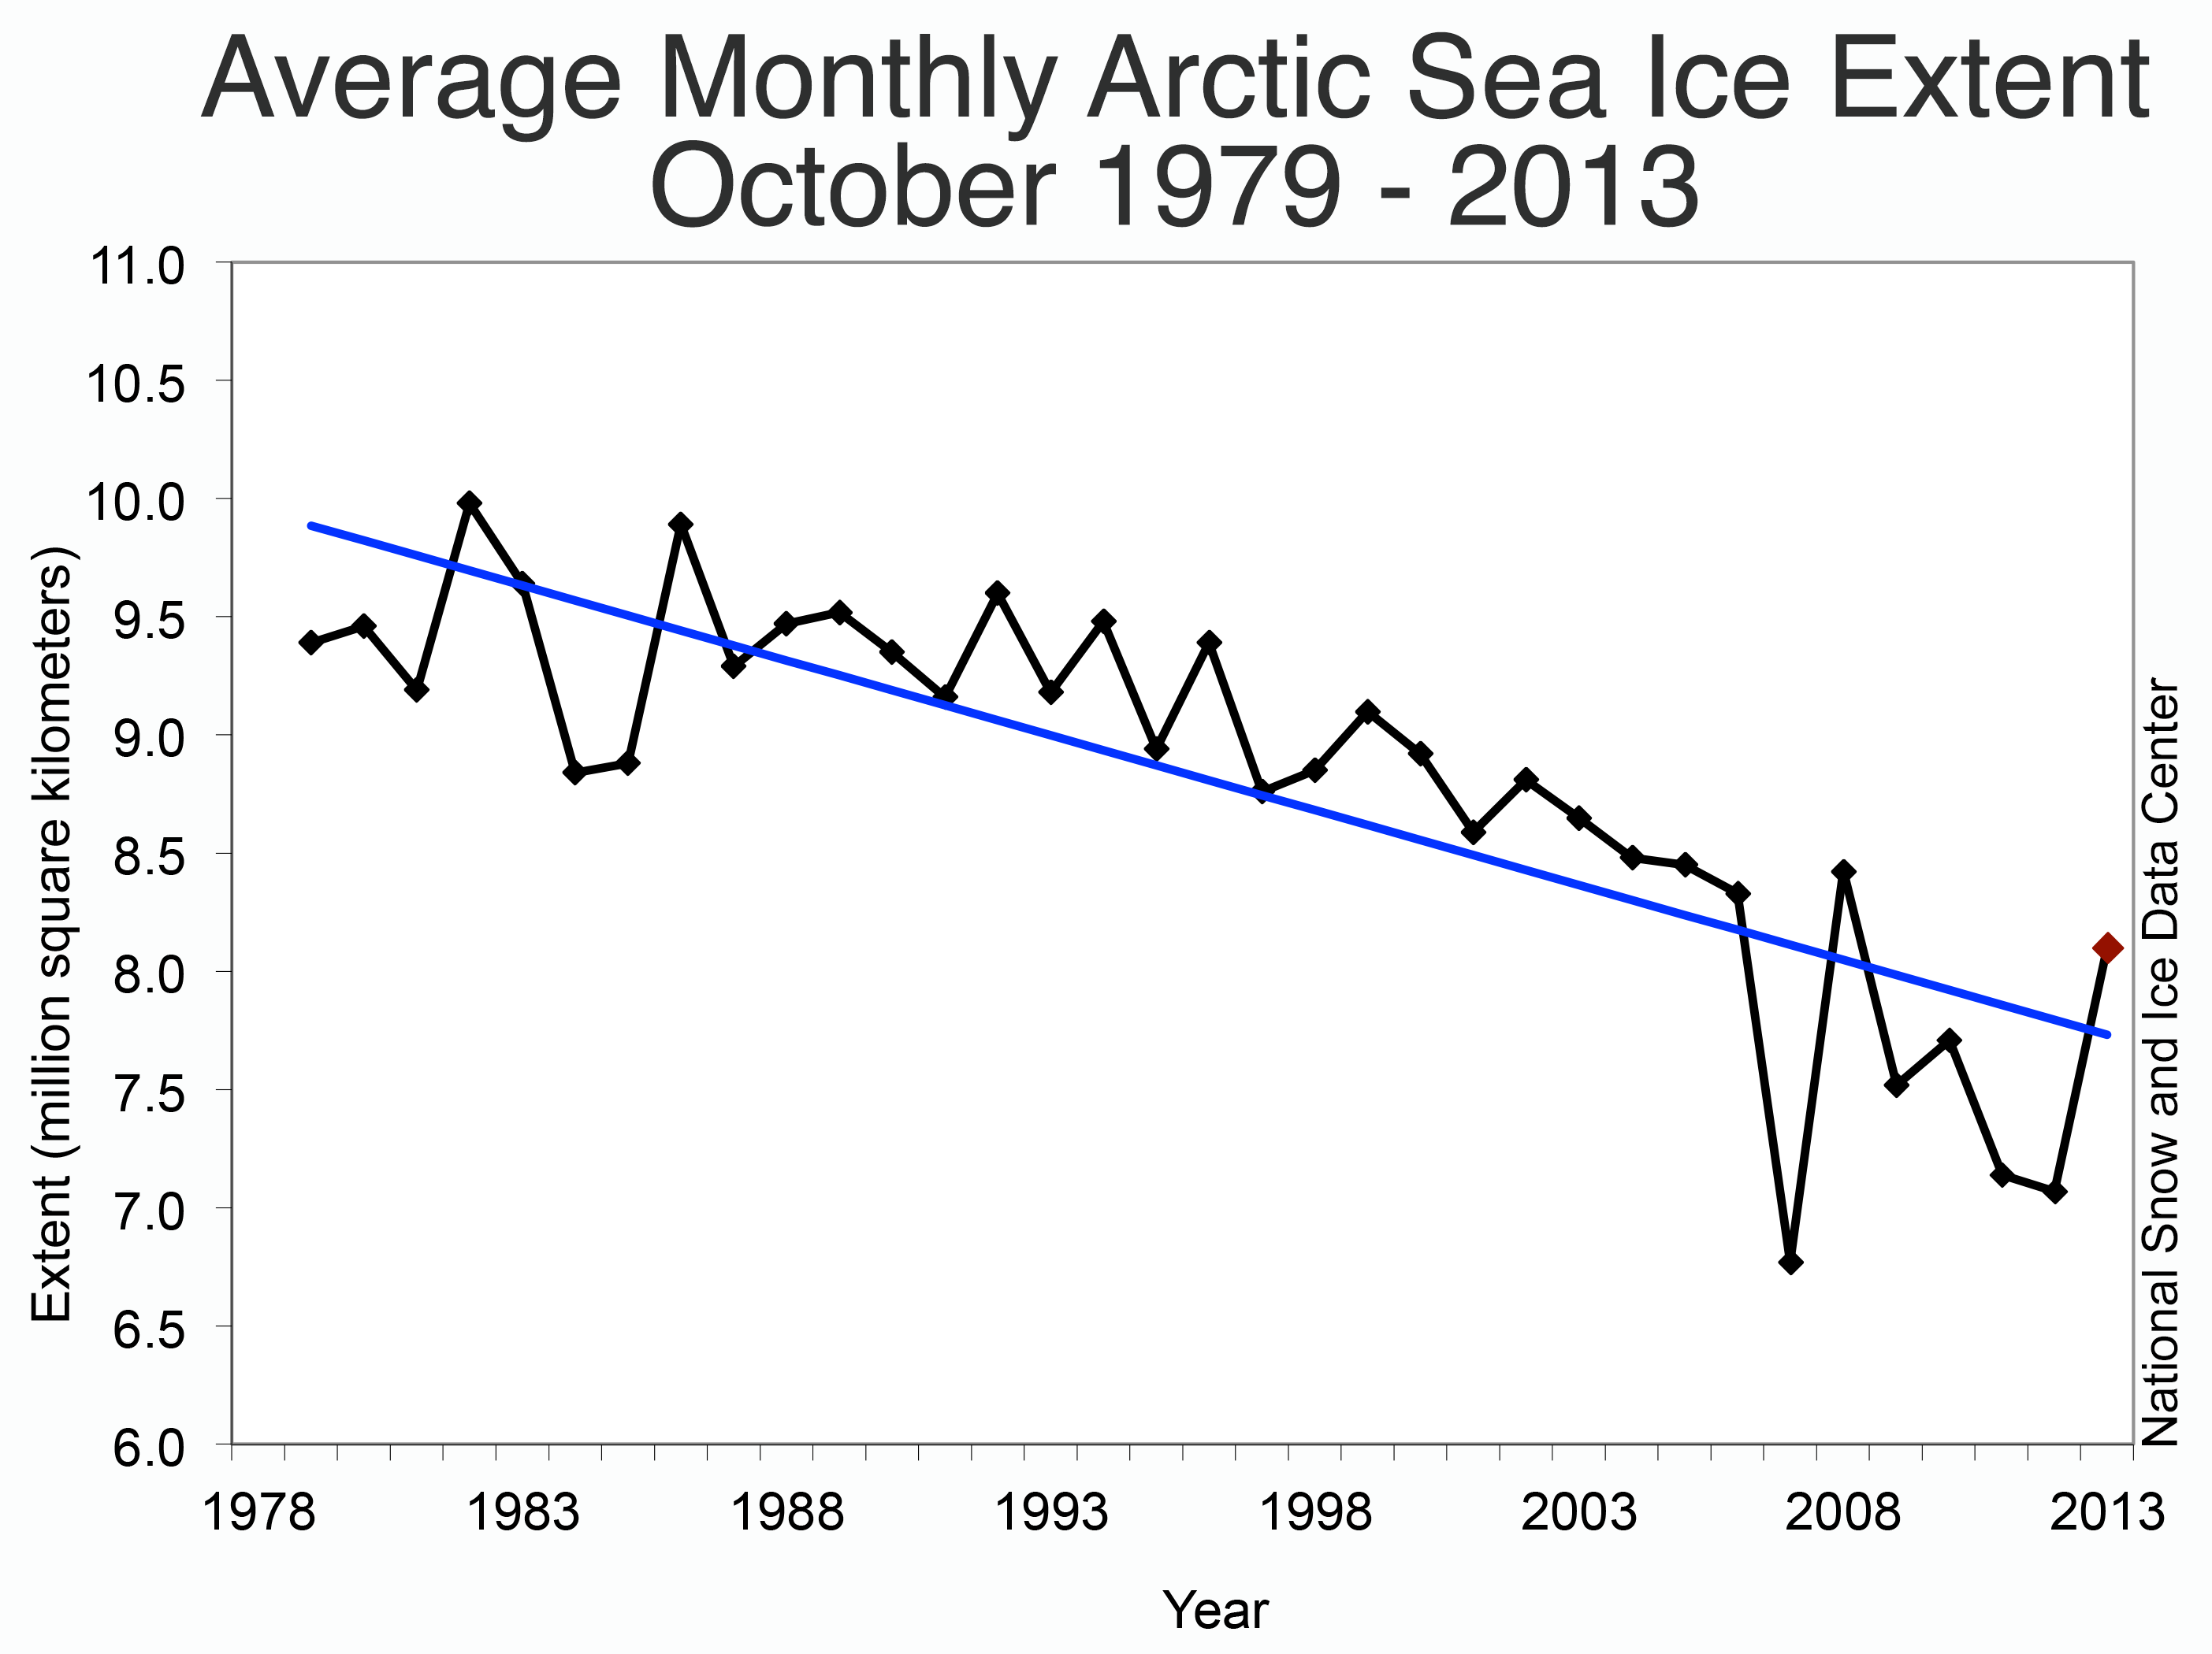
Human Energy Systems Unit Activity 2.1 Considerations for Large-Scale Data
Carbon: Transformations in Matter and Energy
Environmental Literacy Project Michigan State University

Slide 2
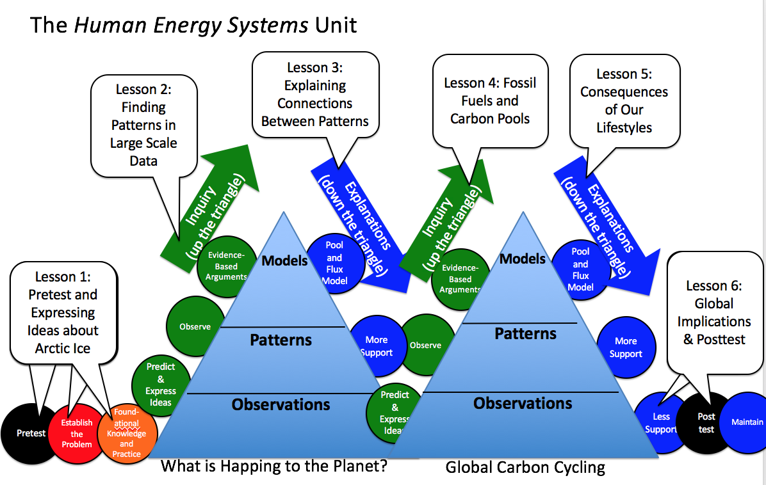
You are here
Notes:
Use the instructional model to show students where they are in the course of the unit.
Show slide 2 of the 2.1 Considerations for Large Scale Data PPT.
Introduce students to the activity.
Explain to students the purpose of this lesson is to examine other phenomenon in addition to Arctic sea ice. In this lesson, they will look at our different data sets and try to understand them. To prepare for the lesson, they will work in “home” and “expert” groups. In this first activity, they will begin in “home” groups.
Give each student a jigsaw card (see instructions on the first page of the cards for how to distribute cards). The worksheet for the CO₂ trend line (Group B) is the longest and most complex. Consider assigning cards labeled “B” to more advanced students when you pass out the jigsaw cards in this activity.
Tell students to form groups with people who have a similar picture on their card. For example: airplanes find other airplanes, gas tanks find other gas tanks. Note: see instructions on the first page of the cards for how to remove cards if your students do not divide evenly into groups of 4. Tell students who do not have a home group of 4 that they are “free agents” and have them choose a home group to join (each should choose a different home group).
Give each home group one copy of 2.1 Finding Patterns Tool for Earth Systems.
Have students create a name for their group (optional) and write their group name (and group members’ names) at the top of their worksheet.

Slide 3
Notes:
http://nsidc.org/arcticseaicenews/2013/11/a-typical-october-in-the-arctic/
Introduce the worksheet.
Tell students that in their home groups, they are going to practice analyzing the arctic sea ice data they worked on in the previous lesson. Show slide 3.
Draw students’ attention to the four columns on their worksheet. Tell them that during this activity they are going to consider four different features of the arctic sea ice data: representation, generalizability, short-term variability, and long-term trends.

Slide 4
Considerations for making sense of large-scale data
Representation
What variables are represented?
What time period is represented?
Generalizability
Which of Earth’s regions are included?
What does this data tell you about global patterns?
Short-term variation
Describe the short-term variability in the data.
Is it predictable or unpredictable?
Long-term trends
Describe the long-term trend in the data.
Is it predictable or unpredictable?
Notes:
Show slide 4 of the PPT and overview these four considerations. Point out that these four considerations are also visible on their worksheet. The goal of the jigsaw activity is to consider each of these factors for different phenomena.
Explain to students addressing the issues of representation, generalizability, short-term variability, and long-term trends are important for understanding large-scale phenomena such as the decline in Arctic Sea ice which takes place over large spatial and temporal scales.
First, we will practice in our home groups with arctic sea ice before moving on to other phenomena.

Slide 5
Notes:
http://nsidc.org/arcticseaicenews/2013/11/a-typical-october-in-the-arctic/
Watch and discuss the arctic sea ice video.
Begin by showing the video from NOAA that shows arctic sea ice extent from 1990-2016 (https://www.youtube.com/watch?v=c6jX9URzZWg). You may wish to pause the video and help students interpret what they are seeing. Students should notice the overall trend: the extent and age of Arctic Sea ice appears to decrease over the period of 1990-2016.
Use slide 5 of the PPT to display the graph of the Artic Sea ice data and give students a minute to individually interpret it.
Ask students to share their interpretation of the graph with their home groups, then have a few students share with the whole class to check for understanding.
Students should recognize that the October average Artic Sea ice extent demonstrates a negative trend for the period 1979 – 2013.

Slide 6
Questions about Arctic Sea Ice
a. What is sea ice? Sea ice is frozen ocean water and only exists in the Arctic and Antarctic. When sea water freezes, it freezes just the water and the salt is forced out into the surrounding ocean water. Sea ice grows during the winter months and some melts during the summer.
b. How do we measure sea ice? Scientists have been using photos taken by satellites measure the extent of sea ice since the 1970s.
c. Why is sea ice important? Sea ice slows down global warming. Sea ice is mostly white, so when sunlight hits the surface of sea ice, most of the energy is reflected right back where it came from—space. Less sea ice means the earth’s surface has more dark ocean water, which absorbs solar energy. So sea ice is kind of like air conditioning. You can learn more about why sea ice matters in this short video: https://youtu.be/MIMuPW4Lebg
Notes:
Show slide 6. Discuss as a class the answers to the questions about arctic sea ice. You may choose to show the short video on why arctic sea ice matters (https://youtu.be/MIMuPW4Lebg).

Slide 7
Note: Fill out only the Arctic Sea Ice row of the Finding Paterns Tool. You will complete the other rows later.
Representation • What variables? • What time period? | Generalizability Which regions are included? What does this tell you about global patterns | Short-term variability What is the short-term variability in the data? • What is the long-term trend? Is it predictable or unpredictable? | Long Term Trend What is the long-term trend? Is it predictable or unpredictable?
Notes:
Have students complete the tool for Arctic Sea Ice in their home groups.
Instruct each group to complete the first row of their tool as a small group. Students may find it helpful to designate one person as the recorder.
Explain to students they will use this table as a tool for making sense of five different phenomena: Artic Sea ice extent, global temperature, sea level, atmospheric CO₂ concentration, and the atmospheric CO₂ annual cycle. The first row of the table will be filled out as a class to demonstrate the process
Give students about 10 minutes to complete the row, circulating in the classroom and helping them with questions.
Listen to the types of questions that come up in the groups and bring common questions to the class.
Help the class reach consensus.
Tell students that in scientific communities, an important practice is to discuss evidence and data to come to a shared understanding of what is happening. This is called “reaching consensus.”
Use slide 7 to record the class consensus (type on the slide) about the four considerations for the Arctic Sea ice graph.
Help students revise the ideas until consensus is reached for each box.
Use the example in the assessment section below to help guide students to the ideas represented in the example chart.

Slide 8
How do these considerations help us make sense of large-scale data?
What do we mean by “large-scale” data?
How do graphs help simplify what we observe & measure (as compared to video animations for example)?
What do we mean by representation?
What do we mean by generalizability?
What do we mean by short-term variability?
What do we mean by long-term trends?
How do trend lines help us visualize long-term trends?
Notes:
Discuss the consensus.
Use slide 8 to prompt more discussion of the answers you reached during the consensus discussion. Use this as formative assessment to see if all of your students understand what is meant by “representation,” “generalizability,” “short-term variation” and “long-term trend.”
When we talk about “representation,” we want to know which data are represented, how they are represented, and over what time period.
When we talk about “generalizability,” we want to know if the data in one graph or data set are representative only of their local region, or if they are generalizable to other places on the planet, too.
When we talk about “short-term variation,” we want to look for how the data change in a short period of time. Note: a “short period of time” will change depending on the time period represented in the graph. In the arctic sea ice graph, “short-term” is year to year, and “long-term” is the entire span of the graph. This is different for different graphs.
When we talk about “long-term trend,” we want to know what overall change you see in the entire graph. .

