Slide 1

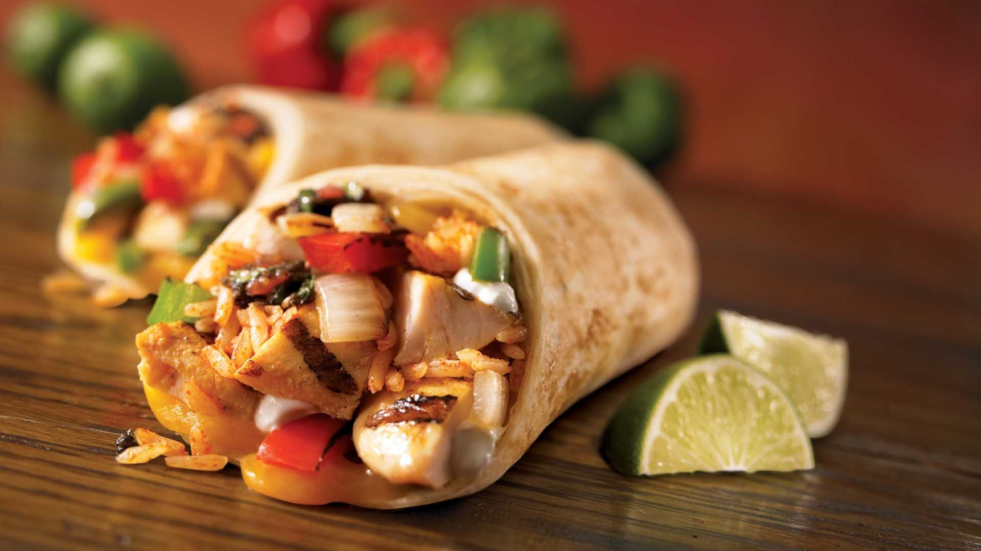
Ecosystems Unit
Community Connections: Do my food choices matter?
Carbon: Transformations in Matter and Energy
Environmental Literacy Project
Michigan State University

Slide 2
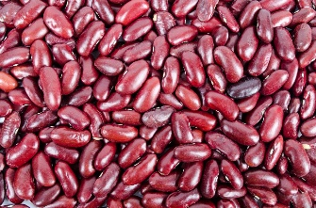
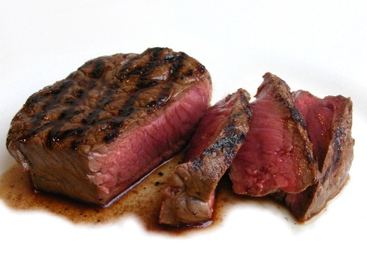
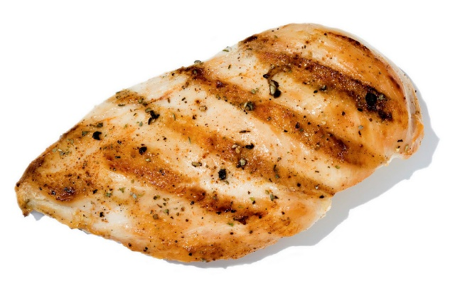
Do my food choices affect the environment?
For lunch, you have a choice of bean, chicken, or beef burritos. Does your choice affect the environment? Why or why not?
Notes:
Get students’ predictions of if and how their burrito choice affects the environment.
Pass out Food Choice Handout.

Slide 3
Food ingredients come from ecosystems
Food ingredients are the products of ecosystems
Unless you grow your own food, all your food is the product of chains of multiple ecosystems.
These ecosystems are managed by people to maximize production.
Notes:
Have students read Do My Food Choices Matter Reading

Slide 4
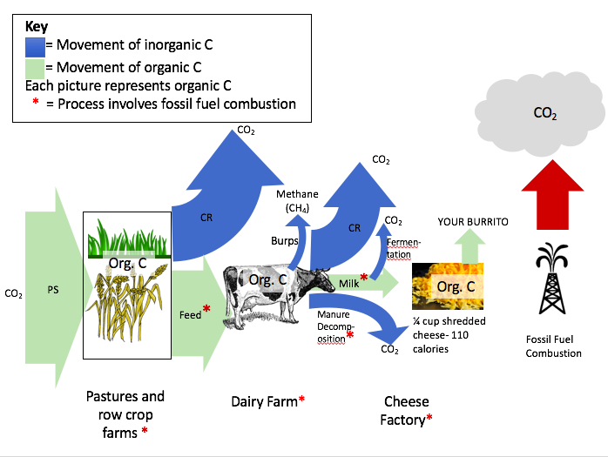
Discussion question
Which ecosystems are most like unmanaged ecosystems in the way they transform carbon?

Slide 5
How agricultural ecosystems affect the environment
One important way that agricultural ecosystems affect the environment is through the use of fossil fuels.
Most of our food comes from farms that use fossil fuels to power equipment that is used to manage the agricultural ecosystems and to transport and process ecosystem products.
In addition, a large amount of fossil fuels are burned to manufacture nitrogen fertilizer used on row crops.

Slide 6
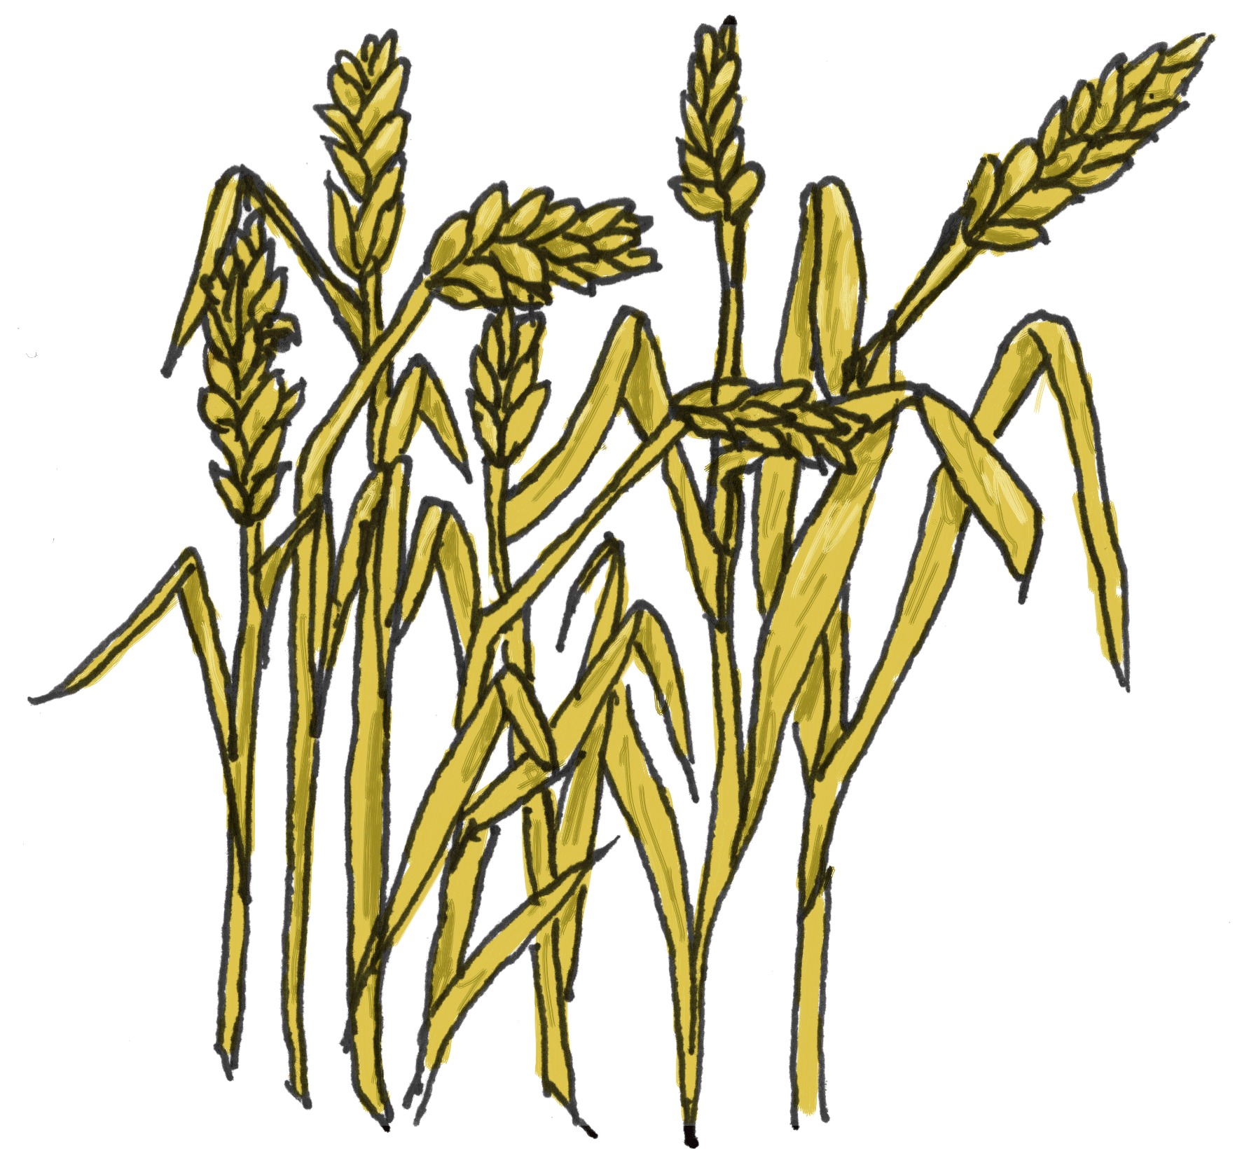
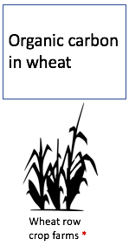
Discussion Question
Look at the chain of ecosystems that produces each ingredient in the burrito.
The red asterisks indicate the use of fossil fuels.
Identify the processes (indicated with red asterisks) that require fossil. For example, in the wheat row crop farm, the machines that plant and harvest the wheat use fossil fuels.

Slide 7
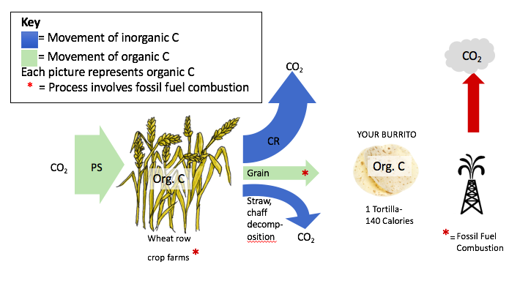
Tortilla ecosystem chain
Notes:
Identify the processes (indicated with red asterisks) that require fossil fuel as energy sources.
Wheat row crop farm – planting, harvesting, and fertilizing equipment; fertilizer production
Transporting and processing wheat into flour and eventually tortillas

Slide 8
Cheese ecosystem chain
Notes:
Pasture land – harvesting hay, maybe fertilizing
Row crop farm – planting, fertilizing, harvesting; fertilizer production
Transportation of food to cattle
Cooling, transporting, and processing milk into cheese
Manure releases greenhouse gases

Slide 9
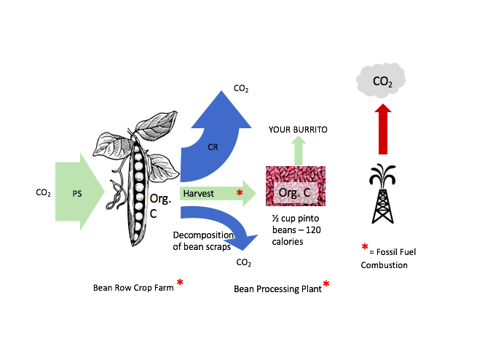
Bean ecosystem chain
Notes:
Planting, fertilizing, harvesting beans; fertilizer production (though beans are legumes and need less N than other crops)

Slide 10
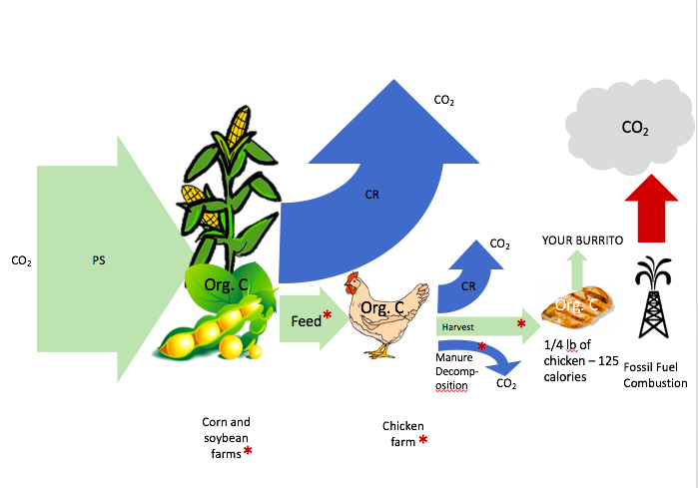
Chicken ecosystem chain
Notes:
Row crop farms – planting, fertilizing, harvesting crops; fertilizer production
Transport of feed and chicks to chicken ranches
Heating and running feeding & watering equipment; removing manure
Transport and processing of chicken

Slide 11
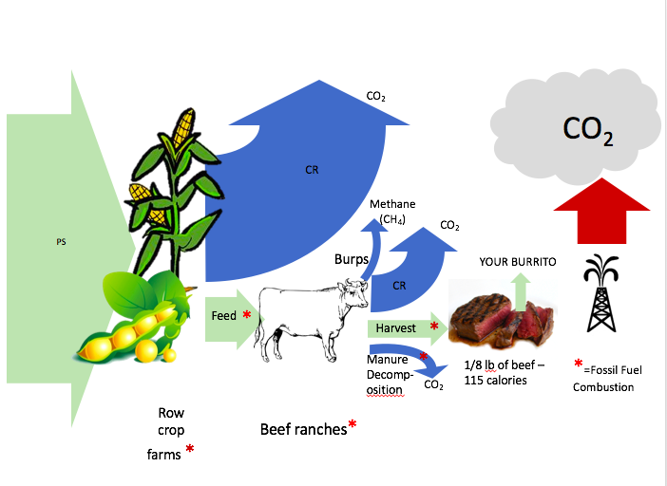
Beef ecosystem chain
Notes:
For simplicities’ sake, we have drawn all of the different stages of beef production that we learned about in Reading 5.2 as one place – the beef ranches.
Row crop farms – planting, fertilizing, harvesting grain; fertilizer production
Transport of feed
Transport of cattle at different stages; manure removal
Transport and processing of beef

Slide 12
What is a carbon footprint?
The carbon footprint is a measure of the net amount of carbon that is released into the atmosphere when something is made and used.
Notes:
Get students’ ideas before showing definition.
Handout Do My Food Choices Matter Worksheet

Slide 13
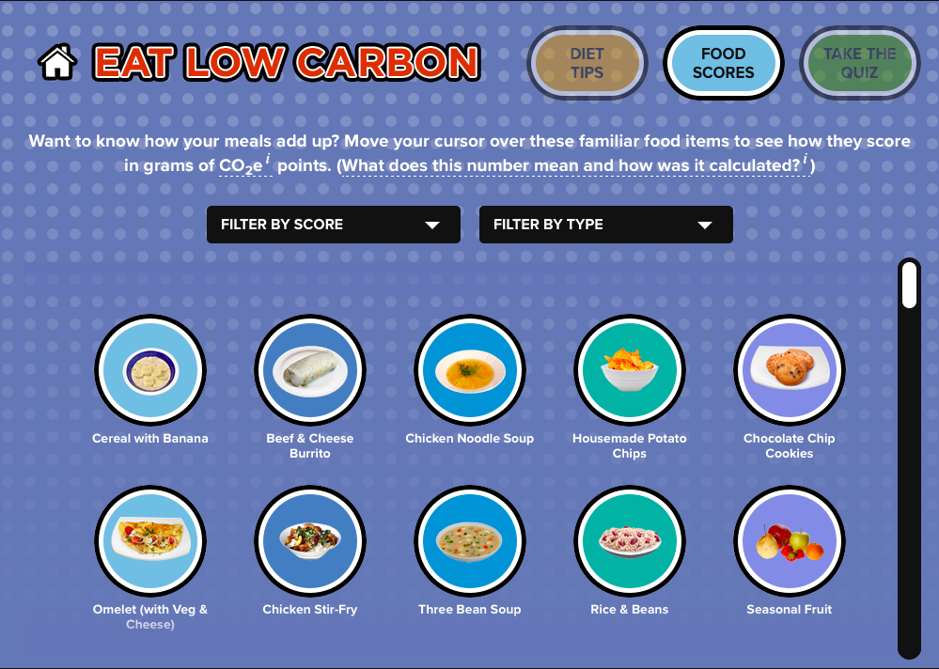
Carbon footprint calculator
Use the online carbon footprint calculator
http://www.eatlowcarbon.org/food-scores/
To calculate the carbon footprint of each type of burrito and some of your favorite foods.
Notes:
Note: the carbon footprint usually given as mass of CO2 equivalents. If greenhouse gases other than CO2 are emitted, their footprint is calculated as the amount of CO2 that would have the same warming effect.

Slide 14
Carbon footprint of different foods
Food | C Footprint (g CO₂ eq) | Food | C Footprint (g CO₂ eq) | Food | C Footprint (g CO₂ eq)
Beef cheese burrito
Chicken cheese burr.
Bean cheese burrito
Notes:
Collect students’ C footprint findings in table. Ask students to identify patterns. What kinds of foods typically have large footprints? Which ones have low footprints?

Slide 15
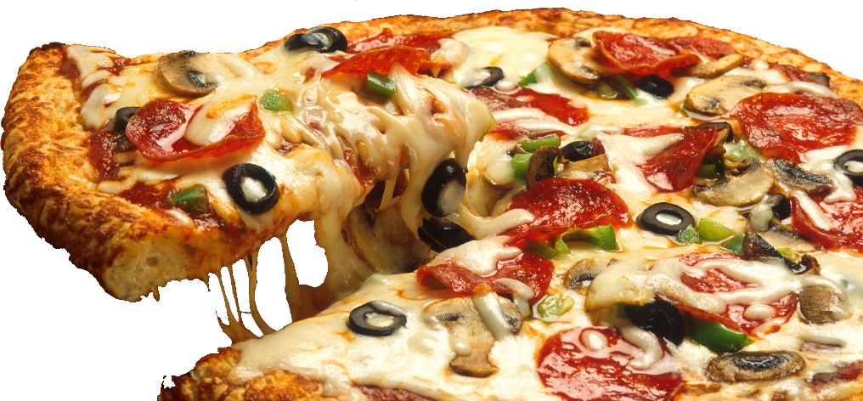
Other patterns in the carbon footprints of foods
Which of your favorite foods have large carbon footprints?
Which of your favorite foods have small carbon footprints?
How do you explain these?
Notes:
Have students complete the worksheet and then discuss these Qs. Whose favorite food has the highest carbon footprint? Lowest? Why?

