Slide 1
Ecosystems Unit Activity 5.3b: Ecosystem Posters
Carbon: Transformations in Matter and Energy
Environmental Literacy Project Michigan State University
Notes:
Image Credit: Craig Douglas, Michigan State University

Slide 2
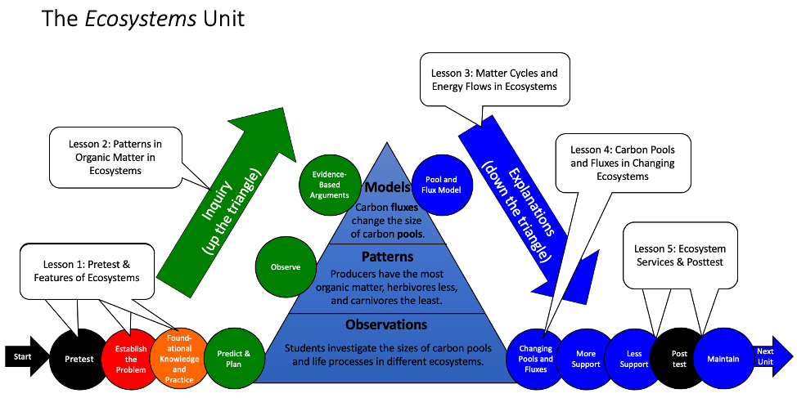
Unit map
You are here
Notes:
Use the instructional model to show students where they are in the course of the unit.
Display slide 2 of the 5.3b Ecosystem Posters PPT.

Slide 3
What makes an ecosystem?
Notes:
Have a class discussion about the elements of an ecosystem.
Show Slide 3.
Have a whole class discussion about what makes an ecosystem worksheet.
Focus on the question: what elements does an ecosystem need? Make sure students note the need for producers, herbivores, carnivores, soil carbon, carbon dioxide, and sun.

Slide 4
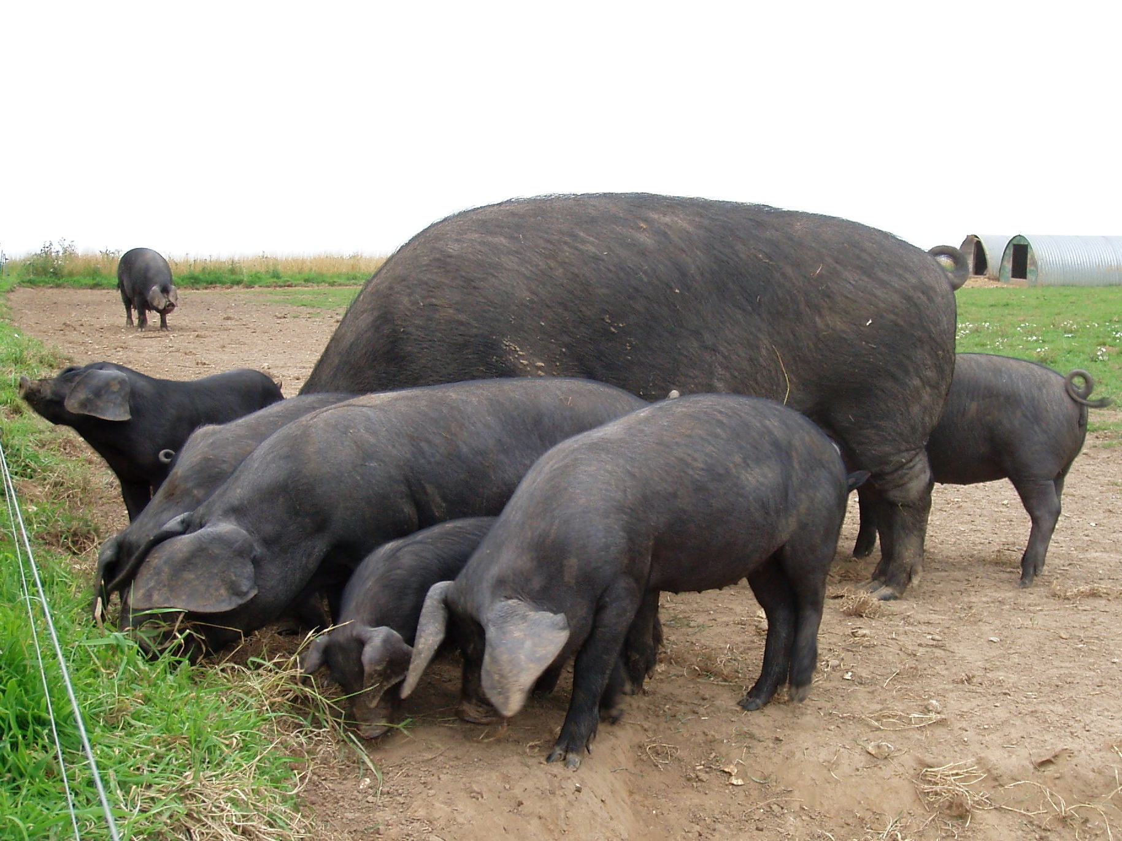
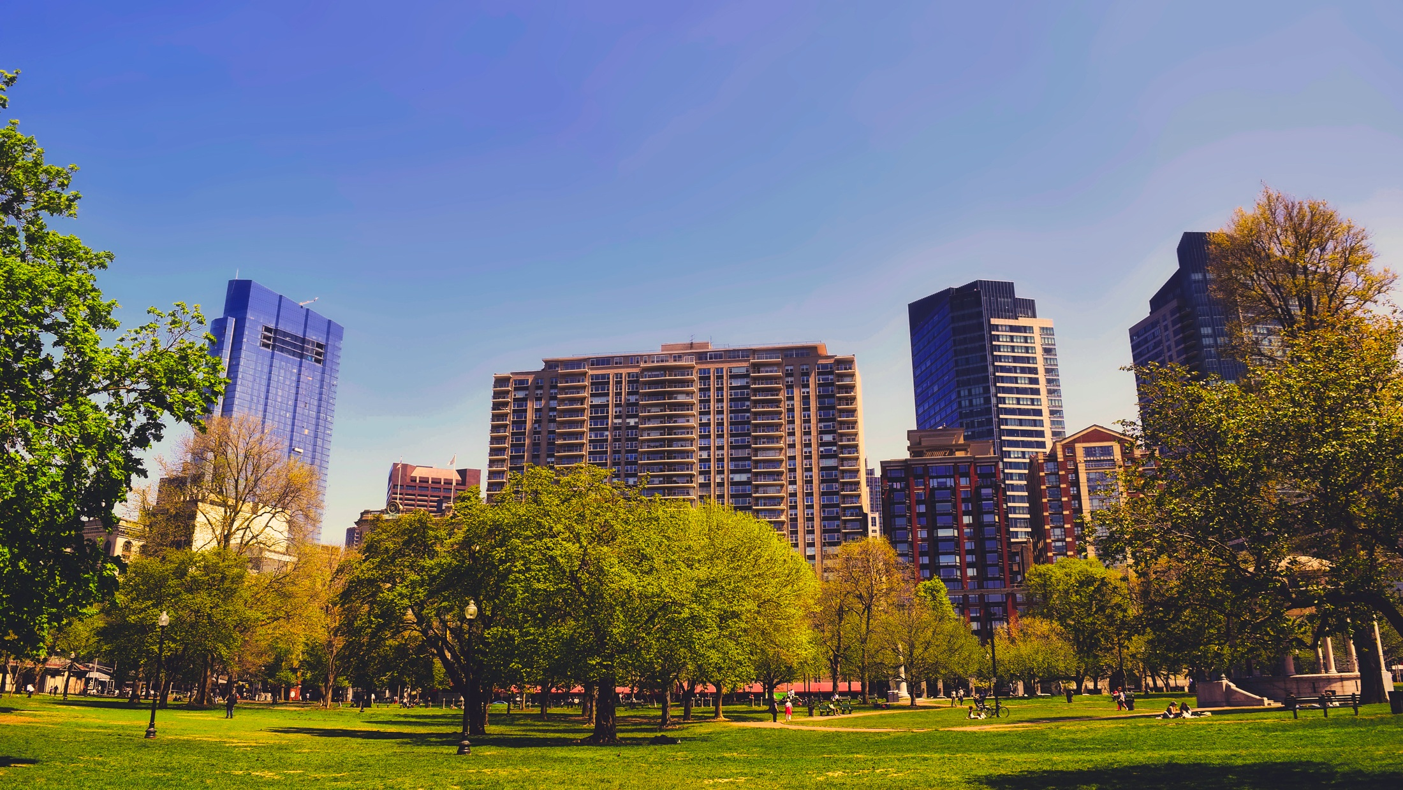
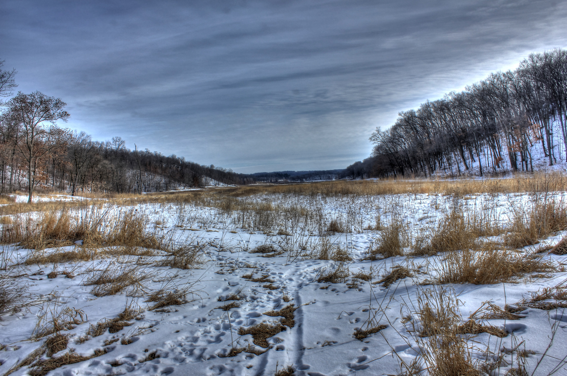
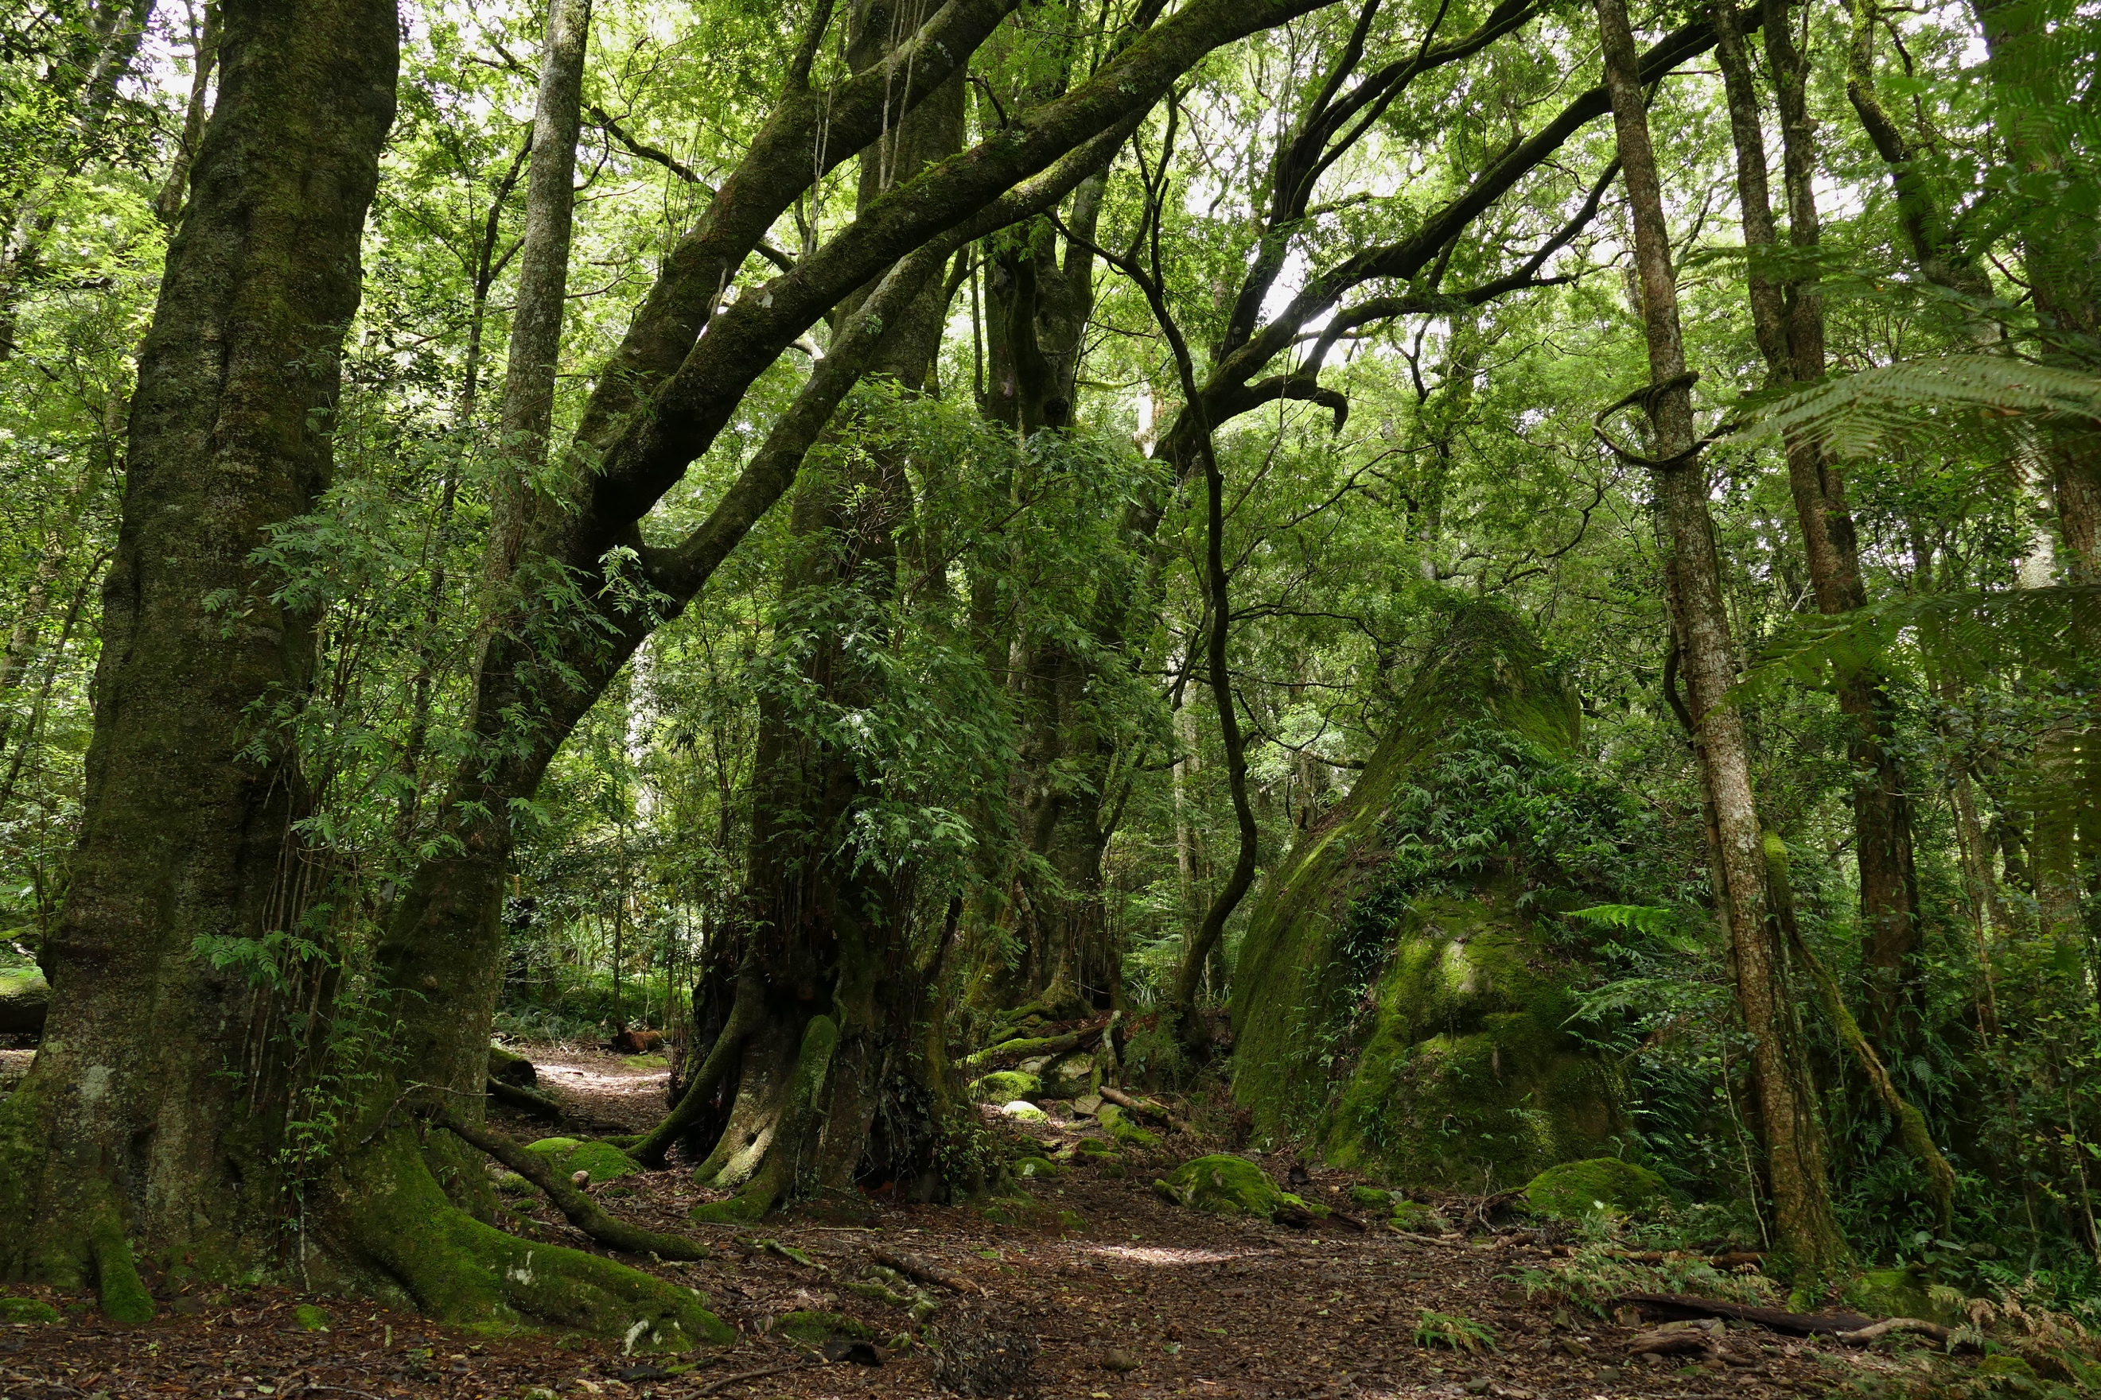
Ecosystem Posters
Notes:
Students work in groups on their ecosystem posters.
Display slide 4 of 5.3b Ecosystem Posters PPT.
Divide students into groups of four.
Pass out a 5.3b Ecosystem Posters Handout and a poster to each group.
Have each group choose which ecosystem they will focus on, making sure that at least one group is doing each of the ecosystems.
Have students to continue to work through the questions on 5.3b Ecosystem Posters Handout. All questions will be completed on the poster.

Slide 5
Gallery Walk
What are the carbon pools and what is in each carbon pool?
How does carbon move within the ecosystem?
How does energy flow through the ecosystem?
How does the disturbance effect the ecosystem?
What are the products and services provided by the ecosystem?
Notes:
Students do a gallery walk of the posters.
Display slide 5 of the 5.3b Ecosystem Posters PPT. Display each of the posters around the room.
Have groups walk around the room and look at each poster. While at each poster, students should discuss the questions on slide 5.

Slide 6
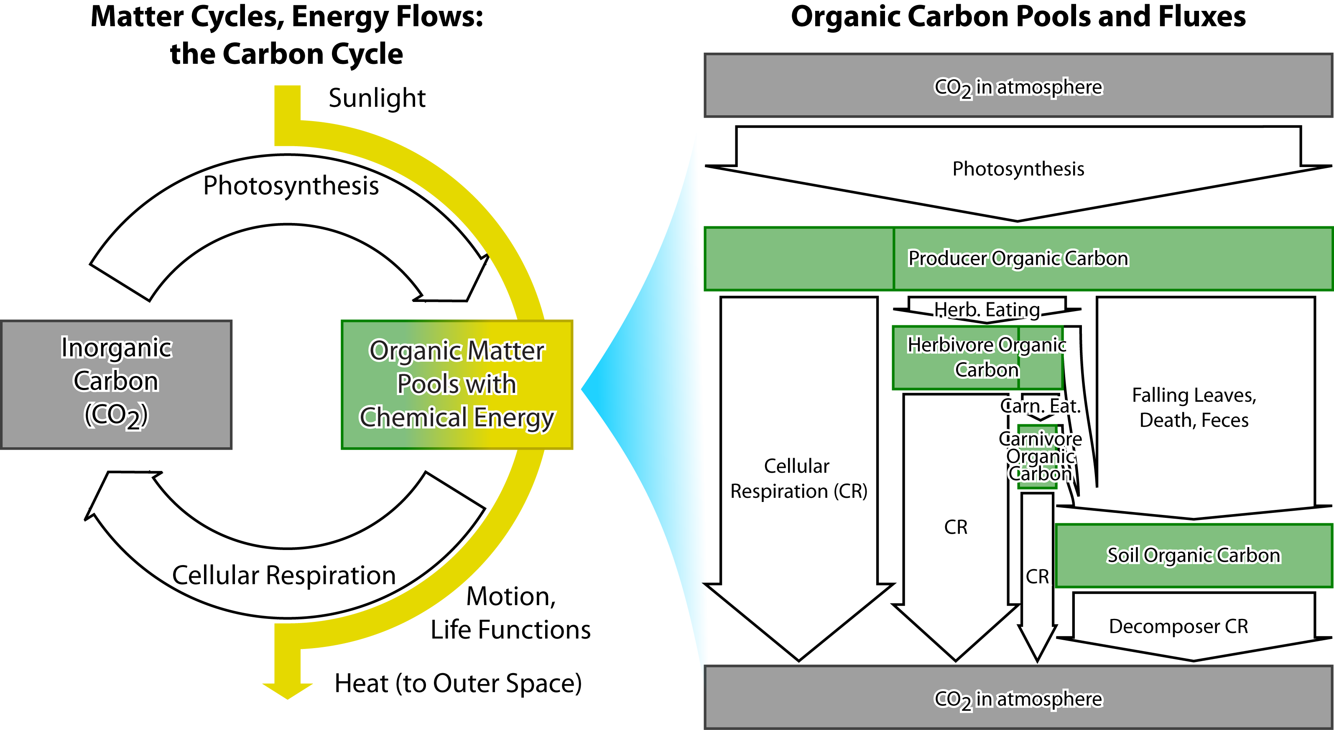
Matter and Energy in Ecosystems
Notes:
Have a whole class review discussion.
Using slide 6, have a whole class discussion about how carbon cycles and energy flows in ecosystems using the carbon cycling diagram.
Image Credit: Craig Douglas, Michigan State University

