Slide 1
Ecosystems Unit Activity 4.4 Seasonal Changes and Ecosystem Disturbances
Carbon: Transformations in Matter and Energy
Environmental Literacy Project Michigan State University
Notes:
Image Credit: Craig Douglas, Michigan State University

Slide 2
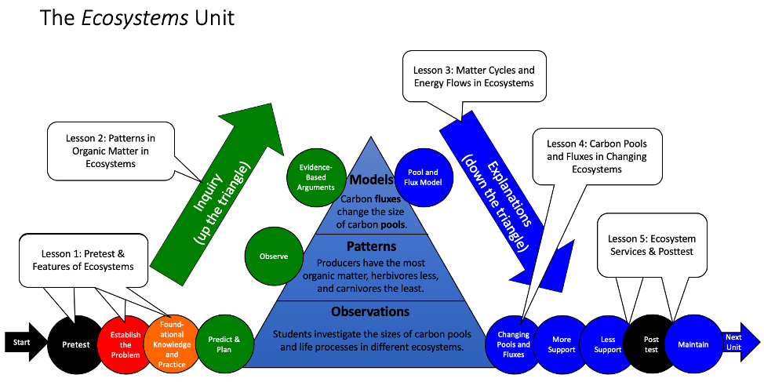
Unit map
You are here
Notes:
Use the instructional model to show students where they are in the course of the unit.
Show Slide 2 of the 4.4 Seasonal Changes and Ecosystem Disturbances PPT.

Slide 3
Review of Changing Fluxes Model
What patterns did you find in the Changing Fluxes Model?
How does a photosynthesis limit lead to stable carbon pools?
What are other ways that pools and fluxes can change?
Notes:
Review the Constant and Changing Fluxes Models and introduce the Seasons and Disturbances Model.
Show Slide 3. Review what students concluded from the Constant and Changing Fluxes Models.

Slide 4
Computer Model for Seasons and Disturbances
Read the handout until Section A to review the Constant Flux and Changing Fluxes Simulations.
What did you learn from the first two simulations?
How is Model 3 different?
Notes:
Review the Constant and Changing Fluxes Models and introduce the Seasons and Disturbances Model.
Show Slide 4. Pass out the 4.4 Computer Model for Seasons and Disturbances Handout to each student.
In partners or as a whole class, have students read the handout until Part A.
Discuss what students learned from the first two models and how Model 3 is different.
https://carbontime.bscs.org/sites/default/files/simulations/pool-flux-simulation-updated/index.html

Slide 5
The Seasons
Model 3 without seasonal variation
Carrying capacity = 90 kg/yr
Atmospheric pool = 500 kg
Organic carbon pool = 500 kg
Notes:
Students run the simulation.
Pass out 4.4 Computer Model for Seasons and Disturbances Worksheet to each student.
Have students follow the directions on 4.4 Computer Model for Seasons and Disturbances Handout to complete Part A and B on their worksheet.
(Optional) Use Slides 5-11 to go through Part A and B with the students. The questions can be completed together using the slides.

Slide 6
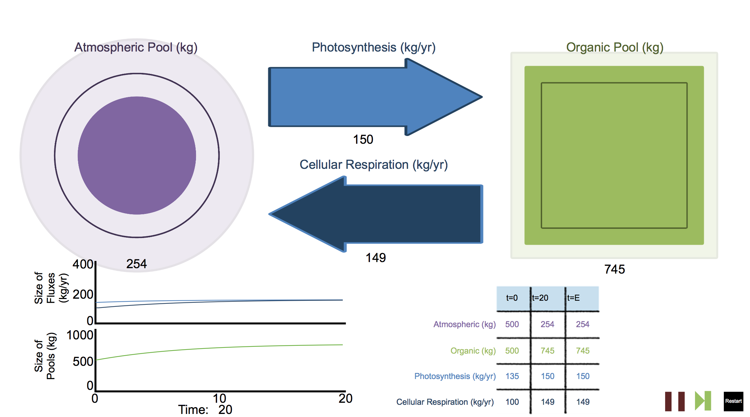
Notes:
Students run the simulation.
Pass out 4.4 Computer Model for Seasons and Disturbances Worksheet to each student.
Have students follow the directions on 4.4 Computer Model for Seasons and Disturbances Handout to complete Part A and B on their worksheet.
(Optional) Use Slides 5-11 to go through Part A and B with the students. The questions can be completed together using the slides.

Slide 7
Question 1
 | Year 14.0 | Year 16.0
Photosynthesis flux
Cellular respiration flux
Organic matter pool
Notes:
Students run the simulation.
Pass out 4.4 Computer Model for Seasons and Disturbances Worksheet to each student.
Have students follow the directions on 4.4 Computer Model for Seasons and Disturbances Handout to complete Part A and B on their worksheet.
(Optional) Use Slides 5-11 to go through Part A and B with the students. The questions can be completed together using the slides.

Slide 8
The Seasons
Model 3 with seasonal variation
Carrying capacity = 90 kg/yr
Atmospheric pool = 500 kg
Organic carbon pool = 500 kg
Notes:
Students run the simulation.
Pass out 4.4 Computer Model for Seasons and Disturbances Worksheet to each student.
Have students follow the directions on 4.4 Computer Model for Seasons and Disturbances Handout to complete Part A and B on their worksheet.
(Optional) Use Slides 5-11 to go through Part A and B with the students. The questions can be completed together using the slides.

Slide 9
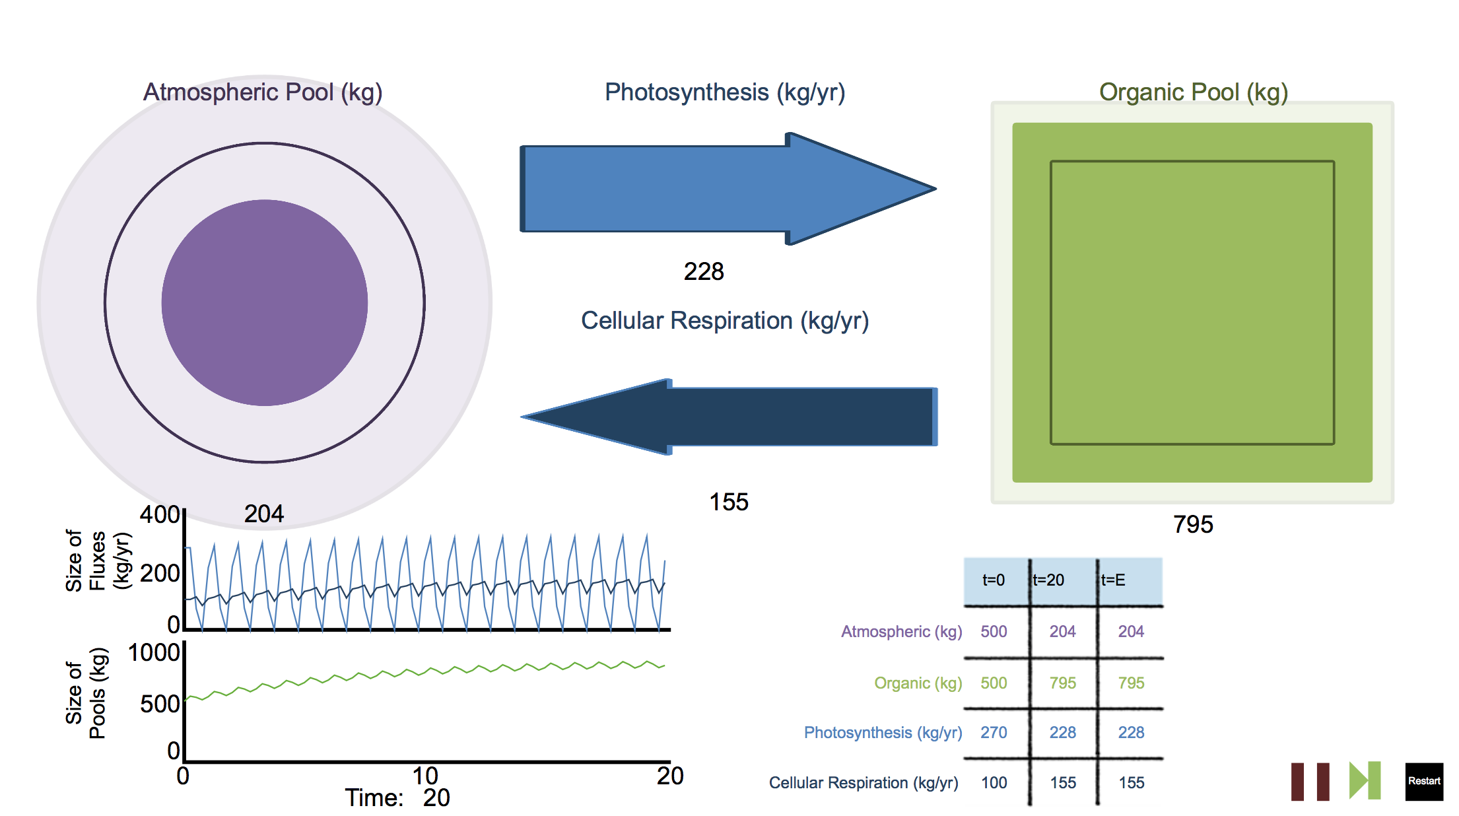
Notes:
Students run the simulation.
Pass out 4.4 Computer Model for Seasons and Disturbances Worksheet to each student.
Have students follow the directions on 4.4 Computer Model for Seasons and Disturbances Handout to complete Part A and B on their worksheet.
(Optional) Use Slides 5-11 to go through Part A and B with the students. The questions can be completed together using the slides.

Slide 10
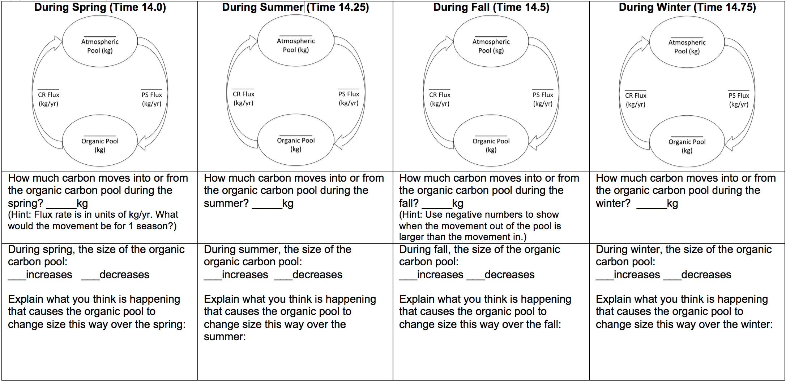
Question 2
Notes:
Students run the simulation.
Pass out 4.4 Computer Model for Seasons and Disturbances Worksheet to each student.
Have students follow the directions on 4.4 Computer Model for Seasons and Disturbances Handout to complete Part A and B on their worksheet.
(Optional) Use Slides 5-11 to go through Part A and B with the students. The questions can be completed together using the slides.

Slide 11
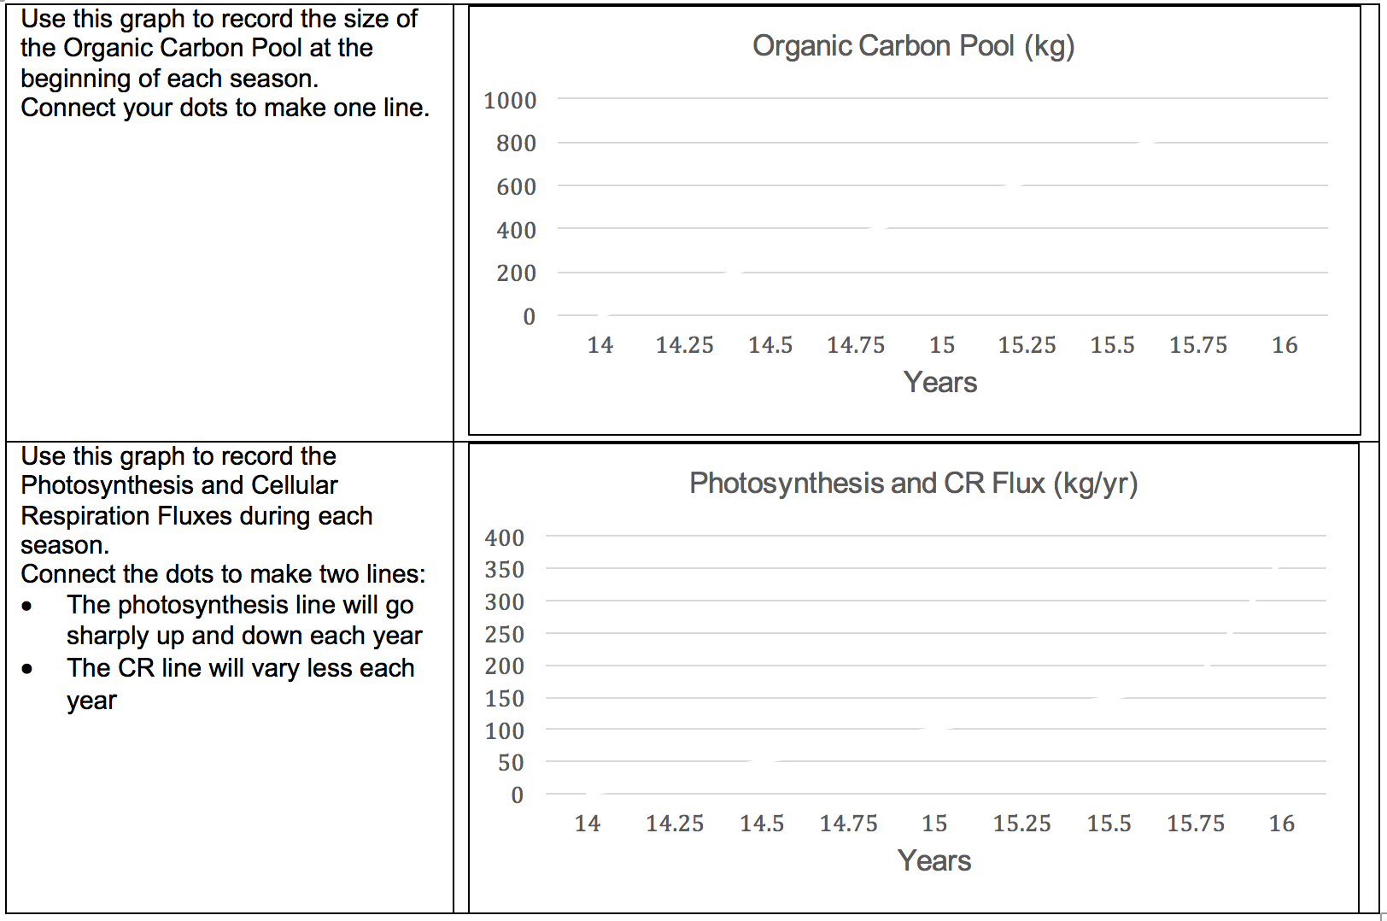
Question 3
Notes:
Students run the simulation.
Pass out 4.4 Computer Model for Seasons and Disturbances Worksheet to each student.
Have students follow the directions on 4.4 Computer Model for Seasons and Disturbances Handout to complete Part A and B on their worksheet.
(Optional) Use Slides 5-11 to go through Part A and B with the students. The questions can be completed together using the slides.

Slide 12
Press and Pulse Disturbances
Notes:
Students continue to run the simulation.
Have students follow the directions on 4.4 Computer Model for Seasons and Disturbances Handout to complete Part C on their worksheet.
(Optional) Use Slide 12 to go through Part C with the students.

Slide 13
Disturbances in Real Ecosystems
Read about disturbances in real ecosystems.
What are some examples of press and pulse disturbances? Record your answer for Question 6 on your worksheet.
Notes:
Students read about disturbances in real ecosystems.
Show Slide 13.
Have students read the last section of 4.4 Computer Model for Seasons and Disturbances Handout about disturbances in real ecosystems.
Have students answer Part D of their worksheet.

Slide 14
Discussion
How do the pools and fluxes change during seasons? Why?
How do press and pulse disturbances affect pools and fluxes in ecosystems?
Notes:
Discuss the patterns.
Show Slide 14. Have students share and discuss their answers to questions.

Slide 15
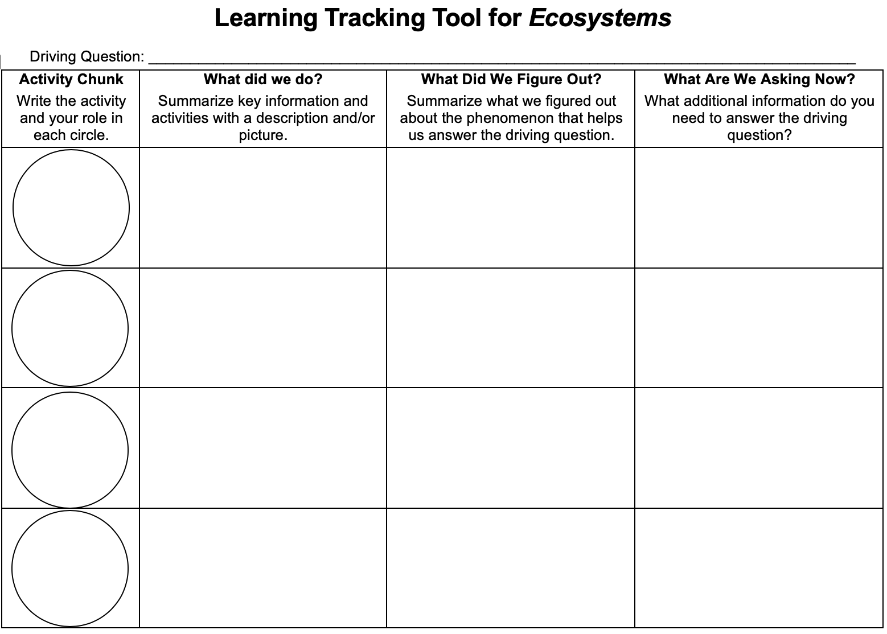
Learning Tracking Tool
Record the activity chunk name “Carbon Pools and Fluxes, Explainers”
Discuss what you did during the activity chunk and record your ideas in the column, “What Did We Do?”
Discuss with your classmates what you figured out will help you to answer the unit driving question. Record your ideas in the column “What Did We Figure Out?”
Discuss questions you now have related to the unit driving question and record them in the column “What Are We Asking Now?”
Notes:
Have a discussion to complete the Learning Tracking Tool for this activity.
Show slide 15 of the 4.4 Seasonal Changes and Ecosystem Disturbances PPT.
Pass out a Learning Tracking Tool for Ecosystems to each student.
Have students write the activity chunk name in the first column, "Carbon Pools and Fluxes, Explainers"
Have a class discussion about what students did during the activity chunk. When you come to consensus as a class, have students record the answer in the second column of the tool.
Have a class discussion about what students figured out during the activity chunk that will help them in answering the unit driving question. When you come to consensus as a class, have students record the answer in the third column of the tool.
Have a class discussion about what students are wondering now that will help them move towards answering the unit driving question. Have students record the questions in the fourth column of the tool.
Have students keep their Learning Tracking Tool for Ecosystems for future activities.
Example Learning Tracking Tool
Activity Chunk: Carbon Pools and Fluxes, Explainer
What Did We Do? Explain changes in ecosystems by keeping track of carbon pools and carbon fluxes.
What Did We Figure Out? Carbon pools are stable when fluxes are balanced and change size when fluxes are unbalanced.
What Are We Asking Now? Seasons and disturbances cause unbalanced fluxes.
How do humans depend on and disturb ecosystems?

