Slide 1
Ecosystems Unit Activity 4.1 Tiny Pool and Flux Game
Carbon: Transformations in Matter and Energy
Environmental Literacy Project Michigan State University
Notes:
Image Credit: Craig Douglas, Michigan State University

Slide 2
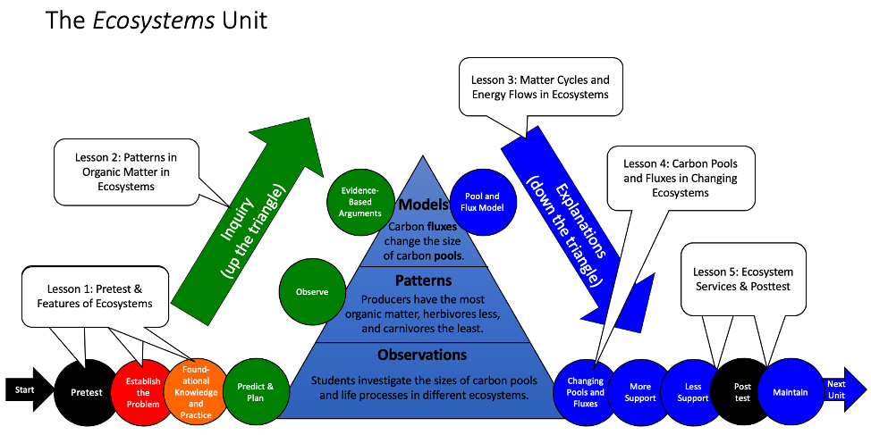
Unit map
You are here
Notes:
Use the instructional model to show students where they are in the course of the unit.
Show Slide 2 of the 4.1 Tiny Pool and Flux Game PPT.

Slide 3
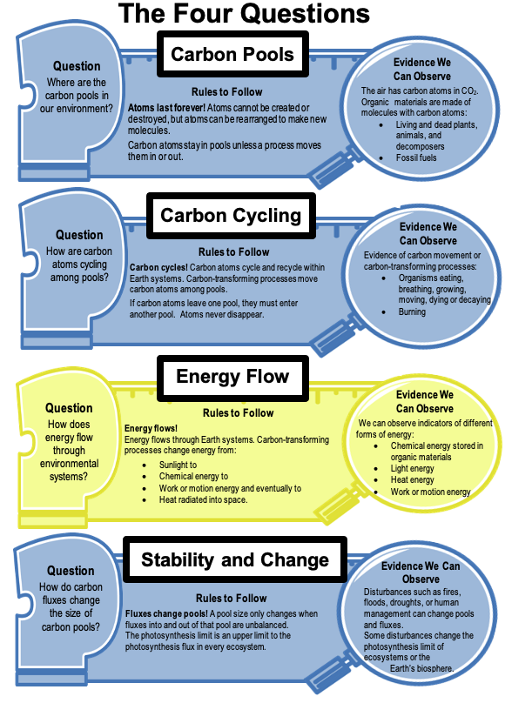
The Stability and Change Question
How do carbon fluxes change the size of carbon pools?
You have studied carbon pools.
What are carbon fluxes?
Notes:
Use the instructional model to show students where they are in the course of the unit.
Show Slide 3 and discuss Stability and Change as the main focus for this lesson. Students have been introduced to carbon pools in previous lessons. In this lesson, they will study carbon fluxes.

Slide 4
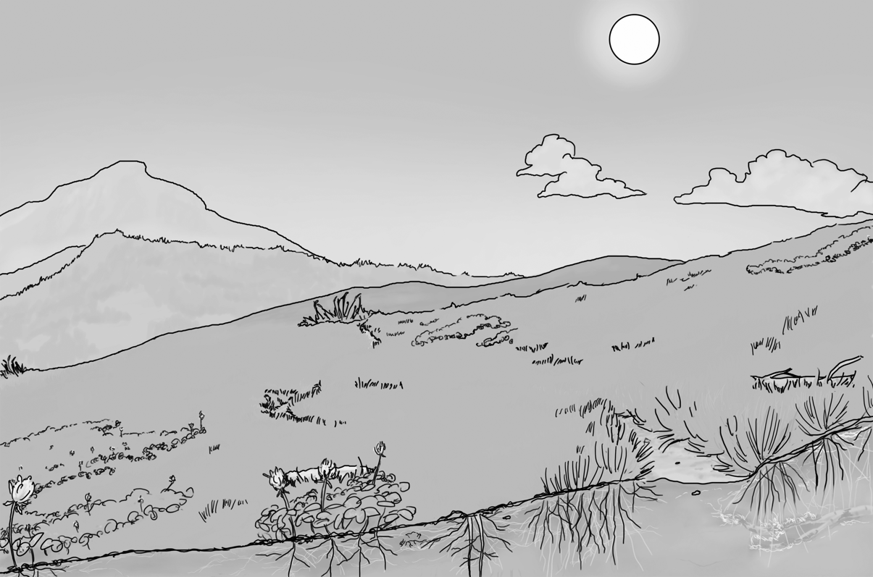
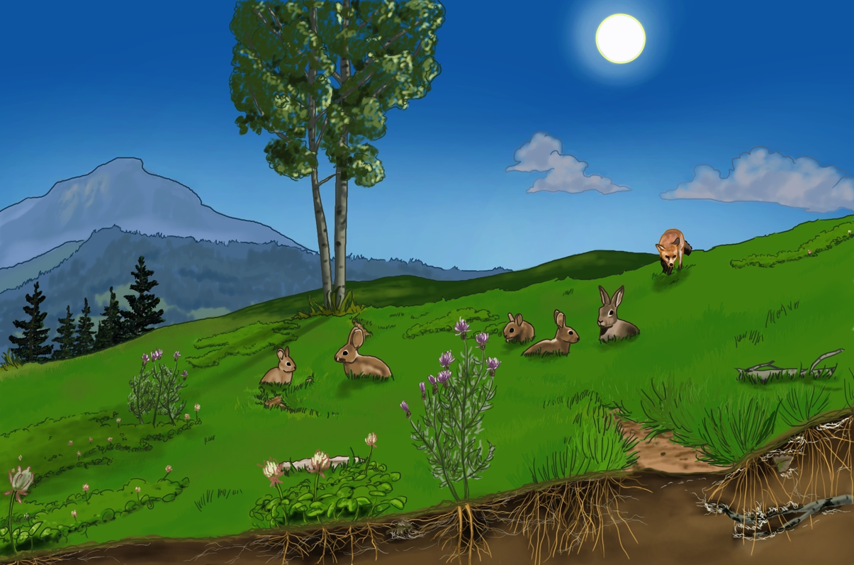
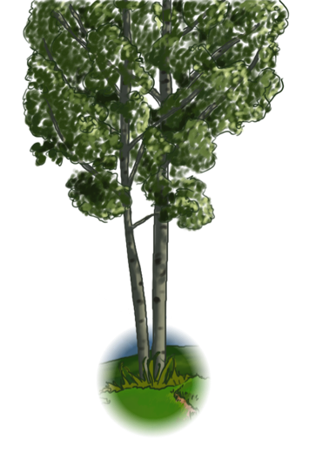
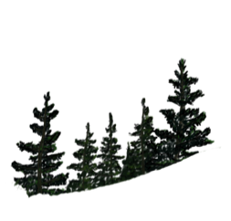
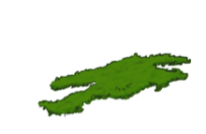
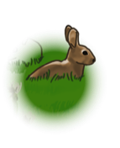
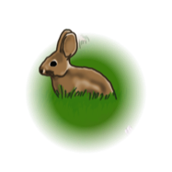
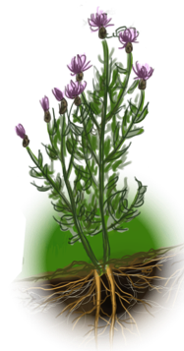
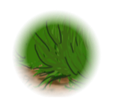
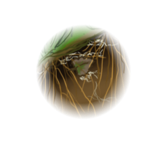
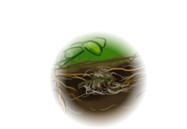
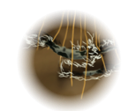
Many ecosystems have five carbon pools
Carnivores organic carbon
Atmosphere CO₂
Herbivores organic carbon
Soil
Organic Carbon
Producers organic carbon
Notes:
Students review the two-pools model of carbon in an ecosystem.
Use Slide 4 to remind students how the carbon in the meadow simulation can be divided into five pools.
Image Credit: Craig Douglas, Michigan State University

Slide 5
These smaller carbon pools can be classified into two big carbon pools
Carbon Pools
Producers
Organic pools
Inorganic pools
Others we won’t look at now
Herbivores
CO₂ in atmosphere
Carnivores
Soil
Notes:
Students review the two-pools model of carbon in an ecosystem.
Use Slide 5 to show how scientists categorize organisms into particular two pools of carbon, organic and inorganic.

Slide 6
Fluxes Are Rates
Carbon movements are processes that move carbon from one pool to another
Carbon fluxes measure how fast carbon moves: the amount of carbon that moves in a certain amount of time (usually a year).
photosynthesis
organic pools
inorganic pools
Notes:
Use Slides 6-9 to define fluxes as rates (mass/time).
Show Slide 6. Explain the terms, movements and fluxes.

Slide 7
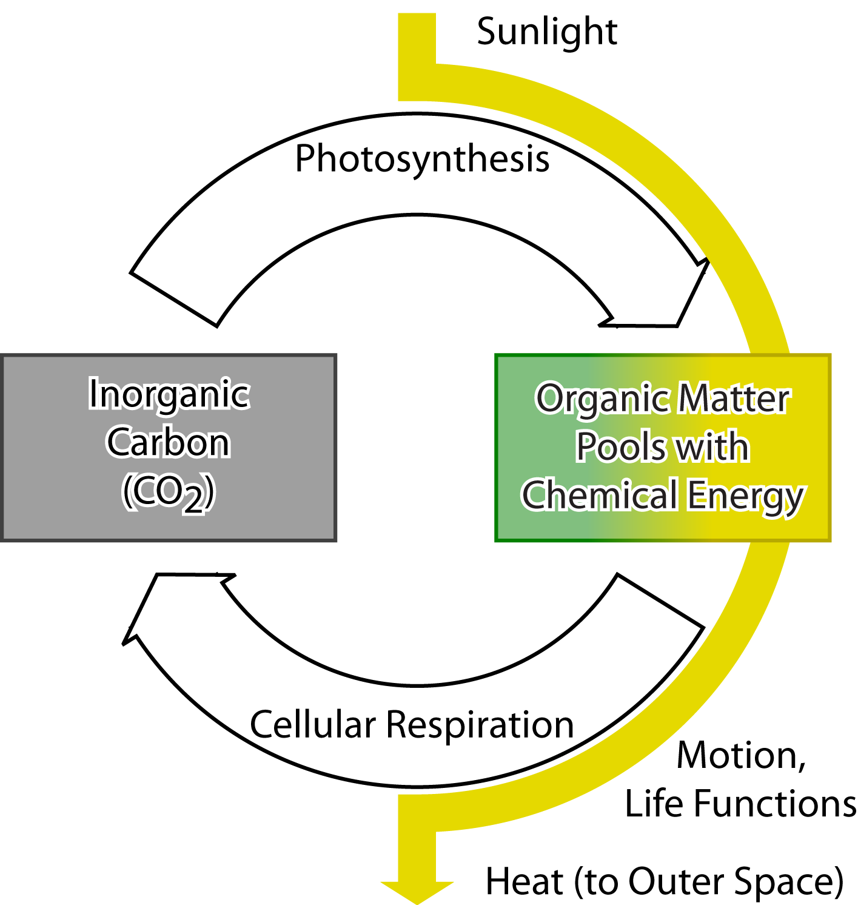
Carbon Pools and Fluxes in Ecosystems
Ecosystems have two main carbon pools….
Notes:
Use Slides 6-9 to define fluxes as rates (mass/time).
Show Slide 7 to show students the two main pools.
Image Credit: Craig Douglas, Michigan State University

Slide 8
Carbon Pools and Fluxes in Ecosystems
….and ecosystems have two main carbon fluxes.
Notes:
Use Slides 6-9 to define fluxes as rates (mass/time).
Show Slide 8 to show students the two main fluxes. Tell students that photosynthesis moves carbon from the inorganic to the organic pool. Cellular respiration moves carbon from the organic to the inorganic pool. Remind students that they found this during the Carbon Dice Game.
Image Credit: Craig Douglas, Michigan State University

Slide 9
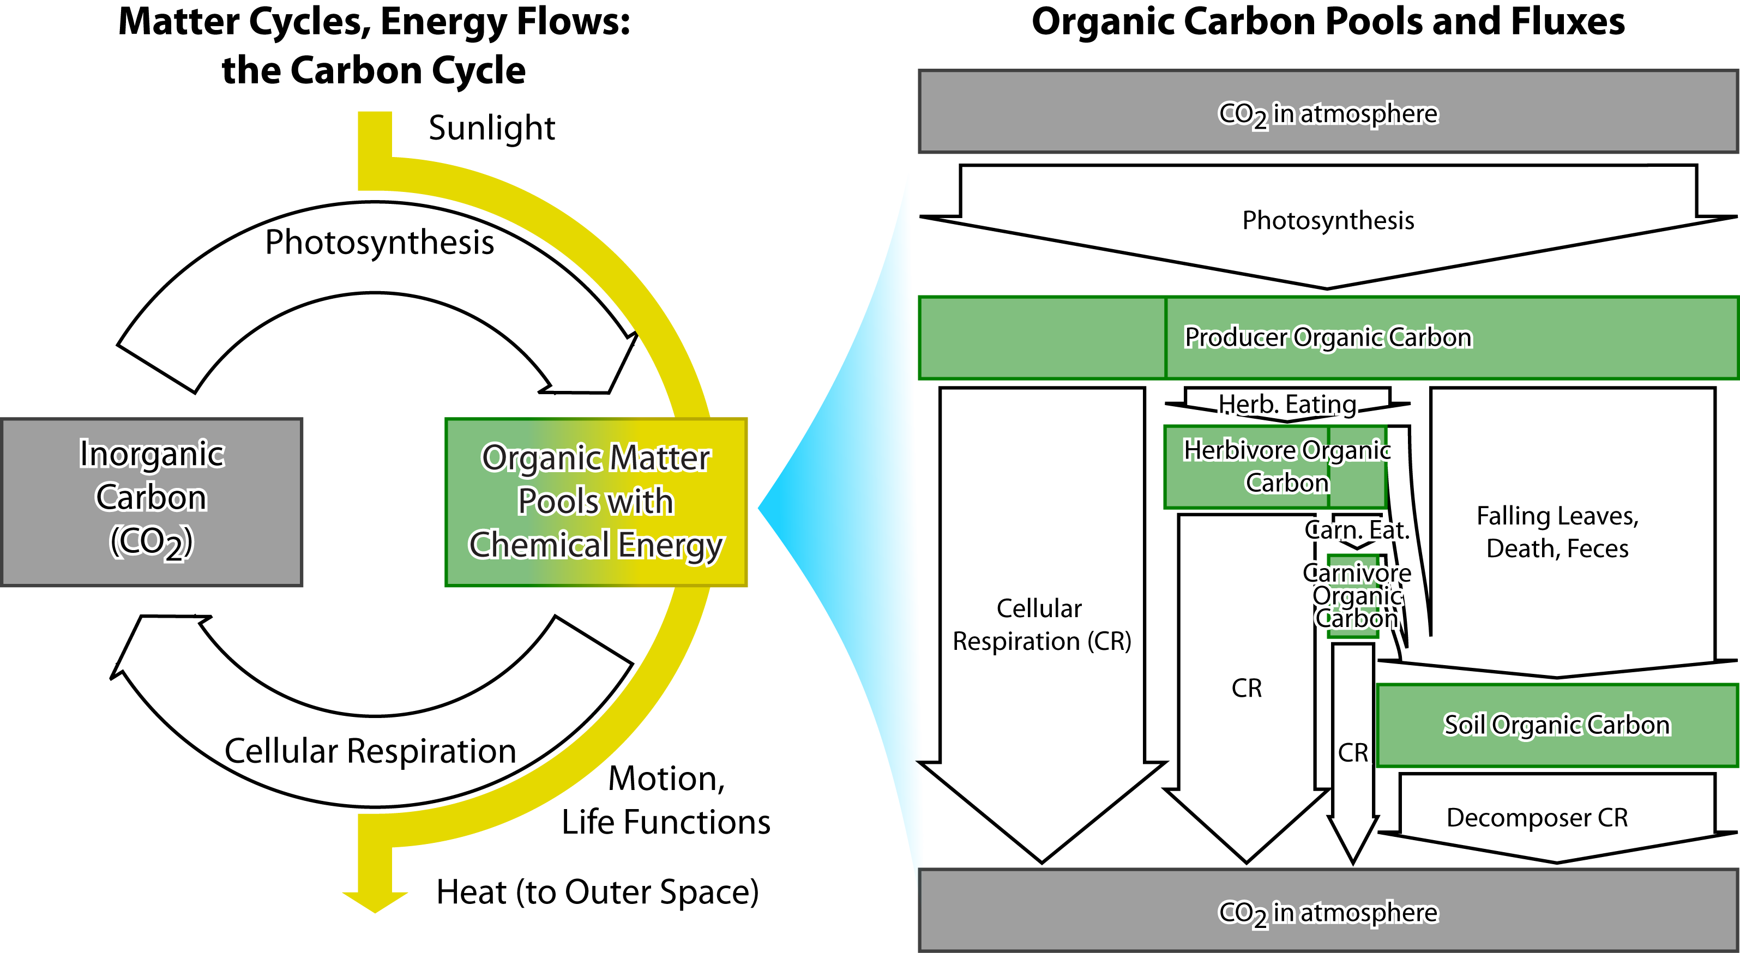
The organic carbon pool includes many smaller pools and fluxes
Notes:
Use Slides 6-9 to define fluxes as rates (mass/time).
Show Slide 9 to show the other fluxes within the organic carbon pool. Remind students that they traced their movement on this diagram in Lesson 3.
Image Credit: Craig Douglas, Michigan State University

Slide 10
Pools & Fluxes Activity
In this activity you can see how carbon fluxes can change the size of carbon pools.
This ecosystem is very tiny - it has only 10 carbon atoms (too tiny to be real but it will be a good model).
Notes:
As a class, run through Scenario 1 of the Tiny Pool Flux Game
Handout one 4.1 Tiny Pool and Flux Worksheet to each student along with a 4.1 Tiny Pool and Flux Game Placemat and 10 markers. The game can be done by individual students or in pairs. Each student keeps their own data and graphs.
Show Slides 10-12 to explain the game and setup.

Slide 11
Pools & Fluxes Activity
This tiny ecosystem is also very simple.
The system has only two carbon pools.
1) CO₂ in the atmosphere.
2) An organic carbon pool that includes all living things - producers, consumers, and decomposers.
The system has only two carbon fluxes:
1) Photosynthesis that moves carbon atoms from CO₂ to organic matter.
2) Cellular respiration that moves carbon atoms from organic matter to CO₂.
Notes:
As a class, run through Scenario 1 of the Tiny Pool Flux Game
Handout one 4.1 Tiny Pool and Flux Worksheet to each student along with a 4.1 Tiny Pool and Flux Game Placemat and 10 markers. The game can be done by individual students or in pairs. Each student keeps their own data and graphs.
Show Slides 10-12 to explain the game and setup.

Slide 12
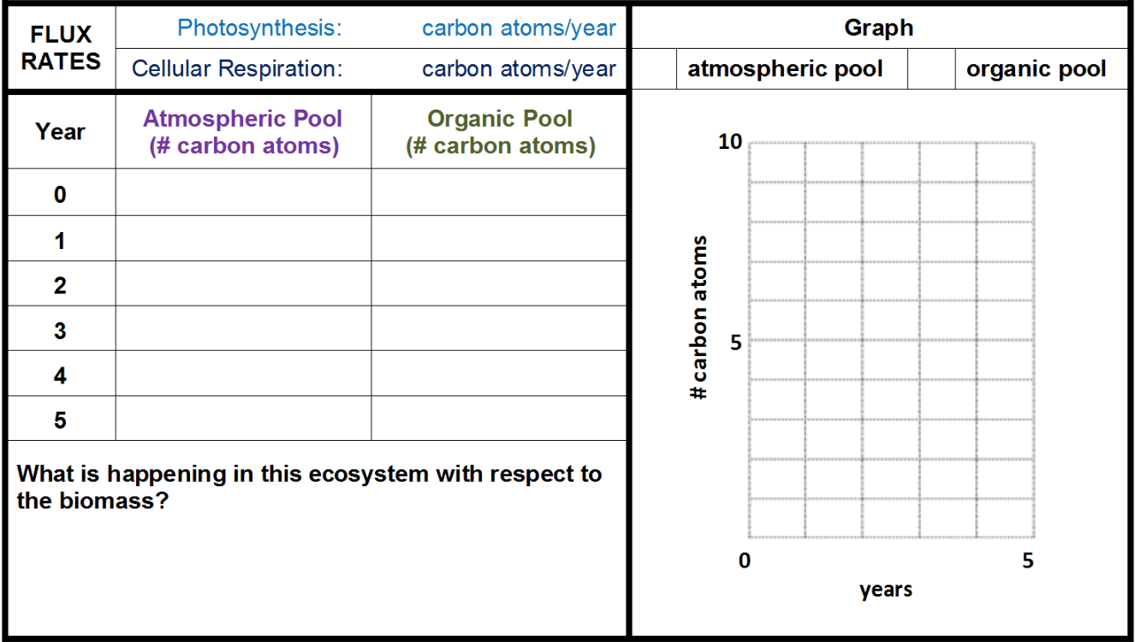
A very simple, tiny model of carbon pools and fluxes
Picture of placemat
Notes:
As a class, run through Scenario 1 of the Tiny Pool Flux Game
Handout one 4.1 Tiny Pool and Flux Worksheet to each student along with a 4.1 Tiny Pool and Flux Game Placemat and 10 markers. The game can be done by individual students or in pairs. Each student keeps their own data and graphs.
Show Slides 10-12 to explain the game and setup.

Slide 13
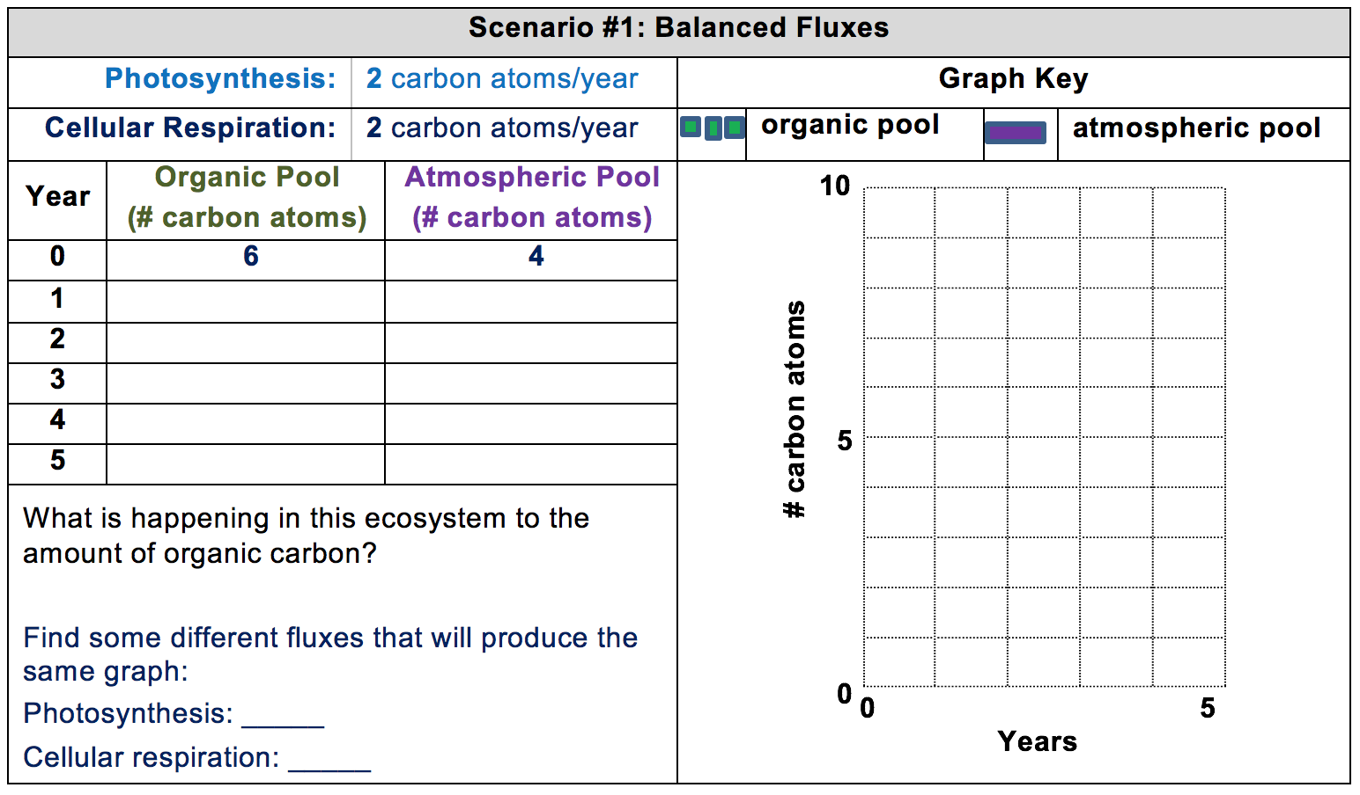
Notes:
As a class, run through Scenario 1 of the Tiny Pool Flux Game
Handout one 4.1 Tiny Pool and Flux Worksheet to each student along with a 4.1 Tiny Pool and Flux Game Placemat and 10 markers. The game can be done by individual students or in pairs. Each student keeps their own data and graphs.
Show Slide 13. In this scenario, they will have 6 carbon atoms in the organic pool and 4 in the organic pool. Have students put the appropriate number of markers on placemat and starting points on the graph. Both the photosynthesis and cellular respiration rates are at 2 carbon atoms/year. Have class work through years by moving markers according to the fluxes and recording each year’s result in the chart and on the graph. Students should connect the dots for the organic (green) pool with a dashed line and use a solid line for the inorganic atmospheric pool
Have students play through year 5, recording and graphing their data as they go.

Slide 14
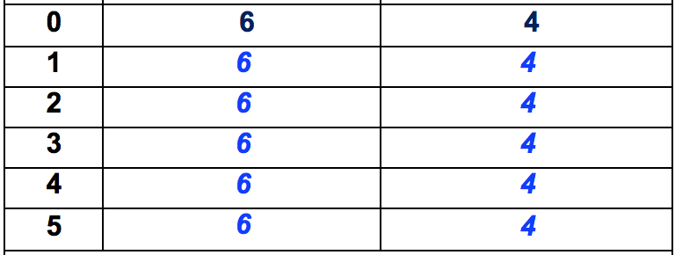
Notes:
As a class, run through Scenario 1 of the Tiny Pool Flux Game
Have students compare their results to Slide 14.

Slide 15
Notes:
Have students determine other starting conditions that yield the same graph.
Show Slide 15. Have students find another set of fluxes that produce the same graph.
Have students share their results.
Discuss the pattern in the results. Students should find that any starting conditions with the same original pool sizes and equal flux rates will produce the same results.

Slide 16
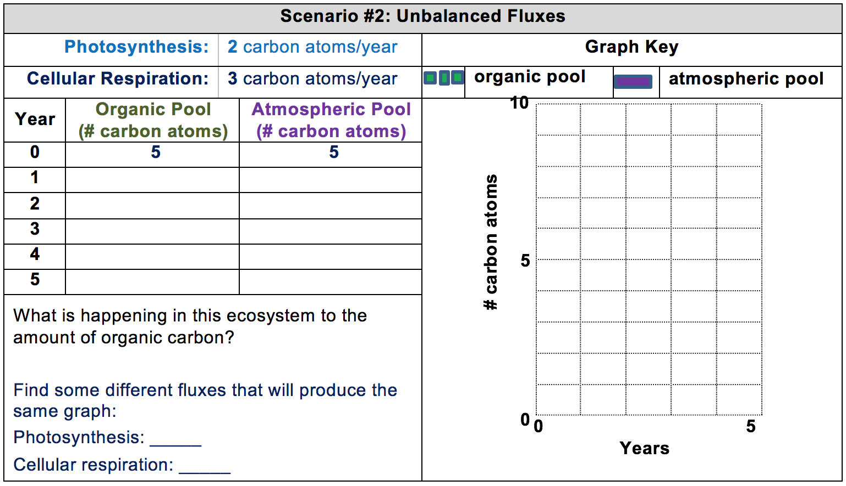
Notes:
Have students try Scenario 2.
Show Slide 16. Have students try Scenario 2 and graph the results.

Slide 17
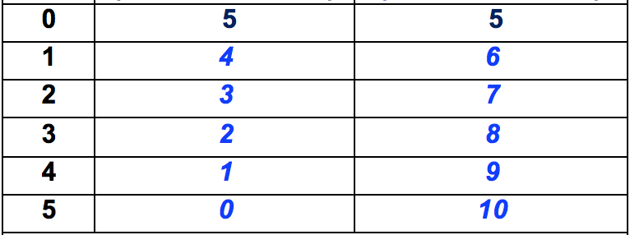
Notes:
Have students try Scenario 2.
Show Slide 17. Discuss the pattern.

Slide 18
Notes:
Have students try Scenario 2.
Show Slide 18. Have students try to find another set of fluxes that produce the same results. Students should find that any set of fluxes that differ by the same amount should produce the same results.

Slide 19
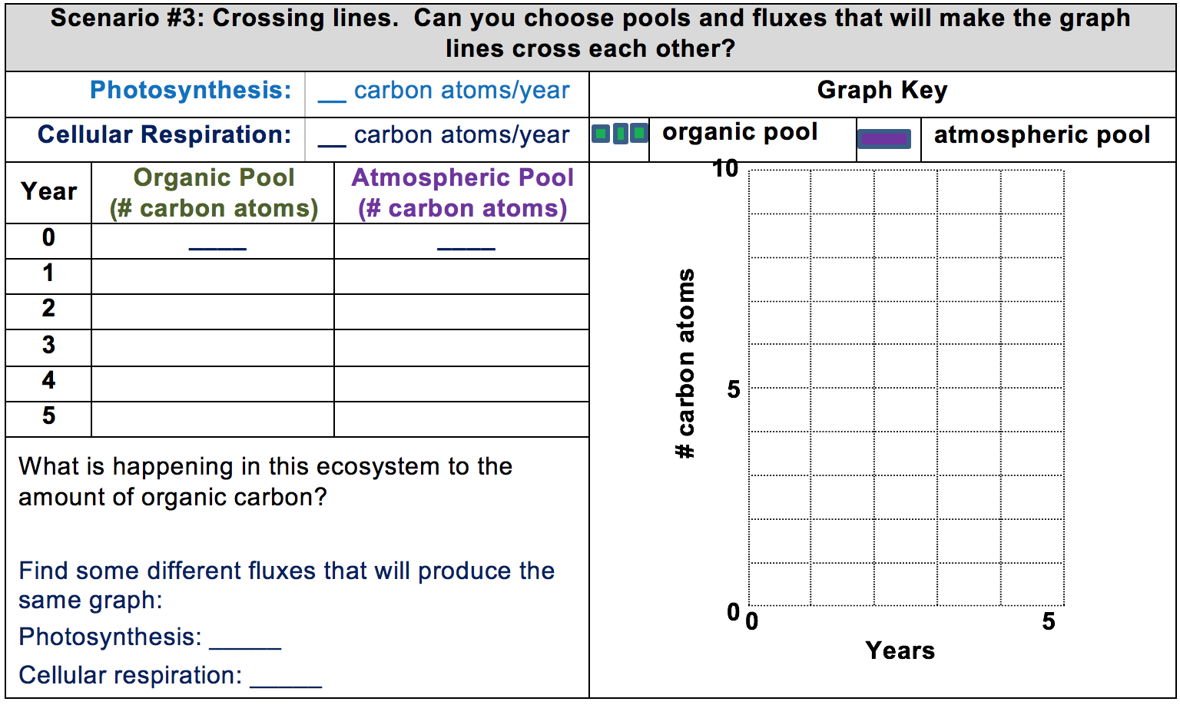
Your Challenge
Notes:
Challenge students to find a set of starting conditions that produces a graph with crossing lines.
Use Slide 19 to challenge students to find a set of starting conditions that will make the graph lines cross.
After the students find one set of conditions, challenge them to find another set of conditions that produce the same graph.
Have students discuss their results and find patterns.

Slide 20
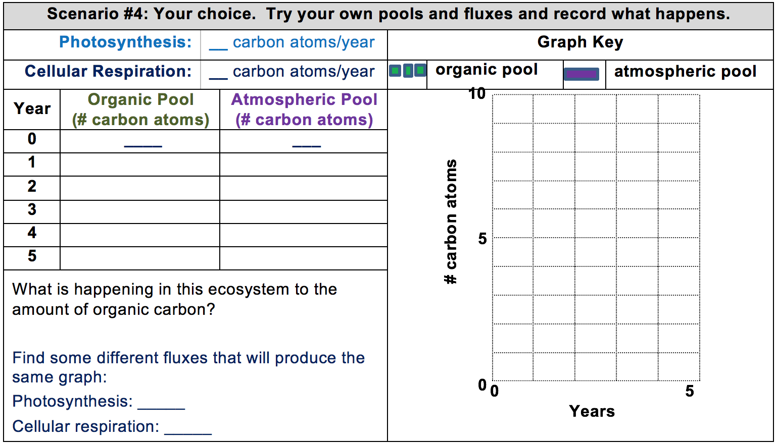
Your Choice
Notes:
Allow students to try their own starting pools and fluxes.
Show Slide 20 to have students try their own starting pools and fluxes.
After, have them find different fluxes that produce the same graph.
Have students share and discuss their results.

Slide 21
Rules for pools and fluxes
When opposing fluxes are equal, pool sizes don’t change.
When opposing fluxes are not equal, pool sizes change.
How fast the pool sizes changes depends on the difference between the opposing fluxes. We call the difference the net flux.
When the incoming fluxes are bigger than the outgoing fluxes, the net flux is positive and the pool grows.
When the incoming fluxes are smaller than the outgoing fluxes, The net flux is negative and the pool shrinks.
Notes:
Introduce the idea of net flux.
Use Slide 21 to have students summarize what they found about the relationship between pool size and fluxes as a whole class. Don’t show the bullet points until they are finished summarizing.
Use the bullet points to introduce the idea of net flux.

Slide 22
Exit Ticket
Conclusions
How do carbon fluxes change the size of carbon pools?
Predictions
How are real ecosystems and the tiny ecosystem alike and different?
Notes:
Have students complete an exit ticket.
Show slide 22 of the 4.1 Tiny Pool and Flux Game PPT.
Conclusions: How do carbon fluxes change the size of carbon pools?
Predictions: How are real ecosystems and the tiny ecosystem alike and different?
On a sheet of paper or a sticky note, have students individually answer the exit ticket questions. Depending on time, you may have students answer both questions, assign students to answer a particular question, or let students choose one question to answer. Collect and review the answers.
The conclusions question will provide you with information about what your students are taking away from the activity. Student answers to the conclusions question can be used on the Driving Question Board (if you are using one). The predictions question allows students to begin thinking about the next activity and allows you to assess their current ideas as you prepare for the next activity. Student answers to the predictions question can be used as a lead into the next activity.

