Slide 1

Ecosystems Unit
Activity 3.6: Explaining Patterns in Ecosystems
Carbon: Transformations in Matter and Energy
Environmental Literacy Project
Michigan State University
Notes:
Image Credit: Craig Douglas, Michigan State University

Slide 2
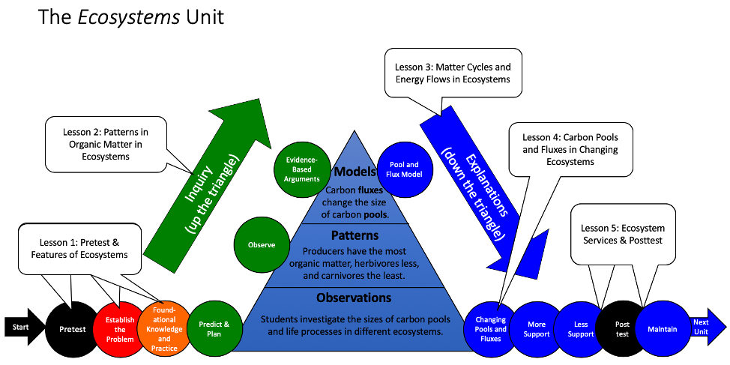
Unit Map
You are here
Notes:
Use the instructional model to show students where they are in the course of the unit.
Show Slide 2 of the 3.6 Explaining Patterns in Ecosystems PPT.

Slide 3
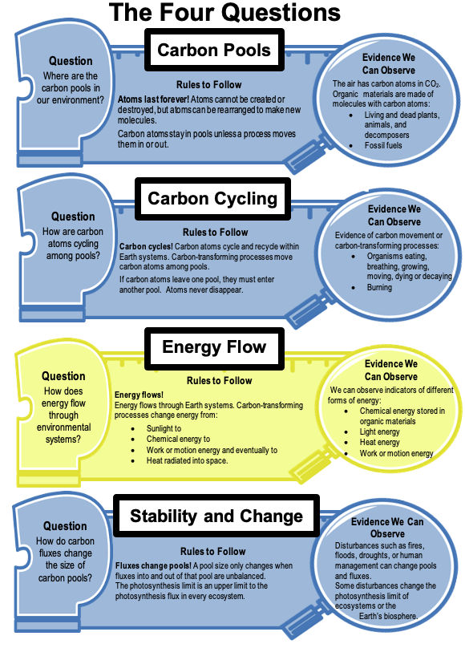
Explaining the Organic Matter Pyramid
We can explain the organic matter pyramid by answering the Carbon Pools Question, the Carbon Cycling Question, and the Energy Flow Question.
Notes:
Review the Ecosystems Story.
Display Slide 3. Tell students that at this point in the unit they should have evidence to support an explanation for the pattern in the organic matter pyramid. The Explanations Tool in this activity will help them record their ideas about the Large-Scale Four Questions and combine these ideas into a scientific explanation.
Pass out the 3.6 Telling the Ecosystems Story Reading to each student. Have students read the section on Lessons 1, 2, and 3.
Discuss how this section summarizes what students have learned about ecosystems so far.

Slide 4
Telling the Ecosystems Story
Read “Telling the Ecosystems Story,” Lessons 1, 2, 3.
How have your ideas changed?
Notes:
Review the Ecosystems Story.
Display Slide 4. Pass out the 3.6 Telling the Ecosystems Story Reading to each student. Have students read the section on Lessons 1, 2, and 3.
Discuss how this section summarizes what students have learned about ecosystems so far.

Slide 5
Constructing Explanations
Consider the following as you construct your explanation:
Evidence from the Meadow Simulation
The Carbon Dice Game
Four Questions Handout
Notes:
Students answer the first three Large-Scale Questions on their Explanations Tool.
Show Slide 5. Give each student one copy of the 3.6 Explanations Tool for Ecosystems. Tell students that in order to make sure we have the pieces for a complete explanation they will first compose their ideas in pieces that correspond with the first three of the Four Questions.
Give students 10 minutes to complete the questions on the front of the Explanations Tool.

Slide 6
Comparing Ideas with a Partner
Compare your explanations for the first three of the Four Questions.
  How are they alike?
  How are they different?
Check your explanation with the middle- and right-hand columns of the Four Questions handout.
Consider making revisions to your explanation based on your conversation with your partner.
Notes:
Students compare their responses to a partner’s responses.
Display Slide 6. After students have had a chance to record their own ideas, have them find a partner and swap papers. Have the partners read each other’s explanations and compare. Encourage them to look for differences between each other’s ideas. They can refer to the Large Scale Four Questions Handout with Checklist. Have them look for key components:
Does the explanation follow the rules (atoms and energy last forever?)
Does the explanation use evidence from the atomic-molecular, cellular, and macroscopic scales to answer the question?
Does the explanation explain why the organic matter pyramid pattern happens in ecosystems?
Give students a chance to revise their explanations based on the results of their discussion with a partner.

Slide 7
The Carbon Pools Question
In a stable meadow ecosystem, which pools are carbon atoms in?
Carbon atoms are in the atmosphere, soil, producer,
herbivore, and carnivore pools.
Notes:
Discuss the answer to the Carbon Pools question.
Use Slide 7 to have the students discuss the Carbon Pools question on their 3.6 Explanations Tool for Ecosystems.
If students have model explanations to share, display student work and discuss. If students have common areas of weakness in their explanations, ask for a volunteer to share, display student work, and discuss ways of strengthening the response.

Slide 8
The Carbon Cycling Question
What processes are causing carbon atoms to move from one pool to another?
Photosynthesis and cellular respiration, death, defecation, and eating
Why are there more carbon atoms in the producer pool than in the herbivore and carnivore pools?
When herbivores eat the producers, most of the high-energy carbon-based molecules are used for functioning, which means that a lot of the carbon atoms are released into the air during cellular respiration. In each step up the organic matter pyramid, more carbon atoms are lost to the air than are transformed into biomass.
Notes:
Discuss the answer to the Carbon Cycling question.
Use Slide 8 to have the students discuss the Carbon Cycling question on their 3.6 Explanations Tool for Ecosystems.
If students have model explanations to share, display student work and discuss. If students have common areas of weakness in their explanations, ask for a volunteer to share, display student work, and discuss ways of strengthening the response.

Slide 9
The Energy Flow Question
Sunlight is the only source of energy for the meadow ecosystem. How is that light energy transformed in the meadow ecosystem?
Plants transform light energy into chemical energy during photosynthesis in their cells.
Some of this chemical energy is stored in bonds of new molecules in the plants’ bodies that the plants build during biosynthesis.
Other chemical energy in plants is used for functioning, transformed into heat energy, and lost to the atmosphere.
When herbivores eat plants, the chemical energy in the plant biomass is transferred.
In the herbivore’s body, the chemical energy is either used for functioning and transformed into heat energy which is lost, or stored in the herbivore’s biomass through biosynthesis.
When the carnivore eats the herbivore, the same transfer and transformation occurs.
Notes:
Discuss answer to the Energy Flow question.
Use Slide 9 to have the students discuss the Energy Flow question on their 3.6 Explanations Tool for Ecosystems.
If students have model explanations to share, display student work and discuss. If students have common areas of weakness in their explanations, ask for a volunteer to share, display student work, and discuss ways of strengthening the response.

Slide 10
Telling the Whole Story
Question: Why does the meadow ecosystem need so much grass to support so few foxes? Does your story include these parts?
Carbon Pools: Carbon atoms are in the atmosphere, soil, producer, herbivore, and carnivore pools.
Carbon Cycling: The organic matter that foxes need for growth and energy must go through the producer and herbivore pools. But carbon atoms are lost at each level to the atmosphere because of cellular respiration.
Energy Flow: The energy that foxes need must go through the producer and herbivore pools. But energy in the form of heat is lost at each level through movement and functioning.
Notes:
Students critique and improve their full explanations.
Display Slide 10 for the full explanation. Have students use the Large Scale Four Questions Handout with Checklist to check that their story includes each of the parts (carbon pools, carbon cycling, and energy flow).
If students don’t have all three parts in their explanation, instruct them to add to their explanation using a different colored writing utensil.
If students have model explanations to share, display student work and discuss. If students have common areas of weakness in their explanations, ask for a volunteer to share, display student work, and discuss ways of strengthening the response.

Slide 11
Telling the Ecosystems Story
Read “Telling the Ecosystems Story,” Lessons 4 and 5.
What questions do you still need to answer?
Notes:
Students complete the Ecosystems Story Reading and discuss upcoming lessons.
Show Slide 11 of the PPT.
Have students read the section on Lessons 4 and 5 in 3.6 Telling the Ecosystems Story Reading.
If you are not teaching Lesson 4, tell students, but still have them read the subsection on Lesson 4.
Discuss the section as a class. Include discussion of the new vocabulary. Have students explain the new vocabulary in their own words.

Slide 12
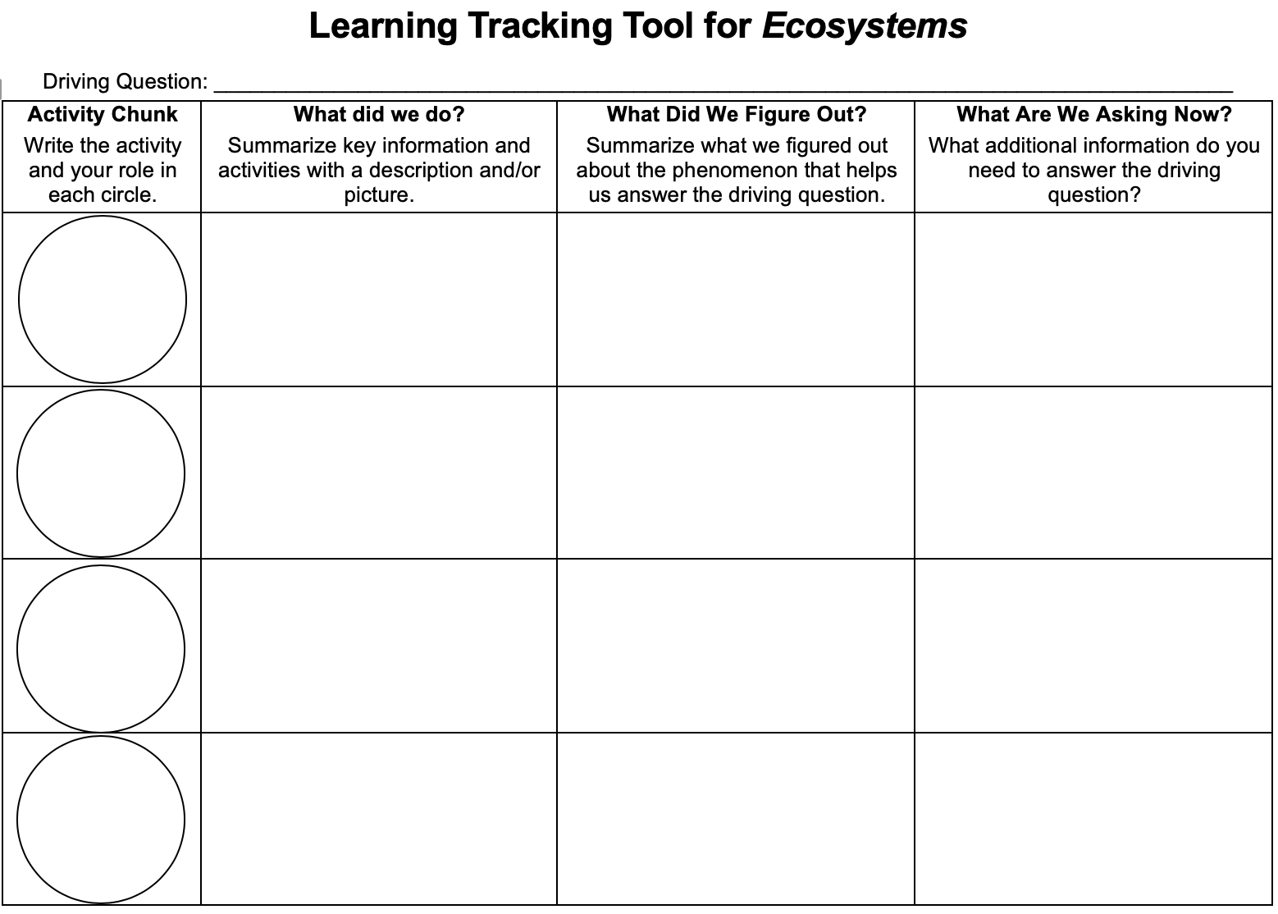
Learning Tracking Tool
Record the activity chunk name “Matter Cycles and Energy Flows, Explainers”
Discuss what you did during the activity chunk and record your ideas in the column, “What Did We Do?”
Discuss with your classmates what you figured out will help you to answer the unit driving question. Record your ideas in the column “What Did We Figure Out?”
Discuss questions you now have related to the unit driving question and record them in the column “What Are We Asking Now?”
Notes:
Have a discussion to complete the Learning Tracking Tool for this Lesson.
Show Slide 12 of the 3.6 Explaining Patterns in Ecosystem PPT.
Pass out a Learning Tracking Tool for Ecosystems to each student.
Have students write the activity chunk name in the first column, "Matter Cycles and Energy Flows, Explainers"
Have a class discussion about what students did during the activity chunk. When you come to consensus as a class, have students record the answer in the second column of the tool.
Have a class discussion about what students figured out during the activity chunk that will help them in answering the unit driving question. When you come to consensus as a class, have students record the answer in the third column of the tool.
Have a class discussion about what students are wondering now that will help them move towards answering the unit driving question. Have students record the questions in the fourth column of the tool.
Have students keep their Learning Tracking Tool for Ecosystems for future activities.
Example Learning Tracking Tool
Activity Chunk: Matter Cycles and Energy Flows, Explainer
What Did We Do? Use the Carbon Dice game to model how carbon atoms move through ecosystems and use the Explanations Tool to explain the organic matter pyramid.
What Did We Figure Out? Matter cycles and energy flows among carbon pools because of life processes and functions: photosynthesis, cellular respiration, biosynthesis, eating, death, defecation.
What Are We Asking Now? How and why do carbon pools in ecosystems change over time?

Slide 13
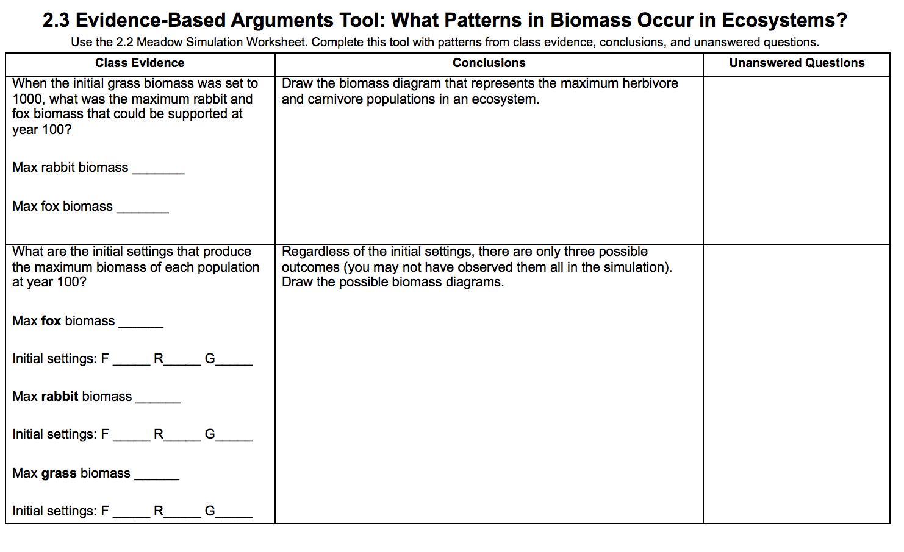
Revisit unanswered questions (need new image of EBA tool)
Which unanswered questions can you now answer with what you understand about cellular respiration?
Which questions are left unanswered?
Do you have any new questions to add?
Notes:
Revisit unanswered questions.
Show slide 11. Have students look at their 2.3 Evidence-Based Arguments Tool for Ecosystems. Display the class list of unanswered questions from Activity 2.3.
Ask students which of their unanswered questions they can now answer with their understanding of Ecosystems. Which ones are left unanswered? Do they have any new questions to add to the list?

Slide 14
Revisit your arguments
Think about what you know now that you didn’t know before. What have you learned?
Notes:
Revisit students' arguments.
Display slide 3. Tell students that at this point in the unit they should have evidence to support an explanation for the pattern in the biomass pyramid. The Explanations Tool in this activity will help them record their ideas about the Four Questions and combine these ideas into a scientific explanation.
Pass out students’ completed 2.3 Evidence-Based Arguments Tool for Ecosystems. Have them review their arguments from earlier. At that point, they would have been able to identify the pattern in the biomass pyramid, but they would not have explanations for why it happens.
Ask the for ideas about what additional evidence they have for why this might be happening. Encourage them to consider what they learned in the carbon dice game, and to consider evidence from multiple spatial scales: the atomic-molecular, the cellular, and the macroscopic.

Slide 15
How have your ideas changed?
Gather together your process tools for the unit (Expressing Ideas Tool, Predictions Tool, & Evidence-Based Argument Tool).
How have your ideas changed related to:
  Scale?
  Movement?
  Carbon?
What do you know now about ecosystems that you didn’t know before?
Notes:
Lead a discussion about how student ideas have changed over time.
Show slide 10 of the 3.6 Explaining Patterns in Ecosystems PPT. Have students look back over their process tools for this unit.
Have students consider how their ideas changed with regard to scale, movement, and carbon.
What do they know now about ecosystems that they didn’t know before the simulation and game?

