Slide 1
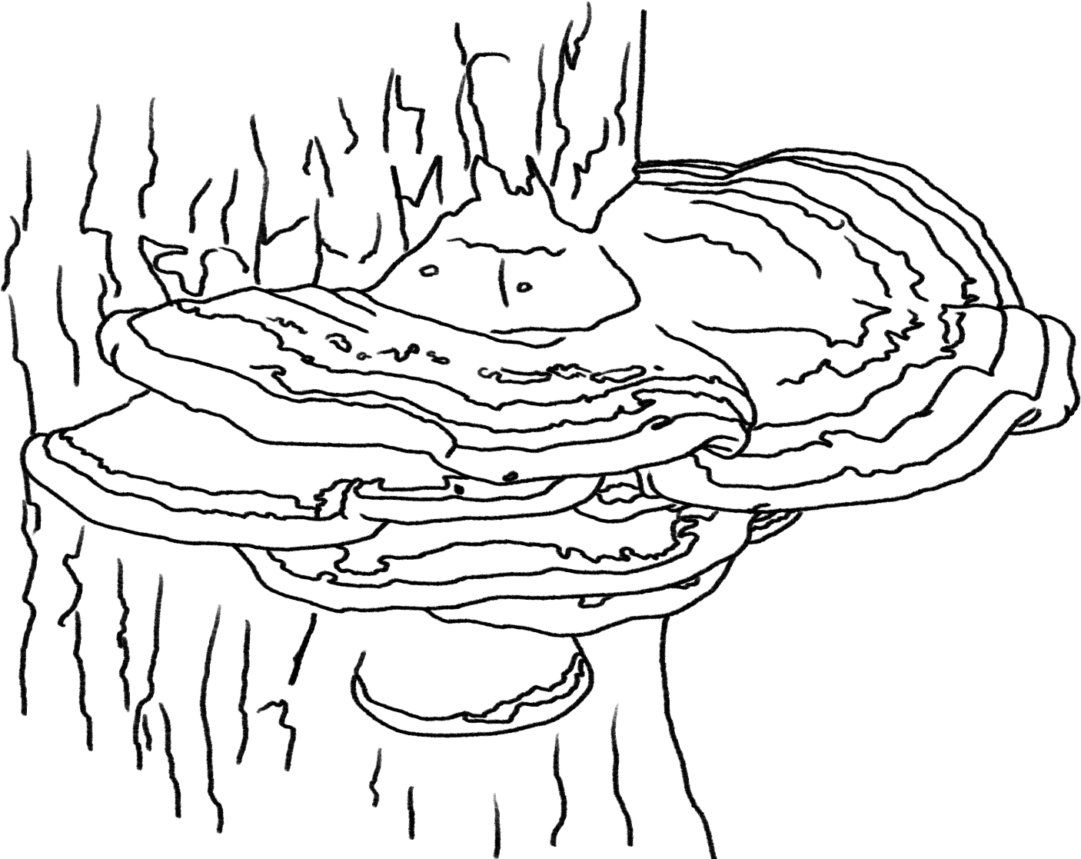
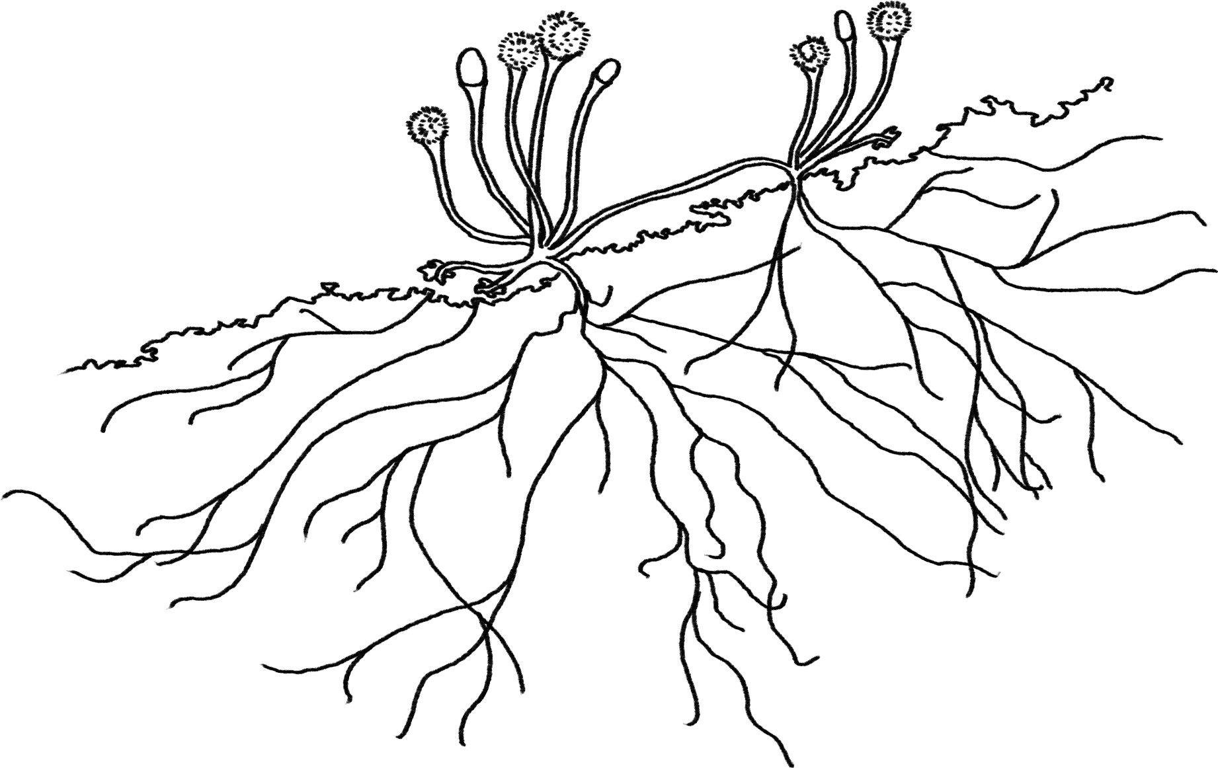
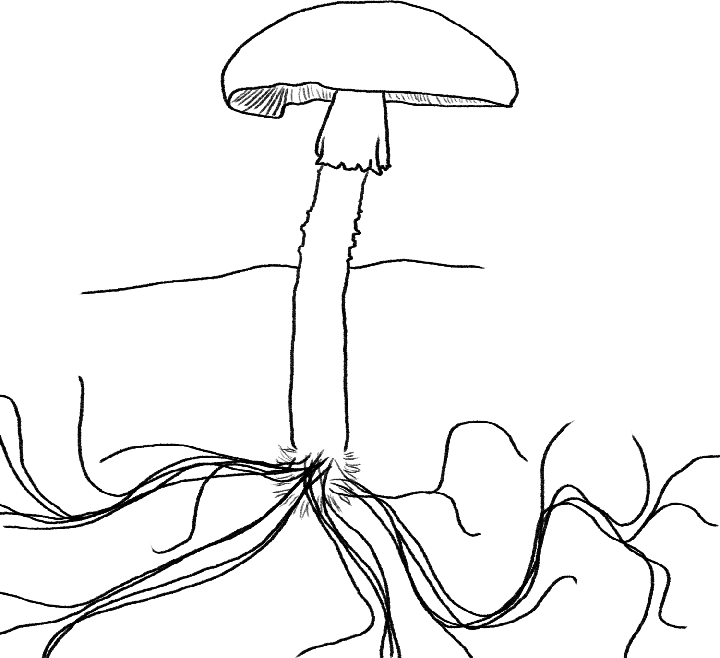
Decomposers Unit Activity 6.3 Comparing Decomposers, Plants, and Animals
Carbon: Transformations in Matter and Energy
Environmental Literacy Project Michigan State University
Notes:
Image Credit: Craig Douglas, Michigan State University

Slide 2
Unit Map
You are here
Notes:
Use the instructional model to show students where they are in the course of the unit.
Display Slide 2 of the 6.3 Comparing Decomposers, Plants, and Animals PPT.

Slide 3
Scenarios of Decomposer Growth, Movement, and Functioning
A pile of leaves sits for a few weeks. If you put your hand on the leaf pile, it feels warm. Where did the heat come from?
An apple is left to sit on a back porch accidentally. After a week, the apple is much smaller. What happened to the matter that used to be part of the apple?
A stand of mushrooms shoot up around the base of a large tree. Where did the mushrooms get the energy they needed to push themselves out of the leaf litter?
Notes:
Have students try explaining new examples.
Display Slides 3-4. Have students work to explain the scenarios on the slides about decomposer’s growth, movement, and function.
Have students discuss the scenarios with a partner and then discuss each as a class.
At this point in the unit, you will want to point out places where their explanations do not align with scientific explanations.

Slide 4
More Scenarios
4. Millions of bacteria live on the tip of your finger. They multiply quickly. Where do they get the material to make new cells?
5. A container of leftover macaroni and cheese is left in a refrigerator for a long time. A layer of mold grows on top of the food. When you open the container, the inside of the lid is covered with water. Where did the water come from?
Notes:
Have students try explaining new examples.
Display Slides 3-4. Have students work to explain the scenarios on the slides about decomposer’s growth, movement, and function.
Have students discuss the scenarios with a partner and then discuss each as a class.
At this point in the unit, you will want to point out places where their explanations do not align with scientific explanations.

Slide 5
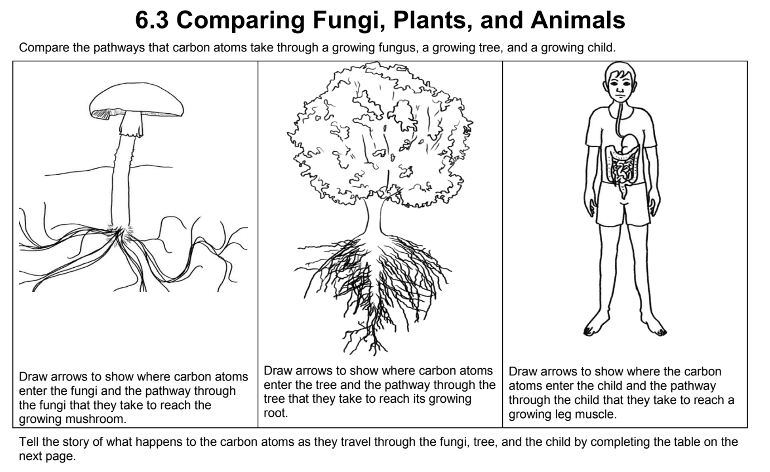
Comparing Decomposers, Plants, and Animals
Use what you learned in Decomposers, Plants, and Animals to trace carbon atoms in decomposers, plants, and animals.
You may want to look back at your Process Tools from Decomposers, Plants, and Animals.
Notes:
Have students compare decomposers, plants, and animals.
Display Slide 5 of the 6.3 Comparing Decomposers, Plants, and Animals PPT. Tell students they will be comparing what they learned about in the Plants and Animals units with what they have learned about decomposers.
Pass out the 6.3 Comparing Decomposers, Plants, and Animals Worksheet to each student.
Have students complete the comparison individually or in pairs.
Students may need to look back at their Process Tools from Plants and Animals.
Display Slide 6 of the PPT to remind students that good answers to the questions about decomposers, plants, and animals should address each of the four numbered questions of the Three Questions 11 x 17 Poster (or Handout).

Slide 6
Good answers to questions about decomposer cells
Answer each of the questions (numbered 1-4) below to explain how matter and energy move and change in a system. Note that matter movement is addressed at both the beginning (1) and end (4) of your explanation.
Question
Where are molecules moving?
How do molecules move to the location of the chemical change?
How do molecules move away from the location of the chemical change?
Evidence We Can Observe
Moving solids, liquids, and gases are made of moving molecules.
A change in mass shows that molecules are moving.
Rules to Follow
All materials (solids, liquids, and gases) are made of atoms that are bonded together in molecules.
Scale: The matter movement question can be answered at the atomic-molecular, cellular, or macroscopic scale.
Question
How are atoms in molecules being rearranged into different molecules?
What molecules are carbon atoms in before and after the chemical change?
What other molecules are involved?
Evidence We Can Observe
BTB can indicate CO₂ in the air.
Organic materials are made up of molecules containing carbon atoms:
• fuels • foods
• living and dead plants and animals
decomposers
Rules to Follow
Atoms last forever in combustion and living systems.
Atoms can be rearranged to make new molecules, but not created or destroyed.
Carbon atoms are bound to other atoms in molecules.
Scale: The matter change question is always answered at the atomic-molecular scale.
Question
What is happening to energy?
What forms of energy are involved?
What energy transformations take place during the chemical change?
Evidence We Can Observe
We can observe indicators of different forms of energy before and after chemical changes:
• light energy • heat energy
• chemical energy stored in organic materials
• motion energy
Rules to Follow
Energy lasts forever in combustion and living systems.
Energy can be transformed, but not created or destroyed.
C-C and C-H bonds have more stored chemical energy than C-O and H-O bonds.
Scale: The energy change question can be answered at the atomic-molecular, cellular, or macroscopic scales.
Notes:
Have students compare decomposers, plants, and animals.
Display Slide 6 of the PPT to remind students that good answers to the questions about decomposers, plants, and animals should address each of the four numbered questions of the Three Questions 11 x 17 Poster (or Handout).

Slide 7
Share Your Answers
How do carbon atoms move into, through, and out of decomposers, plants, and animals?
How are the molecules carbon atoms are in changed in decomposers, plants, and animals?
How is energy transformed in decomposers, plants, and animals?
Are decomposers more like plants or animals?
Notes:
Allow students to share their explanations with the class.
Display Slide 7 of the 6.3 Comparing Decomposers, Plants, and Animals PPT.
Go through the worksheet with the class and have students share their ideas. At this point in the unit, students should have scientifically correct explanations. Check that they are following the rules about matter and energy.

