Slide 1
Decomposers Unit Activity 3.3 Evidence-Based Arguments Tool: What Happens When Bread Molds?
Carbon: Transformations in Matter and Energy
Environmental Literacy Project Michigan State University
Notes:
Image Credit: Craig Douglas, Michigan State University

Slide 2
Unit map
You are here
Notes:
Use the instructional model to show students where they are in the course of the unit.
Show Slide 2 of the 3.3 Evidence-Based Arguments Tool for Bread Molding PPT.

Slide 3
Reviewing class results
What patterns did we observe in mass change?
What patterns did we observe in BTB color change?
Notes:
Have students review their results from the investigation.
Display Slide 3 of the 3.3 Evidence-Based Arguments Tool for Bread Molding PPT. Draw students’ attention to the Bread Molding Investigation Class Results 11 x 17 Poster (or Spreadsheet) from the investigation and students’ own 3.2 Observing Bread Molding Worksheet, section E, “Results for the whole class.” Ask the students to find a partner, and in their own words, review what happened during the investigation. Tell them to discuss:
What patterns they observed in the mass change
What patterns they observed in the BTB color change
Tell students that when scientists construct arguments for what happened, using evidence from observations is important, so today’s activity is designed to help them use the evidence from the investigation to construct an argument for “What happens when bread molds” and come to class consensus.
Image Credit: FableVision

Slide 4
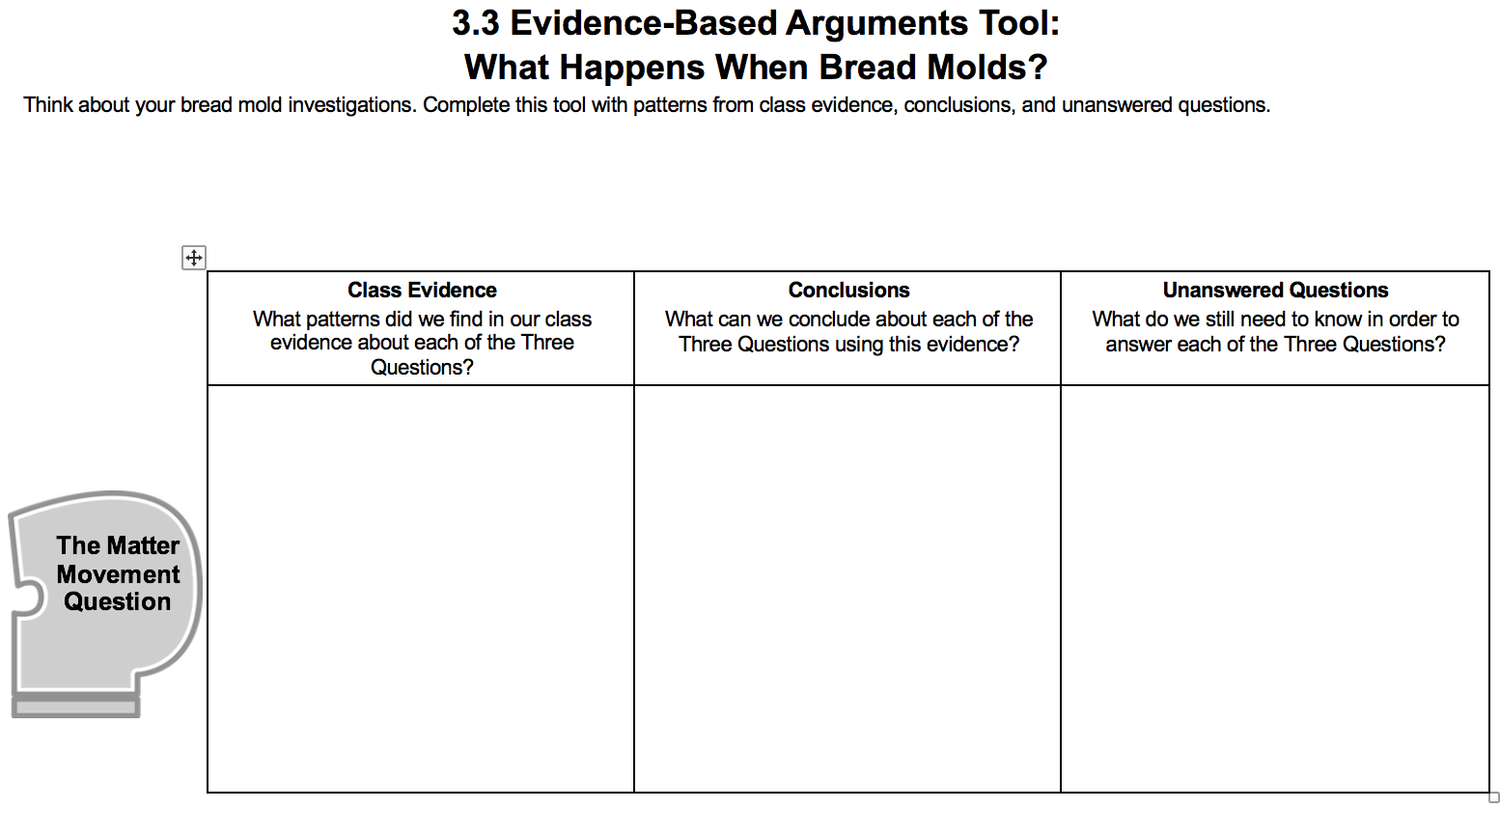
Evidence-Based Arguments
Refer to your Three Questions Handout for:
Prompting about what type of information to include in each row, and
Suggestions about what kind of evidence you might use for each of the Three Questions.
Notes:
Have students develop arguments for what happened as individuals.
Display Slide 4 of the 3.3 Evidence-Based Arguments Tool for Bread Molding PPT. Pass out one copy of 3.3 Evidence-Based Arguments Tool for Bread Molding to each student. Review Tool directions. Also, have students take out their Three Questions Handout and be ready to refer to their class results.
Instruct students to complete their evidence, conclusions, and unanswered questions as individuals for the Three Questions.
Give students about 5-10 minutes to complete the process tool.

Slide 5
Comparing ideas with a partner
Compare your evidence, conclusions, and unanswered questions for each of the Three Questions.
How are they alike?
How are they different?
Convince each other:
Work with your partner to agree on evidence, conclusions, and unanswered questions.
Make revisions to your argument.
Notice any areas of disagreement so these can be addressed as a whole class.
Notes:
Have students compare and revise arguments in pairs.
Display Slide 5 of the 3.3 Evidence-Based Arguments Tool for Bread Molding PPT. Divide students into pairs.
Have each pair compare their evidence, conclusions, and unanswered questions for the Matter Movement Question.
Have partners discuss how their ideas are alike and different. Have students work with their partners to agree on evidence, conclusions, and unanswered questions or take note of where they do not agree. The areas of disagreement can be discussed during the whole class discussion.
Have students repeat this step for the Matter Change Question and the Energy Change Question.
As students are sharing, circulate through the groups. Consider asking questions such as, How does this (refer to students’ evidence and/or conclusions) help us better understand the Matter Movement Question (or substitute one of the other Three Questions)? What questions do you still have at the atomic-molecular level to better understand this phenomenon?
Pay attention to patterns in students’ ideas. You will want to begin moving towards class consensus in this activity.
Partner work should take about 10 minutes.

Slide 6
What are your arguments about the Matter Movement Question?
Evidence | Conclusions | Unanswered Questions
Notes:
Have a class discussion of the Matter Movement Question; move toward class consensus.
Display Slide 6 of the 3.3 Evidence-Based Arguments Tool for Bread Molding PPT.
Have students/pairs share their evidence and conclusions for the Matter Movement question. Keep a class record, using the PPT slides or board. Ask students to update their answers by using a different colored writing utensil. Discussions should move toward class consensus. Use class conversation to correct student ideas. Use the Three Questions Handout to help guide towards consensus by following the established rules.
Have students share unanswered questions. Discussions should move toward class consensus. Use the 3.3 Assessing Evidence-Based Arguments Tool for Bread Molding to guide your goals for consensus. Note that students may contribute unanswered questions that align with rules on the Three Questions Handout but may not closely align with those on the Assessing worksheet. You may still choose to record those unanswered questions. These may be answered in other parts of this unit or even in other units during the school year. However, at this point in this unit, though there may be several viable paths of inquiry moving forward, you will begin to more closely guide the path of inquiry in one direction – in this case towards molecular modeling of cellular respiration.
Class discussion should take about 10 minutes.

Slide 7
What are your arguments about the Matter Change Question?
Evidence | Conclusions | Unanswered Questions
Notes:
Repeat step 5 with the Matter Change Question; move toward class consensus.
Display Slide 7 of the 3.3 Evidence-Based Arguments Tool for Bread Molding PPT.
Class discussion may take another 10 minutes.

Slide 8
What are your arguments about the Energy Change Question?
Evidence | Conclusions | Unanswered Questions
Notes:
Repeat step 5 with the Energy Change Question; move toward class consensus.
Display Slide 8 of the 3.3 Evidence-Based Arguments Tool for Bread Molding PPT.
Class discussion may take another 10 minutes.

Slide 9
Unanswered Questions
Notes:
Discuss how the Unanswered Questions shape our next steps, and the transition from inquiry to application.
Display Slide 9 of the 3.3 Evidence-Based Arguments Tool for Bread Molding PPT.
Use the Unanswered Questions to set the stage for students’ next steps, specifically the need to know what’s happening at the atomic-molecular scale.
Take a moment to show students that you have arrived at the “top of the triangle” on the instructional model poster. This means they will be making a transition. When they went “up the triangle,” they conducted an investigation and collected evidence based on what they could observe using their own eyes and also tools (e.g., macroscopic observations). Now they are preparing to go “down the triangle,” when they will figure out how to explain what happened in the investigations at an atomic-molecular scale by being provided and practicing with a model for scientifically accurate thinking.

Slide 10
Save for later
Later, you will revisit your unanswered questions to see which ones you’ve learned to answer.
Notes:
Save the Evidence-Based Arguments Tools for later.
Display Slide 10. Tell students that they will revisit their unanswered questions later in the unit to see which questions they can now answer. Save the PPT slides with the class’s unanswered questions and/or take a picture of them for later.

Slide 11
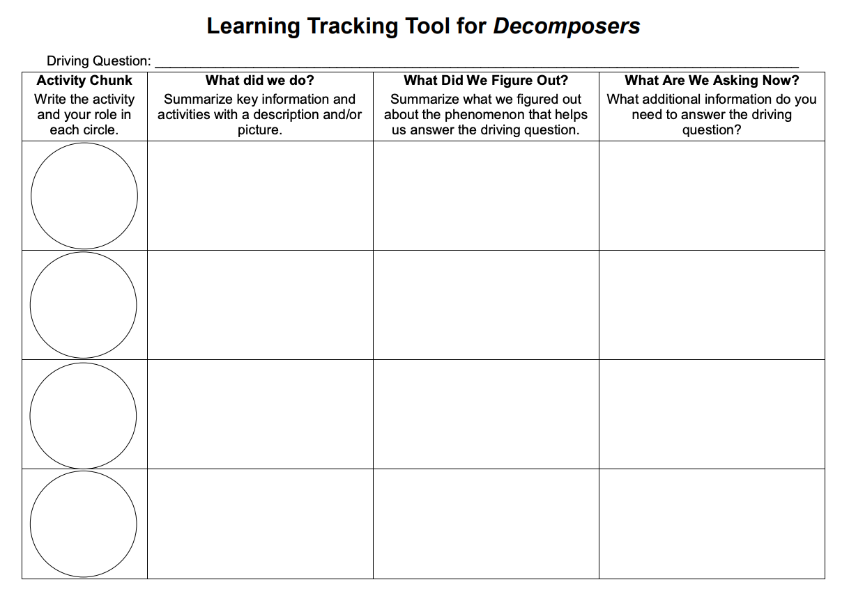
Learning Tracking Tool
Record the activity chunk name “Investigating Bread Molding” and their job, “Investigator.”
Discuss what you did during the activity chunk and record your ideas in the column, “What Did We Do?”
Discuss with your classmates what you figured out will help you to answer the unit driving question. Record your ideas in the column “What Did We Figure Out?”
Discuss questions you now have related to the unit driving question and record them in the column “What Are We Asking Now?”
Notes:
Have a discussion to complete the Learning Tracking Tool for this activity.
Show Slide 11 of the 3.3 Evidence Based Arguments for Bread Molding PPT.
Pass out a Learning Tracking Tool for Decomposers to each student.
Have students write the activity chunk name in the first column, "Investigating Bread Molding" and their role as the “Investigator.”
Have a class discussion about what students did during the activity chunk. When you come to consensus as a class, have students record the answer in the second column of the tool.
Have a class discussion about what students figured out during the activity chunk that will help them in answering the unit driving question. When you come to consensus as a class, have students record the answer in the third column of the tool.
Have a class discussion about what students are wondering now that will help them move towards answering the unit driving question. Have students record the questions in the fourth column of the tool.
Have students keep their Learning Tracking Tool for future activities.
Example Learning Tracking Tool
Activity Chunk: Investigating Bread Molding, Investigator
What Did We Do? Conduct an investigation to explore what happens when bread molds. Use the Predictions and Planning Tool and the Evidence-Based Arguments Tool.
What Did We Figure Out? The bread and mold together lose mass and emit CO₂ as the mold grows
What Are We Asking Now? Where did the missing mass go?

