Slide 1
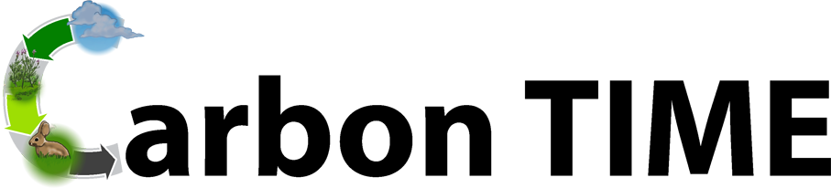
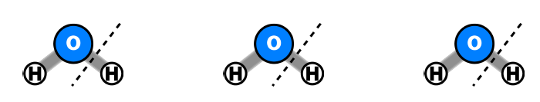
Animals Unit
Activity 5.2: Molecular Models for Cows Growing: Digestion and Biosynthesis
Carbon: Transformations in Matter and Energy
Environmental Literacy Project
Michigan State University
Notes:
Image Credit: Craig Douglas, Michigan State University
Have students start to think about how cows grow.
Tell students that in today’s activity we will use molecular modeling to think more about how cows grow through digestion and biosynthesis.
Open 5.2 Molecular Models for Cows Growing: Digestion and Biosynthesis PPT.

Slide 2
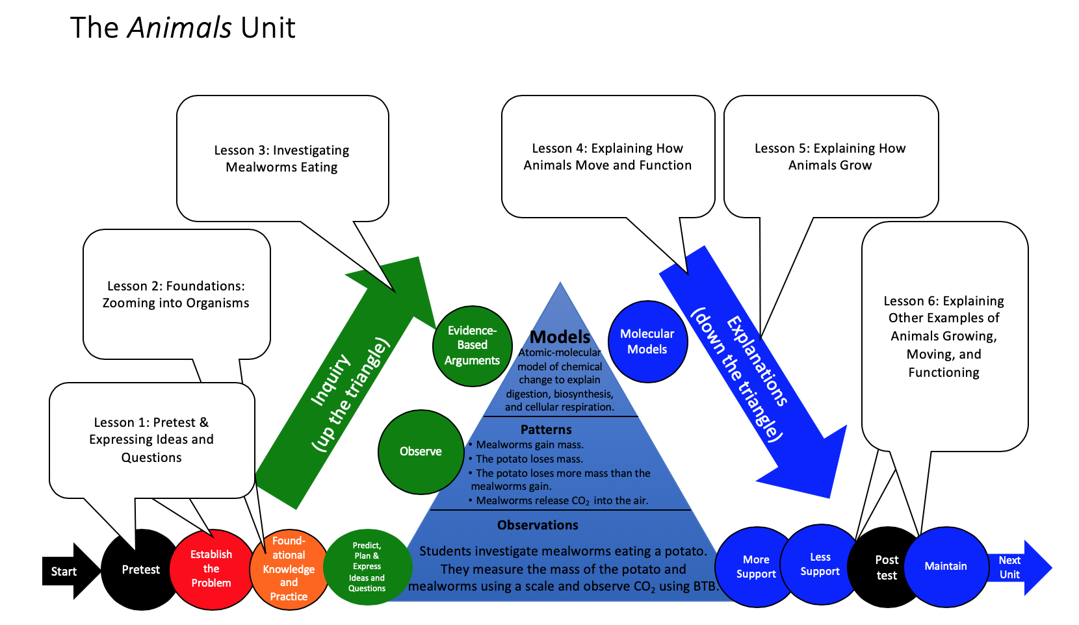
Unit Map
You are here
2
Notes:
Use the instructional model to show students where they are in the course of the unit.
Show slide 2 of the 5.2 Molecular Models for Cows Growing: Digestion and Biosynthesis PPT.

Slide 3
Connecting Questions about Processes at Different Scales: Digestion
Scale | Questions
Macroscopic Scale | How to cows get food to all of their cells?
Microscopic Scale | How do food molecules get into a cow’s blood?
Atomic-Molecular Scale | How are molecules in food changed chemically so that cow cells can use them?
Notes:
Discuss processes at different scales for digestion.
Display slide 3 in the PPT.
Revisit the driving questions first seen in Activity 5.1. Tell students that today’s activity is focused at the atomic-molecular scale.

Slide 4
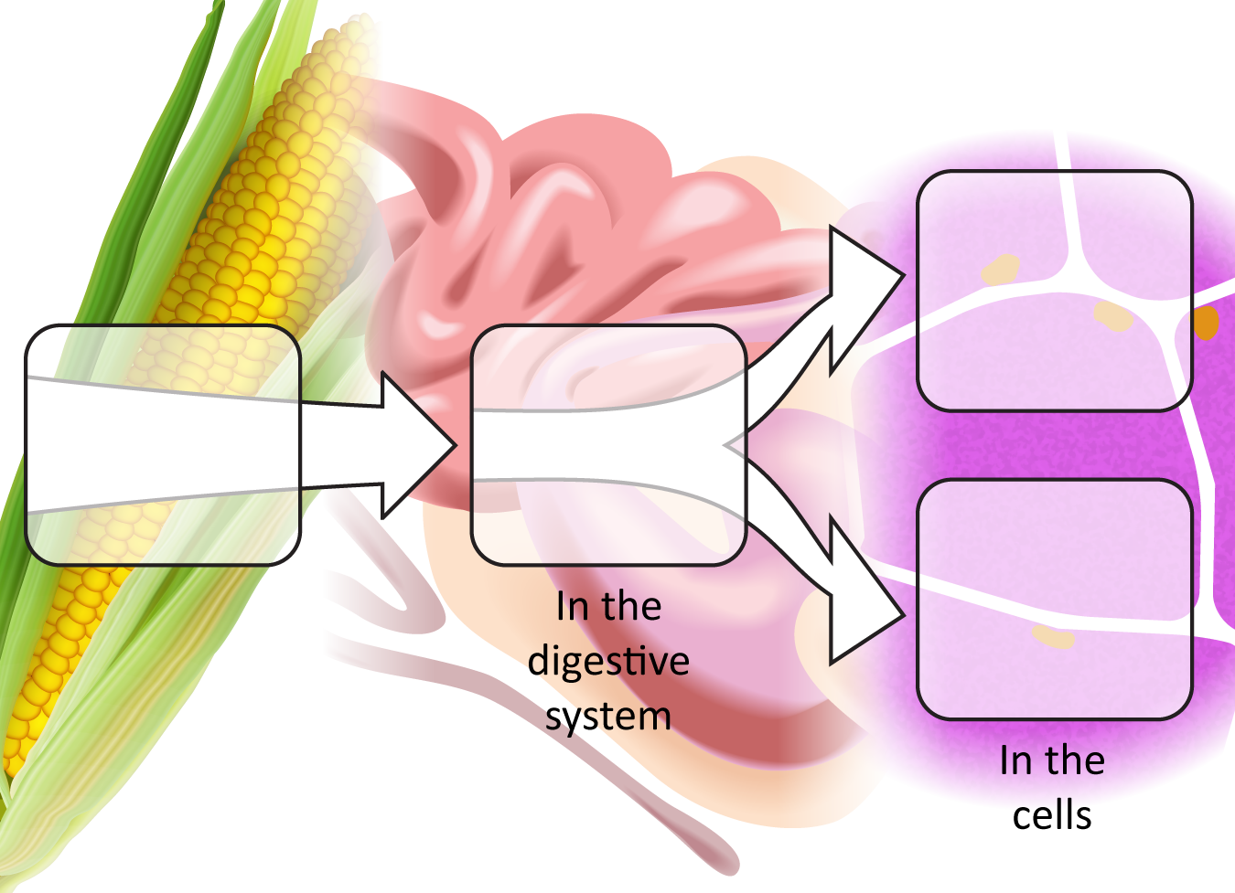
What happens to the food cows eat?
Food
Digestion
Energy:
Cellular
respiration
Notes:
Image Credit: Craig Douglas, Michigan State University
Have students think about what happens to the food cows eat (digestion).
Display Slide 4 to review that animals use digested food in two ways.

Slide 5
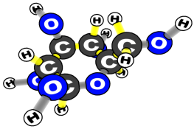
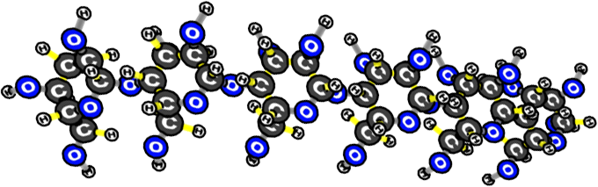
During digestion, large organic molecules are broken down into small organic molecules
LARGE = Polymer
SMALL = Monomers
STARCH
GLUCOSE (SUGAR)
Notes:
Image Credit: Craig Douglas, Michigan State University
Tell students that these large organic molecules in food are broken down into small organic molecules during digestion.
Display slide 5 to show students large organic molecules are broken down into small organic molecules during digestion. Tell students large organic molecules are called polymers and small organic molecules are called monomers. It may help students to remember these words by explaining the meaning of the words’ prefixes (poly means many and mono means one).
Tell students that they’ll be using molecular models to model the process of digestion, which will help them answer several of their unanswered questions.

Slide 6
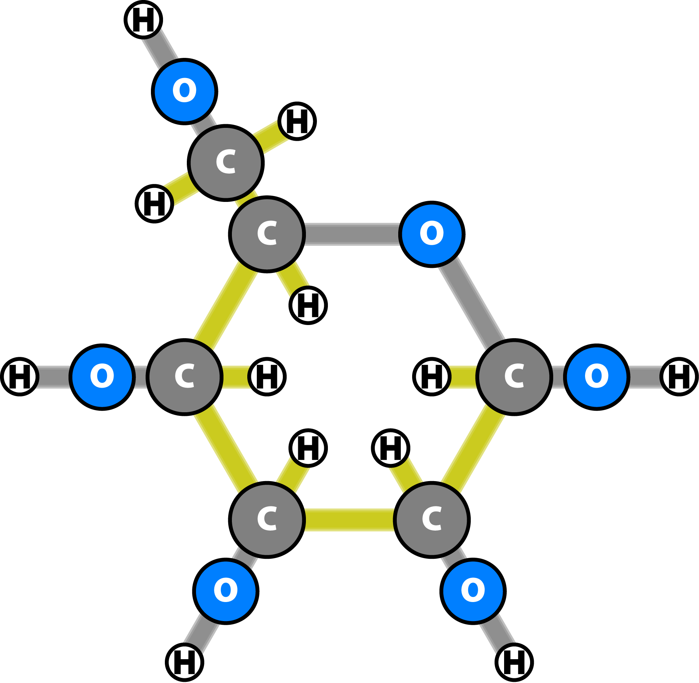
How Atoms Bond Together in Molecules
Atoms in stable molecules always have a certain number of bonds to other atoms:
  Carbon: 4 bonds
  Oxygen: 2 bonds
  Hydrogen: 1 bond
Oxygen atoms do NOT bond to other oxygen atoms if they can bond to carbon or hydrogen instead.
Chemical energy is stored in bonds between atoms
  Some bonds (C-C and C-H) have high chemical energy
  Other bonds (C-O and O-H) have low chemical energy
Notes:
Image Credit: Craig Douglas, Michigan State University
Review the “rules” of molecular bonding in digestion.
Use slide 6 to remind students how atoms bond to make molecules.
Oxygen atoms bond to carbon or hydrogen (not other oxygen atoms) whenever possible. This will help students decide which monomer will bond to an –OH and which will bond to an –H.
Nitrogen forms three bonds.
Point out that digestion will not make or break "high energy" C-C or C-H bonds. Students can use this information to determine where to attach the –H vs. –OH in the activity.

Slide 7
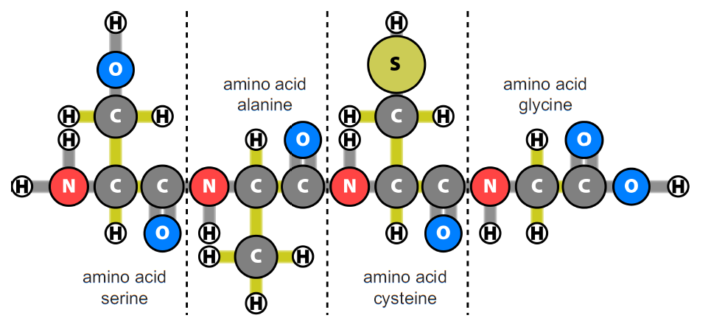
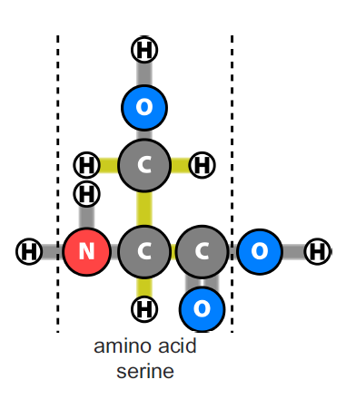
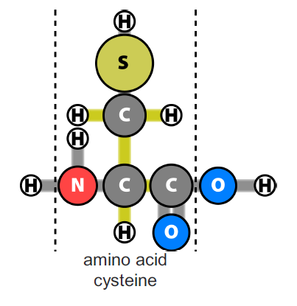
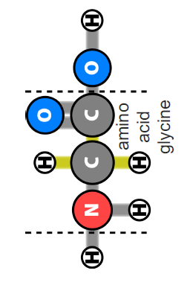
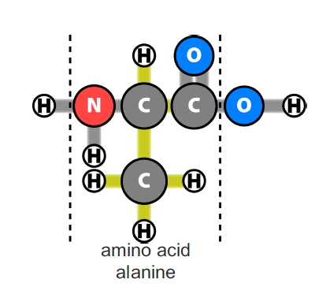
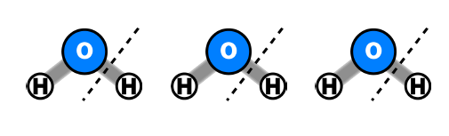
Breakdown Protein Molecules (Digestion)
Let’s focus on what happens to PROTEIN in food.
(Put the other food molecules to the side for now.)
Digest PROTEIN molecules by cutting the protein into individual amino acids.
Notice that after you cut the protein apart there are bonds without atoms. Cut up water molecules to tape an –H and –OH to every amino acid.
Chemical change
Notes:
Image Credit: Craig Douglas, Michigan State University
Have students set up their reactants and model digestion.
Give each pair of students a Molecular Models 11 x 17 Placemat, one set of Forms of Energy Cards, one pair of scissors, a removable tape dispenser, and one protein molecule, one carbohydrate molecule, one fat molecule, and eight water molecules (from the 5.2 Polymers for Cutting Handout).
Have students place a “chemical energy card” on the reactants side of their placemat, along with their water, protein, carbohydrate, and fat molecules.
Coach students to simulate the process of hydrolysis by cutting a water molecule each time they make a cut in the polymer. This helps show that each time a bond between two monomers is broken, the chemical reaction requires water and new bonds form.
Protein: Show slide 7. Have students cut one protein polymer into amino acid monomers. Then, cut the water molecules and attach an –H and an –OH to each amino acid. Watch the animation on slides 8-9.
Carbohydrate: Show slide 10. Have students cut one starch polymer (a type of carbohydrate) into glucose monomers. Then cut the water molecules and attach an –H and an –OH to each glucose. Watch the animation on slides 11-12.
Fat: Show slide 13. Have students cut one fat polymer into glycerol and fatty acid monomers. Then, cut the water molecules and attach an –H and an –OH to each monomer. Watch the animation on slides 14-15.
Have students move the new molecules with the energy card to the products side of their placemat. When watching the slides, ask students what is happening to energy. Listen to see if they notice that chemical potential energy is conserved through digestion.
Show the students the Digestion and Biosynthesis 11 x 17 Posters as a visual of the process.

Slide 8

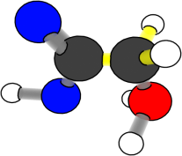
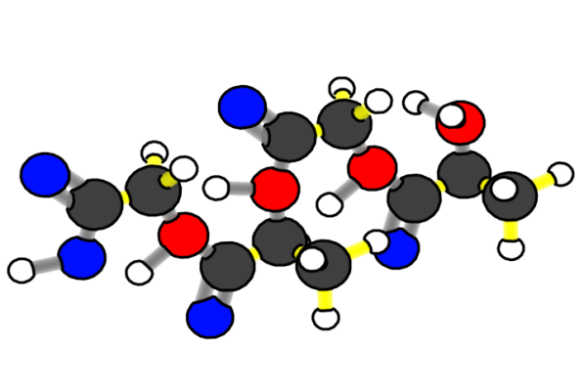
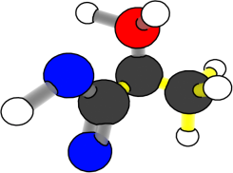
What happens to carbon atoms and chemical energy in digestion?
Chemical change
Protein polymer
(+ water)
Amino acid
monomers
Reactants
Products
Notes:
Image Credit: Craig Douglas, Michigan State University
Have students set up their reactants and model digestion.
Give each pair of students a Molecular Models 11 x 17 Placemat, one set of Forms of Energy Cards, one pair of scissors, a removable tape dispenser, and one protein molecule, one carbohydrate molecule, one fat molecule, and eight water molecules (from the 5.2 Polymers for Cutting Handout).
Have students place a “chemical energy card” on the reactants side of their placemat, along with their water, protein, carbohydrate, and fat molecules.
Coach students to simulate the process of hydrolysis by cutting a water molecule each time they make a cut in the polymer. This helps show that each time a bond between two monomers is broken, the chemical reaction requires water and new bonds form.
Protein: Show slide 7. Have students cut one protein polymer into amino acid monomers. Then, cut the water molecules and attach an –H and an –OH to each amino acid. Watch the animation on slides 8-9.
Carbohydrate: Show slide 10. Have students cut one starch polymer (a type of carbohydrate) into glucose monomers. Then cut the water molecules and attach an –H and an –OH to each glucose. Watch the animation on slides 11-12.
Fat: Show slide 13. Have students cut one fat polymer into glycerol and fatty acid monomers. Then, cut the water molecules and attach an –H and an –OH to each monomer. Watch the animation on slides 14-15.
Have students move the new molecules with the energy card to the products side of their placemat. When watching the slides, ask students what is happening to energy. Listen to see if they notice that chemical potential energy is conserved through digestion.
Show the students the Digestion and Biosynthesis 11 x 17 Posters as a visual of the process.

Slide 9

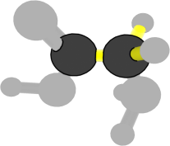
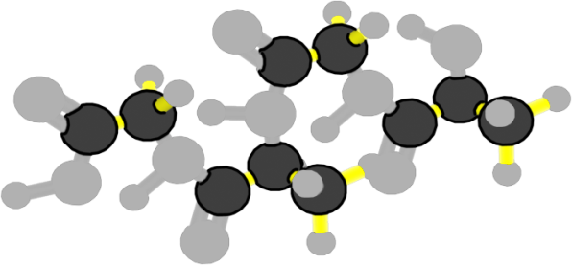
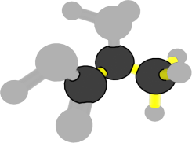
What happens to carbon atoms and chemical energy in digestion?
Chemical change
Carbon atoms stay in organic molecules with high-energy bonds
Protein polymer
(+ water)
Amino acid
monomers
Reactants
Products
Notes:
Image Credit: Craig Douglas, Michigan State University
Have students set up their reactants and model digestion.
Give each pair of students a Molecular Models 11 x 17 Placemat, one set of Forms of Energy Cards, one pair of scissors, a removable tape dispenser, and one protein molecule, one carbohydrate molecule, one fat molecule, and eight water molecules (from the 5.2 Polymers for Cutting Handout).
Have students place a “chemical energy card” on the reactants side of their placemat, along with their water, protein, carbohydrate, and fat molecules.
Coach students to simulate the process of hydrolysis by cutting a water molecule each time they make a cut in the polymer. This helps show that each time a bond between two monomers is broken, the chemical reaction requires water and new bonds form.
Protein: Show slide 7. Have students cut one protein polymer into amino acid monomers. Then, cut the water molecules and attach an –H and an –OH to each amino acid. Watch the animation on slides 8-9.
Carbohydrate: Show slide 10. Have students cut one starch polymer (a type of carbohydrate) into glucose monomers. Then cut the water molecules and attach an –H and an –OH to each glucose. Watch the animation on slides 11-12.
Fat: Show slide 13. Have students cut one fat polymer into glycerol and fatty acid monomers. Then, cut the water molecules and attach an –H and an –OH to each monomer. Watch the animation on slides 14-15.
Have students move the new molecules with the energy card to the products side of their placemat. When watching the slides, ask students what is happening to energy. Listen to see if they notice that chemical potential energy is conserved through digestion.
Show the students the Digestion and Biosynthesis 11 x 17 Posters as a visual of the process.

Slide 10
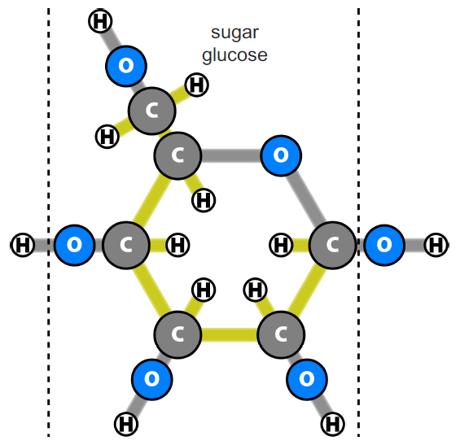
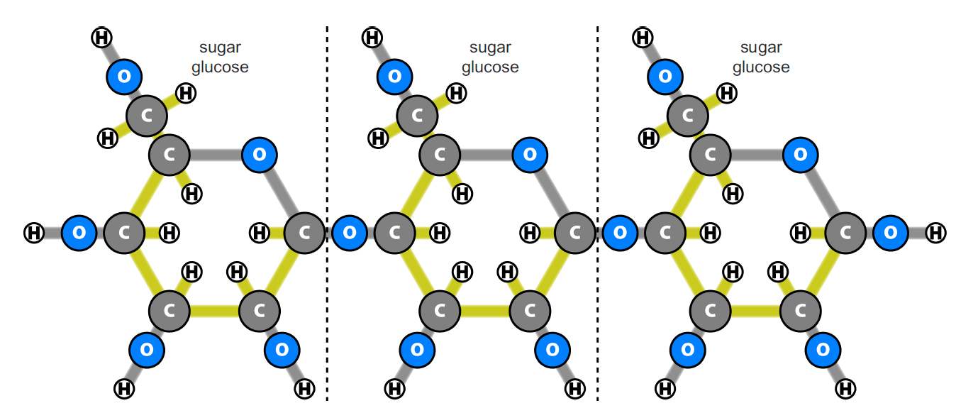
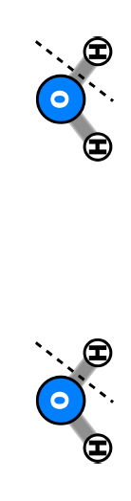
Breakdown of Starch Molecules (Digestion)
Digest STARCH molecules by cutting the starch into individual glucose monomers.
Notice that after you cut the starch apart there are bonds without atoms. Cut up water molecules to tape an –H and –OH to every glucose.
Chemical change
Notes:
Image Credit (molecule): Craig Douglas, Michigan State University
Have students set up their reactants and model digestion.
Give each pair of students a Molecular Models 11 x 17 Placemat, one set of Forms of Energy Cards, one pair of scissors, a removable tape dispenser, and one protein molecule, one carbohydrate molecule, one fat molecule, and eight water molecules (from the 5.2 Polymers for Cutting Handout).
Have students place a “chemical energy card” on the reactants side of their placemat, along with their water, protein, carbohydrate, and fat molecules.
Coach students to simulate the process of hydrolysis by cutting a water molecule each time they make a cut in the polymer. This helps show that each time a bond between two monomers is broken, the chemical reaction requires water and new bonds form.
Protein: Show slide 7. Have students cut one protein polymer into amino acid monomers. Then, cut the water molecules and attach an –H and an –OH to each amino acid. Watch the animation on slides 8-9.
Carbohydrate: Show slide 10. Have students cut one starch polymer (a type of carbohydrate) into glucose monomers. Then cut the water molecules and attach an –H and an –OH to each glucose. Watch the animation on slides 11-12.
Fat: Show slide 13. Have students cut one fat polymer into glycerol and fatty acid monomers. Then, cut the water molecules and attach an –H and an –OH to each monomer. Watch the animation on slides 14-15.
Have students move the new molecules with the energy card to the products side of their placemat. When watching the slides, ask students what is happening to energy. Listen to see if they notice that chemical potential energy is conserved through digestion.
Show the students the Digestion and Biosynthesis 11 x 17 Posters as a visual of the process.

Slide 11

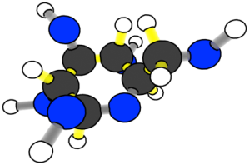
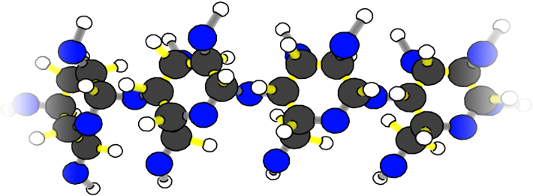
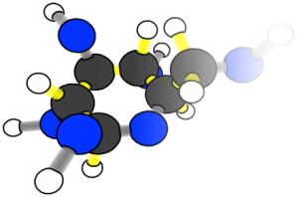
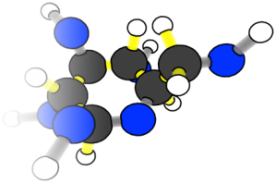
What happens to carbon atoms and chemical energy in digestion?
Chemical change
Starch polymer
(+ water)
Glucose monomers
Reactants
Products
Notes:
Image Credit: Craig Douglas, Michigan State University
Have students set up their reactants and model digestion.
Give each pair of students a Molecular Models 11 x 17 Placemat, one set of Forms of Energy Cards, one pair of scissors, a removable tape dispenser, and one protein molecule, one carbohydrate molecule, one fat molecule, and eight water molecules (from the 5.2 Polymers for Cutting Handout).
Have students place a “chemical energy card” on the reactants side of their placemat, along with their water, protein, carbohydrate, and fat molecules.
Coach students to simulate the process of hydrolysis by cutting a water molecule each time they make a cut in the polymer. This helps show that each time a bond between two monomers is broken, the chemical reaction requires water and new bonds form.
Protein: Show slide 7. Have students cut one protein polymer into amino acid monomers. Then, cut the water molecules and attach an –H and an –OH to each amino acid. Watch the animation on slides 8-9.
Carbohydrate: Show slide 10. Have students cut one starch polymer (a type of carbohydrate) into glucose monomers. Then cut the water molecules and attach an –H and an –OH to each glucose. Watch the animation on slides 11-12.
Fat: Show slide 13. Have students cut one fat polymer into glycerol and fatty acid monomers. Then, cut the water molecules and attach an –H and an –OH to each monomer. Watch the animation on slides 14-15.
Have students move the new molecules with the energy card to the products side of their placemat. When watching the slides, ask students what is happening to energy. Listen to see if they notice that chemical potential energy is conserved through digestion.
Show the students the Digestion and Biosynthesis 11 x 17 Posters as a visual of the process.

Slide 12

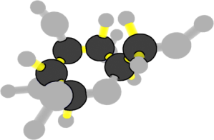
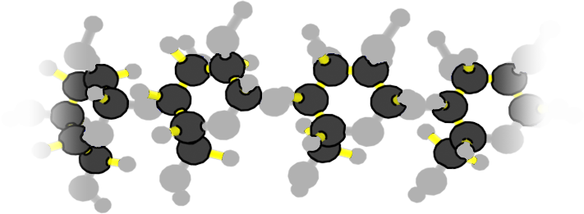
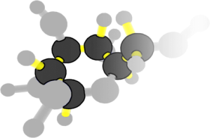
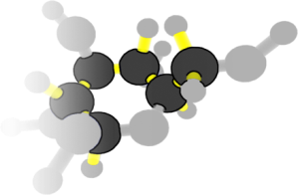
What happens to carbon atoms and chemical energy in digestion?
Chemical change
Carbon atoms stay in organic molecules with high-energy bonds
Starch polymer
(+ water)
Glucose monomers
Reactants
Products
Notes:
Image Credit: Craig Douglas, Michigan State University
Have students set up their reactants and model digestion.
Give each pair of students a Molecular Models 11 x 17 Placemat, one set of Forms of Energy Cards, one pair of scissors, a removable tape dispenser, and one protein molecule, one carbohydrate molecule, one fat molecule, and eight water molecules (from the 5.2 Polymers for Cutting Handout).
Have students place a “chemical energy card” on the reactants side of their placemat, along with their water, protein, carbohydrate, and fat molecules.
Coach students to simulate the process of hydrolysis by cutting a water molecule each time they make a cut in the polymer. This helps show that each time a bond between two monomers is broken, the chemical reaction requires water and new bonds form.
Protein: Show slide 7. Have students cut one protein polymer into amino acid monomers. Then, cut the water molecules and attach an –H and an –OH to each amino acid. Watch the animation on slides 8-9.
Carbohydrate: Show slide 10. Have students cut one starch polymer (a type of carbohydrate) into glucose monomers. Then cut the water molecules and attach an –H and an –OH to each glucose. Watch the animation on slides 11-12.
Fat: Show slide 13. Have students cut one fat polymer into glycerol and fatty acid monomers. Then, cut the water molecules and attach an –H and an –OH to each monomer. Watch the animation on slides 14-15.
Have students move the new molecules with the energy card to the products side of their placemat. When watching the slides, ask students what is happening to energy. Listen to see if they notice that chemical potential energy is conserved through digestion.
Show the students the Digestion and Biosynthesis 11 x 17 Posters as a visual of the process.
12

Slide 13
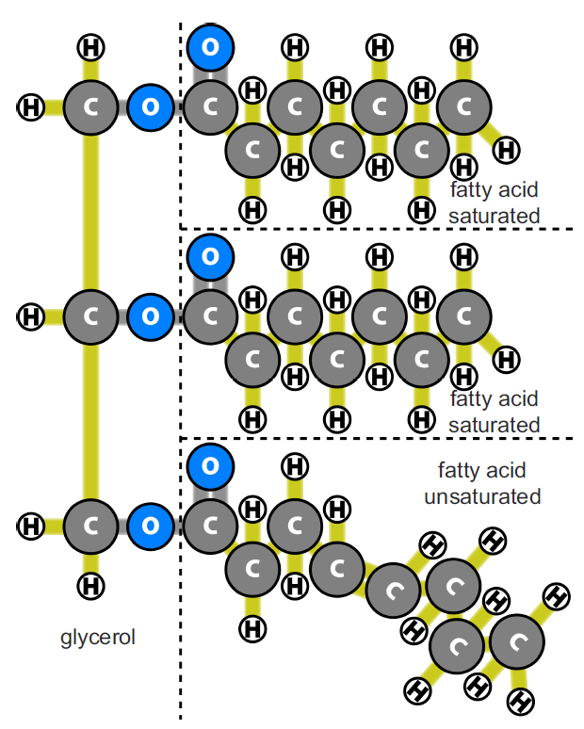
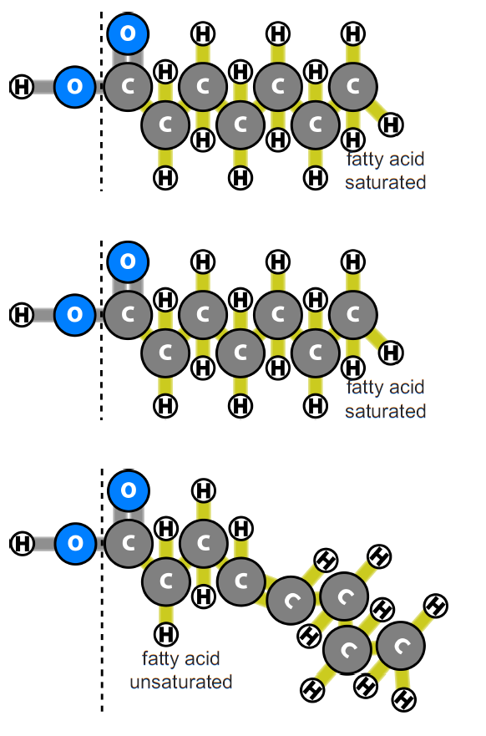
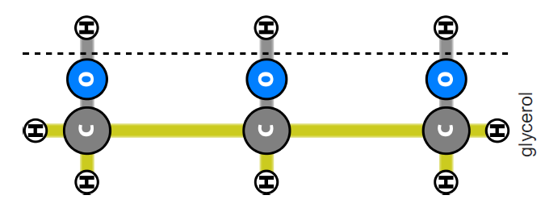
Breakdown of Fat Molecules
(Digestion)
Digest FAT molecules by breaking the fat into individual fatty acid and glycerol monomers.
Notice that after you cut the fat apart there are bonds without atoms. Cut up water molecules to tape an –H and –OH to each fatty acid and glycerol.
Chemical change
Notes:
Image Credit (molecule): Craig Douglas, Michigan State University
Have students set up their reactants and model digestion.
Give each pair of students a Molecular Models 11 x 17 Placemat, one set of Forms of Energy Cards, one pair of scissors, a removable tape dispenser, and one protein molecule, one carbohydrate molecule, one fat molecule, and eight water molecules (from the 5.2 Polymers for Cutting Handout).
Have students place a “chemical energy card” on the reactants side of their placemat, along with their water, protein, carbohydrate, and fat molecules.
Coach students to simulate the process of hydrolysis by cutting a water molecule each time they make a cut in the polymer. This helps show that each time a bond between two monomers is broken, the chemical reaction requires water and new bonds form.
Protein: Show slide 7. Have students cut one protein polymer into amino acid monomers. Then, cut the water molecules and attach an –H and an –OH to each amino acid. Watch the animation on slides 8-9.
Carbohydrate: Show slide 10. Have students cut one starch polymer (a type of carbohydrate) into glucose monomers. Then cut the water molecules and attach an –H and an –OH to each glucose. Watch the animation on slides 11-12.
Fat: Show slide 13. Have students cut one fat polymer into glycerol and fatty acid monomers. Then, cut the water molecules and attach an –H and an –OH to each monomer. Watch the animation on slides 14-15.
Have students move the new molecules with the energy card to the products side of their placemat. When watching the slides, ask students what is happening to energy. Listen to see if they notice that chemical potential energy is conserved through digestion.
Show the students the Digestion and Biosynthesis 11 x 17 Posters as a visual of the process.

Slide 14

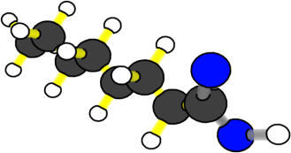
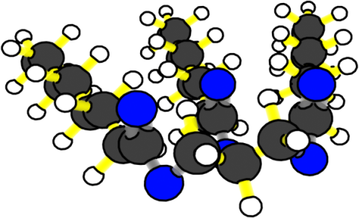
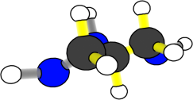
What happens to carbon atoms and chemical energy in digestion?
Chemical change
Fat
(+ water)
Fatty acids
+ glycerol
Reactants
Products
Notes:
Image Credit: Craig Douglas, Michigan State University
Have students set up their reactants and model digestion.
Give each pair of students a Molecular Models 11 x 17 Placemat, one set of Forms of Energy Cards, one pair of scissors, a removable tape dispenser, and one protein molecule, one carbohydrate molecule, one fat molecule, and eight water molecules (from the 5.2 Polymers for Cutting Handout).
Have students place a “chemical energy card” on the reactants side of their placemat, along with their water, protein, carbohydrate, and fat molecules.
Coach students to simulate the process of hydrolysis by cutting a water molecule each time they make a cut in the polymer. This helps show that each time a bond between two monomers is broken, the chemical reaction requires water and new bonds form.
Protein: Show slide 7. Have students cut one protein polymer into amino acid monomers. Then, cut the water molecules and attach an –H and an –OH to each amino acid. Watch the animation on slides 8-9.
Carbohydrate: Show slide 10. Have students cut one starch polymer (a type of carbohydrate) into glucose monomers. Then cut the water molecules and attach an –H and an –OH to each glucose. Watch the animation on slides 11-12.
Fat: Show slide 13. Have students cut one fat polymer into glycerol and fatty acid monomers. Then, cut the water molecules and attach an –H and an –OH to each monomer. Watch the animation on slides 14-15.
Have students move the new molecules with the energy card to the products side of their placemat. When watching the slides, ask students what is happening to energy. Listen to see if they notice that chemical potential energy is conserved through digestion.
Show the students the Digestion and Biosynthesis 11 x 17 Posters as a visual of the process.

Slide 15

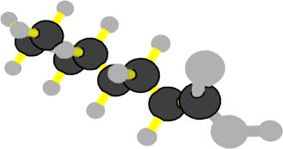
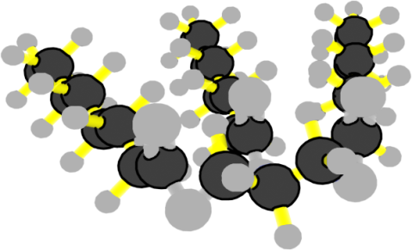
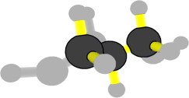
What happens to carbon atoms and chemical energy in digestion?
Chemical change
Carbon atoms stay in organic molecules with high-energy bonds
Fat
(+ water)
Fatty acids
+ glycerol
Reactants
Products
Notes:
Image Credit: Craig Douglas, Michigan State University
Have students set up their reactants and model digestion.
Give each pair of students a Molecular Models 11 x 17 Placemat, one set of Forms of Energy Cards, one pair of scissors, a removable tape dispenser, and one protein molecule, one carbohydrate molecule, one fat molecule, and eight water molecules (from the 5.2 Polymers for Cutting Handout).
Have students place a “chemical energy card” on the reactants side of their placemat, along with their water, protein, carbohydrate, and fat molecules.
Coach students to simulate the process of hydrolysis by cutting a water molecule each time they make a cut in the polymer. This helps show that each time a bond between two monomers is broken, the chemical reaction requires water and new bonds form.
Protein: Show slide 7. Have students cut one protein polymer into amino acid monomers. Then, cut the water molecules and attach an –H and an –OH to each amino acid. Watch the animation on slides 8-9.
Carbohydrate: Show slide 10. Have students cut one starch polymer (a type of carbohydrate) into glucose monomers. Then cut the water molecules and attach an –H and an –OH to each glucose. Watch the animation on slides 11-12.
Fat: Show slide 13. Have students cut one fat polymer into glycerol and fatty acid monomers. Then, cut the water molecules and attach an –H and an –OH to each monomer. Watch the animation on slides 14-15.
Have students move the new molecules with the energy card to the products side of their placemat. When watching the slides, ask students what is happening to energy. Listen to see if they notice that chemical potential energy is conserved through digestion.
Show the students the Digestion and Biosynthesis 11 x 17 Posters as a visual of the process.

Slide 16
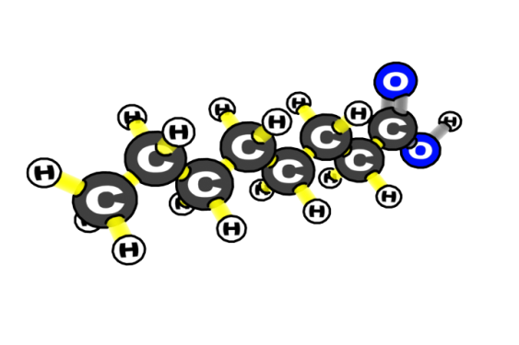
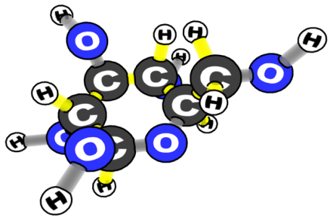
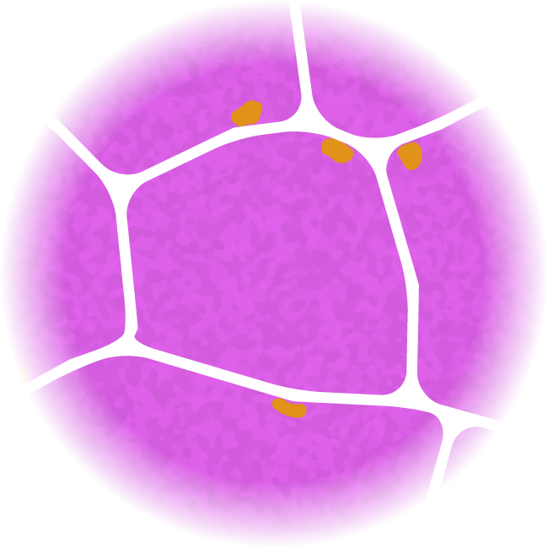
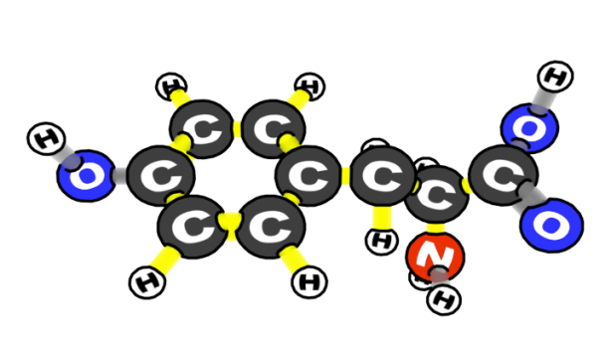
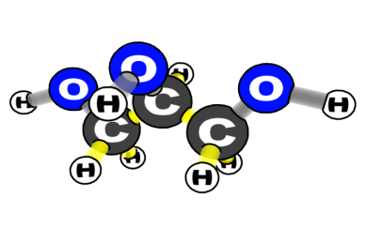
Where do digested monomers go?
glucose
fatty acid
glycerol
amino acid
Notes:
Image Credit: Craig Douglas, Michigan State University
Show students where digested monomers go in the body.
Use slide 16 to remind students that blood carries digested monomers to all parts of animals’ bodies.
Because the molecules are small they can pass through the intestinal walls and into the blood.

Slide 17
Connecting Questions about Processes at Different Scales: Biosynthesis
Scale | Questions
Macroscopic Scale | How do cows grow?
Microscopic Scale | How do cows’ cells use small organic molecules to grow?
Atomic-Molecular Scale | How do cells make their large organic molecules?
Notes:
Transition students to model biosynthesis.
Use slides 17 and 18 in the PPT to transition to biosynthesis.
Ask students what they remember about biosynthesis from Activity 5.1

Slide 18
How do cows’ cells use food to grow?
Materials
for growth:
Biosynthesis
Food
Digestion
Energy:
Cellular
respiration
Notes:
Image Credit: Craig Douglas, Michigan State University
Transition students to model biosynthesis.
Use slides 17 and 18 in the PPT to transition to biosynthesis.
Ask students what they remember about biosynthesis from Activity 5.1.

Slide 19
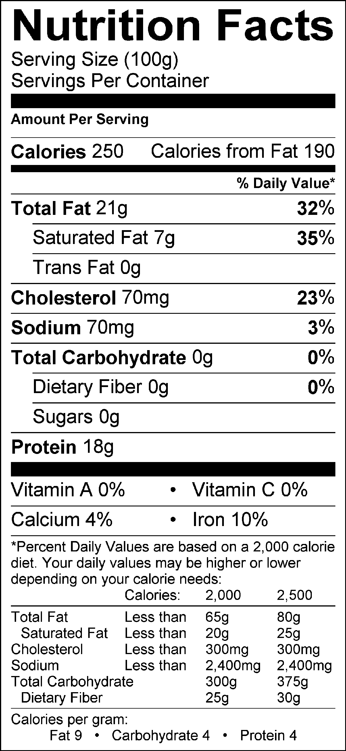
Remember what’s in cow muscles
PROTEIN
FAT
Notes:
Image Credit (molecule): Craig Douglas, Michigan State University
Remind students what is in cow muscle.
Show slide 19 to remind students of the information they learned from beef nutritional labels: cow muscles are made primarily of protein (18g) and fat (21g). This means that the cells in the animal’s leg muscle are going to make fat and protein molecules so the muscle cells can grow bigger and divide.
Tell students that they will use the placemat and molecules to model the process of biosynthesis, which is what happens when animals build polymers from monomers
Point out that when they are modeling, they should remember that during biosynthesis, no "high energy" C-C or C-H bonds will be made or broken. The chemical energy is conserved!
Refer to the Digestion and Biosynthesis 11 x 17 Posters in your classroom to help students visualize the biosynthesis of monomers to polymers.

Slide 20
Build Cow Muscles (Biosynthesis)
Build PROTEIN molecules by taping 4 amino acid monomers together.
Notice you will need to remove an –H and –OH from each amino acid. Tape these back together to make water.
Chemical change
Notes:
Image Credit (molecule): Craig Douglas, Michigan State University
Have students set up their reactants and model biosynthesis.
Have students place a “chemical energy card” on the reactants side of their placemat, along with their amino acids, fatty acids, glycerol and glucose molecules. Coach students to simulate the actual process of dehydration synthesis by making a water molecule each time they tape two monomers together. This helps show that each time a bond is broken a chemical reaction takes place and new bonds form.
Protein: Show slide 20. Have students tape together four amino acid monomers to form one protein polymer and three water molecules. Then, watch the animation on slides 21-22.
Fat: Show slide 23. Have students tape together one glycerol and three fatty acid monomers to form one fat polymer and three water molecules. Then, watch the animation on slides 24-25.
Carbohydrate: Tell students that animals don’t make starch (though they make other carbohydrates)!
Have students move the new molecules with the energy card to the products side of their placemat. Ask students what is happening to energy during biosynthesis. Listen to see if they notice that chemical potential energy is conserved through the chemical change.
Make the connection to cell division: cells have to both get bigger and also divide in order for animals to grow. This is why we perform biosynthesis: to make our cells get bigger (growth) so they can divide.

Slide 21
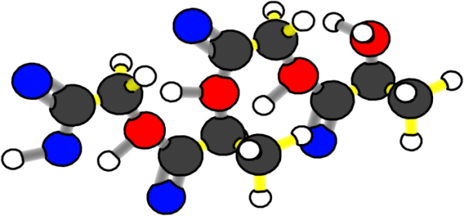
What happens to carbon atoms and chemical energy in biosynthesis?
Chemical change
Amino acid
monomers
Protein polymer
(+ water)
Reactants
Products
Notes:
Image Credit (molecule): Craig Douglas, Michigan State University
Have students set up their reactants and model biosynthesis.
Have students place a “chemical energy card” on the reactants side of their placemat, along with their amino acids, fatty acids, glycerol and glucose molecules. Coach students to simulate the actual process of dehydration synthesis by making a water molecule each time they tape two monomers together. This helps show that each time a bond is broken a chemical reaction takes place and new bonds form.
Protein: Show slide 20. Have students tape together four amino acid monomers to form one protein polymer and three water molecules. Then, watch the animation on slides 21-22.
Fat: Show slide 23. Have students tape together one glycerol and three fatty acid monomers to form one fat polymer and three water molecules. Then, watch the animation on slides 24-25.
Carbohydrate: Tell students that animals don’t make starch (though they make other carbohydrates)!
Have students move the new molecules with the energy card to the products side of their placemat. Ask students what is happening to energy during biosynthesis. Listen to see if they notice that chemical potential energy is conserved through the chemical change.
Make the connection to cell division: cells have to both get bigger and also divide in order for animals to grow. This is why we perform biosynthesis: to make our cells get bigger (growth) so they can divide.

Slide 22

What happens to carbon atoms and chemical energy in biosynthesis?
Chemical change
Carbon atoms stay in organic molecules with high-energy bonds
Amino acid
monomers
Protein polymer
(+ water)
Reactants
Products
Notes:
Image Credit (molecule): Craig Douglas, Michigan State University
Have students set up their reactants and model biosynthesis.
Have students place a “chemical energy card” on the reactants side of their placemat, along with their amino acids, fatty acids, glycerol and glucose molecules. Coach students to simulate the actual process of dehydration synthesis by making a water molecule each time they tape two monomers together. This helps show that each time a bond is broken a chemical reaction takes place and new bonds form.
Protein: Show slide 20. Have students tape together four amino acid monomers to form one protein polymer and three water molecules. Then, watch the animation on slides 21-22.
Fat: Show slide 23. Have students tape together one glycerol and three fatty acid monomers to form one fat polymer and three water molecules. Then, watch the animation on slides 24-25.
Carbohydrate: Tell students that animals don’t make starch (though they make other carbohydrates)!
Have students move the new molecules with the energy card to the products side of their placemat. Ask students what is happening to energy during biosynthesis. Listen to see if they notice that chemical potential energy is conserved through the chemical change.
Make the connection to cell division: cells have to both get bigger and also divide in order for animals to grow. This is why we perform biosynthesis: to make our cells get bigger (growth) so they can divide.

Slide 23
Build Cow Muscles (Biosynthesis)
Build FAT molecules by taping 3 fatty acid monomers to 1 glycerol molecule.
Notice you will need to remove an –H and –OH from each fatty acid and glycerol. Tape these back together to make water.
Chemical change
Notes:
Image Credit (molecule): Craig Douglas, Michigan State University
Have students set up their reactants and model biosynthesis.
Have students place a “chemical energy card” on the reactants side of their placemat, along with their amino acids, fatty acids, glycerol and glucose molecules. Coach students to simulate the actual process of dehydration synthesis by making a water molecule each time they tape two monomers together. This helps show that each time a bond is broken a chemical reaction takes place and new bonds form.
Protein: Show slide 20. Have students tape together four amino acid monomers to form one protein polymer and three water molecules. Then, watch the animation on slides 21-22.
Fat: Show slide 23. Have students tape together one glycerol and three fatty acid monomers to form one fat polymer and three water molecules. Then, watch the animation on slides 24-25.
Carbohydrate: Tell students that animals don’t make starch (though they make other carbohydrates)!
Have students move the new molecules with the energy card to the products side of their placemat. Ask students what is happening to energy during biosynthesis. Listen to see if they notice that chemical potential energy is conserved through the chemical change.
Make the connection to cell division: cells have to both get bigger and also divide in order for animals to grow. This is why we perform biosynthesis: to make our cells get bigger (growth) so they can divide.

Slide 24
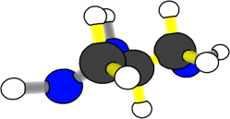
What happens to carbon atoms and chemical energy in biosynthesis?
Chemical change
Fatty acids
+ glycerol
Fat
(+ water)
Reactants
Products
Notes:
Image Credit (molecule): Craig Douglas, Michigan State University
Have students set up their reactants and model biosynthesis.
Have students place a “chemical energy card” on the reactants side of their placemat, along with their amino acids, fatty acids, glycerol and glucose molecules. Coach students to simulate the actual process of dehydration synthesis by making a water molecule each time they tape two monomers together. This helps show that each time a bond is broken a chemical reaction takes place and new bonds form.
Protein: Show slide 20. Have students tape together four amino acid monomers to form one protein polymer and three water molecules. Then, watch the animation on slides 21-22.
Fat: Show slide 23. Have students tape together one glycerol and three fatty acid monomers to form one fat polymer and three water molecules. Then, watch the animation on slides 24-25.
Carbohydrate: Tell students that animals don’t make starch (though they make other carbohydrates)!
Have students move the new molecules with the energy card to the products side of their placemat. Ask students what is happening to energy during biosynthesis. Listen to see if they notice that chemical potential energy is conserved through the chemical change.
Make the connection to cell division: cells have to both get bigger and also divide in order for animals to grow. This is why we perform biosynthesis: to make our cells get bigger (growth) so they can divide.

Slide 25
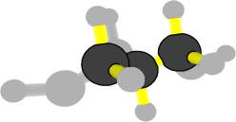
What happens to carbon atoms and chemical energy in biosynthesis?
Chemical change
Carbon atoms stay in organic molecules with high-energy bonds
Fatty acids
+ glycerol
Fat
(+ water)
Reactants
Products
Notes:
Image Credit (molecule): Craig Douglas, Michigan State University
Have students set up their reactants and model biosynthesis.
Have students place a “chemical energy card” on the reactants side of their placemat, along with their amino acids, fatty acids, glycerol and glucose molecules. Coach students to simulate the actual process of dehydration synthesis by making a water molecule each time they tape two monomers together. This helps show that each time a bond is broken a chemical reaction takes place and new bonds form.
Protein: Show slide 20. Have students tape together four amino acid monomers to form one protein polymer and three water molecules. Then, watch the animation on slides 21-22.
Fat: Show slide 23. Have students tape together one glycerol and three fatty acid monomers to form one fat polymer and three water molecules. Then, watch the animation on slides 24-25.
Carbohydrate: Tell students that animals don’t make starch (though they make other carbohydrates)!
Have students move the new molecules with the energy card to the products side of their placemat. Ask students what is happening to energy during biosynthesis. Listen to see if they notice that chemical potential energy is conserved through the chemical change.
Make the connection to cell division: cells have to both get bigger and also divide in order for animals to grow. This is why we perform biosynthesis: to make our cells get bigger (growth) so they can divide.

Slide 26

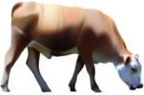
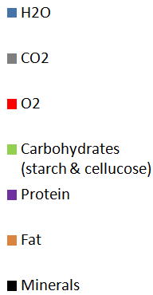
Matter entering and leaving animals
Materials in grass
(entering cow)
Protein
Materials in a cow
minerals
Protein
minerals
Fat
H₂O
H₂O
Carbohydrates
minerals
minerals
Carbohydrates
CO2
Fat
Materials leave a
cow by breathing,
urination, feces, and perspiration.
H2O
H2O
Protein
From lungs
feces
Notes:
Image Credit (grass): Hannah Miller, Michigan State University
Image Credit (cow): Craig Douglas, Michigan State University
Conclude by having students think about the composition of materials that enter, stay in, and leave the cow.
Use slide 26 to have students consider the composition of materials that enter, stay in, and leave a cow.
Students may point out that there is fat in the cow, but not in the grass. Ask them “Where did the fat in the cow come from?” After the lesson, they should be able to answer that question as they “built” fat molecules in their model biosynthesis.

