Slide 1
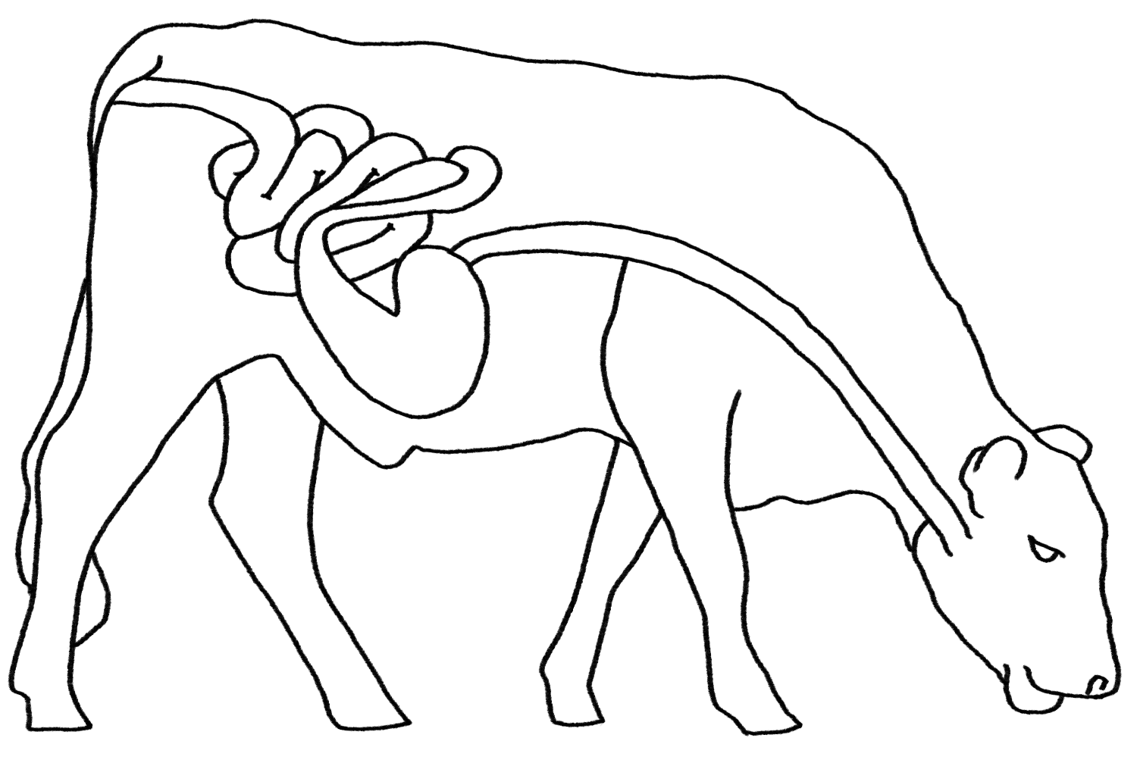
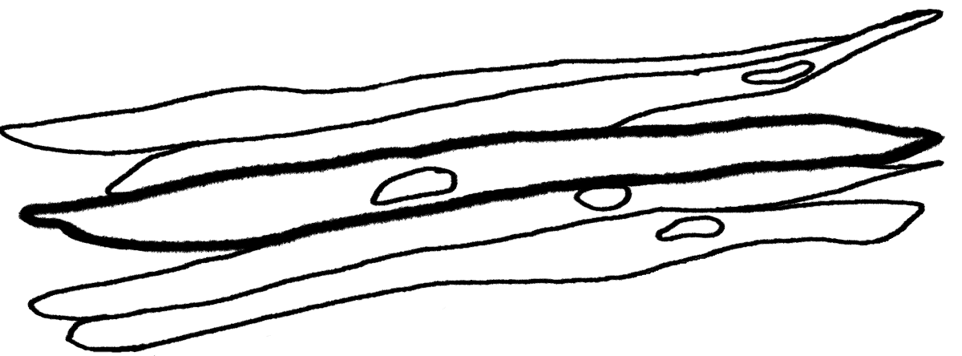
Animals Unit Activity 4.2: Explaining How Cows Move and Function: Cellular Respiration
Carbon: Transformations in Matter and Energy
Environmental Literacy Project Michigan State University
Notes:
Image Credit: Craig Douglas, Michigan State University

Slide 2
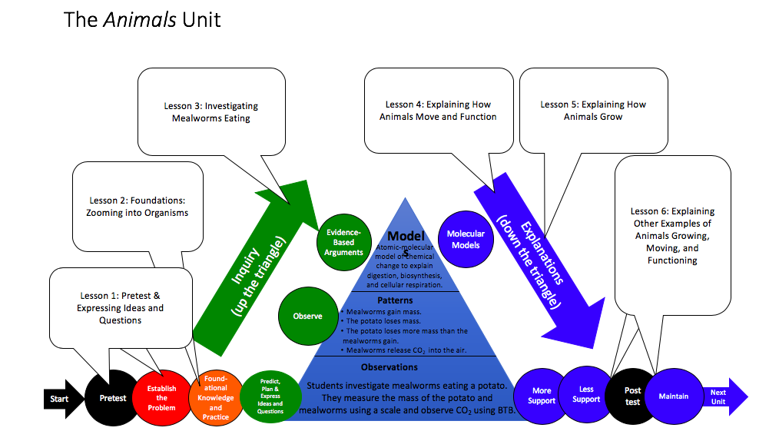
Unit Map
You are here
Notes:
Use the instructional model to show students where they are in the course of the unit.
Show slide 2 of the 4.2 Explaining How Cows Move and Function: Cellular Respiration PPT.

Slide 3
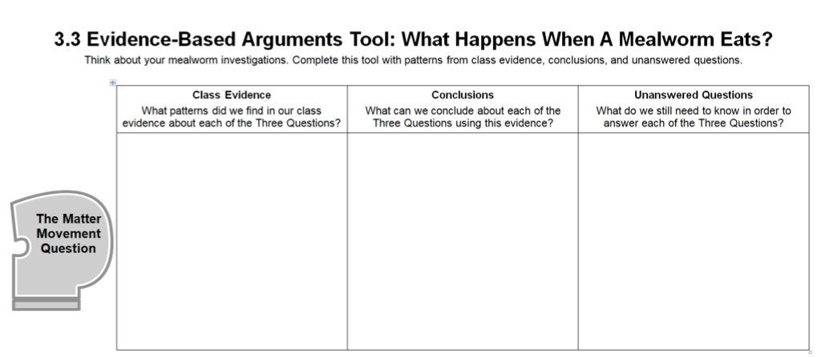
Revisit your arguments
Think about what you know now that you didn’t know before. What have you learned?
Notes:
Revisit students’ arguments about what happens when mealworms eat.
Show slide 3 of the 4.2 Explaining How Cows Move and Function: Cellular Respiration PPT.
Tell students that this activity’s purpose is to develop explanations for how cows use food to move and function.
Return each student’s copy of 3.3 Evidence-Based Arguments Tool for Mealworms Eating and have them review their arguments before they completed the molecular modeling activity. Their arguments and unanswered questions should also apply to cows.
Ask them to think about what they know now that they didn’t know then.

Slide 4
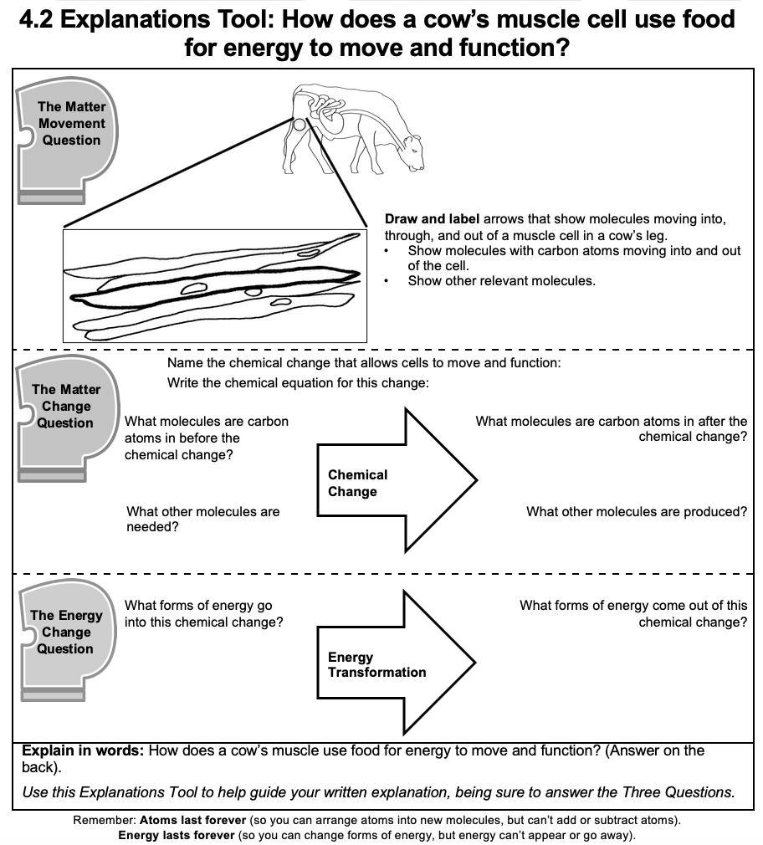
Completing the Front of the Explanations Tool
Consider the following as you complete the front:
Evidence from the investigation
What you learned from the molecular modeling activity
Three Questions Handout
Notes:
Have students complete the front of the Explanations Process Tool.
Show slide 4 of the 4.2 Explaining How Cows Move and Function: Cellular Respiration PPT. Give each student one copy of 4.2 Explanations Tool for Cow Cellular Respiration.
Make sure students understand that they will use the information from the to help them construct their explanations paragraphs on the back.
Give students about 10 minutes to complete the front of the Explanations Process Tool.
Display slide 5. Then, have students compare their responses with a partner, with the goal of confirming that their responses are the same.

Slide 5
Comparing Ideas with the Class
Compare your arrows and responses for each of the Three Questions.
How are they alike?
How are they different?
Revise your arrows and responses based on your conversations with the class.
Notes:
Have students complete the front of the Explanations Process Tool.
Show slide 4 of the 4.2 Explaining How Cows Move and Function: Cellular Respiration PPT. Give each student one copy of 4.2 Explanations Tool for Cow Cellular Respiration.
Make sure students understand that they will use the information from the to help them construct their explanations paragraphs on the back.
Give students about 10 minutes to complete the front of the Explanations Process Tool.
Display slide 5. Then, have students compare their responses with a partner, with the goal of confirming that their responses are the same.

Slide 6
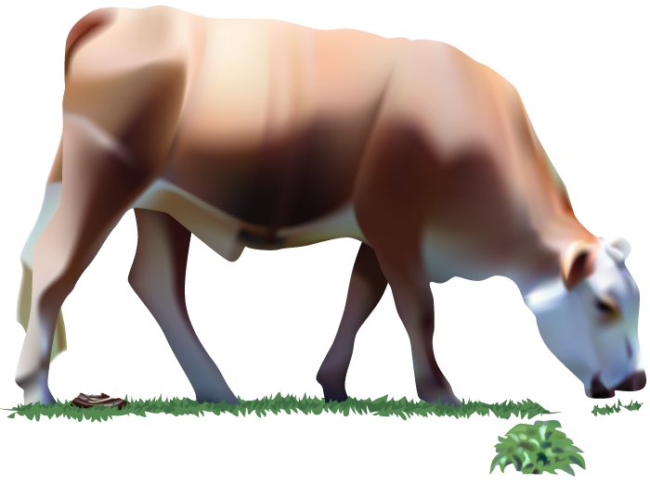
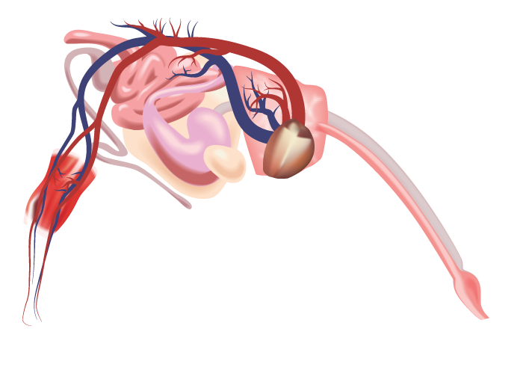
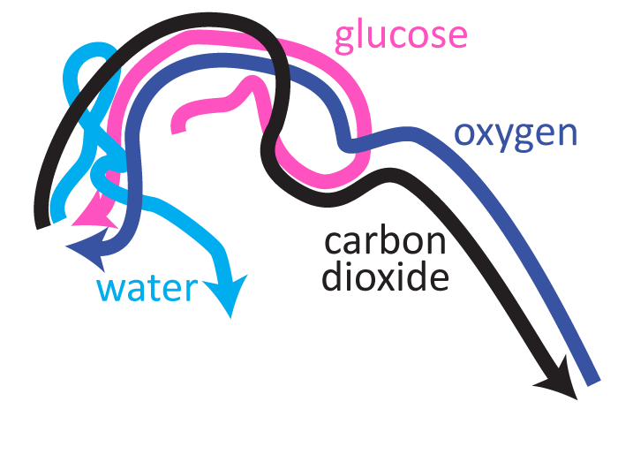
The Matter Movement Question
How do molecules move to the location of the chemical change?
How do molecules move away from the location of the chemical change?
Notes:
Image Credit: Craig Douglas, Michigan State University
Have students think about how cellular respiration answers the Matter Movement question.
Use slides 6-12 in the PPT to have the students discuss what is happening to matter during cellular respiration and to have them check their answers to the Matter Movement Question on their 4.2 Explanations Tool for Cow Cellular Respiration.
Show students slide 6 to have them think about where atoms are moving from and moving to during cellular respiration.
Show slide 7 to explain that atoms and molecules are moving so that animals can get energy through cellular respiration: Animals need glucose and oxygen as reactants, and they must get rid of carbon dioxide and water as waste.
Show slide 8 to explain a simplified version of movement of all these materials through the cow.
Display slides 9-12 to have students compare their answers to the Matter Movement Question with the answers on the slide. Students only need to have arrows showing the movement of molecules into and out of the cell. Have students use a different colored writing utensil to make any needed changes to their answers. Allow students to ask questions if they do not understand why their ideas are incorrect.
If students have model explanations to share, display student work and discuss. If students have common areas of weakness in their explanations, ask for a volunteer to share, display student work, and discuss ways of strengthening the response.

Slide 7
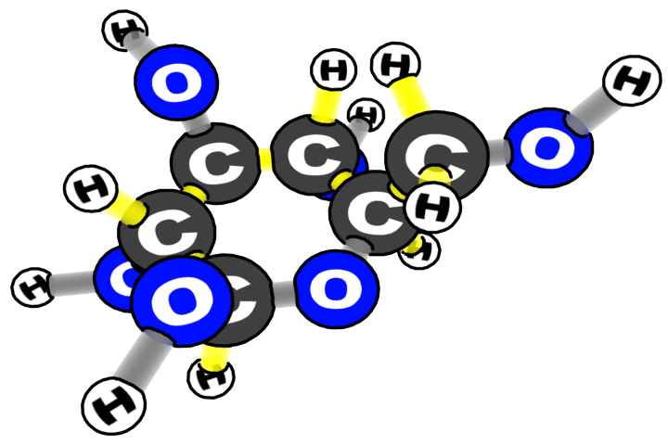
Which atoms and molecules move during cellular respiration?
water
carbon dioxide | oxygen
glucose
Notes:
Image Credit: Craig Douglas, Michigan State University
Have students think about how cellular respiration answers the Matter Movement question.
Use slides 6-12 in the PPT to have the students discuss what is happening to matter during cellular respiration and to have them check their answers to the Matter Movement Question on their 4.2 Explanations Tool for Cow Cellular Respiration.
Show students slide 6 to have them think about where atoms are moving from and moving to during cellular respiration.
Show slide 7 to explain that atoms and molecules are moving so that animals can get energy through cellular respiration: Animals need glucose and oxygen as reactants, and they must get rid of carbon dioxide and water as waste.
Show slide 8 to explain a simplified version of movement of all these materials through the cow.
Display slides 9-12 to have students compare their answers to the Matter Movement Question with the answers on the slide. Students only need to have arrows showing the movement of molecules into and out of the cell. Have students use a different colored writing utensil to make any needed changes to their answers. Allow students to ask questions if they do not understand why their ideas are incorrect.
If students have model explanations to share, display student work and discuss. If students have common areas of weakness in their explanations, ask for a volunteer to share, display student work, and discuss ways of strengthening the response.

Slide 8
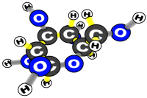
How do glucose, oxygen, water, and carbon dioxide move through the cow?
water
carbon dioxide | oxygen
glucose
Notes:
Image Credit: Craig Douglas, Michigan State University
Have students think about how cellular respiration answers the Matter Movement question.
Use slides 6-12 in the PPT to have the students discuss what is happening to matter during cellular respiration and to have them check their answers to the Matter Movement Question on their 4.2 Explanations Tool for Cow Cellular Respiration.
Show students slide 6 to have them think about where atoms are moving from and moving to during cellular respiration.
Show slide 7 to explain that atoms and molecules are moving so that animals can get energy through cellular respiration: Animals need glucose and oxygen as reactants, and they must get rid of carbon dioxide and water as waste.
Show slide 8 to explain a simplified version of movement of all these materials through the cow.
Display slides 9-12 to have students compare their answers to the Matter Movement Question with the answers on the slide. Students only need to have arrows showing the movement of molecules into and out of the cell. Have students use a different colored writing utensil to make any needed changes to their answers. Allow students to ask questions if they do not understand why their ideas are incorrect.
If students have model explanations to share, display student work and discuss. If students have common areas of weakness in their explanations, ask for a volunteer to share, display student work, and discuss ways of strengthening the response.

Slide 9
Matter Movement
Do you have:
an arrow showing glucose going into the cow’s leg cell?
Glucose
Notes:
Display slides 9-12 to have students compare their answers to the Matter Movement Question with the answers on the slide. Students only need to have arrows showing the movement of molecules into and out of the cell. Have students use a different colored writing utensil to make any needed changes to their answers. Allow students to ask questions if they do not understand why their ideas are incorrect.
If students have model explanations to share, display student work and discuss. If students have common areas of weakness in their explanations, ask for a volunteer to share, display student work, and discuss ways of strengthening the response.

Slide 10
Matter Movement
Do you have:
an arrow showing oxygen or O₂ going into into the cow’s leg cells?
O₂
Glucose
Notes:
Display slides 9-12 to have students compare their answers to the Matter Movement Question with the answers on the slide. Students only need to have arrows showing the movement of molecules into and out of the cell. Have students use a different colored writing utensil to make any needed changes to their answers. Allow students to ask questions if they do not understand why their ideas are incorrect.
If students have model explanations to share, display student work and discuss. If students have common areas of weakness in their explanations, ask for a volunteer to share, display student work, and discuss ways of strengthening the response.

Slide 11
Matter Movement
Do you have:
an arrow showing carbon dioxide or CO₂ leaving the cow’s leg cell?
O₂
Glucose
CO₂
Notes:
Display slides 9-12 to have students compare their answers to the Matter Movement Question with the answers on the slide. Students only need to have arrows showing the movement of molecules into and out of the cell. Have students use a different colored writing utensil to make any needed changes to their answers. Allow students to ask questions if they do not understand why their ideas are incorrect.
If students have model explanations to share, display student work and discuss. If students have common areas of weakness in their explanations, ask for a volunteer to share, display student work, and discuss ways of strengthening the response.

Slide 12
Matter Movement
Do you have:
an arrow showing water or H₂O leaving the cow’s leg cells?
O₂
Glucose
CO₂
H₂O
Notes:
Display slides 9-12 to have students compare their answers to the Matter Movement Question with the answers on the slide. Students only need to have arrows showing the movement of molecules into and out of the cell. Have students use a different colored writing utensil to make any needed changes to their answers. Allow students to ask questions if they do not understand why their ideas are incorrect.
If students have model explanations to share, display student work and discuss. If students have common areas of weakness in their explanations, ask for a volunteer to share, display student work, and discuss ways of strengthening the response.

Slide 13
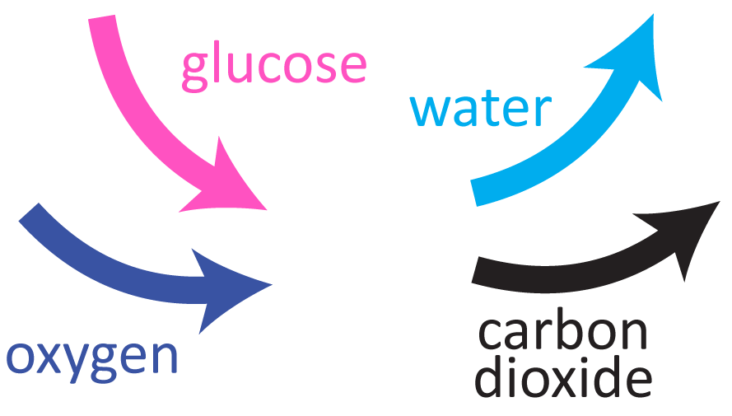
The Matter Change Question
How are atoms in molecules being rearranged into different molecules inside a muscle cell during cellular respiration?
Chemical change
Notes:
Image Credit: Craig Douglas, Michigan State University
Have students think about how cellular respiration also answers the Matter Change Question.
Show slide 13 to zoom into a muscle cell in the cow’s leg to illustrate cellular respiration at the cellular scale. Glucose and oxygen enter the cell; carbon dioxide and water leave—and cell gets energy to function!
Display slides 14-15 to have students compare their answers to the Matter Change Question on the 4.2 Explanations Tool for Cow Cellular Respiration with the answers on the slide. Have students use a different colored writing utensil to make any needed changes to their answers. Allow students to ask questions if they do not understand why their ideas are incorrect.
If students have model explanations to share, display student work and discuss. If students have common areas of weakness in their explanations, ask for a volunteer to share, display student work, and discuss ways of strengthening the response.

Slide 14
Matter Change
What is the name of the chemical change that allows cells to move and function?
Cellular respiration
Write the chemical equation for this change:
C₆H₁₂O₆ + 6 O₂ → 6 CO₂ + 6 H₂O
Notes:
Display slides 14-15 to have students compare their answers to the Matter Change Question on the 4.2 Explanations Tool for Cow Cellular Respiration with the answers on the slide. Have students use a different colored writing utensil to make any needed changes to their answers. Allow students to ask questions if they do not understand why their ideas are incorrect.
If students have model explanations to share, display student work and discuss. If students have common areas of weakness in their explanations, ask for a volunteer to share, display student work, and discuss ways of strengthening the response.

Slide 15
Matter Change
What molecules are carbon atoms in before the chemical change?
Glucose or sugar
What other molecules are needed?
Oxygen or O₂
What molecules are carbon atoms in after the chemical change?
Carbon dioxide or CO₂
What other molecules are produced?
Water or H₂O
Chemical Change
Notes:
Display slides 14-15 to have students compare their answers to the Matter Change Question on the 4.2 Explanations Tool for Cow Cellular Respiration with the answers on the slide. Have students use a different colored writing utensil to make any needed changes to their answers. Allow students to ask questions if they do not understand why their ideas are incorrect.
If students have model explanations to share, display student work and discuss. If students have common areas of weakness in their explanations, ask for a volunteer to share, display student work, and discuss ways of strengthening the response.

Slide 16
Energy Change
What forms of energy go into this chemical change?
Chemical energy or C-C and C-H bonds
What forms of energy come out of this chemical change?
Motion (or cellular function) and heat energy
Energy Transformation
Notes:
Discuss how cellular respiration helps to answer Energy Change questions, including unanswered questions about mealworms and cows.
Display slide 16 to have students compare their answers to the Energy Change Question on the 4.2 Explanations Tool for Cow Cellular Respiration with the answers on the slide.
Have students use a different colored writing utensil to make any needed changes to their answers. Allow students to ask questions if they do not understand why their ideas are incorrect.
If students have model explanations to share, display student work and discuss. If students have common areas of weakness in their explanations, ask for a volunteer to share, display student work, and discuss ways of strengthening the response.
Have students consider how these answers address Energy Change at macroscopic, atomic-molecular, and cellular scales.

Slide 17
Constructing Explanations
Write an explanation: How does a cell in a cow use food to move and function?
Use your:
Front of the Explanations Tool
Your Three Questions Handout and Explanations Checklist
Notes:
Have students write paragraph explanations of the process of ethanol burning.
Display slide 17. Ask students to write paragraphs explaining the process of cellular respiration on the second page of the 4.2 Explanations Tool for Cow Cellular Respiration.
Refer student to the checklist and questions on the Three Questions Handout for reminders about what to include in their paragraph
Remind students that they have the information they need in their responses to the questions on the front of the Explanations Tool.
Remind students that the graphic organizer on the front has the information they need to write their explanations paragraphs.
Remind students to refer to their Three Questions Handout and Explanations Checklist to review what should be included in a good explanation.

Slide 18
Comparing Ideas with a Partner
Compare your explanations for each of the Three Questions.
How are they alike?
How are they different?
Check your explanation with the middle- and right-hand columns of the Three Questions handout.
Consider making revisions to your explanation based on your conversation with your partner.
Notes:
Have students share explanations with each other.
Show slide 18 of the 4.2 Explaining How Cows Move and Function: Cellular Respiration PPT. Divide students into pairs and have them compare explanations for the Three Questions and the final explanation on the process tool.
Have students use the Three Questions 11 x 17 Poster (or Handout) as a reference. Have students check their explanations with the middle and right-hand columns of the poster to make sure they are following the “rules.”

Slide 19
Telling the Whole Story
Question: How does a cell in the cow’s leg use food to move and function?
Does your story include these parts? (Check the back of the Three Questions Handout.)
Matter movement: Sugar or glucose and oxygen enter into the cell.
Matter change: Sugar or glucose react with oxygen to produce carbon dioxide and water.
Energy change: Chemical energy in sugar or glucose is transformed into energy for motion (and cell functioning) and body heat.
Matter movement: Carbon dioxide and water leave the cell.
Notes:
Have students share explanations with each other.
Show slide 19 of the 4.2 Explaining How Cows Move and Function: Cellular Respiration PPT. Divide students into pairs and have them compare explanations for the Three Questions and the final explanation on the process tool.
Have students use the Three Questions 11 x 17 Poster (or Handout) as a reference. Have students check their explanations with the middle and right-hand columns of the poster to make sure they are following the “rules.”
(Optional) Have students critique example explanations
Display Slide 19 of the PPT. Have students look at two handouts: (a) The Three Questions Handout, and (b) the Animals Example Explanations Handout.
Ask students to evaluate the two example explanations of cow cellular respiration on the Animals Example Explanations Handout : Which explanation is better? Why?
Have students use the Three Questions Explanation Checklist on the back of the Three Questions Handout to justify their critiques of the explanations.
Have students critique and improve their full explanations.
Display slide 19 of the PPT for the full explanation. Have students use the Three Questions Explanation Checklist on the back of the Three Questions Handout to check that their story includes each of the parts (matter movement, matter change, energy change, and matter movement).
If students don’t have all four parts in their explanation, instruct them to add to their explanation using a different colored writing utensil.
If students have model explanations to share, display student work and discuss. If students have common areas of weakness in their explanations, ask for a volunteer to share, display student work, and discuss ways of strengthening the response.

Slide 20
How can learning about cows help you to understand people? Using the Animals Matter Tracing Tool
Notes:
Have students connect their atomic molecular explanations to the macroscopic scale by using the Animals Matter Tracing Tool.
Show slide 20. Give students the Animals Matter Tracing Tool. Have students individually:
Choose a cell and draw arrows showing the carbon-containing molecules that go to the cell and leave the cell (first page)
Use the steps in the Three Questions to explain how matter and energy move and change in the cell (second page
Show slides 21 and 22. Have students compare their answers to the answers on the slides, discuss, and revise their answers if necessary.

Slide 21
Drawing arrows to show matter movement for cellular respiration
Choosing a cell in the child’s leg as an example
Green arrow: Small organic molecules coming to the cell through the blood (from the digestive system)
Blue arrow: CO₂ going away from the cell in the blood (and out of the child’s body through the lungs)
Other molecules:
O₂ as a reactant
H₂O as a product
Notes:
Show slides 21 and 22. Have students compare their answers to the answers on the slides, discuss, and revise their answers if necessary.

Slide 22
What happens inside human cells
Cellular respiration is just the same inside a cow’s cells and a child’s cells!
Matter movement: Sugar or glucose and oxygen enter the cell from the blood.
Matter change: Sugar or glucose react with oxygen to produce carbon dioxide and water.
Energy change: Chemical energy in sugar or glucose is transformed into energy for motion (and cell functioning) and body heat.
Matter movement: Carbon dioxide and water leave the cell.
Notes:
Show slides 21 and 22. Have students compare their answers to the answers on the slides, discuss, and revise their answers if necessary.

Slide 23
Revisit unanswered questions
Which unanswered questions can you now answer with what you understand about cellular respiration?
Which questions are left unanswered?
Do you have any new questions to add?
Notes:
Revisit unanswered questions
Show slide 23. Have students look at their 3.3 Evidence-Based Arguments Tool for Mealworms Eating. Display the class list of unanswered questions from Activity 3.3.
Ask students which of their unanswered questions they can now answer with their understanding of Cellular Respiration. Which ones are left unanswered? Do they have any new questions to add to the list?
One question that students should have is: if cows eat plants that are mostly carbohydrates, where does the glucose that enters the cell come from? This and other remaining questions will be answered in future lessons on digestion and biosynthesis.

Slide 24
Exit Ticket
Conclusions
How do matter and energy change during cellular respiration?
Predictions
Where do you think the glucose for cellular respiration comes from?
Notes:
Have students complete an exit ticket.
Show slide 24 of the 4.2 Explaining Cow Cellular Respiration PPT.
Conclusions: How do matter and energy change during cellular respiration?
Predictions: Where do you think the glucose for cellular respiration comes from?
On a sheet of paper or a sticky note, have students individually answer the exit ticket questions. Depending on time, you may have students answer both questions, assign students to answer a particular question, or let students choose one question to answer. Collect and review the answers.
The conclusions question will provide you with information about what your students are taking away from the activity. Student answers to the conclusions question can be used on the Driving Question Board (if you are using one). The Predictions question allows students to begin thinking about the next activity and allows you to assess their current ideas as you prepare for the next activity. Student answers to the Predictions question can be used as a lead into the next activity.

Slide 25
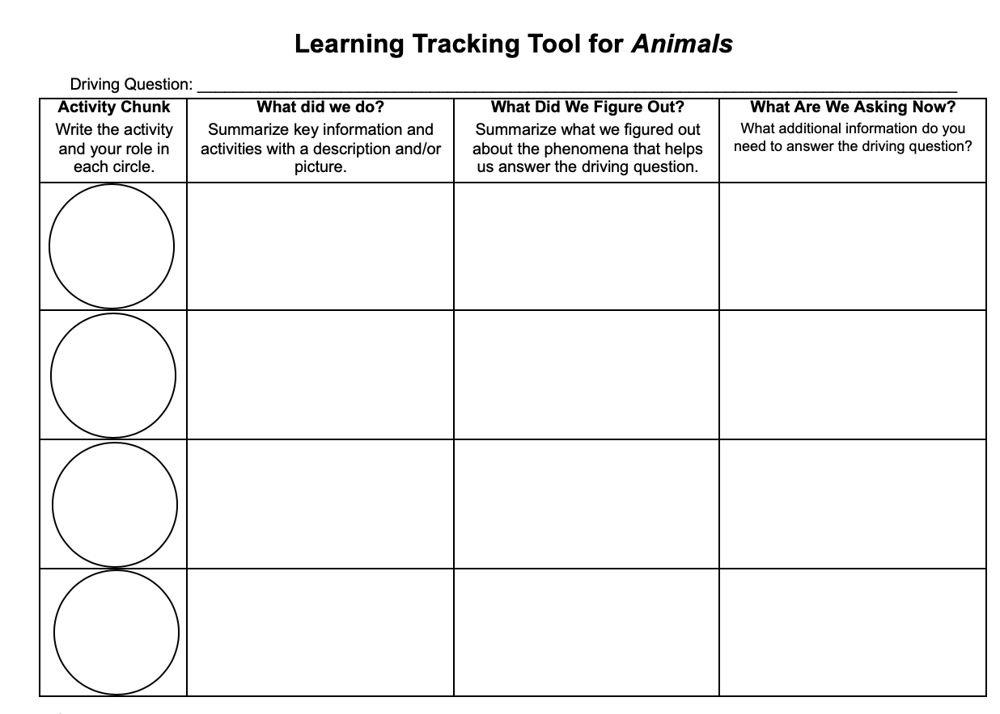
Learning Tracking Tool
Record the activity chunk name “Explaining How Cows Move and Function: Cellular Respiration,” and your role in the first column.
Discuss what you did during the activity chunk and record your ideas in the column, “What Did We Do?”
Discuss with your classmates what you figured out will help you to answer the unit driving question. Record your ideas in the column “What Did We Figure Out?”
Discuss questions you now have related to the unit driving question and record them in the column “What Are We Asking Now?”
Notes:
Show slide 25 of the 4.2 Explaining Cow Cellular Respiration PPT.
Pass out a Learning Tracking Tool to each student.
Explain that students will add to the tool after activities to keep track of what they have figured out that will help them to answer the unit driving question.
Have students write the activity name, "Explaining How Cows Move and Function" and their role, “Explainer” in the first column.
Have a class discussion about what students figured out during the activity that will help them in answering the unit driving question. When you come to consensus as a class, have students record the answer in the second column of the tool.
Have a class discussion about what students are wondering now that will help them move towards answering the unit driving question. Have students record the questions in the third column of the tool.
Have students keep their Learning Tracking Tool for future activities.
Example Learning Tracking Tool
Activity Chunk: Explaining How Cows Move and Function, Explainer
What Did We Do? Model the oxidation of glucose to carbon dioxide and water using molecular model kits and use the Explanations Tool to explain what happens when cows move and function.
What Did We Figure Out? Some matter leaves the body as urine and waste but most matter leaves the body as CO₂ during cellular respiration.
What Are We Asking Now? What happens to food when it is in the body?

