Slide 1

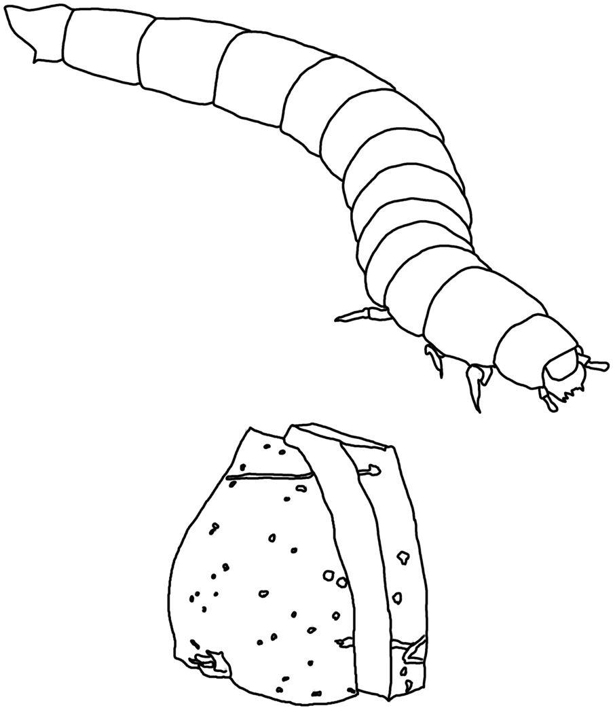
Animals Unit
Activity 3.2 Observing Mealworms Eating
Carbon: Transformations in Matter and Energy
Environmental Literacy Project
Michigan State University
Notes:
Image Credit: Craig Douglas, Michigan State University

Slide 2
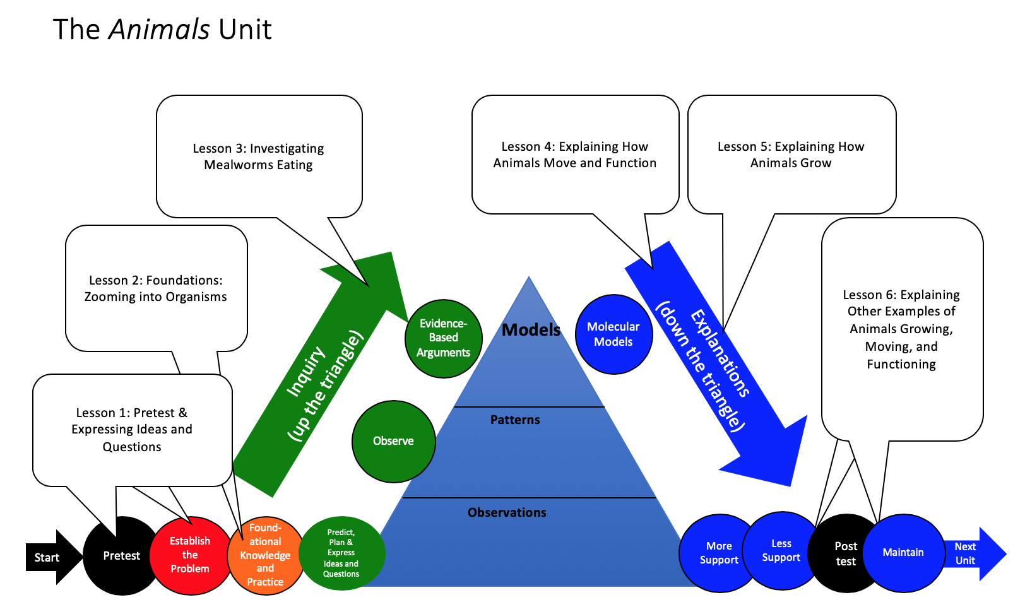
Unit Map
You are here
Notes:
Use the instructional model to show students where they are in the course of the unit.
Show slide 2 of the 3.2 Observing Mealworms Eating PPT.

Slide 3
Materials for the investigation
How will you measure mass changes?
How will you observe changes in the color of BTB?
Notes:
Image Credit: FableVision
(Day 1) Have students prepare for the investigation.
Display slide 3 on the 3.2 Observing Mealworms Eating PPT. Divide students into groups of four.
Pass out one copy of 3.2 Observing Mealworms Eating Worksheet to each student. Walk through the steps in Part A of the worksheet that overview how to set up and conduct the investigation.
Ask students for their ideas about how they might conduct the investigation to learn more about what happens when mealworms eat, move, and breathe.

Slide 4
Procedures for the investigation, Day 1
Get a small container for your mealworms during the investigation. Make sure the container is deep enough for mealworms to not crawl out, or has holes in the lid for ventilation so your mealworms have air.
If your mealworms are already in their meal bedding and container, you will need to separate the mealworms from the bedding. Using the end of a pencil, separate all the worms from the meal. If your worms come already separated from bedding, skip this step.
Place an empty small container onto the digital balance and “zero” out the scale. Then gently pour about 15 g of mealworms into this container. Record on your worksheet the “Mass of the mealworms before” box in Part C .
Cut a small piece off of the potato (about 10g) and place on the scale. Record on your worksheet the “Mass of the potato before” box in Part C .
Place the piece of potato that you massed into the container with worms.
Place the small container with the worms and food into a large disposable plastic container.
Measure the mass of the entire container with all of its contents. Record on your worksheet the “Mass of whole container before” box in Part C.
Place a petri dish with about 25 ml of blue BTB into the large disposable plastic container near the container with the mealworms. Record the color of the BTB in the “Color of BTB before” box. Seal the large disposable plastic container.
Complete Part B of your worksheet.
Notes:
(Day 1) Have students read through procedures for the investigation.
Display slide 4 of the 3.2 Observing Mealworms Eating PPT.
Go through the steps to make sure that all the students understand them (or students could follow their own procedures that they developed).

Slide 5
Let’s do the investigation!
What mass changes do you observe?
What changes in BTB do you observe?
Notes:
Image Credit: FableVision
(Day 1) Have students record initial data on mealworms eating.
Display slide 5 of the 3.2 Observing Mealworms Eating PPT. Have students work in groups of four to set up their investigations.
Have students 1) either follow the procedures that they developed themselves in the previous activity, or 2) follow the procedure in the 3.2 Observing Mealworms Eating Worksheet.
Use Slide 6 to remind students of the range of bromothymol blue (BTB) colors. Refer the BTB Information and Instructions Handout for instructions for preparing BTB.

Slide 6
Possible BTB colors
Notes:
Image Credit: FableVision
(Day 1) Have students record initial data on mealworms eating.
Display slide 5 of the 3.2 Observing Mealworms Eating PPT. Have students work in groups of four to set up their investigations.
Have students 1) either follow the procedures that they developed themselves in the previous activity, or 2) follow the procedure in the 3.2 Observing Mealworms Eating Worksheet.
Use Slide 6 to remind students of the range of bromothymol blue (BTB) colors. Refer the BTB Information and Instructions Handout for instructions for preparing BTB.

Slide 7
Before you leave, Day 1
Complete Part B
Complete “before” column in Part C
Leave mealworms overnight in the sealed containers
Notes:
(Day 1) Check that students have recorded their data.
Display slide 7 of the 3.2 Observing Mealworms Eating PPT.
Before leaving the mealworms overnight, make sure that the students have completed Part B and the “before” column in Part C of their worksheets. When this is done, leave the mealworms overnight in sealed containers. The containers have enough oxygen for the mealworms to breathe for 24 hours.

Slide 8
Procedures for the investigation, Day 2
Final Mass: After 24 hours you will measure the mass of the potato and the mass of the mealworms. Use the same “zeroing” procedures as above. Record mass measurements in the “Measurements After” boxes. Observe the color of the BTB and record it in the “Changes in color of BTB” box.
Notes:
(Day 2) Have students record data and observations after 24 hours.
Display slide 8 of the 3.2 Observing Mealworms Eating PPT.
Have students collect and record their data in Part C of their 3.2 Observing Mealworms Eating Worksheets. They will need the digital balance and their worksheets to do this. They may also use the BTB Information and Instructions Handout, slide 6 of the PPT, or the BTB Color Handout to talk about how BTB has a gradient of colors depending on how much CO₂ is absorbed.
Note that mealworms might produce some frass (feces) after 24 hours. Because the frass is difficult to separate from the mealworms, have students measure it along with the mass of the mealworm biomass. Have each student record results for his or her group on the 3.2 Mealworms Eating Observations Worksheet.

Slide 9
Comparing group results
Results for mass changes
What patterns are there in measurements made by all the groups?
Do the patterns match your predictions?
Results for BTB changes
What patterns are there in observations made by all the groups?
Do the patterns match your predictions?
Notes:
Have students compare data between groups and look for patterns.
Display slide 9 of the 3.2 Observing Mealworms Eating PPT
Have students select a recorder to input their group’s results on the 3.2 Mealworms Investigation Class Results 11 x 17 Poster, or in the 3.2 Mealworms Investigation Class Results Spreadsheet. Lead a discussion to help students compare results across groups and identify patterns in the data.
First, have students calculate the change in mass of the whole system by calculating the overall mass change. Tell students to use the class averages from the spreadsheet to calculate the change in mass of the potato plus mealworms before and after.
Discuss patterns that students see in the class results.
Ask students to identify patterns in the data for both the mass change and also the BTB color change, and discuss any outliers or unexplained data points.
Note: If you input data into the spreadsheet, the software will construct a graph of the students’ data. You can use the graph to elicit more interpretation of their observations.

Slide 10
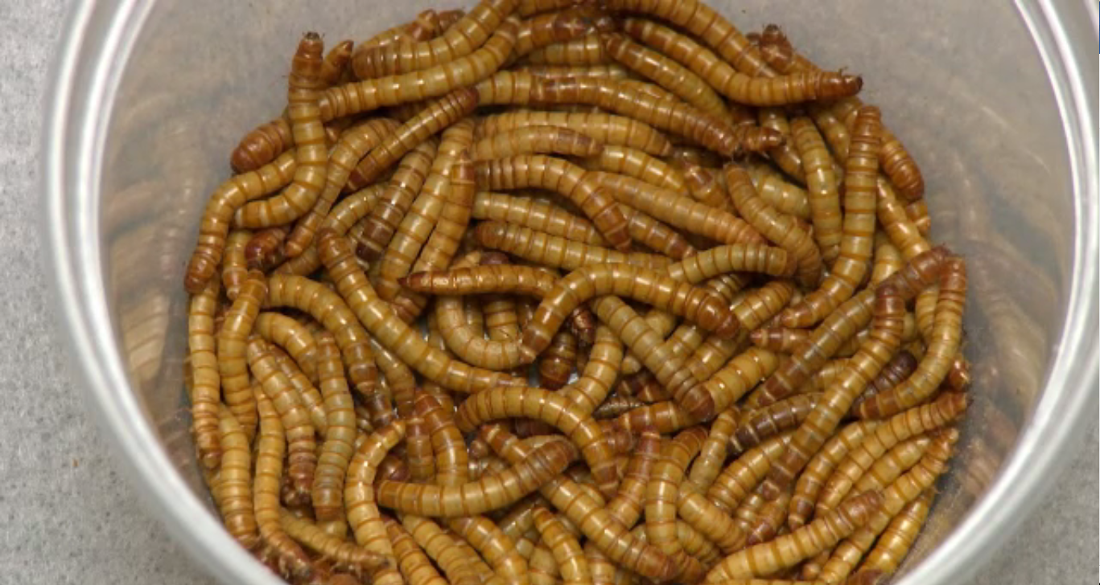
Mealworms eating video
Notes:
Watch the end of the Mealworms Eating Video.
Display slide 10 of the 3.2 Observing Mealworms Eating PPT.
Have students watch the Mealworms Eating Video starting from where Darryl and Nina show their results to the investigation.
Ask the class to compare their own results to Darryl and Nina’s results, pausing the video when the data are shown.

Slide 11
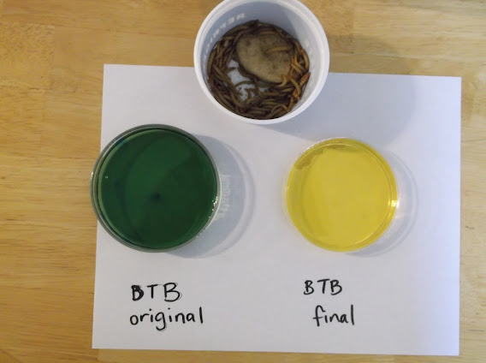
BTB Results for Ms. Angle’s class
Day 1 | Day 2
start BTB color | end BTB color
blue | yellow
blue | yellow
blue | yellow
blue | yellow
blue | yellow
blue | yellow
Compare your results to the results for Ms. Angle’s class. What similarities or differences do you notice? What patterns do you see?
Notes:
Have students compare their class’s data with data from another class to identify patterns.
Show slide 11 of the PPT and ask students to compare their results to Ms. Angle’s class results.
Ask students if they recognize similar patterns from their own data. Use the poster or spreadsheet to compare.
Image Credit: Michigan State University

Slide 12
Weight results for Ms. Angle’s class
Initial Mass Potato (g) | Initial Mass Worms (g) | Final Mass Potato (g) | Final Mass Worms (g) | Change in Potato Mass (g) | Change In Worm Mass (g)
12.50 | 15.40 | 11.30 | 15.90 | -1.20 | 0.50
9.87 | 16.61 | 9.35 | 17.05 | -0.52 | 0.44
11.57 | 15.41 | 10.94 | 15.65 | -0.63 | 0.24
9.35 | 17.05 | 8.89 | 17.35 | -0.46 | 0.30
13.59 | 14.77 | 12.88 | 15.01 | -0.71 | 0.24
9.20 | 14.50 | 8.79 | 14.99 | -0.41 | 0.49
Average change in weight = |  |  |  | -0.66 | +0.37
How do your results compare with the results for Ms. Angle’s class?
Notes:
Have students compare their class’s weight results with data from another class to identify patterns.
Show slide 12 of the PPT and ask students to compare their results to the results for Ms. Angle’s class. Ask students if they see the same patterns. What similarities or differences do they notice? What patterns do they see?

Slide 13
Weight results for Ms. Angle’s class
Notes:
Have students compare the data from the video.
Show slide 13 of the PPT and ask students to compare their results to the results for Ms. Angle’s class.
Explain to students that the data from the video (or from Ms. Angle’s class) showed that the potato lost 0.66 g and the mealworms gained only 0.37 g. So overall the system lost 0.29 g. Remind students that atoms are forever, so this mass must have gone somewhere. Students may have some ideas about where the mass went. Tell students that you will discuss this missing mass later in the unit.
Potatoes lose mass both because mealworms eat them and because water evaporates from the potatoes themselves. We checked to see how much mass potatoes lose to evaporation by leaving potatoes in a container without mealworms. In 24 hours they lost about 0.5% of their mass to evaporation—considerably less than the difference between what the mealworms ate and the weight they gained (about 3% of the potato mass). If your students are concerned about evaporation, we can suggest a couple of strategies:
Try what we did: Put some potato slices in a container as a control.
Discuss with the students whether they think that evaporation is the ONLY process that is causing the system to lose mass.
The remainder of the unit is based on the assumption that your class results are similar to those of Ms. Angle’s class and the Mealworms Eating video. If your class results are significantly different for any reason, after a conversation about why that may have happened, decide whether to have students conduct the investigation again or to refer to Ms. Angle’s data as they work through the remainder of the unit.

Slide 14
Explaining group results
Explaining results for mass changes
How are the mass changes connected with The Matter Movement Question: Where are atoms moving?
What unanswered questions do you have?
Explaining results for BTB changes
How are the BTB results connected to The Matter Change Question: What molecules are carbon atoms in before and after the chemical change?
What unanswered questions do you have?
What did we learn about the Energy Change Question?
What unanswered questions do you have?
Notes:
Have students complete Part D of their worksheet.
Use slide 14 and Part D of the worksheet to help students describe the patterns they observed during the observation.
Help students to recognize that while the mass changes provide them with good evidence to answer the Movement Question, the BTB evidence provides only a partial answer to the Carbon Question.
Tell students that it shows that carbon ends up in CO₂ in the air, but not where the carbon came from in the mealworm.

Slide 15
Revisit your predictions
Which predictions were correct?
Which predictions were incorrect?
What did we see? What does it mean?
What questions do you still need to answer?
Notes:
Revisit predictions from the previous activity.
Use slide 15 to revisit students’ predictions from Activity 3.1.
Ask students to retrieve their completed tools from the previous activity: 3.1 Predictions and Planning Tool for Mealworms Eating.
Have them compare the predictions they made with the results of the investigation.
Which predictions were correct? Which predictions were incorrect? What questions do they still need to answer?
Remind students that eating food is necessary for mealworms to be able to grow, and to be able to use energy for things like moving. Tell students that they will use the data that they collected here to help them to be able to explain two processes that relate to animals eating: animals growing and animals moving.

Slide 16
Exit Ticket
Conclusions
  What did you observe during the investigation?
Predictions
  What do you think is one conclusion you can make from the investigation?
Notes:
Have students complete an exit ticket.
Show slide 16 of the 3.2 Observing Mealworms Eating PPT .
Conclusions: What did you observe during the investigation?
Predictions: What do you think is one conclusion you can make from the investigation?
On a sheet of paper or a sticky note, have students individually answer the exit ticket questions. Depending on time, you may have students answer both questions, assign students to answer a particular question, or let students choose one question to answer. Collect and review the answers.
The conclusions question will provide you with information about what your students are taking away from the activity. Student answers to the conclusions question can be used on the Driving Question Board (if you are using one). The predictions question allows students to begin thinking about the next activity and allows you to assess their current ideas as you prepare for the next activity. Student answers to the predictions question can be used as a lead in to the next activity. Not linked

