Slide 1
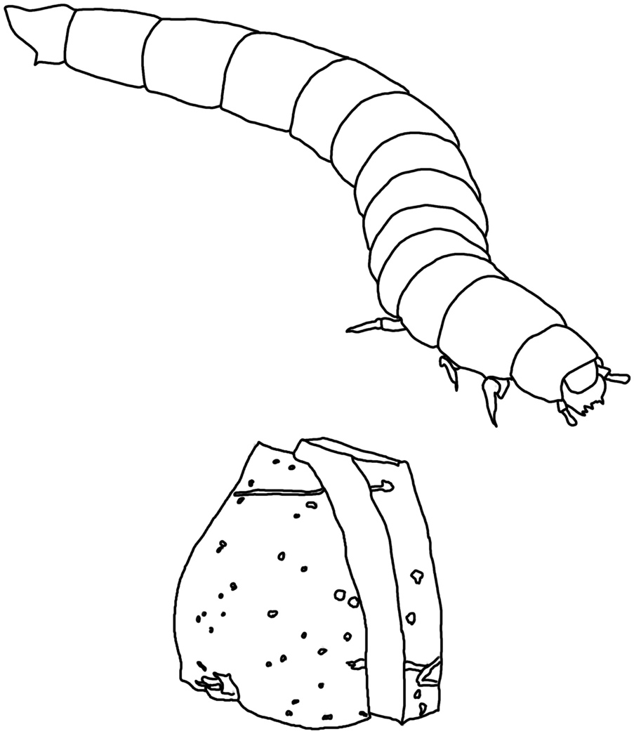
Animals Unit Activity 3.1: Predictions and Planning about Mealworms Eating
Carbon: Transformations in Matter and Energy
Environmental Literacy Project Michigan State University
Notes:
Image Credit: Craig Douglas, Michigan State University

Slide 2
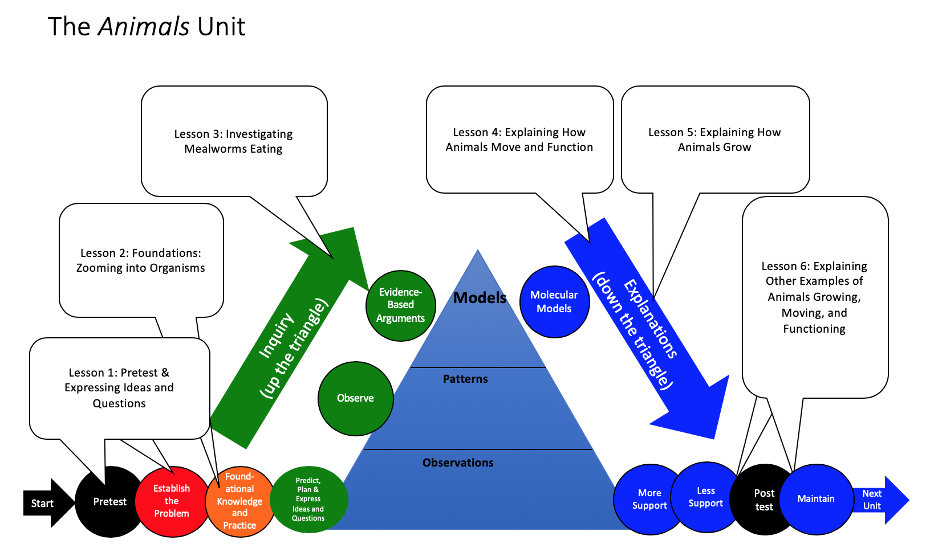
Unit Map
You are here
Notes:
Use the instructional model to show students where they are in the course of the unit.
Show slide 2 of the 3.1 Predictions and Planning about Mealworms Eating PPT.

Slide 3
Mealworms video
Notes:
Introduce Lesson 3 by watching the first half of the Mealworms Video.
Tell students that in this lesson, they will be investigating what happens when mealworms eat, move, and breathe to learn more about what happens to matter and energy during chemical changes. Show slide 3 of the PPT.
Watch the Mealworms Video until the first intermission where Darryl and Nina ask students to make Predictions and Planning about what happens when mealworms eat. Pause the video to discuss the questions posed on the screen before students complete the Predictions and Planning tool.

Slide 4
Answer each of the questions (numbered 1-4) below to explain how matter and energy move and change in a system. Note that matter movement is addressed at both the beginning (1) and end (4) of your explanation.
Question
Where are molecules moving?
How do molecules move to the location of the chemical change?
How do molecules move away from the location of the chemical change?
Rules to Follow
All materials (solids, liquids, and gases) are made of atoms that are bonded together in molecules.
Scale: The movement question can be answered at the atomic-molecular, cellular, or macroscopic scale.
Evidence We Can Observe
Moving solids, liquids, and gases are made of moving molecules.
A change in mass shows that molecules are moving.
Notes:
Review the Matter Movement Question.
Display slide 4 of the PPT. Put a copy of the Three Questions 11 x 17 Poster on the wall for reference if it is not there already. Give each student one copy of the Three Questions Handout or have them take out their existing copies.
Draw students’ attention to the poster and point out that each question is accompanied with “rules to follow” as well as ways to “connect atoms to evidence.”
Have students highlight, underline, or box the following rule about matter: Atoms are bonded together in molecules.

Slide 5
Answer each of the questions (numbered 1-4) below to explain how matter and energy move and change in a system. Note that matter movement is addressed at both the beginning (1) and end (4) of your explanation.
Rules to Follow
Atoms last forever in combustion and living systems.
Atoms can be rearranged to make new molecules, but not created or destroyed.
Carbon atoms are bound to other atoms in molecules.
Scale: The chemical change question is always answered at the atomic-molecular scale.
Evidence We Can Observe
BTB can indicate CO₂ in the air.
Organic materials are made up of molecules containing carbon atoms:
• fuels • foods
• living and dead plants and animals
• decomposers
Question
How are atoms in molecules being rearranged into different molecules?
What molecules are carbon atoms in before and after the chemical change?
What other molecules are involved?
Notes:
Review the Matter Change Question.
Display slide 5 of the PPT.
Have students highlight, underline, or box the following rule about matter: Atoms last forever.

Slide 6
Answer each of the questions (numbered 1-4) below to explain how matter and energy move and change in a system. Note that matter movement is addressed at both the beginning (1) and end (4) of your explanation.
Question
What is happening to energy?
What forms of energy are involved?
What energy transformations take place during the chemical change?
Rules to Follow
Energy lasts forever in combustion and living systems.
Energy can be transformed, but not created or destroyed.
C-C and C-H bonds have more stored chemical energy than C-O and H-O bonds.
Scale: The energy question can be answered at the atomic-molecular, cellular, or macroscopic scales.
Evidence We Can Observe
We can observe indicators of different forms of energy before and after chemical changes:
light energy
chemical energy stored in organic materials
motion energy
heat energy
Notes:
Review the Energy Change Question.
Display slide 6 of the PPT.
Have students highlight, underline, or box the following rules about energy: Energy lasts forever, and energy can be transformed.

Slide 7
A. Your Ideas about what happens when mealworms grow and move
Complete and discuss Part A of the Predictions and Planning Tool
How have your ideas changed since you wrote about a child growing on the Expressing Ideas Tool?
Notes:
Have students complete Part A of the Predictions and Planning Tool for Mealworms Eating.
Show slide 7 of the PPT. Pass out one copy of 3.1 Predictions and Planning Tool for Mealworms Eating to each student and ask them to record their ideas as individuals for each of the Three Questions for mealworms eating.
Remind students that these are just predictions, and that there are no wrong answers at this point. Encourage them to write down all of their ideas on the tool.

Slide 8
Tools for the Investigation
Container that traps air
Digital balance
BTB
Your eyes
Notes:
Discuss the Matter Movement Question as it relates to a digital balance
Show slides 8 and 9 of the 3.1 Predictions and Planning about Mealworms Eating PPT. Discuss with students how a digital balance can be used to measure matter moving into or out of a system. Highlight that the mass of the system can be measured before and after a change happens in a system. Discuss the two possible conclusions students can draw from their observations:
If the mass of the system increases, then matter must have moved into the system (remember the facts about atoms)
If the mass of the system decreases, then matter must have moved out of the system.
Image Credit: Michigan State University

Slide 9
Digital balance: a tool to measure matter movement
How can you use a digital balance to measure matter moving into or out of a system?
Measure the mass of the system before and after a change happens in the system.
Possible conclusions:
If the mass of the system increases, then matter must have moved into the system (remember the facts about atoms)
If the mass of the system decreases, then matter must have moved out of the system.
Notes:
Discuss the Matter Movement Question as it relates to a digital balance
Show slides 8 and 9 of the 3.1 Predictions and Planning about Mealworms Eating PPT. Discuss with students how a digital balance can be used to measure matter moving into or out of a system. Highlight that the mass of the system can be measured before and after a change happens in a system. Discuss the two possible conclusions students can draw from their observations:
If the mass of the system increases, then matter must have moved into the system (remember the facts about atoms)
If the mass of the system decreases, then matter must have moved out of the system.
Photo Credit: FableVision

Slide 10
BTB: a tool to detect matter change
How can you use BTB to detect a matter change in a system?
Put BTB in a closed container with the system, then observe the color before and after a change happens in the system.
Possible conclusions:
If the BTB changes from blue to yellow, then a chemical change may be producing CO₂
If the BTB changes from yellow to blue, then a chemical change may be using CO₂ as a reactant.
Notes:
Discuss Matter Change Question as it relates to BTB
Show slide 10 of the 3.1 Predictions and Planning about Mealworms Eating PPT. Discuss with students how BTB can be used to measure matter change in a system. Highlight that the BTB in a closed container can be observed before and after a change happens in the system. Discuss the two possible conclusions students can draw from their observations:
If the BTB changes from blue to yellow, then a chemical change may be producing CO₂
If the BTB changes from yellow to blue, then a chemical change may be using CO₂ as a reactant.
Photo Credit: FableVision

Slide 11
B. Your predictions about what the investigation tools will show
Complete and discuss Part B of the Predictions and Planning Tool
Be sure you are following the rules of Matter Movement and Matter Change as you make your predictions!
Notes:
Have students complete their predictions for Mealworms Eating: Part B of the Predictions and Planning Tool.
Show slide 11 of the PPT. Have students find Part B on 3.1 Predictions and Planning about Mealworms Eating PPT and ask them to record their ideas as individuals for both the matter movement and matter change questions.
Remind students that these are just predictions, and that there are no wrong answers at this point. Encourage them to write down all their ideas on the tool.

Slide 12
Comparing ideas with a partner
Compare and contrast your Predictions and Planning with one another.
Notes:
Have students discuss their predictions in pairs.
When students have completed Part B of their Predictions and Planning Tools, show slide 12 of the PPT. Divide students into pairs and tell them to compare and contrast their predictions with each other and to look for differences and similarities.
Give students 2-3 minutes to compare their predictions. As students are sharing, circulate through the groups. Consider engaging students by: Revoice what students said/wrote (for instance, I see/hear that you think the BTB will turn blue). Why do you think that? What do you two disagree about? Why do you disagree?
Pay attention to patterns in students’ predictions as well as predictions that diverge from any of the patterns. Both will be valuable to discuss next as a whole class.

Slide 13
Save for Later
Later, you will compare your ideas from today to the results of your investigation and to scientific explanations.
Notes:
Save the Predictions and Planning Tools for later.
Display slide 13. Tell students that they will revisit their ideas after the investigation to see how their ideas changed over time.

Slide 14
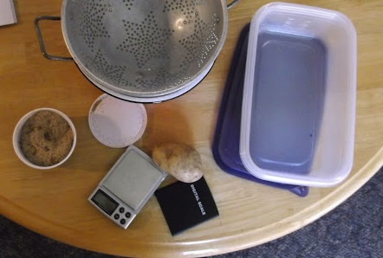
Planning the investigation
How will you measure mass changes?
How will you observe changes in the color of BTB?
Notes:
Have students plan the investigation: Part C of the Predictions and Planning Tool.
Show students Slide 14 of the PPT and describe the instruments and materials necessary for carrying out the investigation. Have students begin planning their investigation. There are two main variations in how much control students can have over this planning process
Minimal student control: Discuss student ideas for how an investigation could be set up. Then have students follow the lab instructions for lesson 3.2.
Maximal student control: Students in class develop their own consensus plans that will replace the lab instructions in lesson 3.2. (They may use the Investigation Planning Tool for making their plans. Note the importance of having different student groups following the same plan so that they can come to a consensus about patterns in data in lesson 3.2 Some possible ideas of using lab materials are below:
Students might choose to add controls to the experiment, for example including both a Petri dish of yellow bromothymol blue (BTB) (made from blowing into the blue BTB with a straw) and a Petri dish of blue BTB to the chamber.
Students might also choose to set up a chamber with a Petri dish of blue BTB alone without the ethanol.
Image Credit: Michigan State University

